Slide 1

Saathi
your chatBot friend is here to help

Slide 2

Limited access to resources for vulnerable groups.
People who are affec by Covid are unable to get out and buy basic things like food, groceries, etc. And vulnerable groups like elders, people with diabetes or front line workers, are having difficulties in access basic needs for life.

Slide 3




Delivery companies are not always the solution.
unfortunately these services are very expensive and not available in every city.

Slide 4
Saathi
A community always there to help
Build by the users for the users

Slide 5
Market Research
Dislike
20%
Eight out of ten people like the idea and would love to help
Like
80%

Slide 6
Product Demo

Slide 7

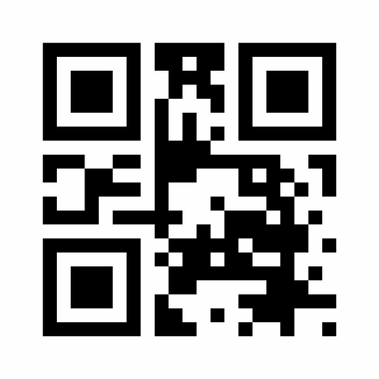
How we are planing to reach out
Using QR codes
Using online advertisements

Slide 8
NEXT STEPS
Improving our security
Reach out to more channels like telegram, WhatsApp, Instagram, etc.
Making the app more accessible to users
Reward system like virtual badges that can be shared on social media
Integrating Maps and Location APIs to have a better matching algorithm and other tracking features

Slide 9
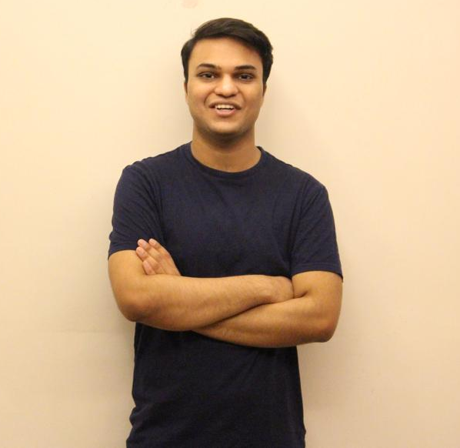
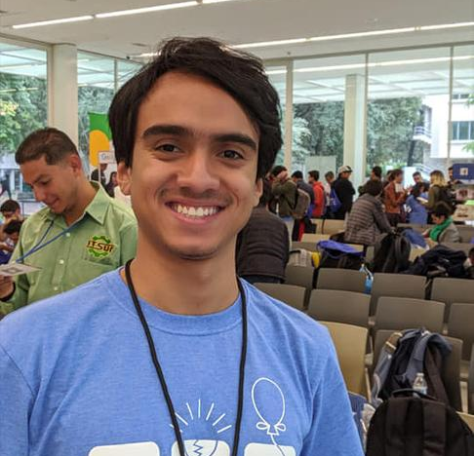
MEET OUR TEAM
Akshit Goyal
Toronto, Canada
Luis Andres Gutierrez
Guanajuato, Mexico

Slide 10
Saathi
your chatBot friend is here to help

