Slide 1
Global Bank Admin Management Application
Batch 2 - Team 1
Akshayarathna Anandakumar
Akshit Gupta
Aniket Srivastava
Ayush Kumar Singh

Slide 2
Problem Statement
To build an application for admin where they can login and perform all high level admin activities.
It includes
Creating new account for customer
Creating a new branch
Displaying customer details
Displaying branch details

Slide 3
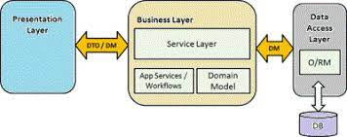
Architecture

Slide 4
Demo

Slide 5
Technology Stack
Backend
Spring framework
Frontend
React
Bootstrap
Database layer
MYSQL Workbench

Slide 6
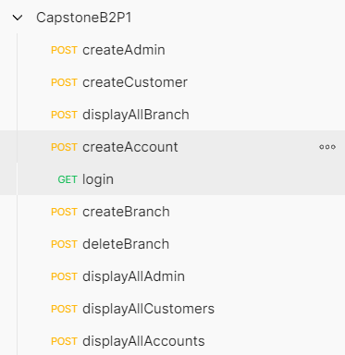
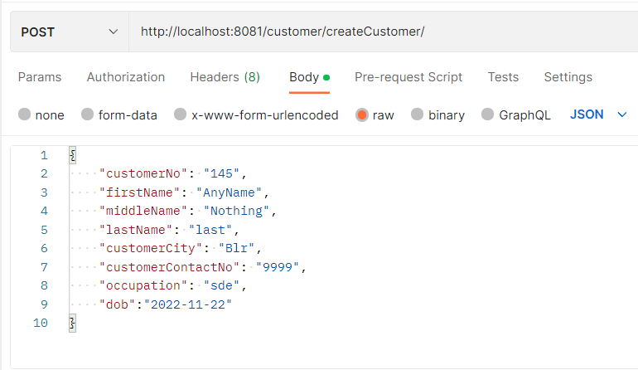
Endpoints

Slide 7
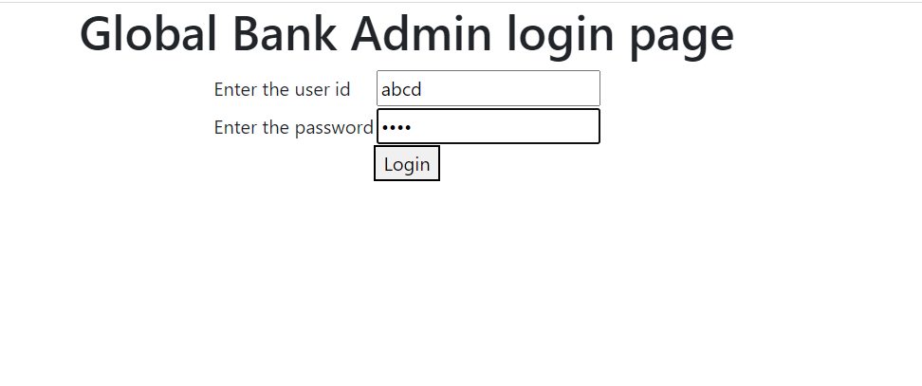
Demo Snippets

Slide 8
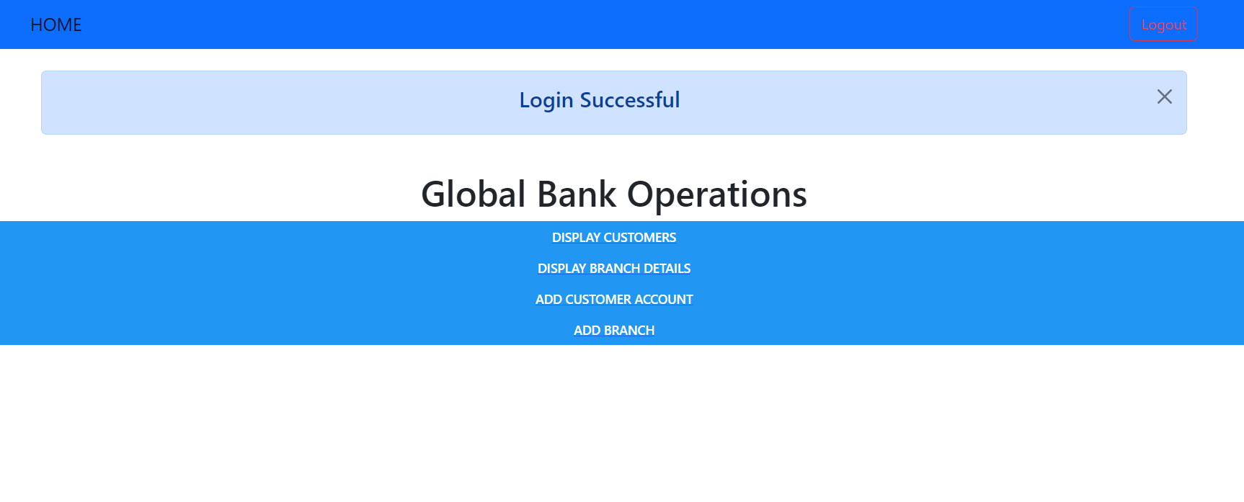

Slide 9
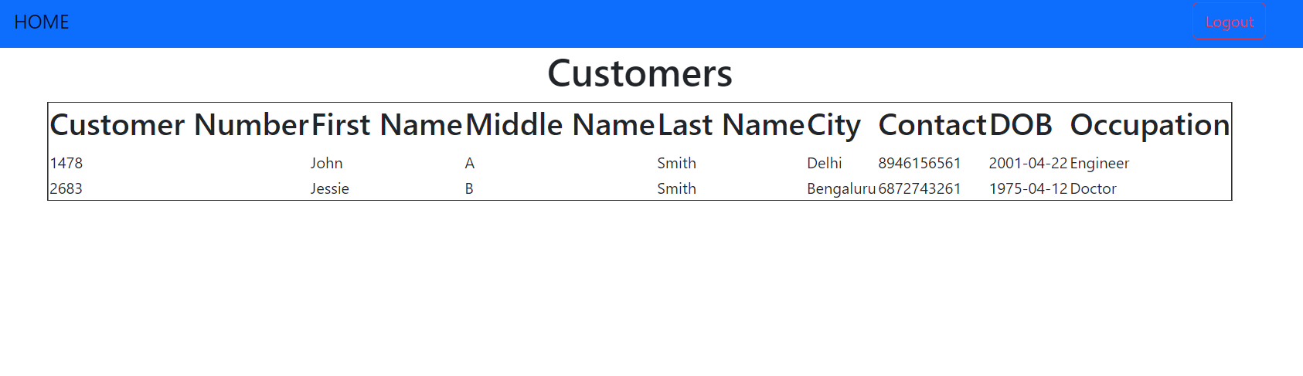

Slide 10
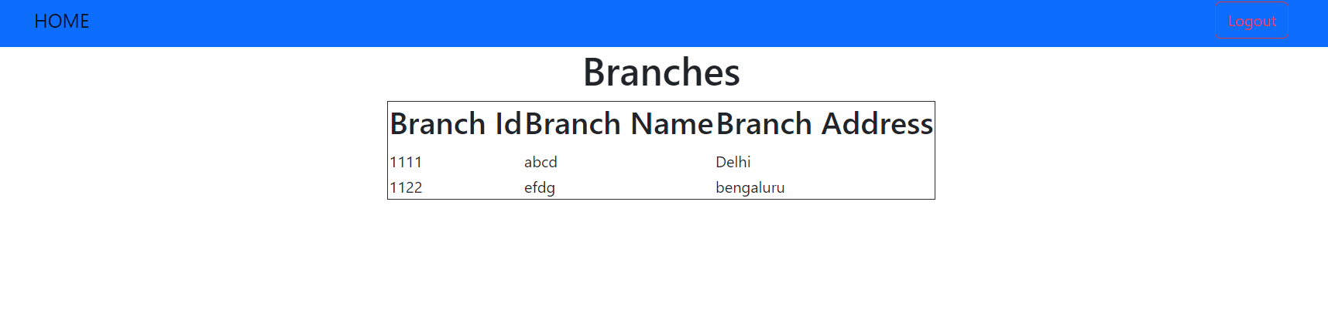

Slide 11
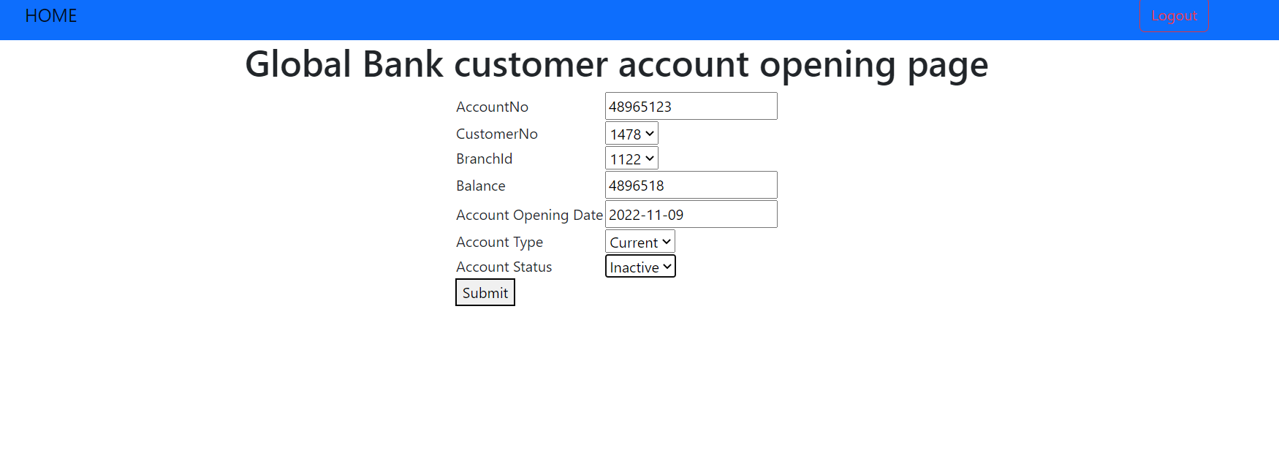

Slide 12
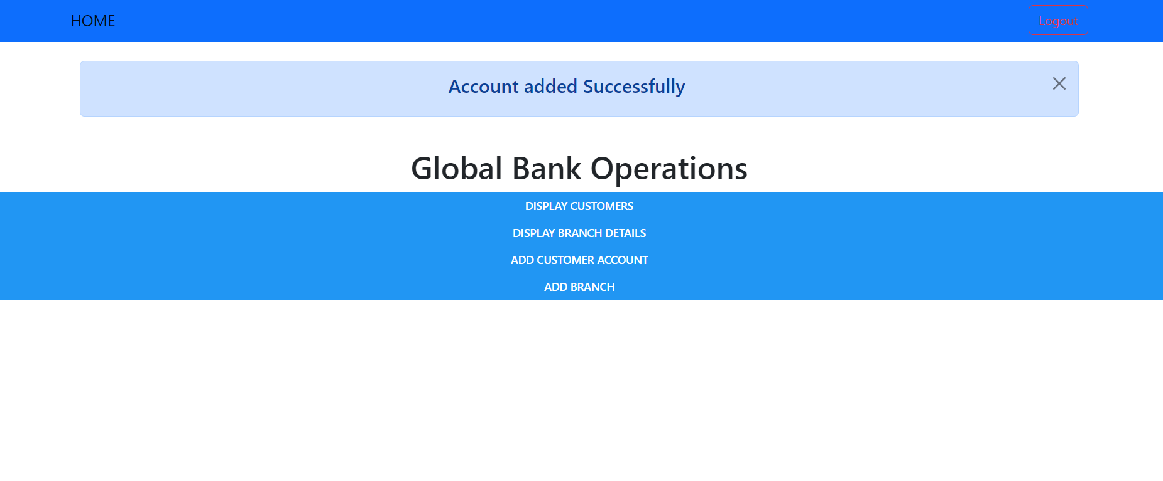

Slide 13
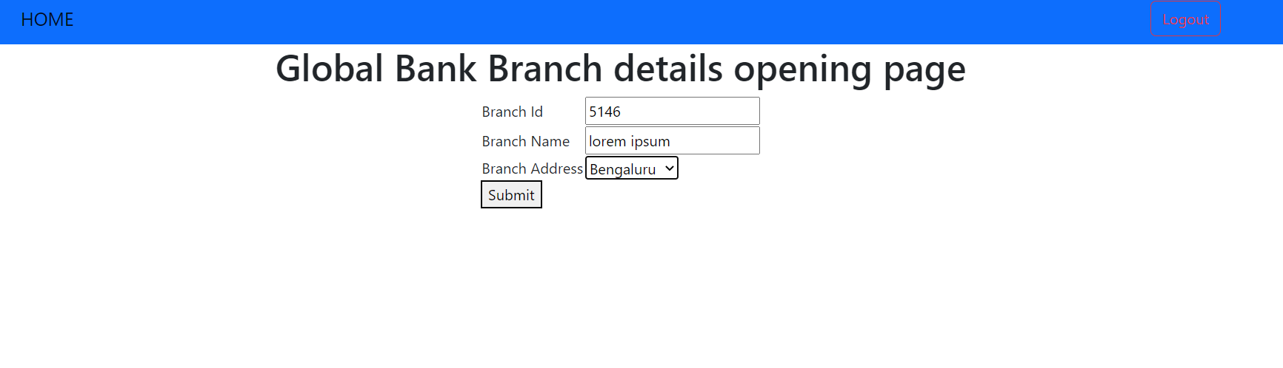

Slide 14
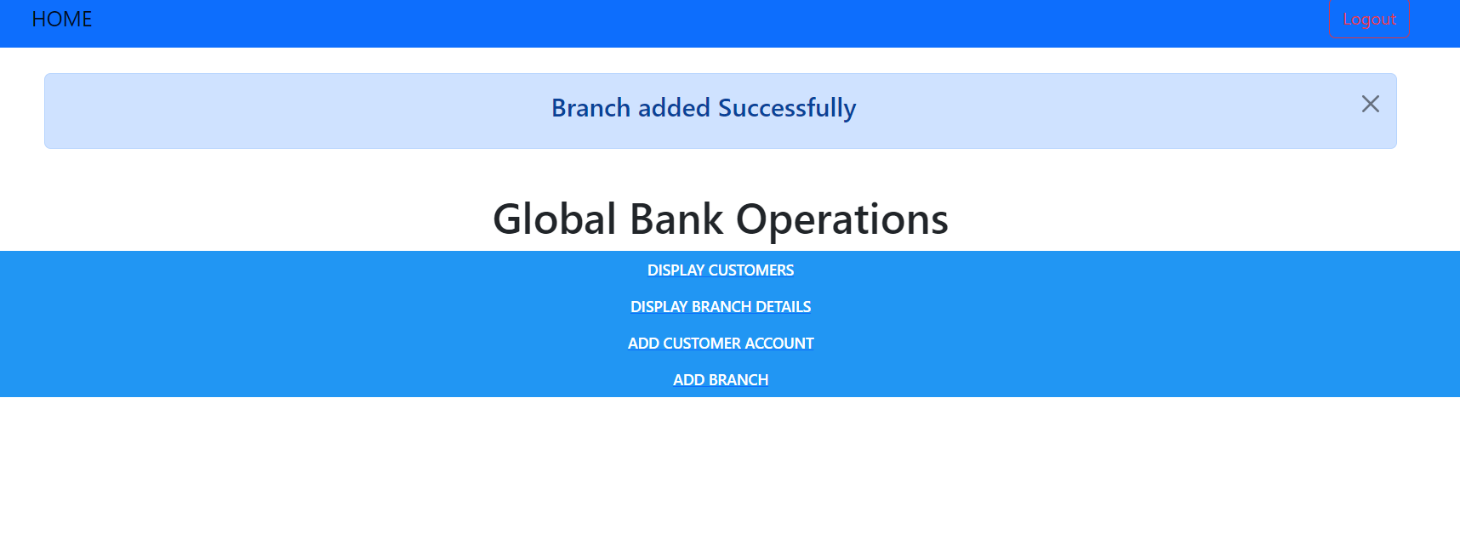

Slide 15
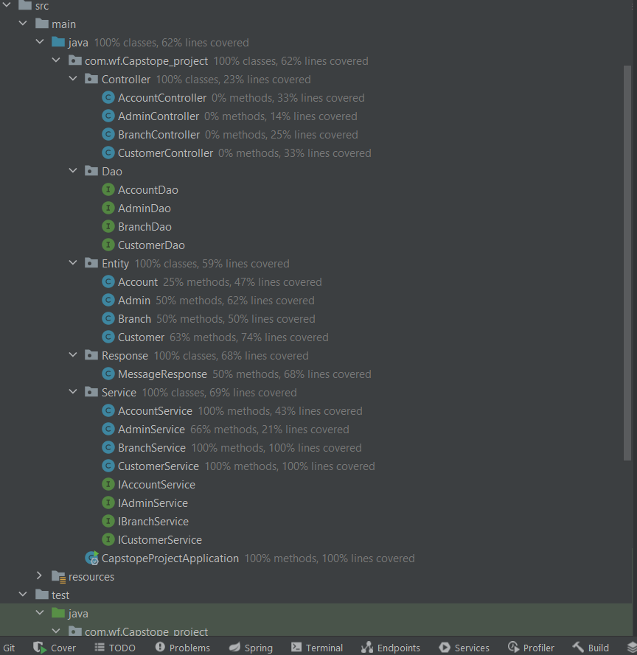
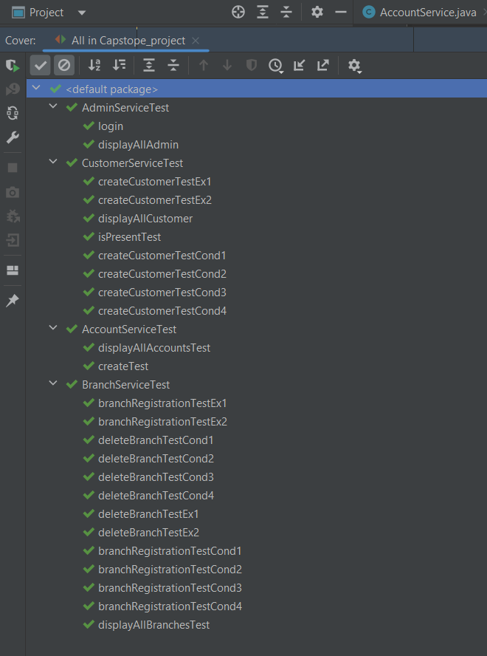
Test Results

Slide 16
Scope of improvement
Whenever admin adds the new account for a customer they should get some OTP on their contact number for authentication purposes.
The admin functionalities could also expand to maintaining loan details, card details etc of customers.
Making logging in and logging out secure by using session.

Slide 17
Thank You

