Slide 1

GREMLIN
An adversarial puzzle compiler using data-flow-driven mutation of three-address code
Akshith M · 24BAI0017
BCSE307P Compiler Design Laboratory · Guide: Ranjithkumar S
Review 3: Final Implementation and Testing
Notes:
GREMLIN compiles a small C-like language, analyses it with liveness and reaching definitions, then deliberately applies unsound optimisations. It keeps a bug only when the interpreter proves the output changed, and turns each proven bug into a debugging puzzle.

Slide 2



Optimisers can break correct programs silently
A miscompilation in one line
Random fuzzing is noisy
Most random edits fail to compile or behave the same
int a = 7;
int r = (a / 2) * 2;
optimiser: (a/2)*2 → a
original prints c=13
mutant prints c=14
Hand-made exercises don't scale
Each one must be written and checked by hand
Theory is detached from symptoms
Source is correct; the bug lives in the translation.
Dataflow equations are taught without the wrong output they prevent
Notes:
Problem: no practical tool generates proven compiler-optimisation bugs for teaching. Fuzzing is noisy, hand-made exercises don't scale, and theory is disconnected from symptoms.

Slide 3



GREMLIN inverts the optimiser
→
→
1 Analyse
2 Mutate
3 Prove
Build the CFG and run liveness and reaching definitions to find where a rewrite would be unsafe
Apply one of six unsound optimisation rules at exactly that instruction
Run original and mutant on the TAC interpreter; keep the mutant only if the output differs
Result: every puzzle is a real, proven bug with a one-line TAC diff, a difficulty rating and three hints.
Notes:
The same analyses that make optimisation safe are used to pick where it would be unsafe. Execution is the final judge.

Slide 4

All eight objectives are met in the final build
37
0
6
91%
automated tests pass
mypy --strict errors
unsound mutation rules
of candidate mutants proven
GremlinC grammar with int, string, int[]
ANTLR4 lexer, parser and AST
Symbol table and static type checker
TAC generation and control-flow graph
Liveness and reaching-definitions analysis
Six analysis-driven mutation rules
Proof by differential execution + puzzles
Tests, strict typing and benchmarks
Notes:
Headline numbers: 37 tests, zero strict type errors, six rules, 42 of 46 candidate mutants proven across 10 programs.

Slide 5
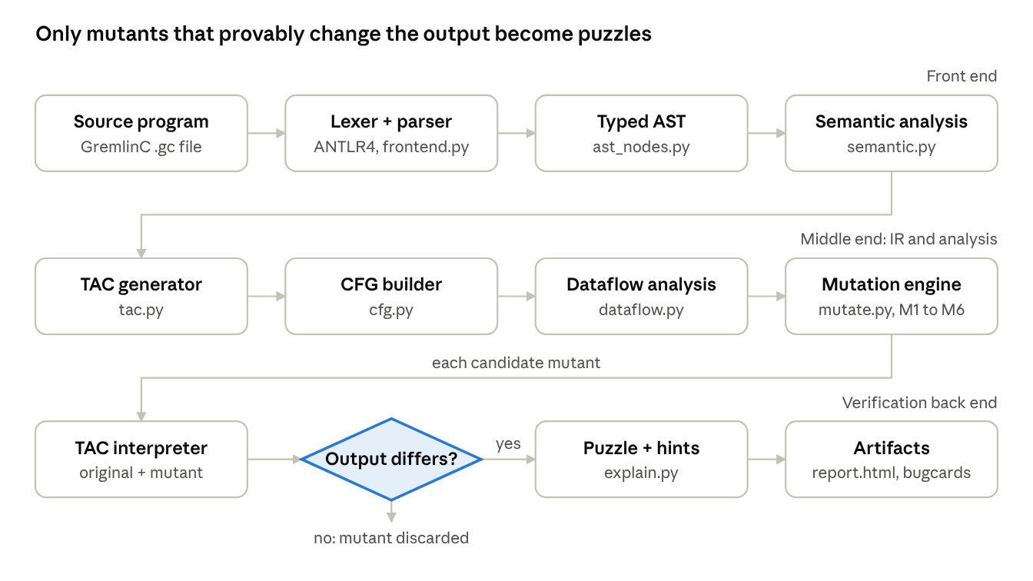
Eleven modules in a three-stage pipeline
Notes:
Front end: ANTLR lexer and parser, typed AST, semantic analysis. Middle end: TAC, CFG, dataflow, mutation engine. Back end: interpreter runs original and mutant; only differing outputs become puzzles.

Slide 6




GremlinC now has integers, strings and arrays
Static type checking
string word = "gremlin";
int a[6] = {4, 8, 15, 16, 23, 42};
int first = a[0];
int n = len(word);
while (i >= 0) {
rev = rev + word[i];
i = i - 1;
}
print rev; // rev="nilmerg"
print a; // a=[4,8,15,...]
int, string, int[]; rejects 8 kinds of type error
Strings
Escapes, + concatenation, len(s), s[i]
Arrays
Initialiser lists, a[i] loads and stores, bounds checks
New TAC
newarr, load, store, len, ++ (13 opcodes total)
Notes:
Final phase added strings and arrays end to end: grammar, AST, type checker, TAC, interpreter, dataflow and mutators.

Slide 7
Every compiler phase is implemented and tested
01
02
03
04
05
Lexical analysis
Parsing
Syntax tree
Symbol table
Semantic analysis
ANTLR4 lexer, 7 keywords, string escapes
18 parser rules, ALL(*)
Immutable typed AST with line numbers
Name to type, redeclaration checks
Types, scope, use before init
06
07
08
09
10
Intermediate code
Basic blocks + CFG
Dataflow
Optimisation
Execution + errors
Three-address code, 13 opcodes
Leader algorithm, branch edges
Liveness and reaching definitions
Six rewrites applied unsoundly
Interpreter with runtime traps
Notes:
All ten phases from the course manual's list except target machine code; the back end is an interpreter, listed in the manual as interpretation and execution. Highlighted: dataflow and optimisation, the core of the project.

Slide 8
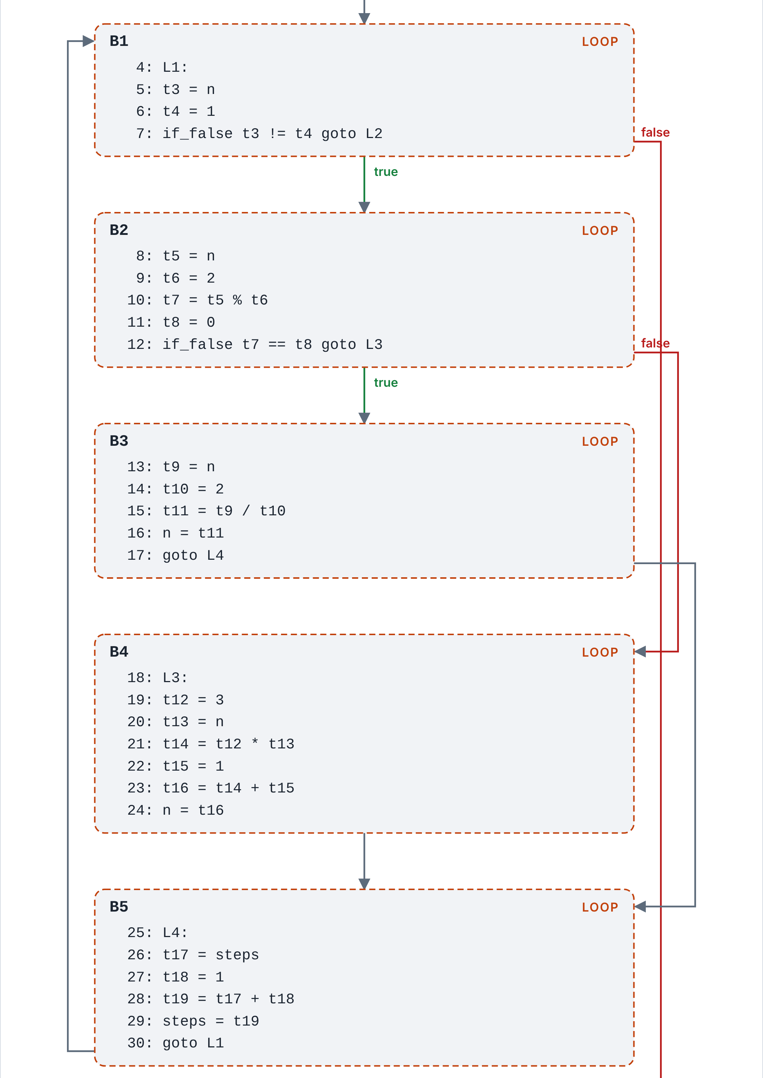
Dataflow analysis decides where a rewrite is unsafe
Liveness (backward)
OUT[B] = ∪ IN[S] IN[B] = use[B] ∪ (OUT[B] − def[B])
M1 deletes a store only when the variable is in OUT[B]
Reaching definitions (forward)
IN[B] = ∪ OUT[P] OUT[B] = gen[B] ∪ (IN[B] − kill[B])
M3 propagates a copy only where another definition reaches the use
Arrays: a store a[i] = v reads a and never kills it, so an array stays live while any later load can see it. Both analyses converge in at most 4 passes.
collatz.gc loop: back edge B5 → B1, if/else diamond
Notes:
Iterative fixpoint over basic blocks. The CFG shows the loop back edge that the Phase 3 fix restored.

Slide 9
Six unsound rules, each tied to a compiler property
Rule | Unsound rewrite | Chosen using | Property violated
M1 Dead store | Delete a live definition or array store | Liveness OUT[B] | Liveness
M2 Algebra | (x / c) * c → x | Constant resolution | Integer division
M3 Copy propagation | Use src where a = src does not reach | Reaching definitions | Reaching definitions
M4 Off-by-one | < ↔ <=, > ↔ >= | Every conditional jump | Branch boundary
M5 Commutativity | Swap operands of -, /, %, string ++ | Non-commutative ops | Commutativity
M6 Store forwarding | Load a[j] takes the value stored to a[i] | Store then load in a block | Memory dependence
Candidates are interleaved round-robin across rules, so a small budget still covers every kind of bug.
Notes:
M1 to M3 came in Phase 2; M4 to M6 and the array and string variants in the final phase.

Slide 10
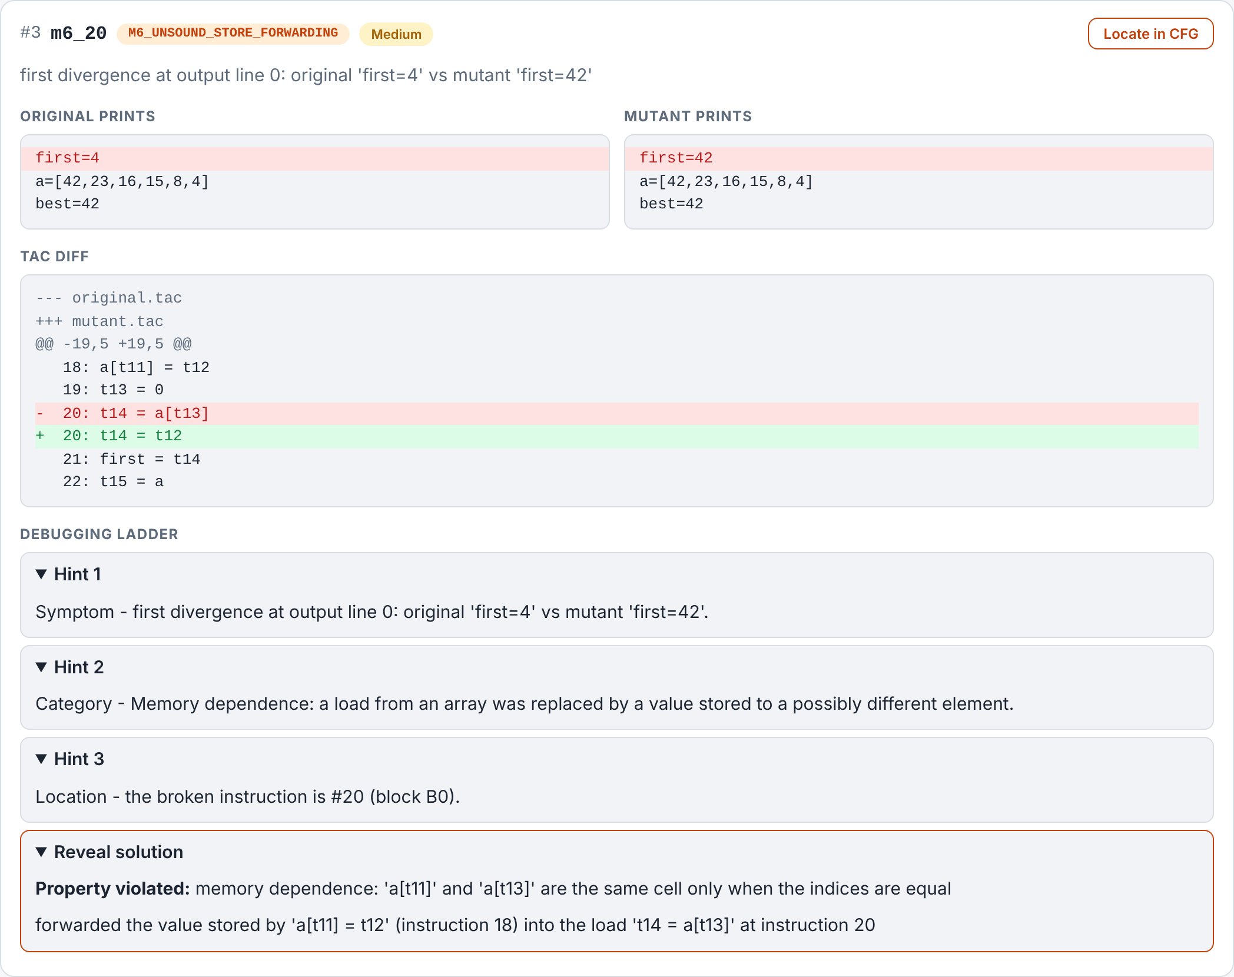
Each proven bug becomes a graded puzzle
One-line TAC diff
Dead code is left in place so the change stays visible
Difficulty 1 to 5
Rule cost, +1 inside a loop, +1 if the first output looks right
Three-step hint ladder
Symptom, then category, then exact instruction
Interactive report
CFG diagram, dataflow table, Locate in CFG
Notes:
The M6 aliasing puzzle on arrays.gc: forwarding the store to a[5] into the load of a[0] prints first=42 instead of 4.

Slide 11
91% of candidate mutants were proven
42 / 46
candidates proven to change output
4
equivalent mutants discarded automatically
4 / 4
invalid programs rejected with a precise error
Notes:
Every valid program yields proven puzzles; the four non-proven candidates behaved identically and were filtered out.

Slide 12
Parsing and execution dominate a 9.2 ms run
203 KiB
peak Python heap
< 0.3 ms
per dataflow analysis
200,000
step limit bounds every run
Notes:
Measured with driver.py --bench 20 on the author's laptop. Run time scales with interpreted steps: collatz takes about 300 ms because some mutants loop until the step limit.

Slide 13
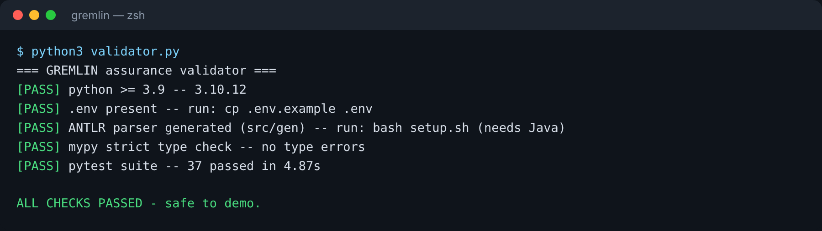
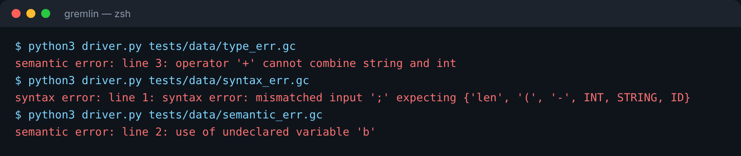
37 tests cover every class of input
Valid inputs
Exact expected output for valid1, gcd, strings, arrays, bubble
Invalid inputs
Syntax error, undeclared variable, 8 distinct type errors
Boundary cases
Empty file, out-of-bounds index, 10,000-iteration loop
Error conditions
Division by zero, step limit, undefined reads, type confusion
Every stage validated by mypy --strict and pytest via validator.py
Analysis checks
Liveness equations, loop back edge, determinism
Notes:
30 test functions, 37 cases including 8 parametrised type-error cases.

Slide 14

Building GREMLIN surfaced a real compiler bug
Before: goto target read from the wrong field
After: _target() reads arg1 for goto
B1 loop header
B1 loop header
No back edge, so liveness was wrong in every loop
Back edge B5 → B1 restored; tests T9 and T10 pin it
B2 body
B2 body
B5 goto L1
B5 goto L1
Notes:
The exact class of bug GREMLIN teaches: a silent analysis error. Found while checking the CFG drawing for collatz.gc.

Slide 15

Conclusion and next steps
What GREMLIN delivers
Future enhancements
A complete, tested compiler for a typed language with strings and arrays
Dataflow analysis inverted to generate proven, explained bugs
Execution is the final judge: 42 of 46 candidates proven
Functions and nested scopes
SSA form with phi-nodes
More rules: unsafe LICM, overflow folding
LLVM IR target, mutate at that level
Web playground with scoring
github.com/akshith-types/gremlin
Live demo next →
Notes:
Switch to the terminal for the live demo: validator, valid1, collatz report, strings, arrays, errors, bench, batch.

