Slide 1

DATABASE SYSTEMS LAB (BCSE302P) • FINAL REVIEW
MedMatch
Inter-Hospital Rare Resource Logistics Network
PROJECT DEMONSTRATION
A conflict-safe reservation and routing network for scarce blood, antivenom and organ units shared between independent hospitals, built on PostgreSQL and Neo4j.
Presented by
Akshith M (24BAI0017)
Sanjaay B (24BCE2181)
Vellore Institute of Technology

Slide 2



1 · ABSTRACT AND PROBLEM STATEMENT
When minutes decide outcomes, phone calls are too slow
Abstract
Manual search
MedMatch links the live inventories of independent hospitals so that a rare blood unit, antivenom vial or donor organ can be found, reserved and routed in seconds. A PostgreSQL ledger guarantees that one physical unit can never be promised to two hospitals, using strict two-phase locking with SELECT … FOR UPDATE and Wait-Die deadlock prevention. Composite B+ tree, hash and partial indexes keep the core lookups under a millisecond on 20,000 units, and a Neo4j graph of road and air corridors returns the fastest cold-chain route for every reservation.
Coordinators phone nearby hospitals one by one while the patient waits.
Double promises
Nothing stops two hospitals being promised the same last unit at once.
No audit trail
Not a hospital management system: no patients or billing, only scarce assets shared between facilities.
No structured record of who requested what, when, and what happened.
MedMatch — Rare Resource Logistics Network
2
Notes:
Open with the problem: the last O-negative unit in the region. Stress this is a coordination layer across hospitals, not a hospital management system.

Slide 3





2 · OBJECTIVES AND SCOPE
What MedMatch sets out to do
Real-time discovery
In scope
Find compatible, unexpired units across the network by blood group, HLA type and distance.
16 hospitals, 10 asset types, 20,000 units
Search, reserve, dispatch, deliver, cancel
Concurrency control and audit
Road and air routing with cold chain
Conflict-free allocation
Exactly one hospital wins each unit, even under simultaneous requests.
Fastest safe delivery
Compute the quickest route that keeps cold-chain items refrigerated.
Out of scope
Full accountability
Patient records, billing, ward management
User authentication and login
Live traffic feeds (route times are estimates)
Record every state change in an append-only audit log.
Low-latency queries
Keep core lookups under a millisecond with targeted indexes.
MedMatch — Rare Resource Logistics Network
3

Slide 4
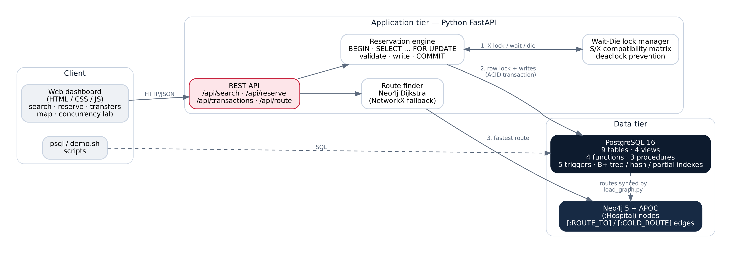
3 · SYSTEM ARCHITECTURE
Three tiers, two databases
Client
Application tier
Data tier
Web dashboard and psql / demo.sh scripts talk to the system over HTTP and SQL.
FastAPI coordinates the Wait-Die lock manager, the reservation transaction and the route finder.
PostgreSQL is the source of truth; Neo4j holds a synced copy of the transport network for routing.
MedMatch — Rare Resource Logistics Network
4

Slide 5
3 · WORKFLOW
Life of one reservation
1
2
3
4
5
6
Search
Lock
Validate
Write
Route
Commit
fn_search_assets returns compatible, unexpired units, nearest first.
Wait-Die grants an exclusive lock; a younger conflicting request dies and retries.
BEGIN; SELECT … FOR UPDATE; re-check status and expiry under the lock.
Asset → RESERVED, request and transfer rows inserted; trigger writes the audit row.
Neo4j Dijkstra on ROUTE_TO or COLD_ROUTE gives the fastest safe path.
COMMIT releases every lock at once (strict 2PL).
After the reservation
ALLOCATED → sp_dispatch_transfer → IN_TRANSIT → sp_complete_transfer → COMPLETED (ownership moves to the requesting hospital)
Or sp_cancel_transfer returns the unit to AVAILABLE. Triggers enforce these transitions and log each one.
MedMatch — Rare Resource Logistics Network
5

Slide 6
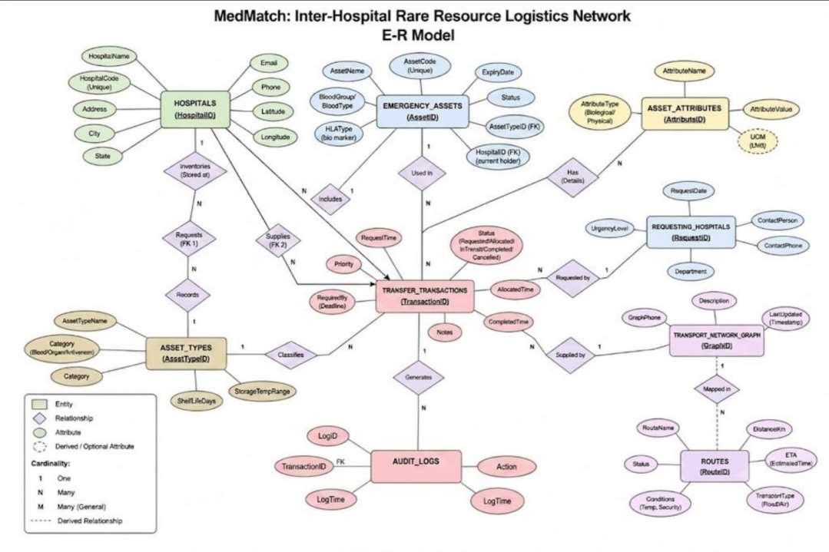
4 · ER DIAGRAM
Entities and relationships
9 entities
Hospitals
Asset_Types
Emergency_Assets
Asset_Attributes (weak, 1:N)
Requesting_Hospitals
Transfer_Transactions
Audit_Logs
Transport_Network_Graph
Routes
Hospitals relate to Transfer_Transactions twice: once as requester, once as supplier.
MedMatch — Rare Resource Logistics Network
6

Slide 7
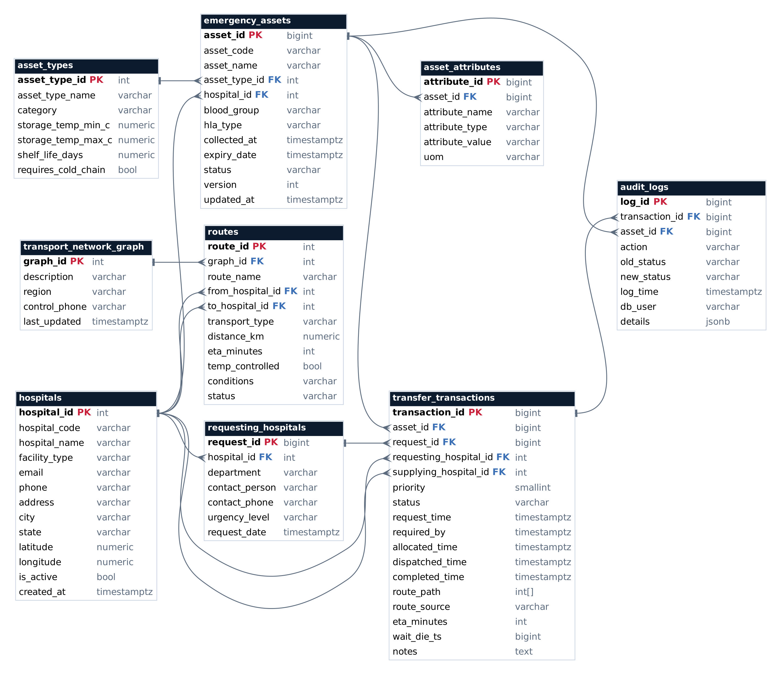
5 · RELATIONAL SCHEMA
Nine tables, thirteen foreign keys
Reading the diagram
PK primary key
FK foreign key
Crow's foot = many, bar = one.
Key design choices
Surrogate keys; natural codes kept UNIQUE
Two FKs from transfers to hospitals (requester, supplier)
Routes stored relationally, synced to Neo4j
Audit rows reference both transfer and asset
MedMatch — Rare Resource Logistics Network
7

Slide 8
5 · NORMALIZATION
From one wide table to 3NF / BCNF
asset_type_id → { category, storage_temp_min_c, storage_temp_max_c, shelf_life_days, requires_cold_chain }
Form | Rule | How MedMatch meets it
1NF | Atomic values, no repeating groups | Latitude and longitude are separate columns; extra properties live as rows in asset_attributes, not as lists.
2NF | No partial dependency on part of a key | Every table has a single-column surrogate key, so partial dependencies cannot arise.
3NF | No transitive dependency | Type attributes moved to asset_types; hospital profile fields live only in hospitals.
BCNF | Every determinant is a candidate key | Each determinant is the table's id or a UNIQUE natural key (asset_code, hospital_code, email).
Anomaly avoided
If shelf life were stored on every unit, changing it for O-negative Packed Red Cells would mean rewriting thousands of rows (update anomaly), and a new asset type could not exist before its first unit (insertion anomaly).
MedMatch — Rare Resource Logistics Network
8

Slide 9




6 · DATABASE IMPLEMENTATION
DBMS, tools and table definitions
PostgreSQL 16
CREATE TABLE emergency_assets (
asset_id BIGSERIAL PRIMARY KEY,
asset_code VARCHAR(20) NOT NULL UNIQUE,
asset_name VARCHAR(100) NOT NULL,
asset_type_id INT NOT NULL REFERENCES asset_types(asset_type_id),
hospital_id INT NOT NULL REFERENCES hospitals(hospital_id),
blood_group VARCHAR(3)
CHECK (blood_group IN ('O-','O+','A-','A+','B-','B+','AB-','AB+')),
hla_type VARCHAR(40),
collected_at TIMESTAMPTZ NOT NULL DEFAULT now(),
expiry_date TIMESTAMPTZ NOT NULL,
status VARCHAR(12) NOT NULL DEFAULT 'AVAILABLE'
CHECK (status IN ('AVAILABLE','RESERVED','IN_TRANSIT',
'DELIVERED','EXPIRED','DISCARDED')),
version INT NOT NULL DEFAULT 1,
CHECK (expiry_date > collected_at)
);
Relational core: tables, PL/pgSQL, indexes, row locking
Neo4j 5 + APOC
Graph of hospitals and routes; Dijkstra
Python 3 · FastAPI
REST API, lock manager, psycopg 3, NetworkX
Docker Compose
Runs both databases with one command
MedMatch — Rare Resource Logistics Network
9

Slide 10
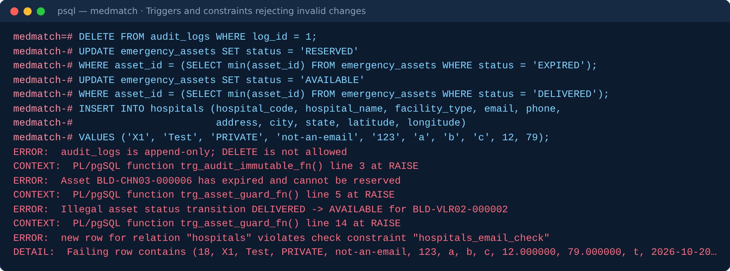
6 · CONSTRAINTS
Rules the database enforces on its own
Constraint | Count | Examples
PRIMARY KEY | 9 | hospital_id, asset_id, transaction_id, log_id …
FOREIGN KEY | 13 | emergency_assets.hospital_id → hospitals; transfer_transactions.supplying_hospital_id → hospitals
UNIQUE | 6 | asset_code, hospital_code, hospitals.email, (from, to, transport_type) on routes
NOT NULL | most columns | names, codes, coordinates, timestamps, status
CHECK | 20+ | blood group values, status values, email format, latitude range, expiry > collected
Partial UNIQUE index | 1 | uq_one_active_claim_per_asset: at most one live claim per unit
Real output: the database rejects four invalid changes
MedMatch — Rare Resource Logistics Network
10

Slide 11
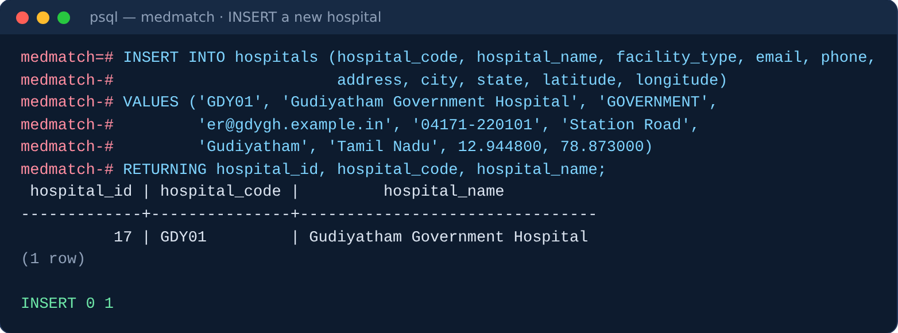
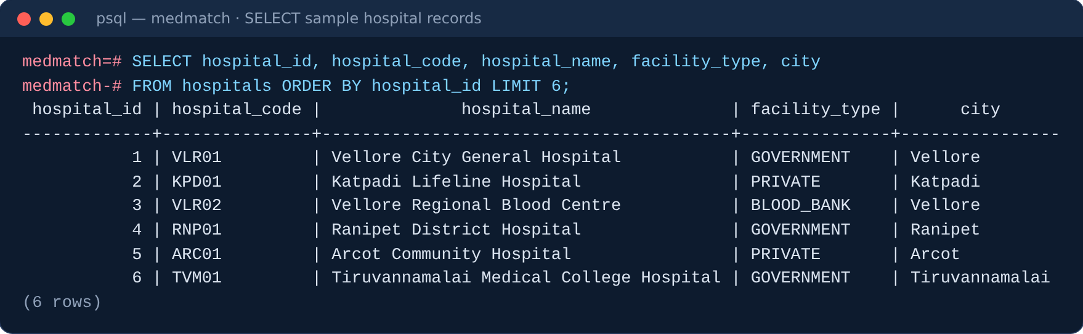
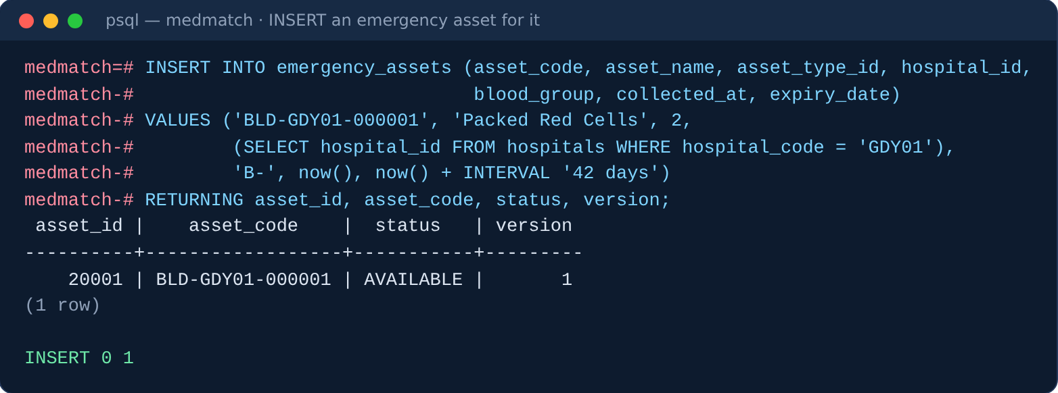
6 · SAMPLE RECORDS
INSERT statements and the data they create
Seed data
16 hospitals, 10 asset types, 112 route edges, 20,000 inventory units bulk-loaded with COPY in about 1 second. Blood groups follow an approximate Indian distribution, so O-negative is about 1.5% of stock.
MedMatch — Rare Resource Logistics Network
11

Slide 12
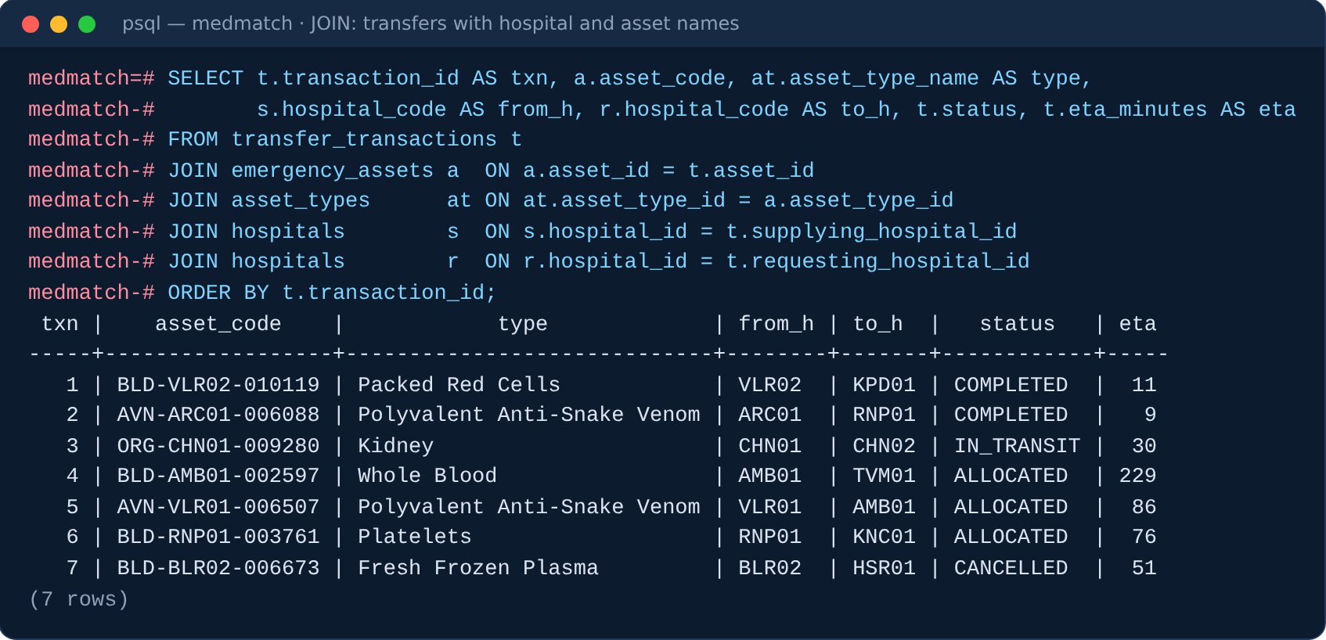
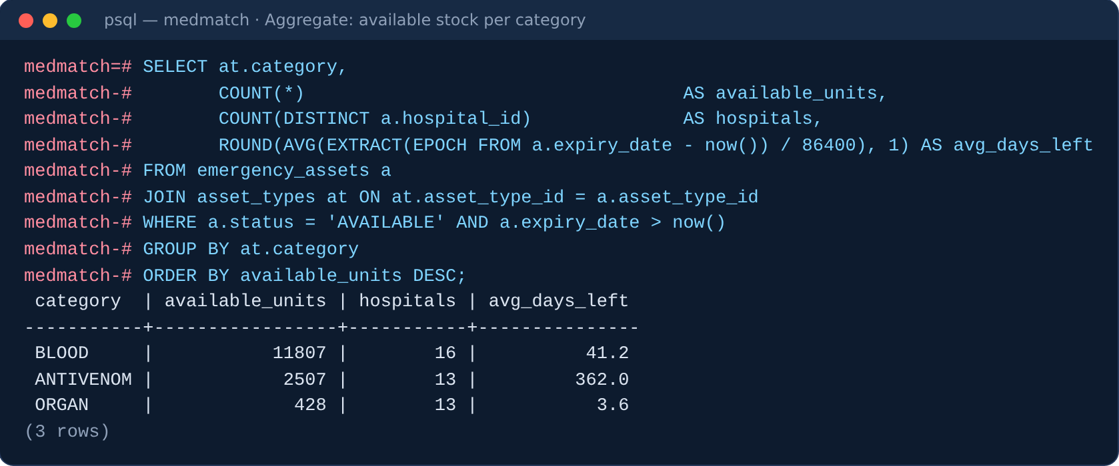
6 · SQL QUERIES AND OUTPUTS
Joins and aggregation
5-table JOIN
Each transfer joined to its asset, the asset type, and the hospitals table twice: once as supplier (s), once as requester (r).
GROUP BY + aggregates
COUNT, COUNT(DISTINCT) and AVG summarise available stock per category. Organs average 3.6 days of life left, antivenom about a year.
MedMatch — Rare Resource Logistics Network
12

Slide 13
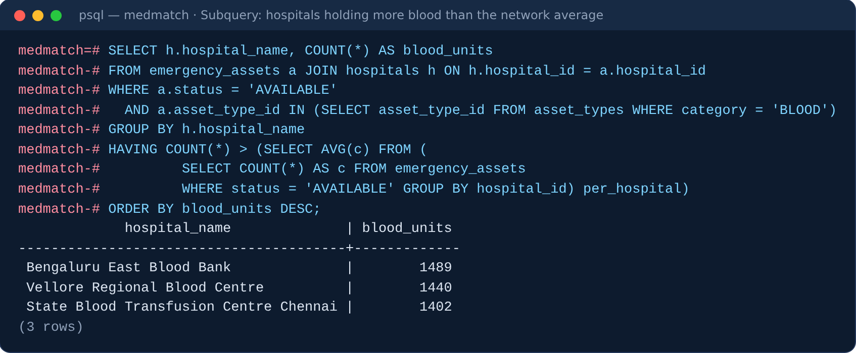
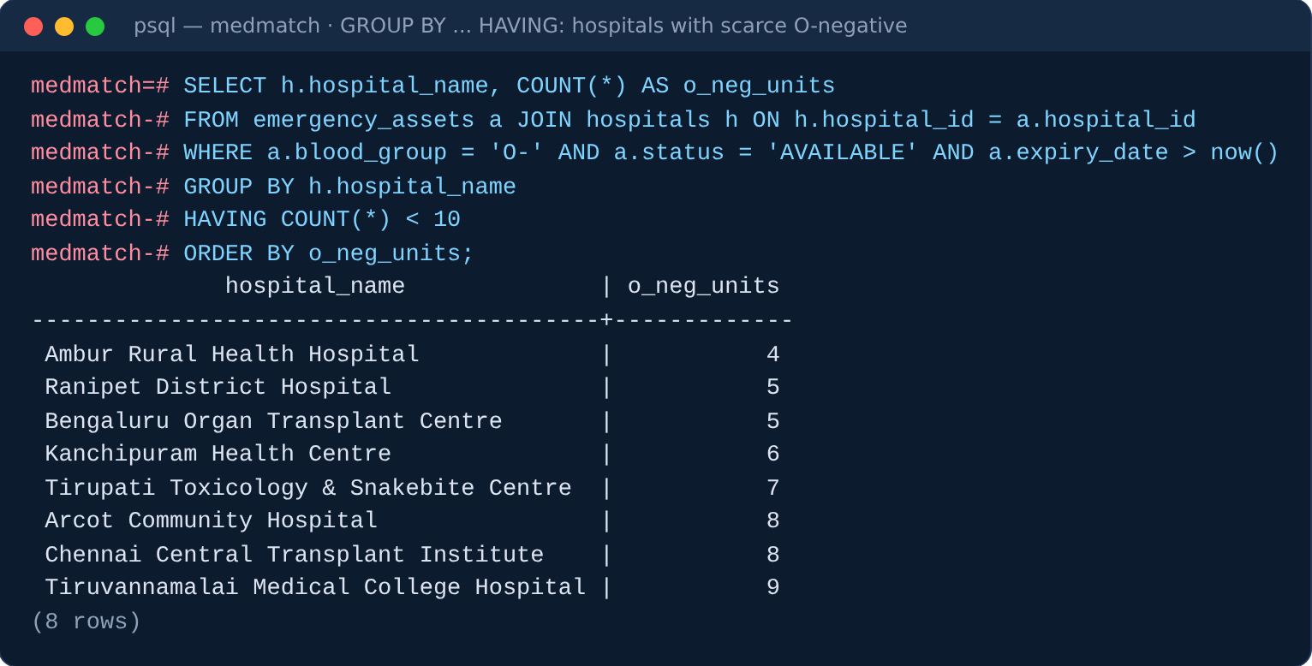
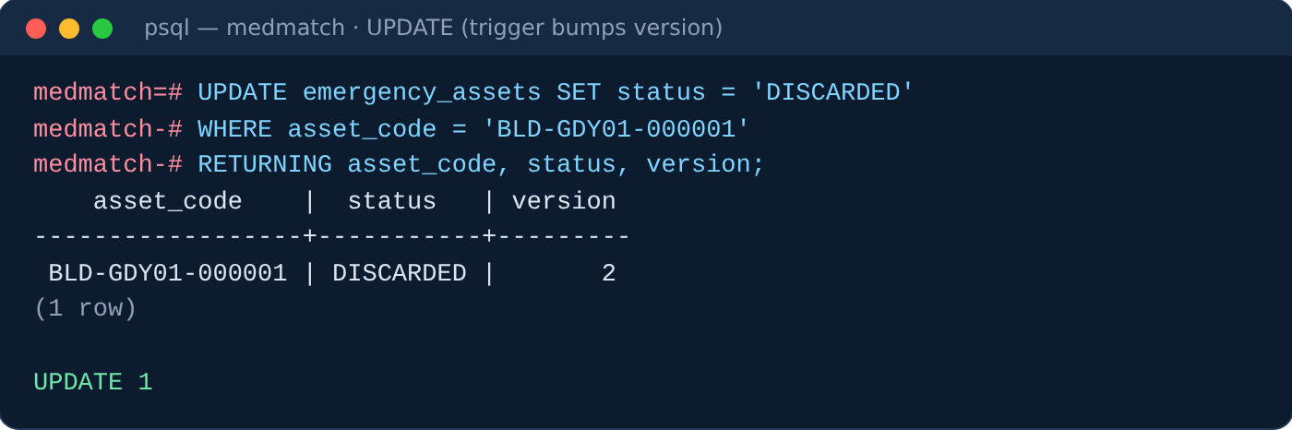
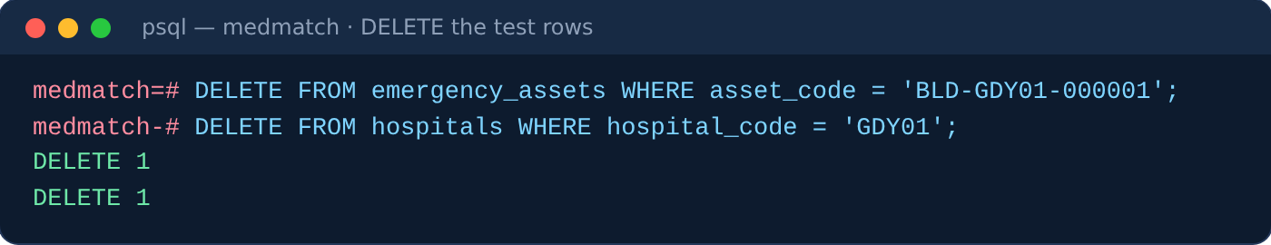
6 · SQL QUERIES AND OUTPUTS
Subqueries, HAVING, UPDATE and DELETE
MedMatch — Rare Resource Logistics Network
13

Slide 14
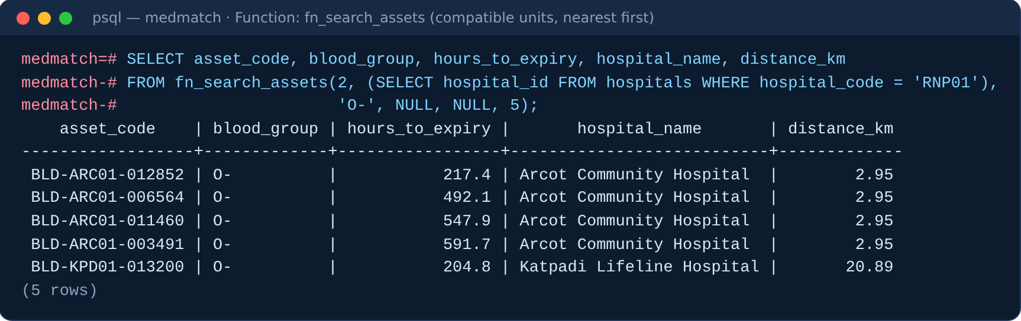
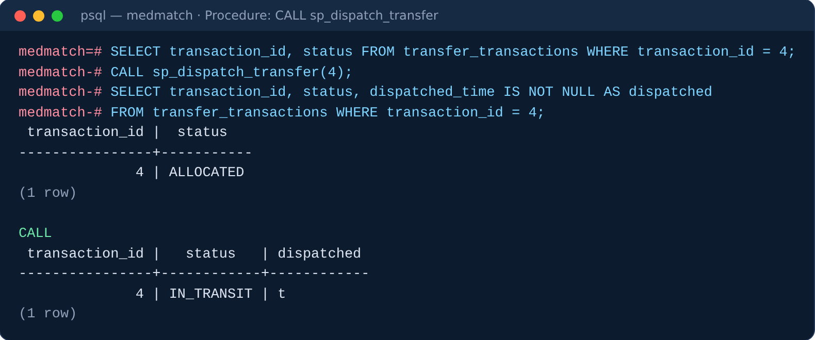
7 · ADVANCED CONCEPTS
Functions and stored procedures
Functions
fn_search_assets
compatible units, nearest first
blood_compatible
ABO / Rh donor-recipient rule
haversine_km
distance between coordinates
fn_expire_assets
marks stale stock EXPIRED
Procedures
sp_dispatch_transfer
sp_complete_transfer
sp_cancel_transfer
Each locks the rows it changes with FOR UPDATE.
MedMatch — Rare Resource Logistics Network
14

Slide 15
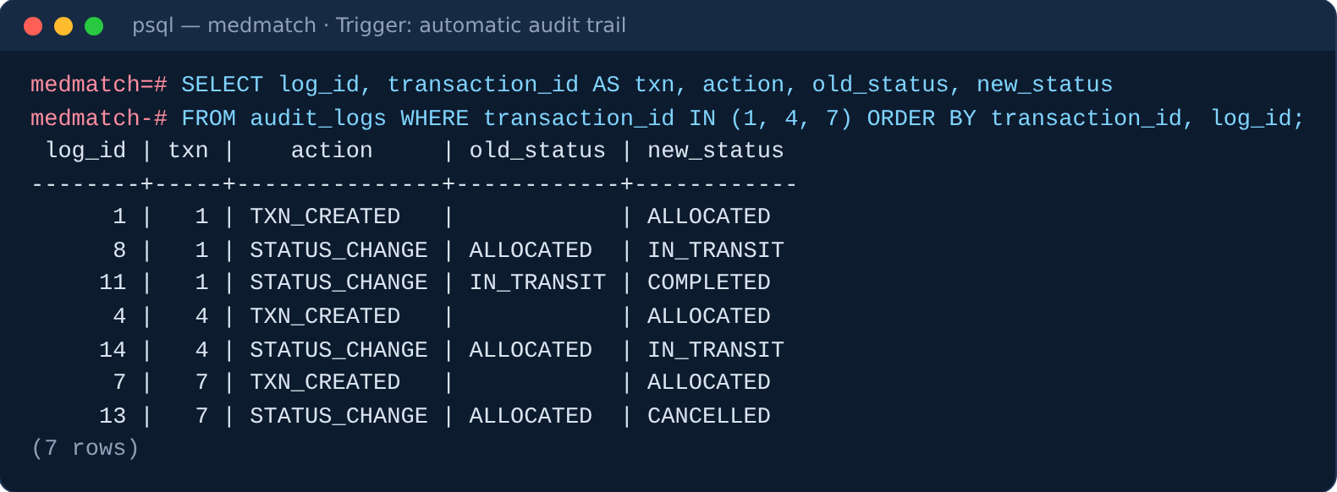
7 · ADVANCED CONCEPTS
Five triggers guard every state change
trg_asset_guard
BEFORE UPDATE · emergency_assets
Legal status transitions only; blocks reserving expired stock; bumps version.
trg_txn_state
BEFORE UPDATE · transfer_transactions
Enforces REQUESTED → ALLOCATED → IN_TRANSIT → COMPLETED / CANCELLED.
Audit rows written by trg_txn_audit for transfers 1, 4 and 7
trg_txn_audit
AFTER INSERT/UPDATE · transfer_transactions
Writes an audit row for every creation and status change.
trg_audit_immutable
BEFORE UPDATE/DELETE · audit_logs
Makes the audit log append-only.
trg_route_touch
AFTER change · routes
Updates the network's last_updated timestamp.
MedMatch — Rare Resource Logistics Network
15

Slide 16
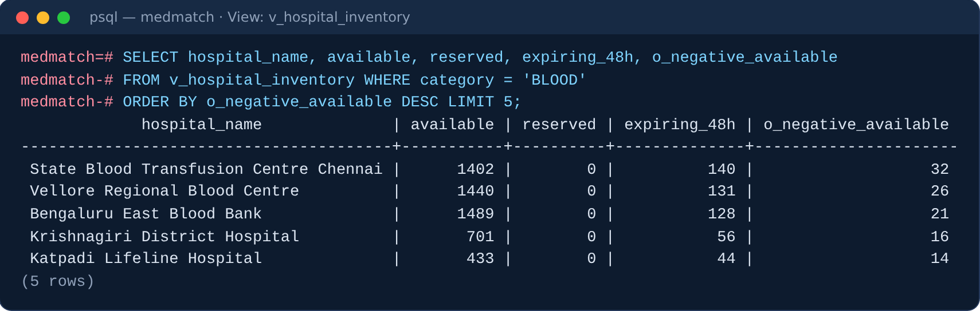
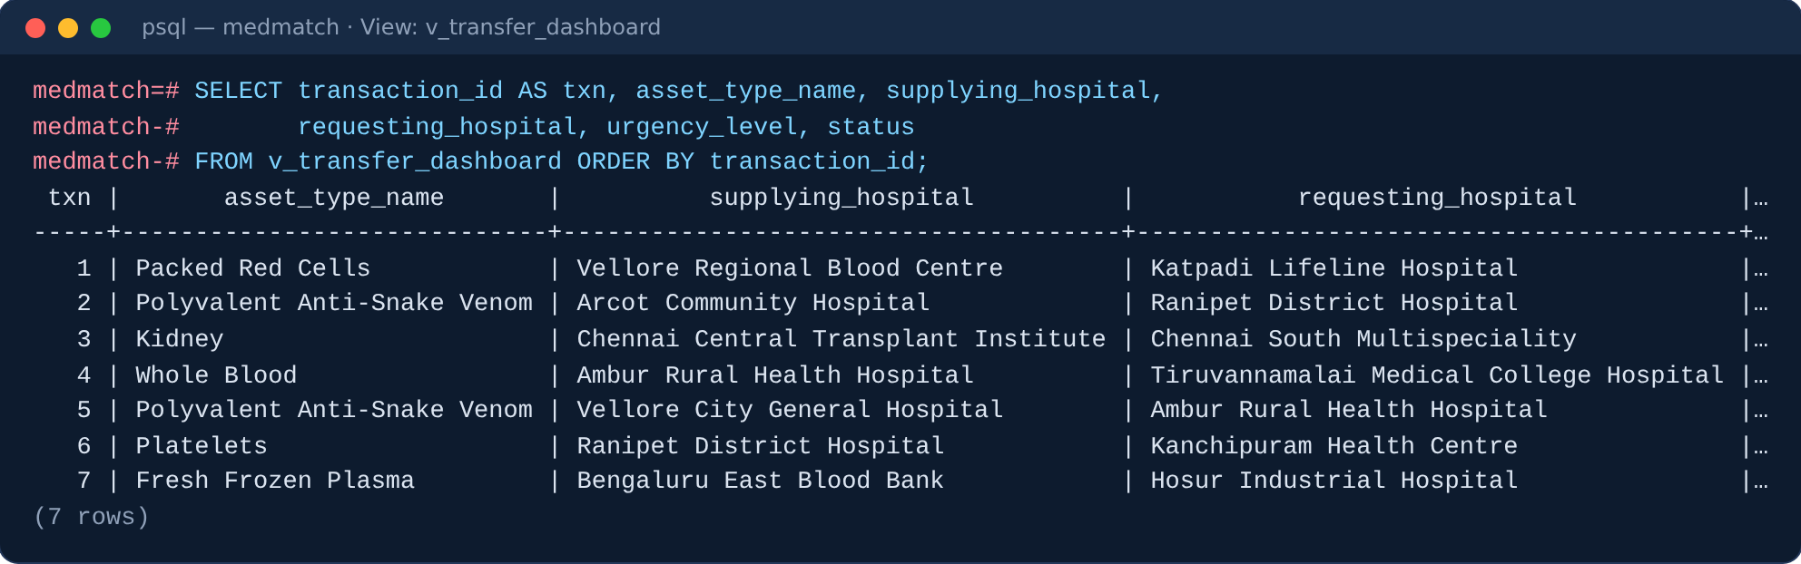
7 · ADVANCED CONCEPTS
Views
MedMatch — Rare Resource Logistics Network
16

Slide 17
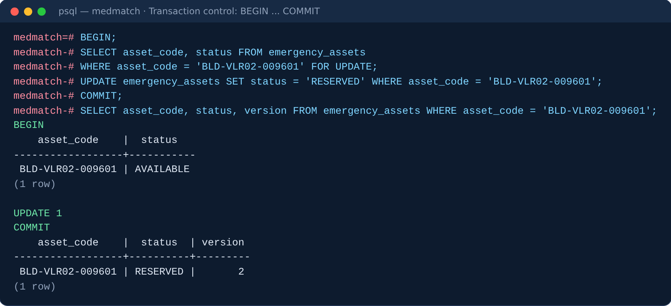
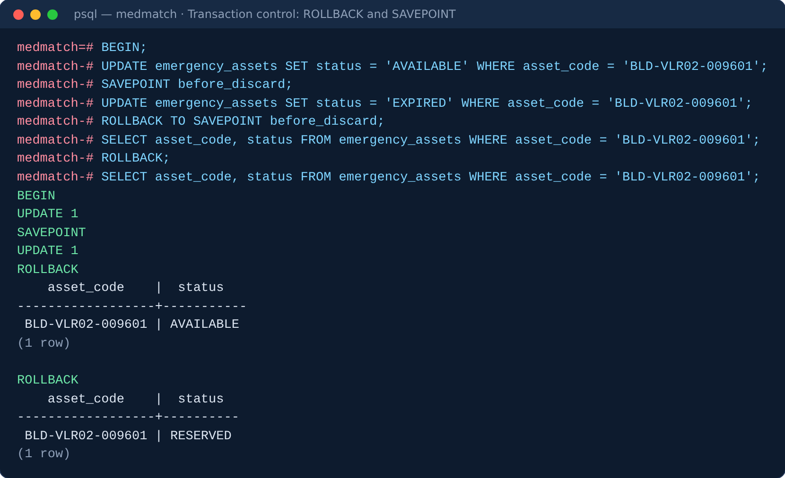
7 · TRANSACTION CONTROL
COMMIT, ROLLBACK and SAVEPOINT
COMMIT made the reservation permanent: status RESERVED, version bumped to 2.
ROLLBACK TO SAVEPOINT undid only the second update; ROLLBACK undid the rest.
MedMatch — Rare Resource Logistics Network
17

Slide 18
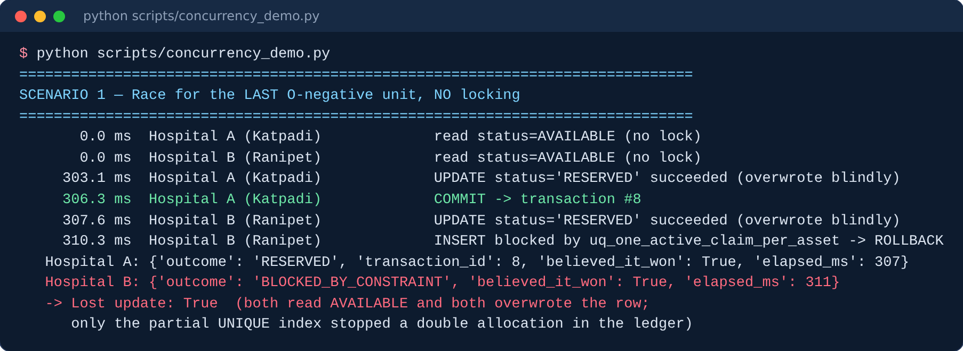
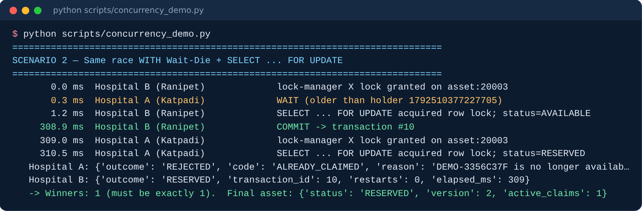
7 · CONCURRENCY CONTROL
Two hospitals, one unit, one winner
Strict two-phase locking
Locks are taken with SELECT … FOR UPDATE and held until COMMIT. The second hospital re-reads the row only after the first commits, sees RESERVED, and is turned away. Without locking, both read AVAILABLE and both believed they won: a lost update.
Held ╲ Requested | Shared | Exclusive
Shared | Granted | Conflict
Exclusive | Conflict | Conflict
Stress test: 15 hospitals reserved the same unit at once — 1 succeeded, 14 were rejected cleanly.
MedMatch — Rare Resource Logistics Network
18

Slide 19
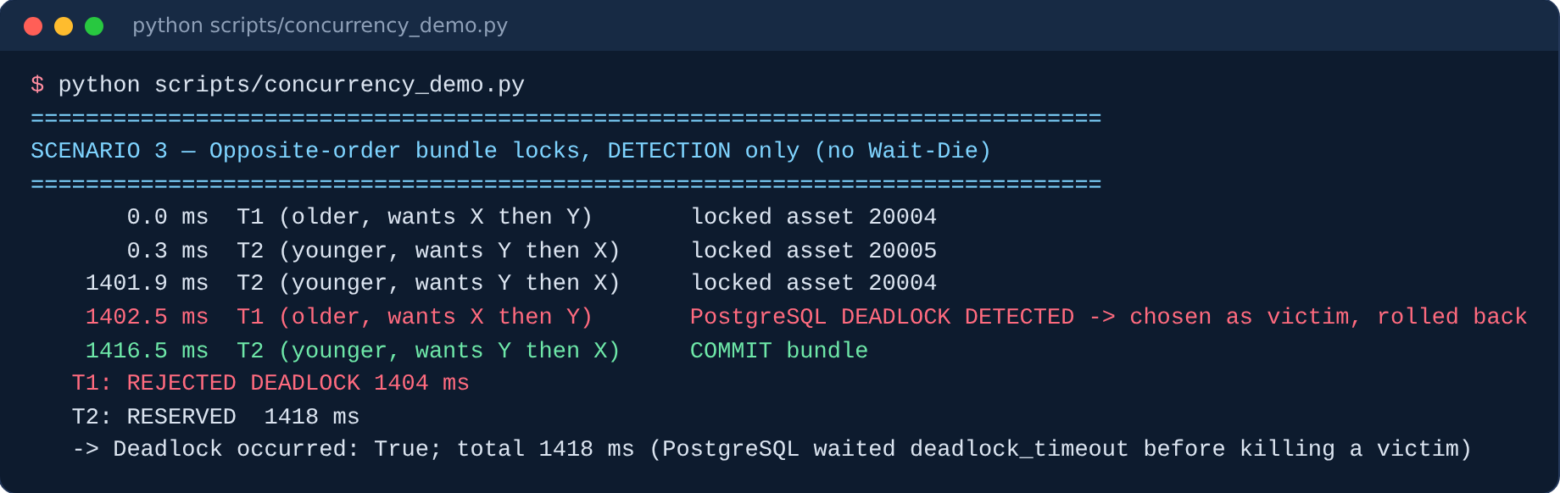
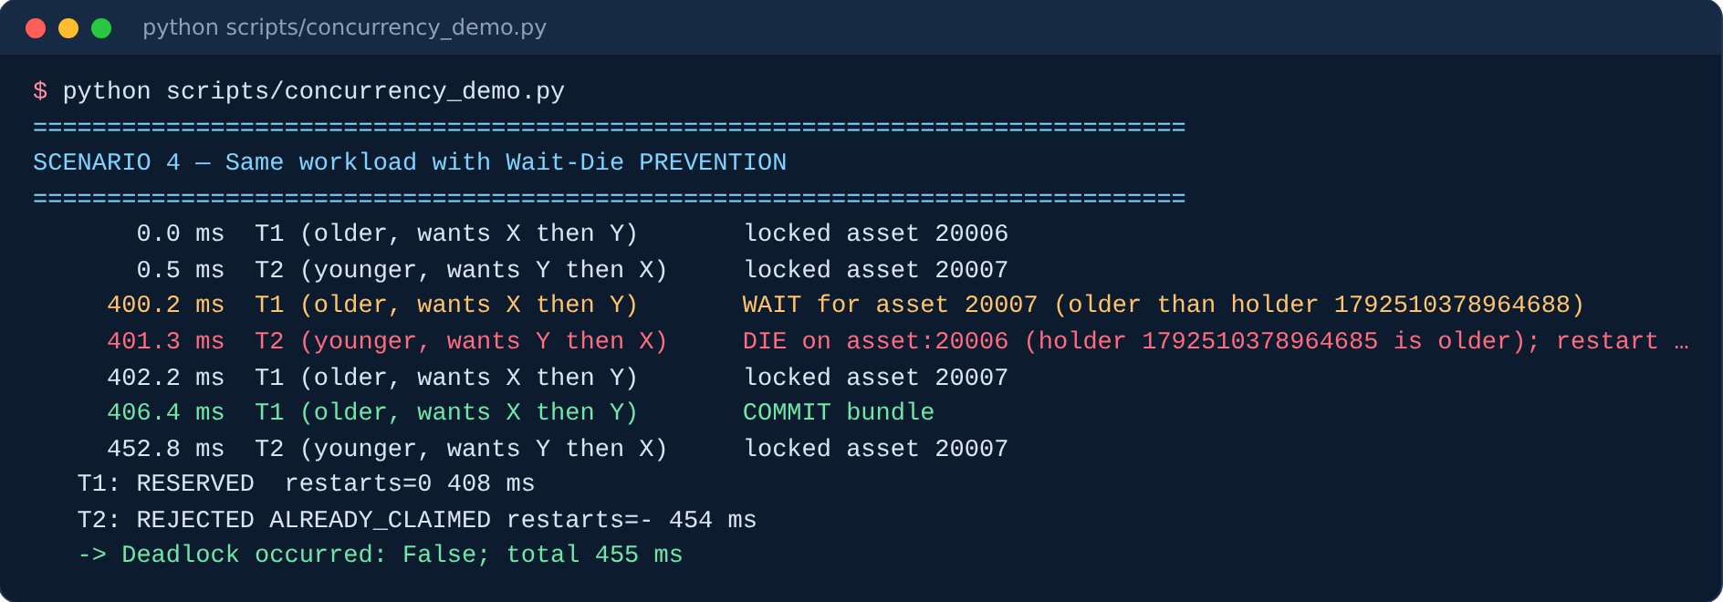
7 · CONCURRENCY CONTROL
Deadlock: detection vs Wait-Die prevention
Wait-Die rule
Older requester → WAIT. Younger requester → DIE and restart with its original timestamp. Waits only go old → young, so no cycle can form. PostgreSQL alone waits deadlock_timeout (1 s) before killing a victim.
MedMatch — Rare Resource Logistics Network
19

Slide 20
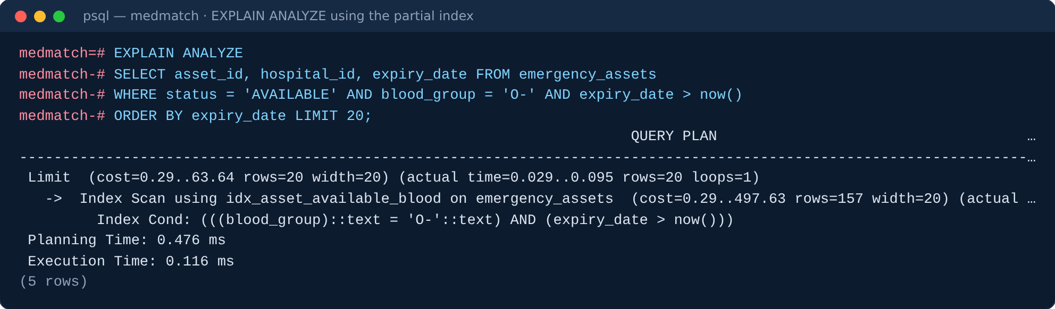
7 · INDEXING AND QUERY OPTIMIZATION
Three index types, up to 96× faster
Relational algebra (Q4)
π code, name ( σ type=2 ∧ group='O-' ∧ status='AVAILABLE' ∧ expiry>now() (ASSETS) ⋈ HOSPITALS )
Index | Type | Serves
idx_asset_lookup | B+ tree (type, expiry, status) | core search
idx_asset_hla_hash | Hash (hla_type) | exact tissue match
idx_asset_available_blood | Partial B+ tree, AVAILABLE only | rare-group lookup
Heuristic: push selections below the join, so only matching units are joined. The partial index is already sorted by expiry, so ORDER BY needs no sort step.
MedMatch — Rare Resource Logistics Network
20

Slide 21
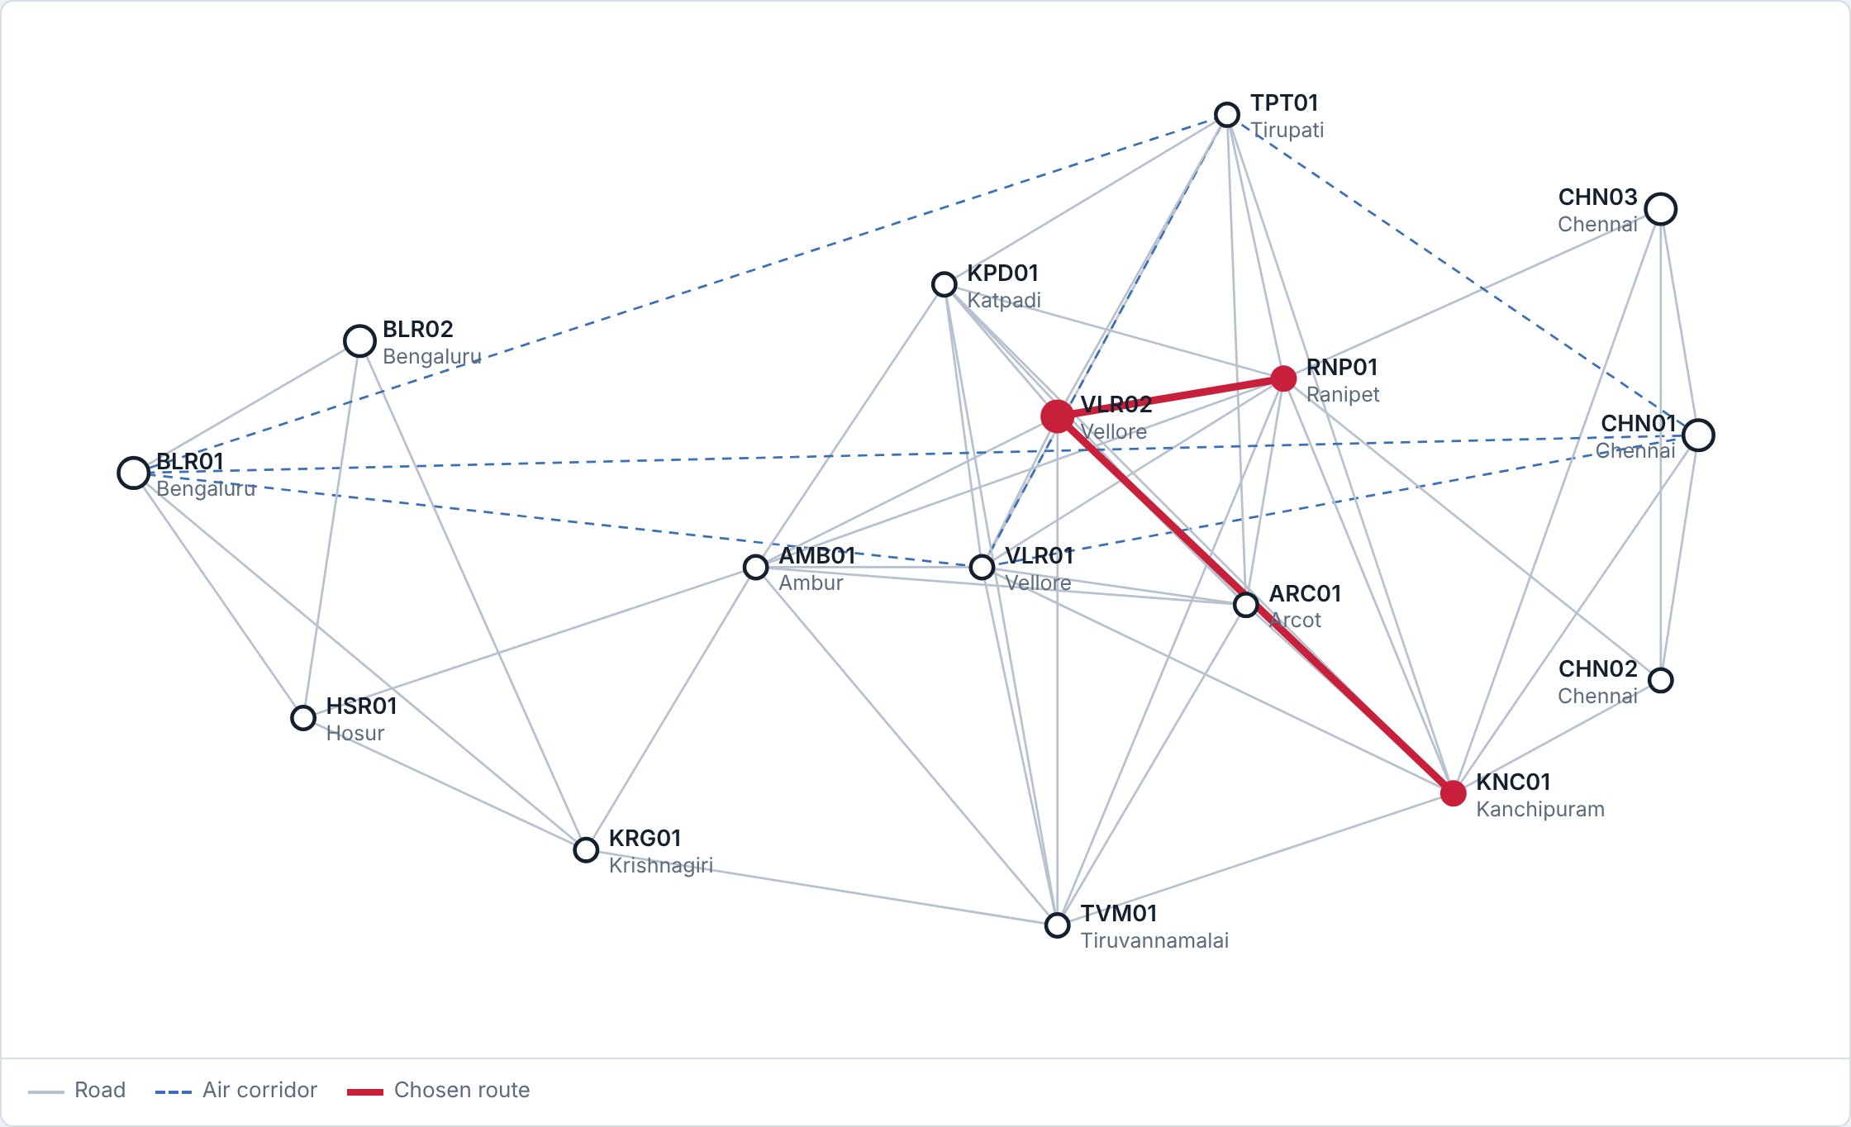
7 · NOSQL GRAPH DATABASE
Routing in Neo4j, with cold-chain awareness
MATCH (a:Hospital {code:'RNP01'}),
(b:Hospital {code:'KNC01'})
CALL apoc.algo.dijkstra(a, b,
'COLD_ROUTE>', 'eta_minutes')
YIELD path, weight
RETURN [n IN nodes(path) | n.code], weight;
Ranipet → Kanchipuram | Route | Time
Normal (ROUTE_TO) | direct road | 76 min
Cold chain (COLD_ROUTE) | via Vellore Regional Blood Centre | 154 min
Nodes: 16 (:Hospital). Edges: 112 [:ROUTE_TO] weighted by eta_minutes; refrigerated legs also copied as [:COLD_ROUTE]. Blood, plasma and organs use cold routes; platelets and anti-snake venom use normal ones.
Chosen cold-chain route highlighted in red
MedMatch — Rare Resource Logistics Network
21

Slide 22
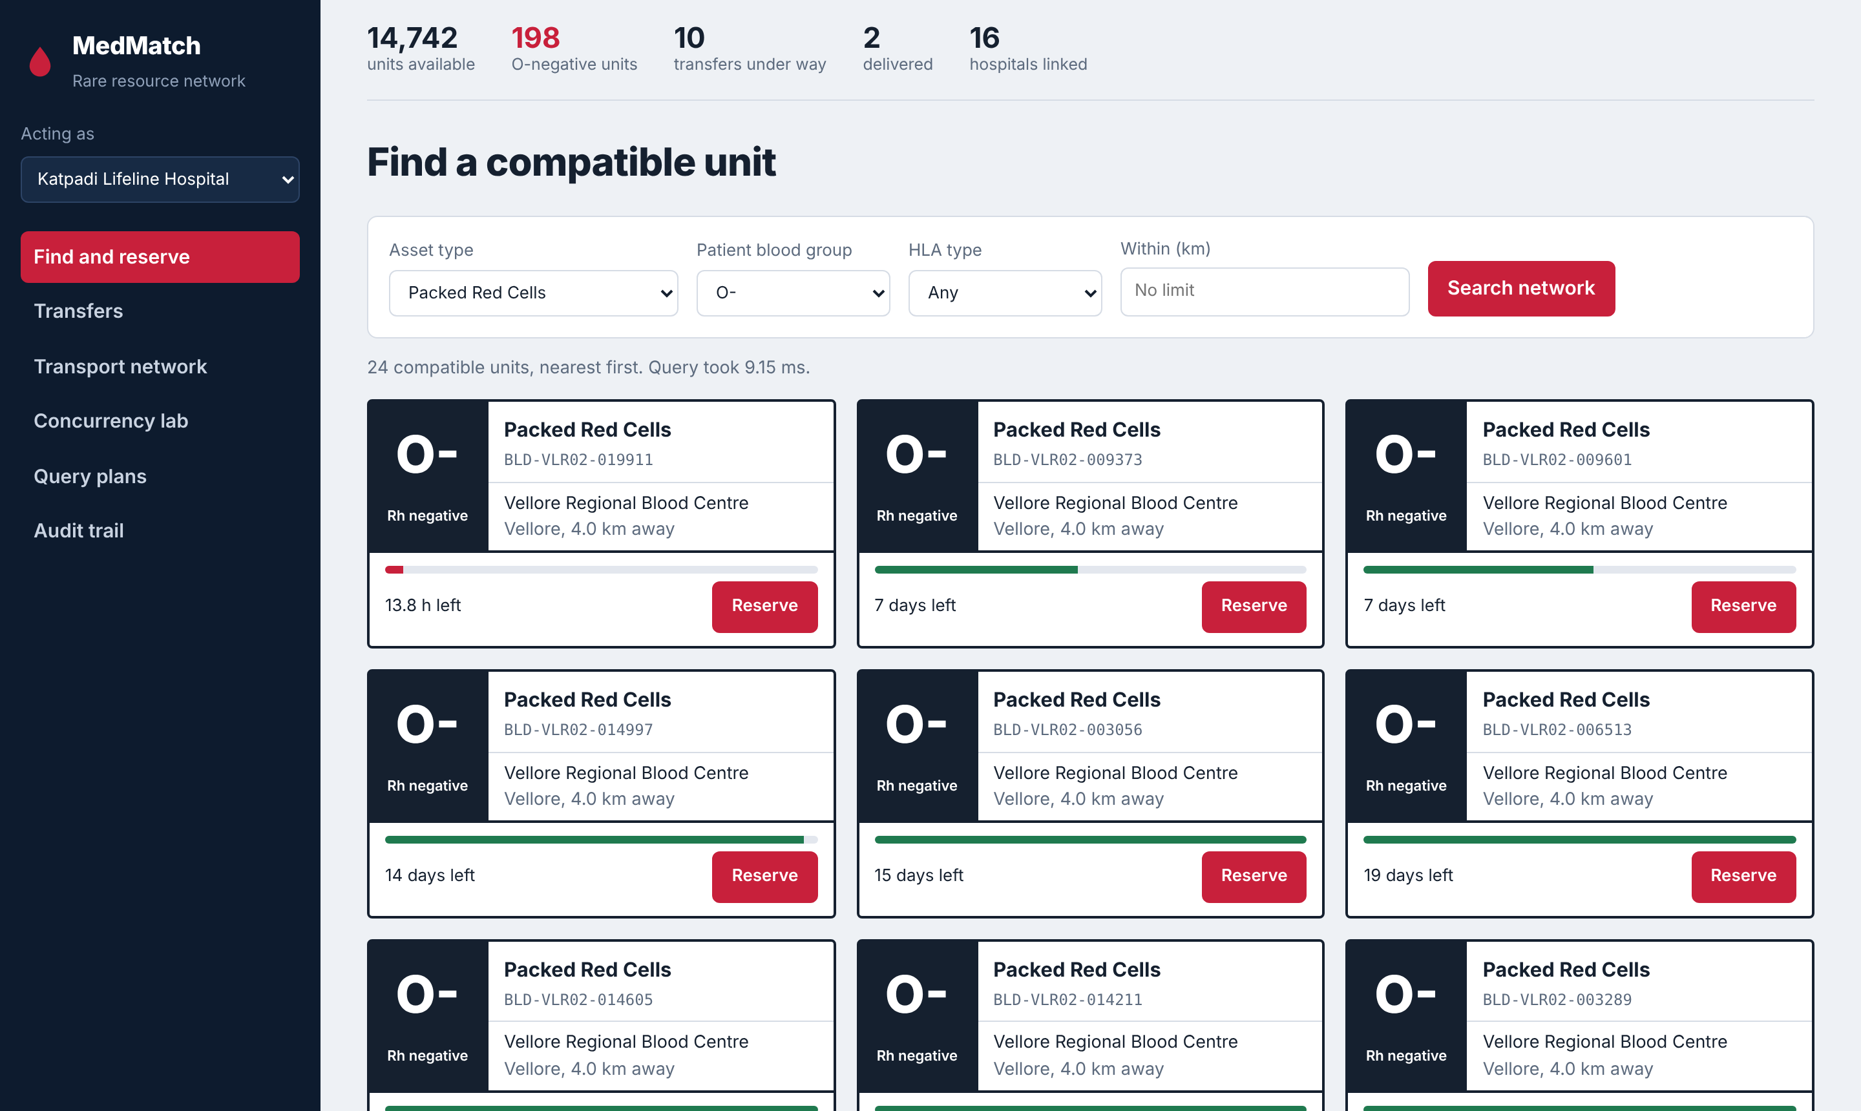
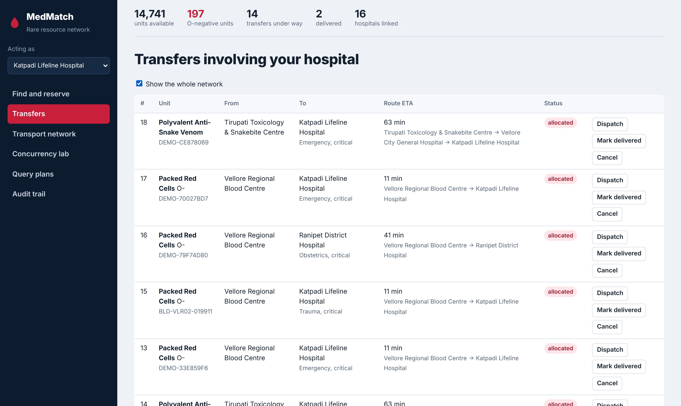
8 · APPLICATION DEMONSTRATION
Find, reserve and track
Find and reserve: compatible O-negative units, soonest-expiring first
Transfers: route, ETA and status; dispatch, deliver or cancel
MedMatch — Rare Resource Logistics Network
22

Slide 23
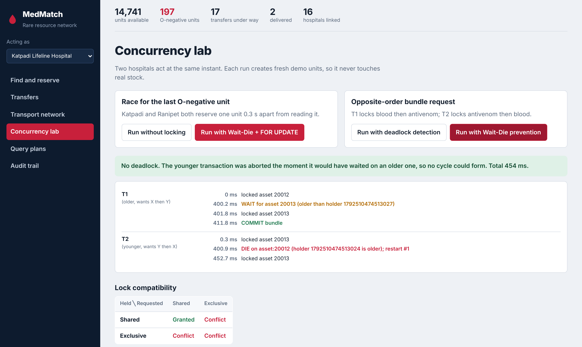
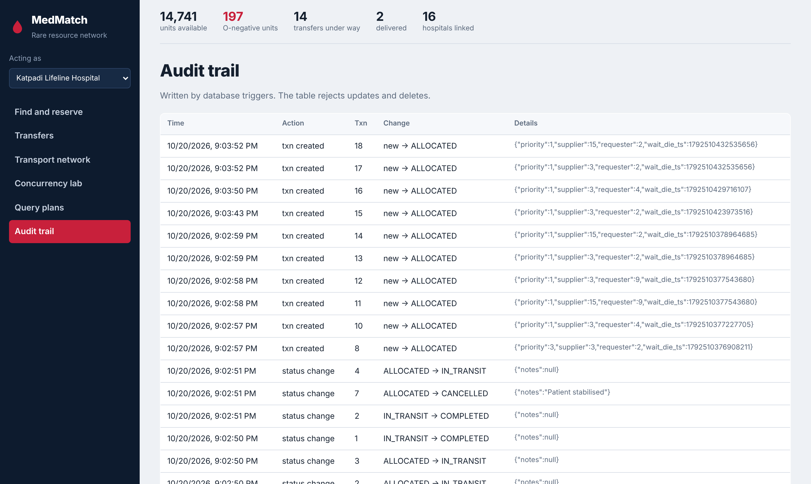
8 · APPLICATION DEMONSTRATION
Concurrency lab and audit trail
Concurrency lab: Wait-Die run, timeline per transaction
Audit trail written by triggers; the table rejects edits
MedMatch — Rare Resource Logistics Network
23

Slide 24
9 · TESTING AND RESULTS
Every test passed
Test | Expected | Observed | Result
15 hospitals reserve one unit at once | Exactly 1 succeeds | 1 succeeded, 14 rejected (HTTP 409) | Pass
Race without locking | Lost update reproduced | Both read AVAILABLE; both believed they won | Pass
Race with 2PL + Wait-Die | One winner, no lost update | Second re-read RESERVED and was rejected | Pass
Opposite-order bundle, detection only | PostgreSQL kills a victim | Deadlock detected after ~1.4 s | Pass
Same workload with Wait-Die | No deadlock | Younger died and restarted; done in ~0.45 s | Pass
Reserve an expired unit | Rejected | trg_asset_guard raised an error | Pass
DELIVERED → AVAILABLE | Rejected | Illegal transition error | Pass
Delete an audit row | Rejected | Append-only error | Pass
Invalid hospital email | Rejected | hospitals_email_check violated | Pass
Cancel a transfer | Unit back in pool | Transfer CANCELLED, unit AVAILABLE | Pass
Cold-chain routing | Avoid non-refrigerated legs | 154 min cold vs 76 min normal | Pass
Indexed search | Faster than sequential scan | 12× – 96× faster | Pass
MedMatch — Rare Resource Logistics Network
24

Slide 25
10 · CONCLUSION AND FUTURE ENHANCEMENT
What we built, and what comes next
Conclusion
Future enhancements
A working inter-hospital reservation network on PostgreSQL and Neo4j.
No double allocation: strict 2PL with SELECT … FOR UPDATE, verified under 15-way contention.
Deadlocks prevented by Wait-Die, about 3× faster than detection.
Indexed lookups in well under a millisecond (12–96× faster than full scans).
Every state change logged by triggers in an append-only audit table.
Fastest cold-chain-safe routes from graph pathfinding.
Authentication and per-hospital access control
Live traffic and weather feeding route weights
Database-backed lock manager (advisory locks) for multiple app servers
Notifications to the supplying hospital and courier
Demand forecasting to pre-position rare stock
Mobile app for transport crews with live tracking
MedMatch — Rare Resource Logistics Network
25

Slide 26
11 · REFERENCES
Sources
A. Silberschatz, H. F. Korth, S. Sudarshan, Database System Concepts, 7th ed., McGraw-Hill, 2019 (Ch. 18: concurrency control, Wait-Die).
R. Elmasri, S. B. Navathe, Fundamentals of Database Systems, 7th ed., Pearson, 2016 (normalization, indexing).
PostgreSQL 16 Documentation — Explicit Locking, Index Types, Triggers, PL/pgSQL. postgresql.org/docs/16
PostgreSQL 16 Documentation — Transaction Isolation and Deadlocks. postgresql.org/docs/16/transaction-iso.html
Neo4j Cypher Manual. neo4j.com/docs/cypher-manual/current
Neo4j APOC Documentation — apoc.algo.dijkstra. neo4j.com/docs/apoc/current
FastAPI Documentation. fastapi.tiangolo.com
Psycopg 3 Documentation. psycopg.org/psycopg3/docs
NetworkX Documentation — Shortest Paths (Dijkstra). networkx.org/documentation/stable
MedMatch — Rare Resource Logistics Network
26

Slide 27
Thank you
Questions and live demonstration
Akshith M (24BAI0017) • Sanjaay B (24BCE2181)

