Slide 1
SEMIRESEARCH AI
India’s Semiconductor Mission
and the Growth of India’s Chip Industry
AI Research Report — VAC Capstone 12
Research → Compare → Verify → Synthesize → Report

Slide 2
METHOD
Research Questions & Multi-AI Workflow
RQ1 Objectives, policies and incentives of ISM
RQ2 Manufacturing, packaging, testing and design projects
RQ3 Opportunities, challenges and risks
Perplexity — independent research
Gemini — independent research
NotebookLM — official-source grounding
ChatGPT — prompts, comparison, synthesis
Official sources + human review — final factual decision

Slide 3
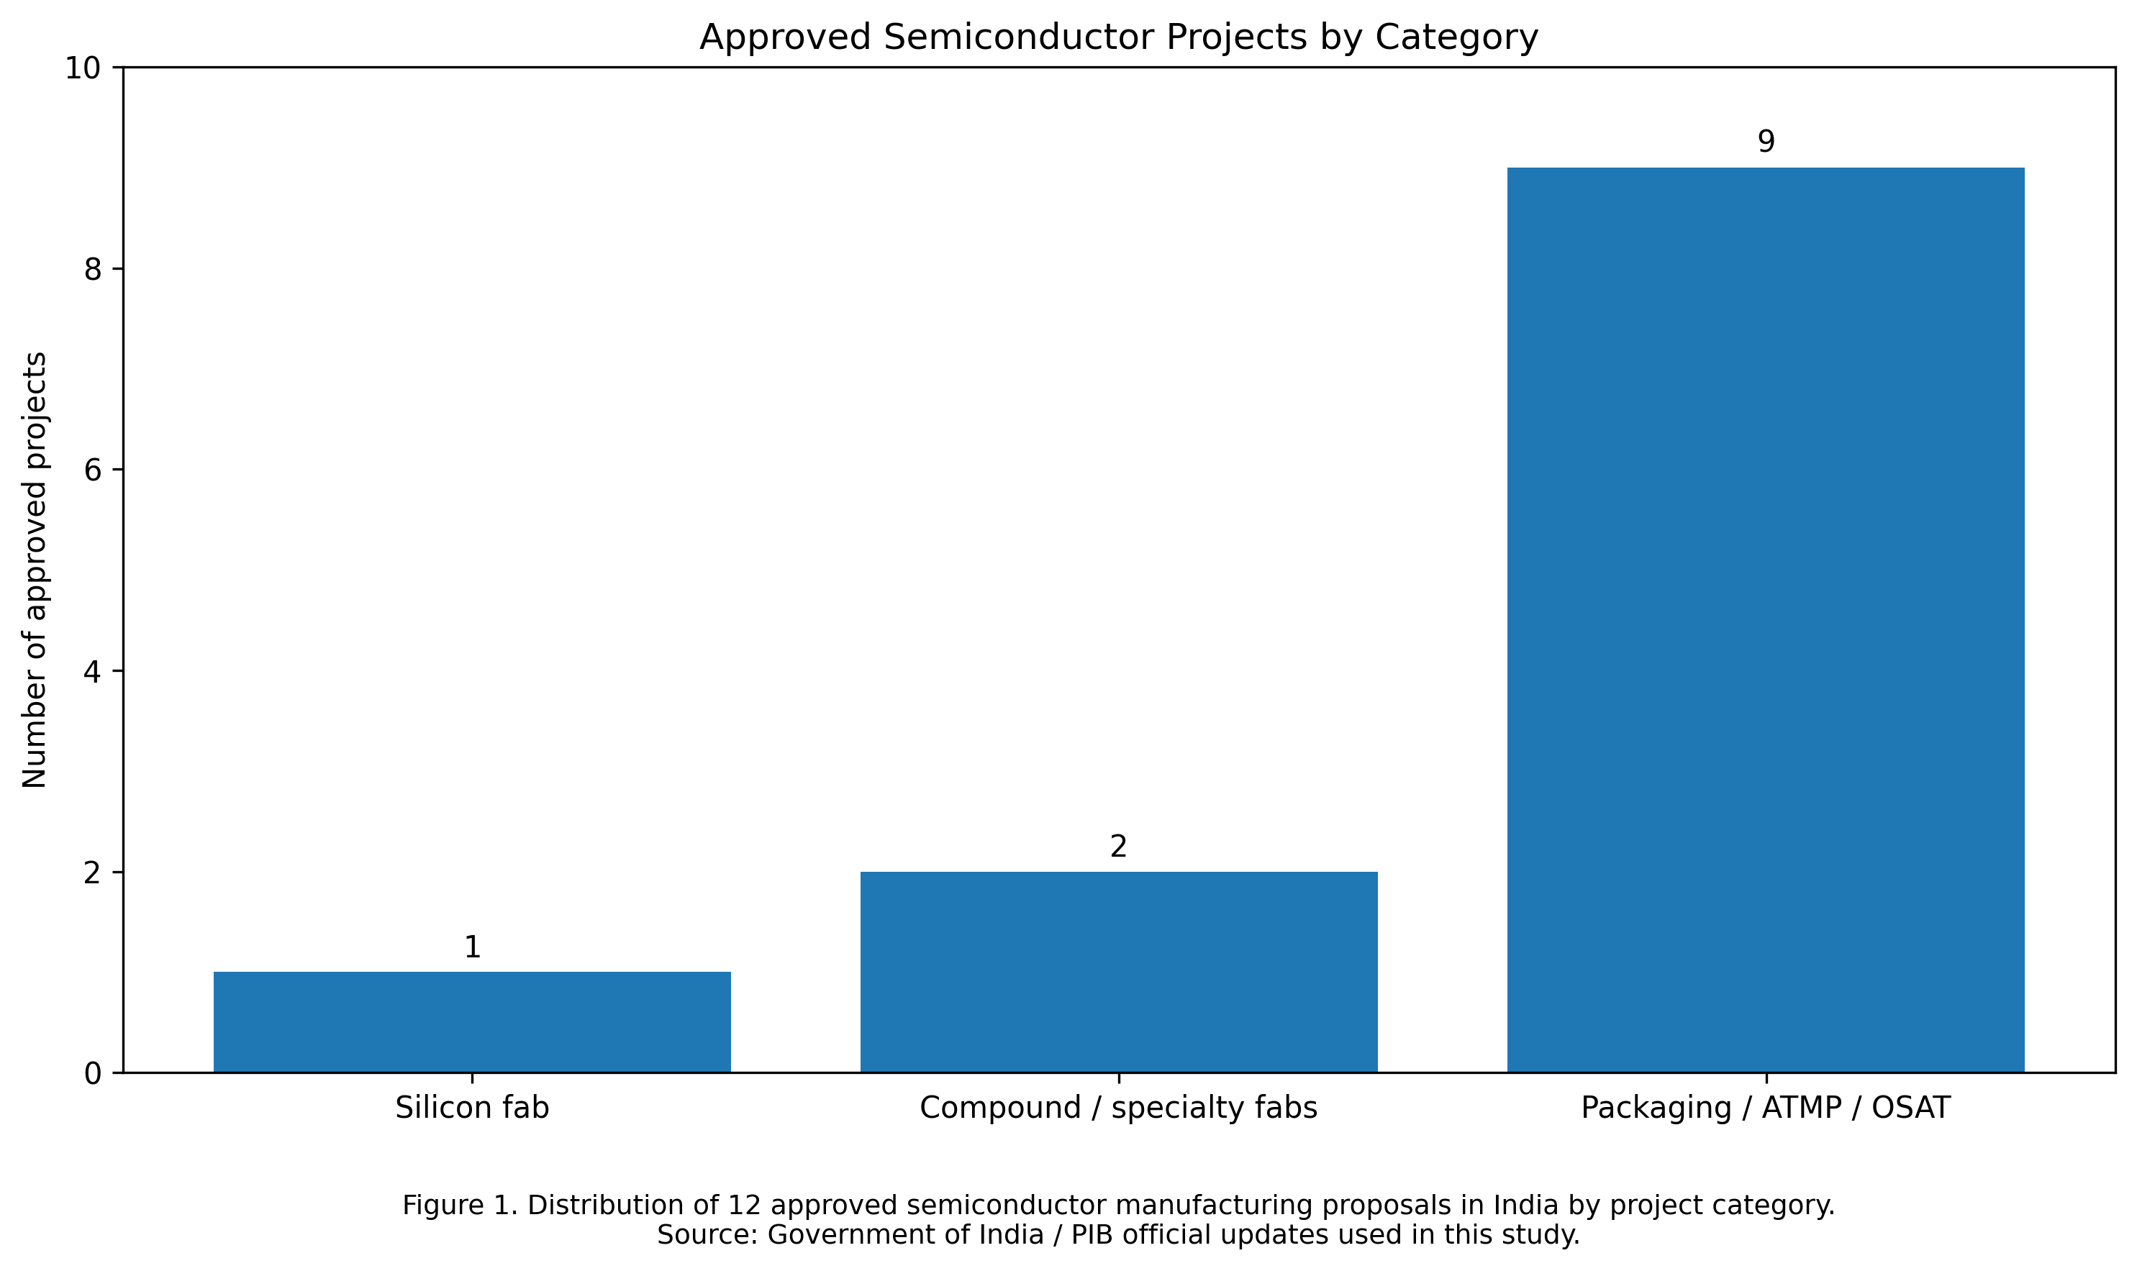
EVIDENCE
Key Verified Findings
₹76,000 Cr — Semicon India Programme 1.0
₹1,27,500 Cr — Semicon 2.0; approved 15 Jul 2026
12 approved manufacturing proposals
>₹1.64 lakh Cr approved investment
1 silicon fab + 2 compound fabs + 9 packaging projects
24 design projects; 23 tape-outs; ~70k trained

Slide 4
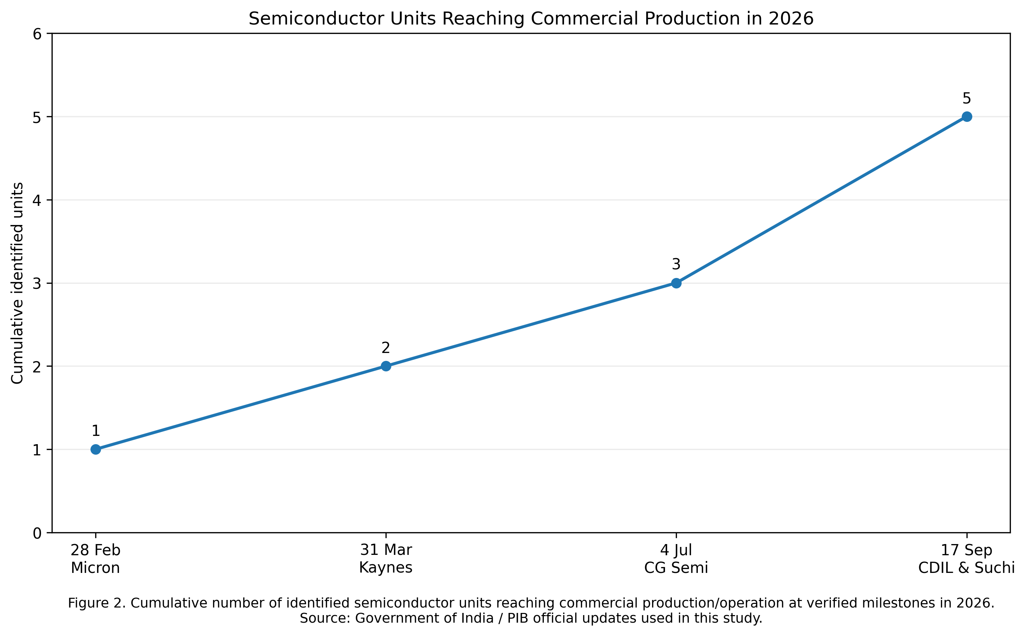
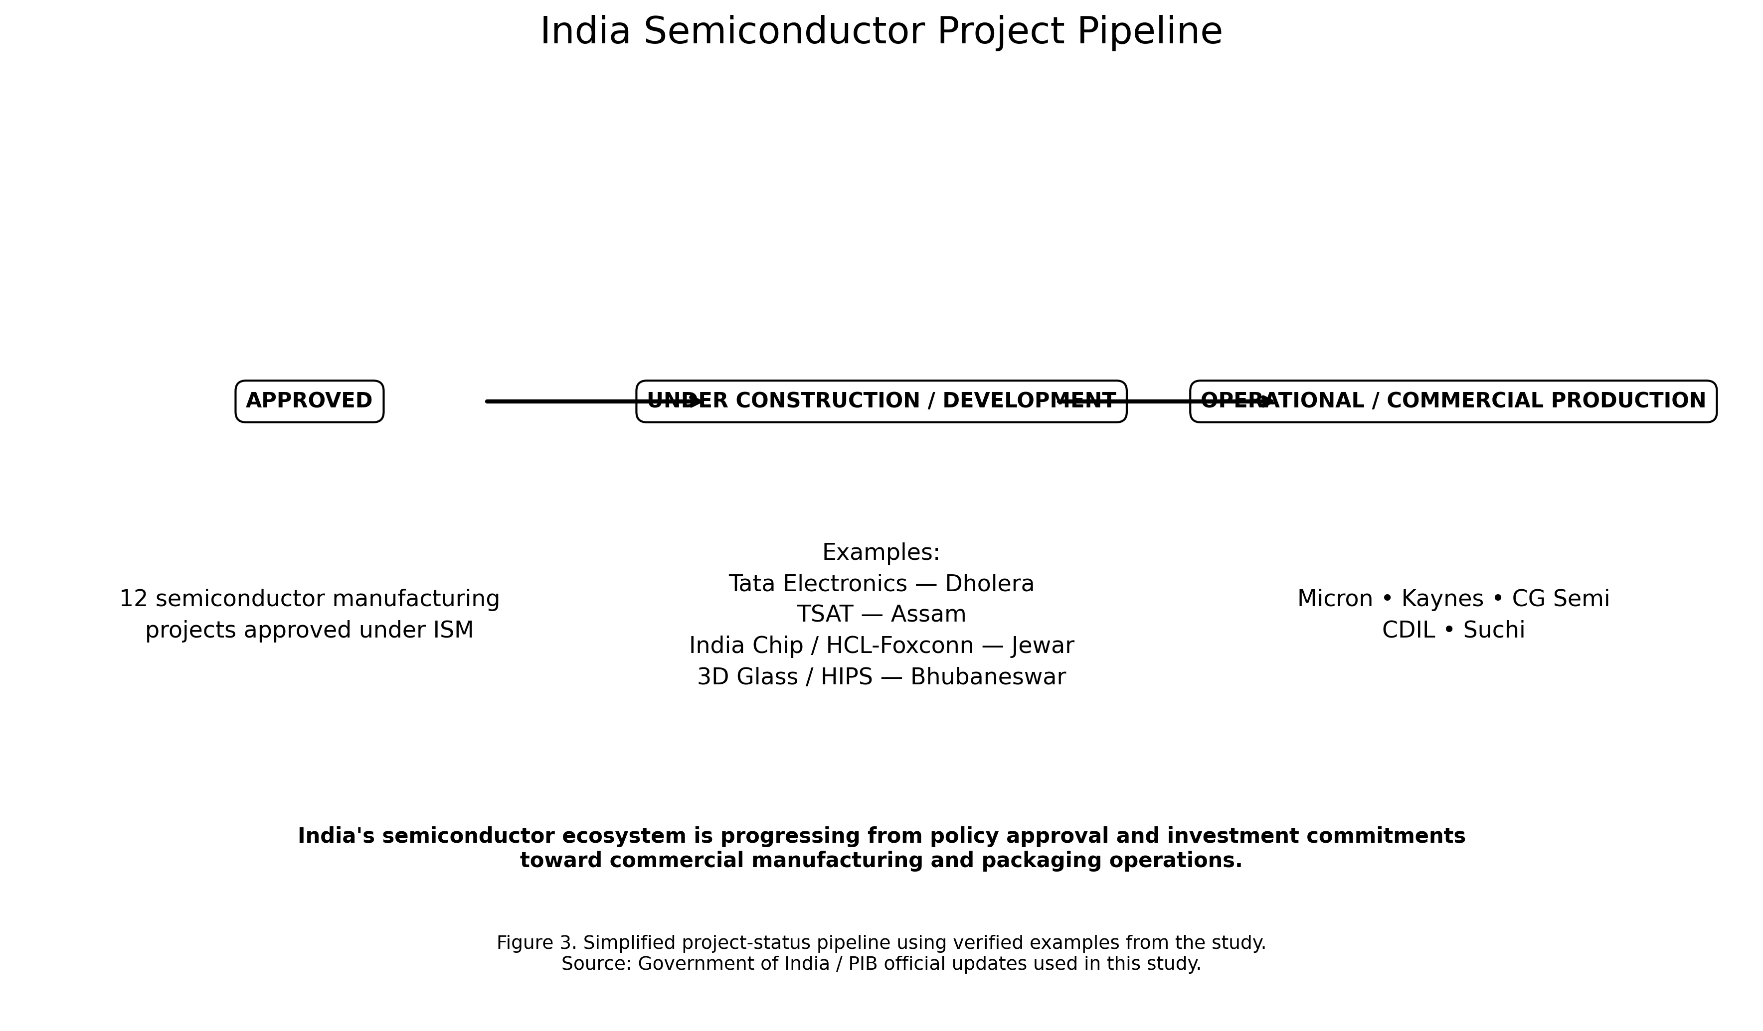
PROGRESS
From Approval to Commercial Operations
Identified commercial/operational units increased from 1 in February to 5 by September 2026.

Slide 5
QUALITY CONTROL
AI Verification & Hallucination Analysis
Suchi / CDIL: earlier “approved” status → updated to commercial lines (17 Sep 2026)
3 operational vs 5 operational → time-sensitive update, not hallucination
3D Glass: ~₹1,500 Cr → corrected to ₹1,943 Cr
SiCSem: “not public” → official ₹2,066 Cr
Tata Dholera late-2026 production target → excluded as not sufficiently established
AI claim → Compare → Official source → Classify → Correct / Remove → Human review

Slide 6
ASSESSMENT
Opportunities, Risks & Responsible AI
OPPORTUNITIES
• Domestic electronics demand
• Strong design talent base
• Global supply-chain diversification
• Packaging / ATMP momentum
RISKS / LIMITATIONS
• Capital and infrastructure intensity
• Specialist manufacturing talent
• Supply-chain dependencies
• Fast-changing project status
• AI can be outdated or unsupported
Verify → Compare → Correct → Cite → Human Review

Slide 7
OUTCOME
Conclusion & Live Demo
India has moved from policy commitments toward measurable commercial semiconductor activity.
Packaging / ATMP / OSAT dominates the current approved portfolio while major wafer-fab capacity continues to develop.
Multi-AI research becomes more reliable only when claims are dated, cross-checked and verified against original sources.
LIVE DEMO
Dashboard → Research Questions → AI Comparison → Verification → Error Log → Visuals → Final Outputs

