Slide 1
COGNITIVEX HACKATHON
TOPIC: Studymate-An AI powered pdf based Q&A system
Presented By
Team :ROKO
B.Akshitha(22R91A0418)
Ch.Naveen kumar (22R91A0447)
B.Lokesh naga Venkata sai(22R91A0431)

Slide 2
INTRODUCTION
Studymate – An AI Powered PDF-Based Q&A System is an intelligent learning assistant designed to make studying more interactive, personalized, and efficient.
Traditional PDFs, such textbooks, research papers, or lecture notes, often require students to manually search through long documents to find answers. This process is time-consuming and can make learning less effective.
Studymate overcomes this challenge by combining Artificial Intelligence (AI) with Natural Language Processing (NLP) to enable direct question-and-answer interactions with PDF documents.
Instead of manually scanning through pages, users can simply upload a PDF and ask questions in plain language. The system automatically processes the document, understands the context of the query, retrieves the most relevant sections, and provides a clear, concise, and accurate response.
The system works on the principle of Retrieval-Augmented Generation (RAG):Extracting and breaking the PDF into smaller, meaningful chunks.
Converting these chunks into vector embeddings for semantic understanding.Matching user queries with relevant content from the PDF using a vector database.
Built on NLP, Machine Learning, and PDF parsing.
Goal: Save time and improve learning efficiency.

Slide 3
PROBLEM STATEMENT
Students struggle with time-consuming manual searches in large PDFs.
Existing tools provide keyword matches, not contextual answers.
Difficulty in finding precise explanations during exams/research.
Lack of personalized, interactive study tools.

Slide 4
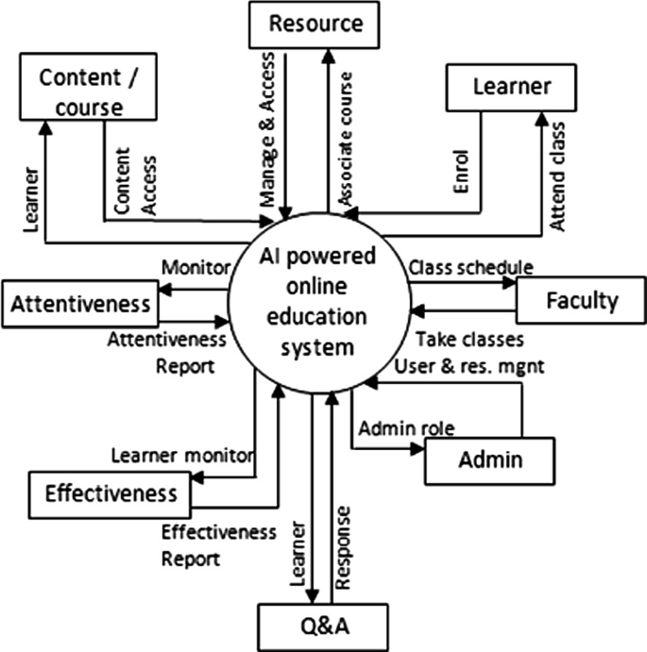
ARCHITECTURE

Slide 5
FUTURE SCOPE
Expand beyond simple multilingual answers to real-time translation of PDFs and queries.Enable cross-lingual Q&A where a user can upload a PDF in one language and ask questions in another.
Support regional educational content to make global learning accessible.Seamless LMS & EdTech IntegrationDirect integration with Learning Management Systems (Moodle, Blackboard, Google Classroom, Canvas, etc.).
Auto-generate assignments, quizzes, and grading assistance from uploaded course materials.Teachers can track student interactions and learning progress via dashboards.
AI-Powered Learning Enhancement ToolsAdvanced auto-summarization of chapters into customizable formats (short notes, bullet points, mind maps).Generate AI-created flashcards, practice tests, and adaptive quizzes for revision.
Personalized learning paths where Studymate adapts to a student’s weak and strong areas.Cross-Platform & MobilityMobile and tablet applications with offline support.Voice-enabled Q&A for accessibility.

Slide 6
SOLUTION(study mate)
Studymate turns static PDFs into an interactive, AI‑assisted learning experience. Using Retrieval‑Augmented Generation (RAG), it extracts, indexes, and semantically retrieves relevant passages from PDFs to answer natural‑language questions with citations.
The solution is designed to be multilingual, privacy‑preserving, LMS‑integrated, mobile‑first, and extensible with analytics, collaboration, and adaptive learning.
Goals & Success : CriteriaPrimary goalsAccurate, cited answers to questions from single or multiple PDFs.Low latency responses for smooth study sessions.Robust support for long/complex documents and scanned PDFs.
Inclusive access : multilingual, mobile, accessible UI.
Users & Use CasesStudents: Ask doubts, generate summaries/flashcards, practice quizzes.Teachers: Create assignments/quizzes from course PDFs, monitor class progress.
Researchers: Rapid literature Q&A across papers with precise citations.Institutions: Integrate with LMS, compliance, analytics.

Slide 7
CONCLUSION
Studymate – An AI Powered PDF-Based Q&A System provides an innovative solution to the challenges of traditional PDF-based learning by transforming static documents into dynamic, interactive, and intelligent study companions.
Through its Retrieval-Augmented Generation (RAG) pipeline, Studymate ensures accurate, citation-backed answers while supporting summaries, flashcards, quizzes, and adaptive learning features.The proposed architecture emphasizes scalability, multilingual accessibility, LMS integration, and data privacy, making it suitable for students, educators, researchers, and institutions worldwide.
By combining cutting-edge technologies—such as vector databases, multilingual embeddings, and large language models—Studymate not only enhances efficiency in learning but also fosters collaboration, inclusivity, and personalization.
The roadmap ensures a gradual evolution: from a minimum viable product (MVP) with core Q&A features to an advanced AI-powered ecosystem supporting real-time collaboration, cross-resource learning, and immersive experiences.
With proper implementation, Studymate has the potential to become a next-generation educational platform, revolutionizing the way learners interact with academic content.

Slide 8
THANK YOU

