Slide 1


Subjective Answer Evaluation Using DL & NLP
Guide:
Mrs. M. Mounika
Assistant Prof, CSE (AI&ML)
CMRIT, Hyderabad
Team 13:
1. N. Shiva | (22R01A66A5)
2. D. Akshitha | (22R01A66E2)
3. P. Balu | (22R01A66H6)

Slide 2
Abstract
This project focuses on the evaluation of subjective answers using Deep Learning (DL) and Natural Language Processing (NLP).We developed a website using Django, HTML, CSS, JS, and MySQL to implement an automatic evaluation system . The system incorporates similarity matching, keyword extraction, and grading .

Slide 3
Introduction
Manual evaluation of subjective answers is time-consuming, error-prone, and inconsistent . Our system automates this process by using NLP techniques such as TF-IDF, Jaccard distance.It aims to assist educators with quick and objective answer evaluation.

Slide 4
Objective
Automate evaluation of subjective answers
Reduce human error and effort
Improve grading consistency
Provide real-time feedback

Slide 5
Software Requirements
OS: Windows/Linux
Backend: Python 3.12+, Django
Frontend: HTML, CSS, JS
Libraries: scikit-learn, kraken, nltk
Database: MySQL

Slide 6
Hardware Requirements
Processor: Intel i3 or better
RAM: 4GB minimum
Storage: 1GB for DB and models
Internet: Required for model downloads and testing

Slide 7
Existing Systems
Manual grading
Pure TF-IDF .
Rule based and key matching Systems .

Slide 8
Existing System (Disadvantages)
Manual evaluation is slow and inconsistent
Bias and fatigue affect grading
Existing systems lack semantic understanding
Cannot evaluate paraphrased sentences properly .
Limited scalability in real environments

Slide 9
Proposed System
Uses NLP (TF-IDF, Jaccard distance ) . Transformer models like Sbert , Trocr.
Keyword and context-based grading
Learns from human-evaluated data
More consistent and efficient evaluation

Slide 10
Literature survey
Subjective Answers Evaluation Using Machine Learning and Natural Language Processing Hamza Arshad, Abdul Rehman Javed.
J. Wang and Y. Dong, Measurement of text similarity: A survey, Information, Aug. 2020.
M. Han, X. Zhang, X. Yuan, J. Jiang, W. Yun, and C. Gao, A survey on the techniques, applications, and performance of short text semantic similarity, Concurrency .Mar. 2021.

Slide 11
Methods used in Proposed System
Method | Captures | Weakness | Best For
CountVectorizer + Cosine | Word overlap | Ignores word meaning | Short factual answers
TF-IDF + Cosine | Weighted word overlap | Still ignores meaning | Long answers
Jaccard (NLTK) | Set similarity of tokens | Ignores word order/semantics | Unique word matching
SBERT | Semantic meaning | Slower, needs GPU/transformer | Paraphrased answers

Slide 12
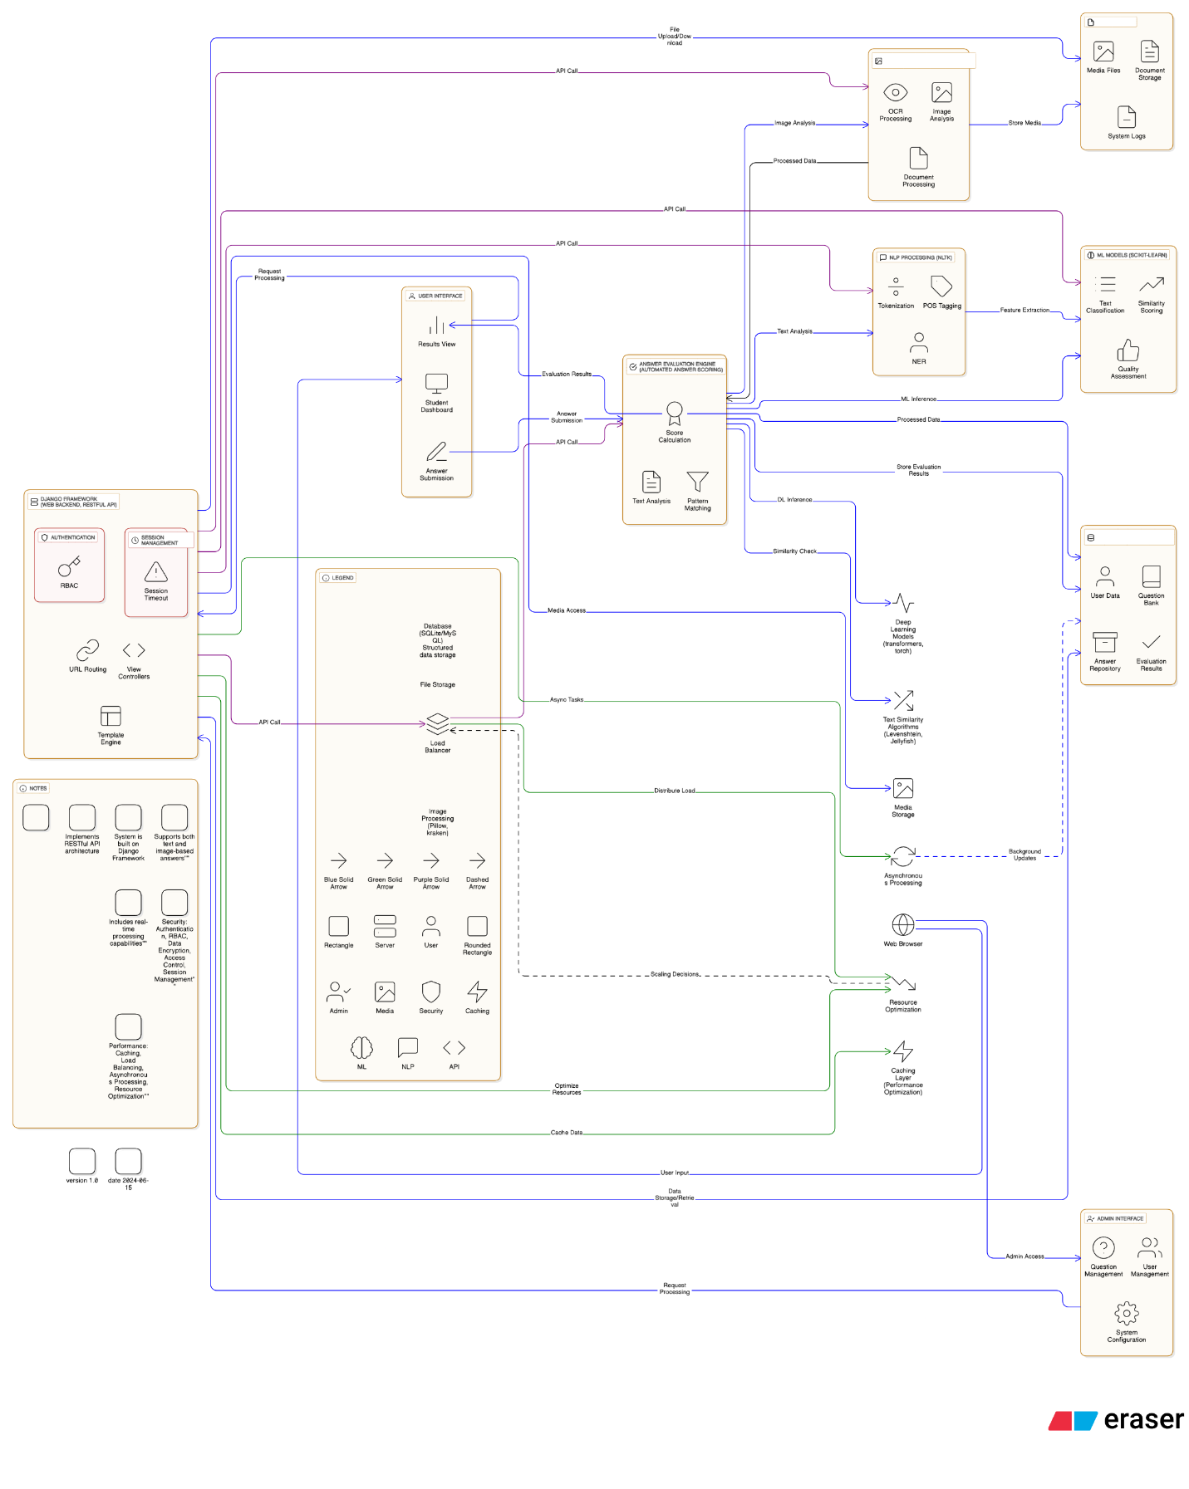
System Architecture

Slide 13
Result
The system successfully predicts scores for subjective answers.
A solution where we can have computerized tests and on paper tests
Improves efficiency and fairness in grading.

Slide 14
Advantages
Handles synonyms and variations in answers
More accurate and scalable than manual checking
Reduces bias and fatigue
Supports feedback and future improvements

Slide 15
Conclusion
The proposed system enhances traditional subjective answer evaluation.
It leverages advanced NLP and DL to bring fairness, speed, and scalability to the evaluation process.
Future improvements can include support for diagrams, multilingual text, and voice input.

Slide 16
References
Farrukh Bashir et al., "Subjective Answers Evaluation using ML and NLP", IEEE Access, 2021
scikit-learn documentation
NLTK documentation
Microsoft Trocr model repository .
Django Project Documentation

Slide 17
Thank You

