Slide 1
Global Cyber Attacks Analysis using PySpark
TEAM 15:
P. Kavyanjali
D. Aksitha
K. Vedhanjali

Slide 2
Problem Statement
Cyber attacks are increasing rapidly in frequency, scale, and complexity.
Organizations generate massive volumes of security logs and network data daily.
01
02
Traditional systems (manual analysis, RDBMS) struggle with speed and scalability.
Delayed insights lead to continued attacks and higher damage.
03
04
Need a fast, scalable, and intelligent system for large-scale cyber data analysis.
05

Slide 3
Objectives
Process large-scale cyber datasets using Apache Spark’s distributed computing.
Reduce execution time via in-memory processing and parallel operations.
Generate clear visual insights (bar charts, pie charts, heatmaps) for decision-making.
Identify attack patterns, trends, and suspicious behaviors.
Analyze attacker behavior (e.g., typing speed, tool usage like Kali Linux).
Determine top attacking countries and geographical distribution.

Slide 4
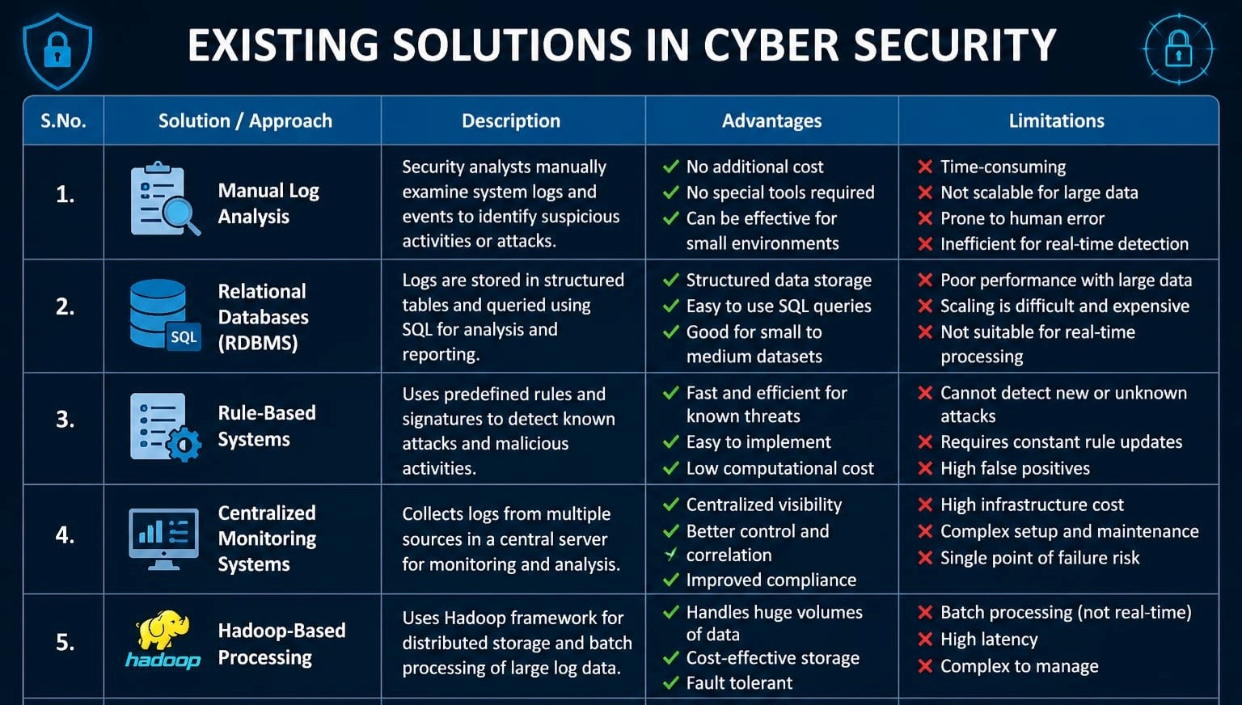

Slide 5
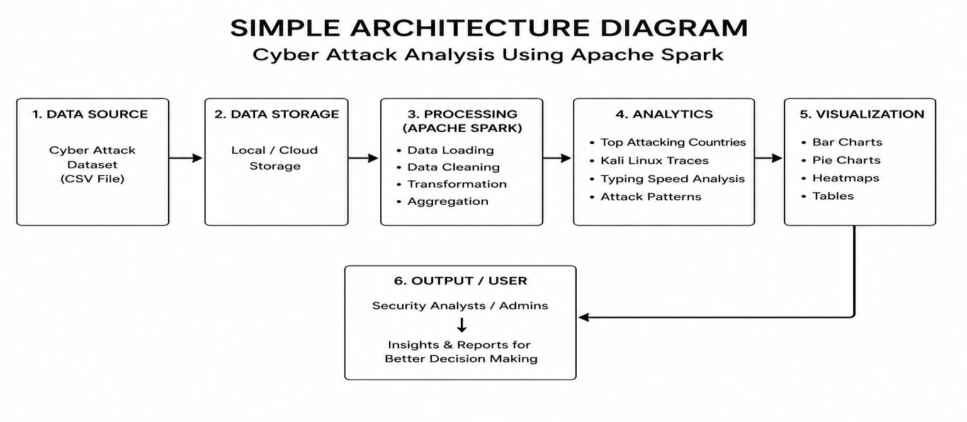
Architecture Diagram
Data Source: CSV cyber attack dataset with attributes (location, speed, corruption, etc.).
Data Storage: Local or cloud storage for persistent access.
Processing: Apache Spark performs cleaning, transformation, filtering, aggregation.
Analytics: Extract insights—top countries, patterns, behavior metrics.
Visualization: Bar charts, pie charts, heatmaps for easy understanding.
Output: Results delivered to analysts for monitoring and decision-making.

Slide 6
Results
01
02
03
04
05
Identified top attacking countries based on server corruption metrics.
Visualized attack distribution across regions using bar and pie charts.
Typing speed analysis revealed patterns of manual vs automated attacks.
Correlation heatmap highlighted relationships among key features.
Insights enable better threat monitoring and proactive defense strategies.

Slide 7
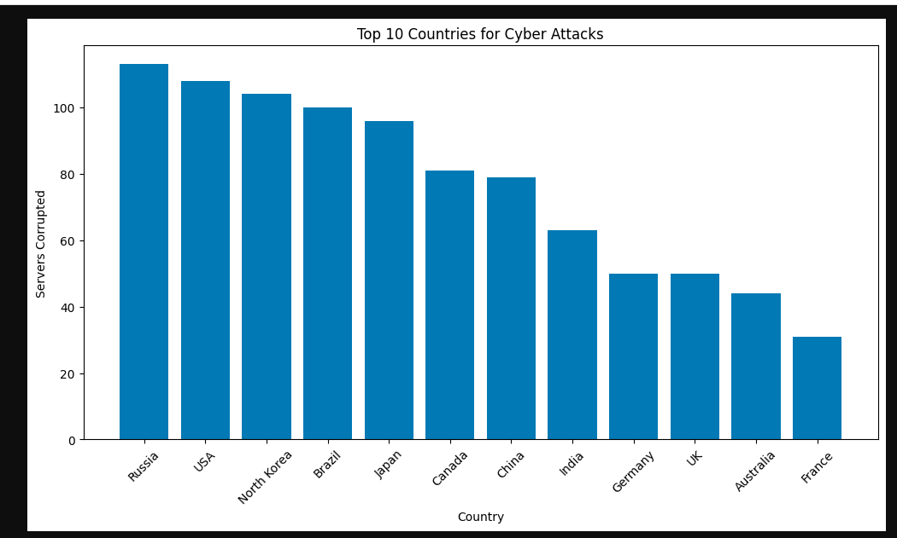
Bar chart of top 10 countries for Cyber Attacks

Slide 8
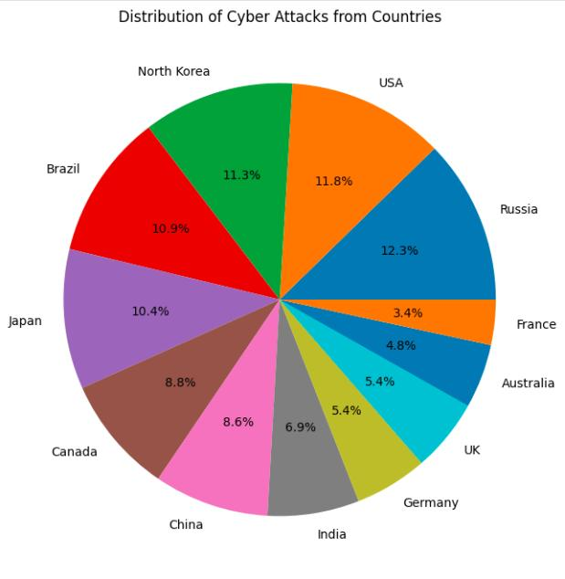
Distribution of Cyber Attacks from Countries

Slide 9
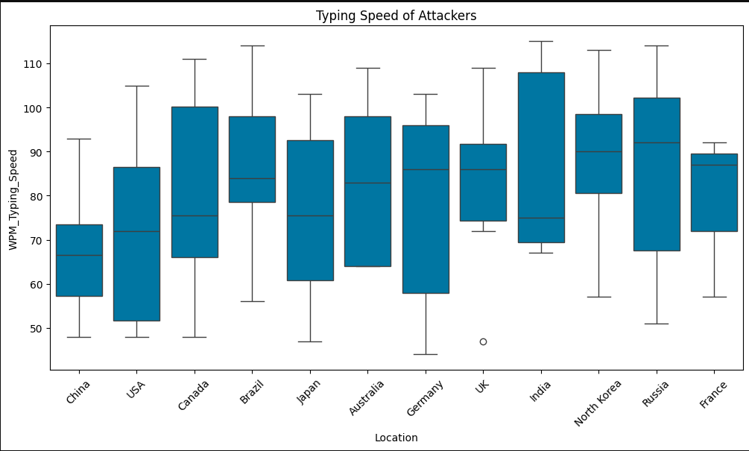
Typing Speed of Attackers

Slide 10
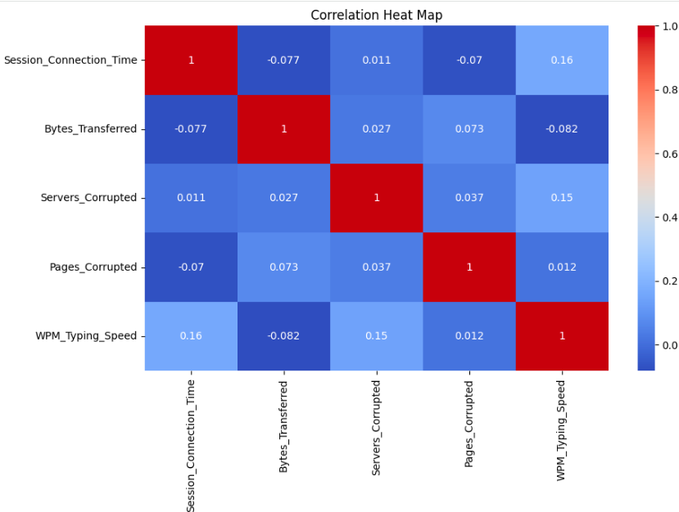
Correlation Heat Map

Slide 11
Conclusion & Future Enhancements
Conclusion: Apache Spark enabled fast, scalable analysis of cyber attack data.
Provided clear insights into attack patterns, locations, and behaviors.
01
02
Improved understanding supports better cybersecurity decision-making.
Future: Integrate Spark Streaming for real-time analysis of live data.
03
04
Apply machine learning for anomaly detection and attack prediction.
Build interactive dashboards and deploy on cloud platforms (AWS/Azure/GCP).
05
06

