Slide 1

Code Refactoring and Bug Fixing

Slide 2
About Me:
Name : Akshitha Kalaboina
I have completed my graduation in B.Tech in the stream of Computer Science Engineering.
Currently learning Data Science course at Innomatics Research Labs.

Slide 3
Title: Refactoring and Debugging a Python Flask Note Taking Application
Objective: The objective of this task is to refactor the existing codebase of a Python Flask Note Taking Application to fix bugs and ensure smooth functionality.

Slide 4
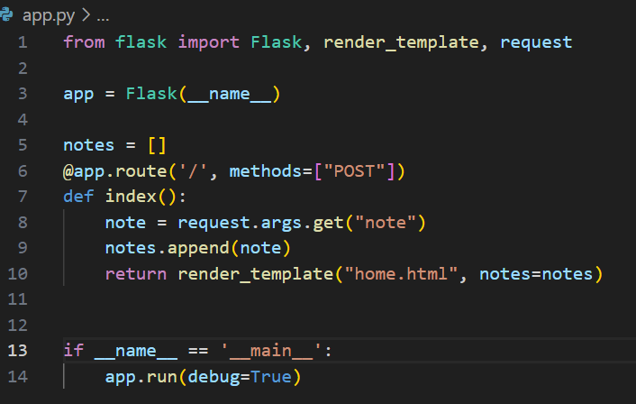
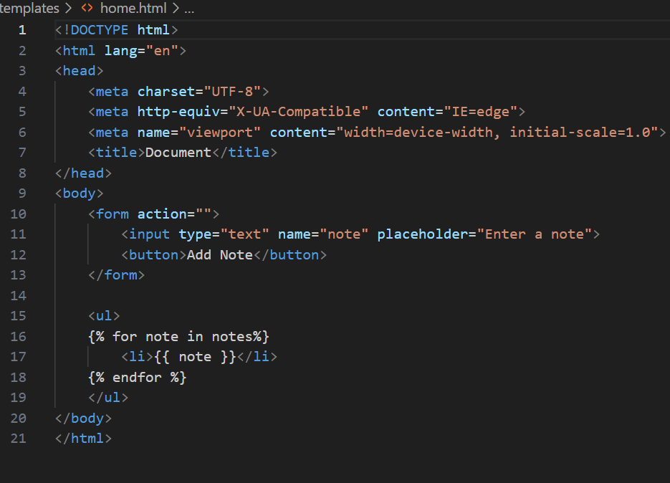
Before Bug Fixing
Flask Code Snippet:
HTML Code Snippet:

Slide 5
Steps Involved in Bug Fixing
Flask Snippet:
Identify the Issue: Code is only POST requests and not GET requests, resulting in notes not being displayed initially.
Update Route Method: Add "GET" to the list of methods in the route to handle GET requests.
Fetch Notes for GET Requests: Modify the index function to fetch notes and pass them to the template for GET requests.
Correct Retrieval of Note: In the index function, ensure that the note is retrieved from form data using request.form.get("note") for POST requests.
Handle Empty Note: Check if the note is not empty before appending it to the notes list to prevent adding empty notes.
Render Template: Return the rendered template with the updated list of notes.

Slide 6
HTML Snippet:
Add Heading: Insert a heading <h1> heading for the note-taking application.
Update Form Action: Set the form action attribute to "/" it submits data to the URL using the POST method.
Specify Button Type: Define the type attribute for the button "submit” it functions as a submit button.
Conditional Display of Notes: Use conditional statements in the template to check if there are notes available before displaying them.
Handle Empty Notes: Handle the case when there are no notes available for display.

Slide 7
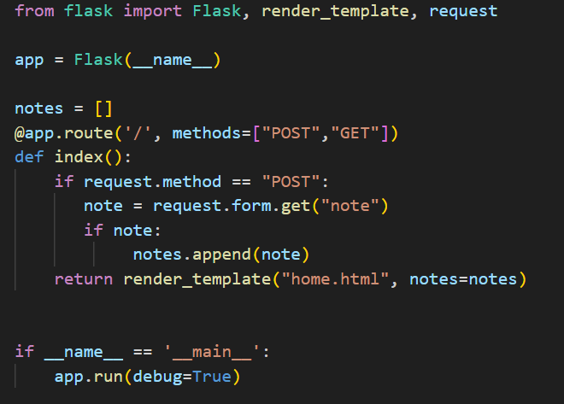
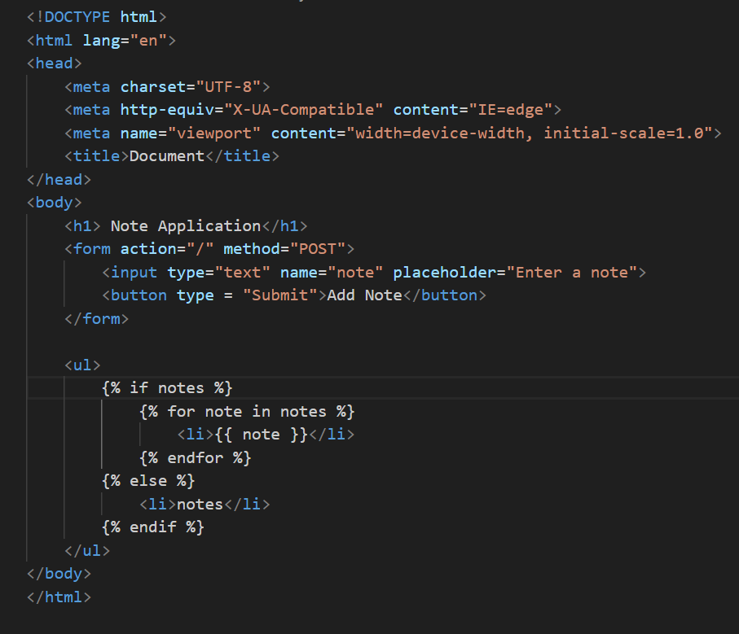
After Bug Fixing
Flask Snippet:
HTML Snippet:

Slide 8
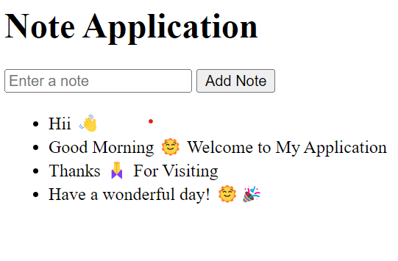
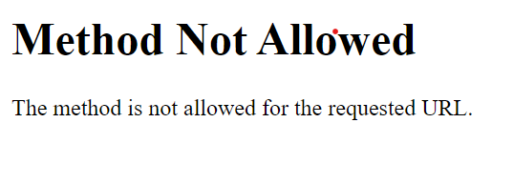
Output
Before Bug Fixing:
After Bug Fixing:

Slide 9

THANK YOU

