Slide 1


CMR TECHNICAL CAMPUS UGC AUTONOMOUS Accredited by NBA & NAAC with ‘A’ Grade Approved by AICTE, New Delhi and JNTU, Hyderabad Kandlakoya(V), Medchal Road, Hyderabad-501401, Telangana Department of Computer Science and Engineering
Designing Secure and Efficient Biometric-Based Secure Access
Mechanism for Cloud Services
BATCH NO:14
K.Akshith Reddy 217R1A0532
P.Dolika 227R5A0503
N.Sunil 217R1A0540
Under the Guidance of
Mrs Najeema Afrin
(Assistant Professor)

Slide 2
CONTENTS:
a.Abstract
b.Existing Systems
c.Disadvantages
d.Proposed Systems
e.Advantages
f. Hardware and Software requirements
g.Novelty of Project
h.Architecture
i.Modules
j.UML Diagrams
k.Sample Code
i.Results
m.Conclusion
n.Future Scope
o.References
p.Github Link

Slide 3

Abstract:
The demand for data storage and computation services is increasing exponentially in our society; thus, the need for secure access to such data and services.
In this project, we design a new biometric-based authentication protocol to provide secure access using cloud server.
In the approach, we consider biometric data of a user as a secret credential. Uses biometric data to generate a unique identity and private key for secure cloud access.
The approach is validated as secure against various attacks.
In addition, we propose an efficient approach to generate a session key.

Slide 4
Existing Systems:
Over the past years, multiple approaches have been proposed to solve the problem of Secure Biometric Detection.
A number of authentication mechanisms have been proposed in the many areas, such as those based on Kerberos , Oauth.
FIDO Standards for secure biometric authentication, used by various cloud services to ensure strong user verification.
The FIDO (Fast Identity Online) standard is widely used for improving security in cloud services, particularly in the context of authentication.
FIDO aims to eliminate the reliance on passwords and provides a more secure, user-friendly method of authenticating.

Slide 5
Disadvantages:
Limited Accuracy in certain conditions.
High Computational Cost..
False Positive/Negative
Recovery

Slide 6
Proposed Systems:
In the proposed approach, we consider a fingerprint,face image of a user as a secret credential.
From the fingerprint,face image, we generate a private key that is used to enroll the user’s credential secretly in the database of an authentication server.
In the authentication phase, we capture a new biometric fingerprint,face image of the user, and subsequently generate the private key.
This biometric data is then transmitted to the authentication server for matching with the stored data.
Once the user is authenticated successfully, he/she is ready to access his/her service from the desired server. Using two datas, we present a fast and robust approach to generate the session key.
We uses the CNN Algorithm.

Slide 7
Advantages:
Enhanced Security.
Improved User Experience.
Fraud Detection and Prevention.
Scalability and Efficiency.
Accessibility.

Slide 8
Hardware and Software requirements:
Hardwarre Requirements:
PROCESSOR : i3 and above
Hard Disk : 40GB
Ram : 8GB
Software Requirements:
Operating Systems:Windows 11
Coding Language : Python 3.7

Slide 9
Novelty of Project:
Innovative Approach to Security:We uses a combination of MFA like face,fingerprint acess,this could provide a more secure and user-friendly systems.
Improved algorithm.
Cloud Service Selection:We have selected drivehq cloud service as its combination of affordability, security features, and ease of use. It provides flexible storage, customized solutions, and robust file management capabilities.
And it also provides a 5GB of free plan storage.For using other storage services like amazon S3,and etc we need to pay for using them,
It is easy to use and easy to access and it will also have inbuilt security.
Efficiency in Biometric Matching: If you've improved biometric matching algorithms that scale effectively, offering fast authentication even with large datasets, this can be a novel contribution.

Slide 10
Architecture:

Slide 11
Modules:
1.Client
2.Authentication Server
3.Admin
4.Resource Server

Slide 12
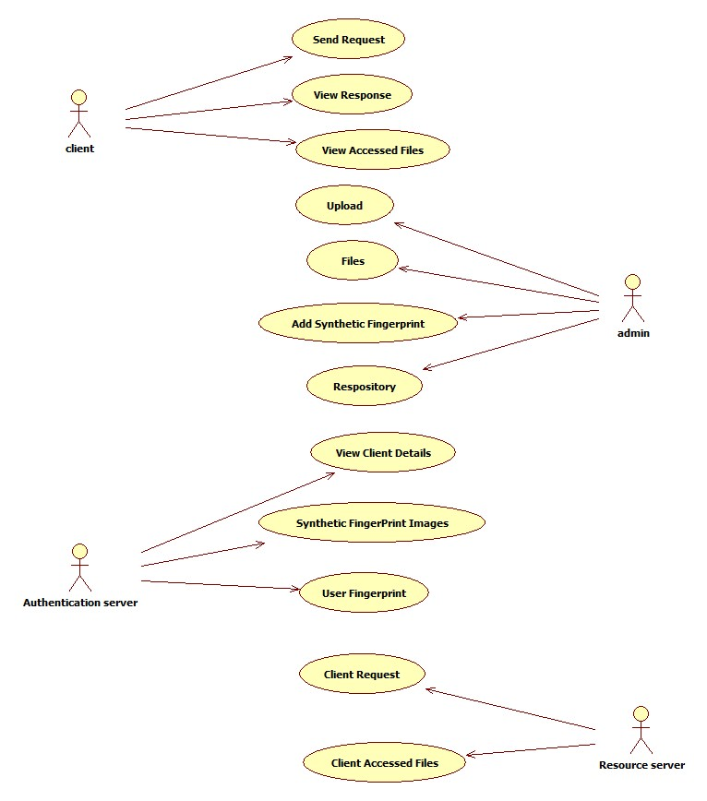
USE CASE DIAGRAM

Slide 13
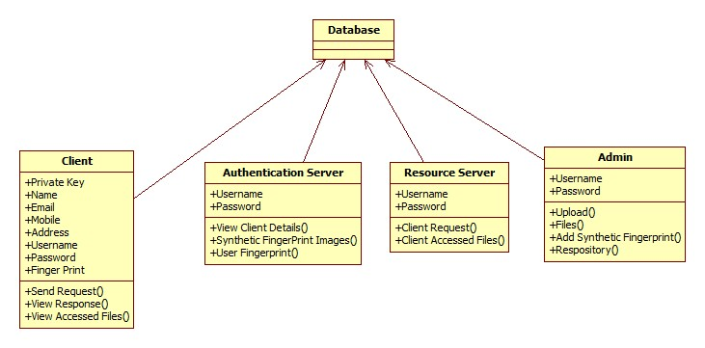
CLASS DIAGRAM

Slide 14
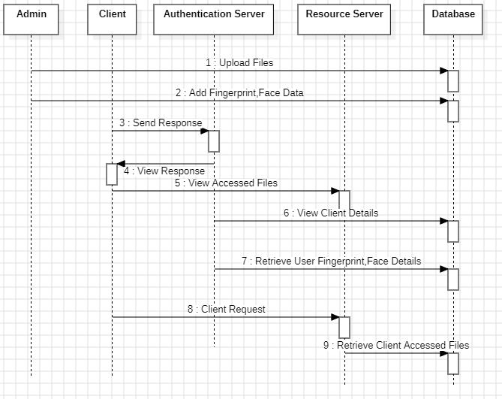
SEQUENCE DIAGRAM

Slide 15
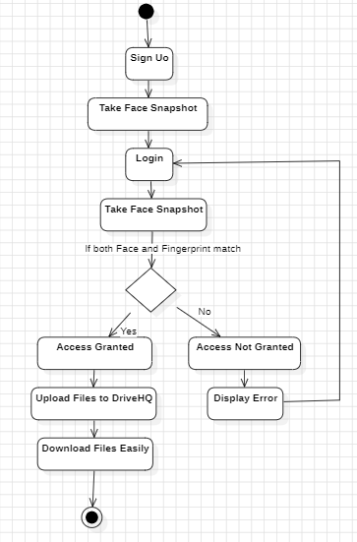
ACTIVITY DIAGRAM

Slide 16
Sample Code
from django.shortcuts import render
from django.template import RequestContext
from django.contrib import messages
from django.http import HttpResponse
import os
from django.core.files.storage import FileSystemStorage
import pymysql
from PIL import Image
import cv2
import base64
import numpy as np
import ftplib
import urllib
global username, password, contact, gender, email, address, finger, finger_image
face_detection = cv2.CascadeClassifier('haarcascade_frontalface_default.xml')
recognizer = cv2.face_LBPHFaceRecognizer.create()
def DownloadFileAction(request):
if request.method == 'GET':
global username
img = request.GET.get('fname', False)
infile = open("SecureBiometricApp/static/files/"+img, 'rb')
data = infile.read()
infile.close()
response = HttpResponse(data, content_type='text/plain')
response['Content-Disposition'] = 'attachment; filename=%s' % img
return response
def Download(request):
if request.method == 'GET':
global username
font = '<font size="" color="black">'
output = '<table border="1" align="center" width="100%"><tr><th>'+font+'Username</th><td>'+font+'Filename</th><td>'+font+'Download File</th></tr>'
con = pymysql.connect(host='127.0.0.1',port = 3306,user = 'root', password = 'root', database = 'securebiometric',charset='utf8')

Slide 17
with con:
cur = con.cursor()
cur.execute("select * FROM upload")
rows = cur.fetchall()
for row in rows:
if row[0] == username:
output+="<tr><td>"+font+row[0]+"</td><td>"+font+row[1]+"</td>"
output+='<td><a href=\'DownloadFileAction?fname='+row[1]+'\'><font size=3 color=black>Click Here</font></a></td></tr>'
context= {'data':output}
return render(request, "Download.html", context)
def UploadAction(request):
if request.method == 'POST':
global username
file = request.FILES['t1']
filename = request.FILES['t1'].name
fs = FileSystemStorage()
fs.save('SecureBiometricApp/static/files/'+filename, file)
ftp = ftplib.FTP_TLS("ftp.drivehq.com")
ftp.login("cdaproject", "Offenburg965#")
ftp.prot_p()
file = open('SecureBiometricApp/static/files/'+filename, "rb")
ftp.storbinary("STOR "+filename, file)
file.close()
ftp.close()
db_connection = pymysql.connect(host='127.0.0.1',port = 3306,user = 'root', password = 'root', database = 'securebiometric',charset='utf8')
db_cursor = db_connection.cursor()
student_sql_query = "INSERT INTO upload(username,filename) VALUES('"+str(username)+"','"+filename+"')"
db_cursor.execute(student_sql_query)
db_connection.commit()
print(db_cursor.rowcount, "Record Inserted")
if db_cursor.rowcount == 1:
output = filename+' saved at driveHQ Cloud'
context= {'data':output}
return render(request, 'Upload.html', context)

Slide 18
def Upload(request):
if request.method == 'GET':
return render(request, 'Upload.html', {})
def ValidateFace(request):
if request.method == 'GET':
return render(request, 'ValidateFace.html', {})
def Login(request):
if request.method == 'GET':
return render(request, 'UserLogin.html', {})
def index(request):
if request.method == 'GET':
return render(request, 'index.html', {})
def Signup(request):
if request.method == 'GET':
return render(request, 'Signup.html', {})
def getUserImages():
names = []
ids = []
faces = []
dataset = "SecureBiometricApp/static/profile"
count = 0
for root, dirs, directory in os.walk(dataset):
for j in range(len(directory)):
pilImage = Image.open(root+"/"+directory[j]).convert('L')
imageNp = np.array(pilImage,'uint8')
name = os.path.splitext(directory[j])[0]
names.append(name)
faces.append(imageNp)
ids.append(count)
count = count + 1
print(str(names)+" "+str(ids))
return names, ids, faces
def getName(predict, ids, names):
name = "Unable to get name"
for i in range(len(ids)):
if ids[i] == predict:
name = names[i]

Slide 19
jjdef UserLoginAction(request):
global username, finger
if request.method == 'POST':
username = request.POST.get('t1', False)
password = request.POST.get('t2', False)
finger_image = request.FILES['t3'].read()
index = 0
msg = "Login or finger matching failed"
finger = ""
page = 'UserLogin.html'
con = pymysql.connect(host='127.0.0.1',port = 3306,user = 'root', password = 'root', database = 'securebiometric',charset='utf8')
with con:
cur = con.cursor()
cur.execute("select username,password,finger FROM signup")
rows = cur.fetchall()
for row in rows:
print(str(row[2]))
if row[0] == username and password == row[1]:
finger = row[2]
index = 1
break
if index == 1:
with open('SecureBiometricApp/static/finger/'+finger, "rb") as file:
content = file.read()
file.close()
if content == finger_image:
msg = "Login & Finger Matching Successful"
page = 'ValidateFace.html'
context= {'data':msg}
return render(request, page, context)
def SignupAction(request):
if request.method == 'POST':
global username, password, contact, gender, email, address, finger, finger_image
username = request.POST.get('t1', False)
password = request.POST.get('t2', False)

Slide 20
def CaptureFaceAction(request):
if request.method == 'POST':
global username, password, contact, gender, email, address, finger
img = cv2.imread('SecureBiometricApp/static/photo/test.png')
gray = cv2.cvtColor(img, cv2.COLOR_BGR2GRAY)
face_component = None
faces = face_detection.detectMultiScale(gray, 1.3,5)
for (x, y, w, h) in faces:
face_component = img[y:y+h, x:x+w]
if face_component is not None:
cv2.imwrite('SecureBiometricApp/static/profile/'+username+'.png',face_component)
db_connection = pymysql.connect(host='127.0.0.1',port = 3306,user = 'root', password = 'root', database = 'securebiometric',charset='utf8')
db_cursor = db_connection.cursor()
student_sql_query = "INSERT INTO signup(username,password,contact_no,gender,email,address,finger) VALUES('"+username+"','"+password+"','"+contact+"','"+gender+"','"+email+"','"+address+"','"+finger+"')"
db_cursor.execute(student_sql_query)
db_connection.commit()
print(db_cursor.rowcount, "Record Inserted")
if db_cursor.rowcount == 1:
context= {'data':'Signup Process Completed'}
return render(request, 'Signup.html', context)
else:
context= {'data':'Unable to detect face. Please retry'}
return render(request, 'CaptureFace.html', context)

Slide 21
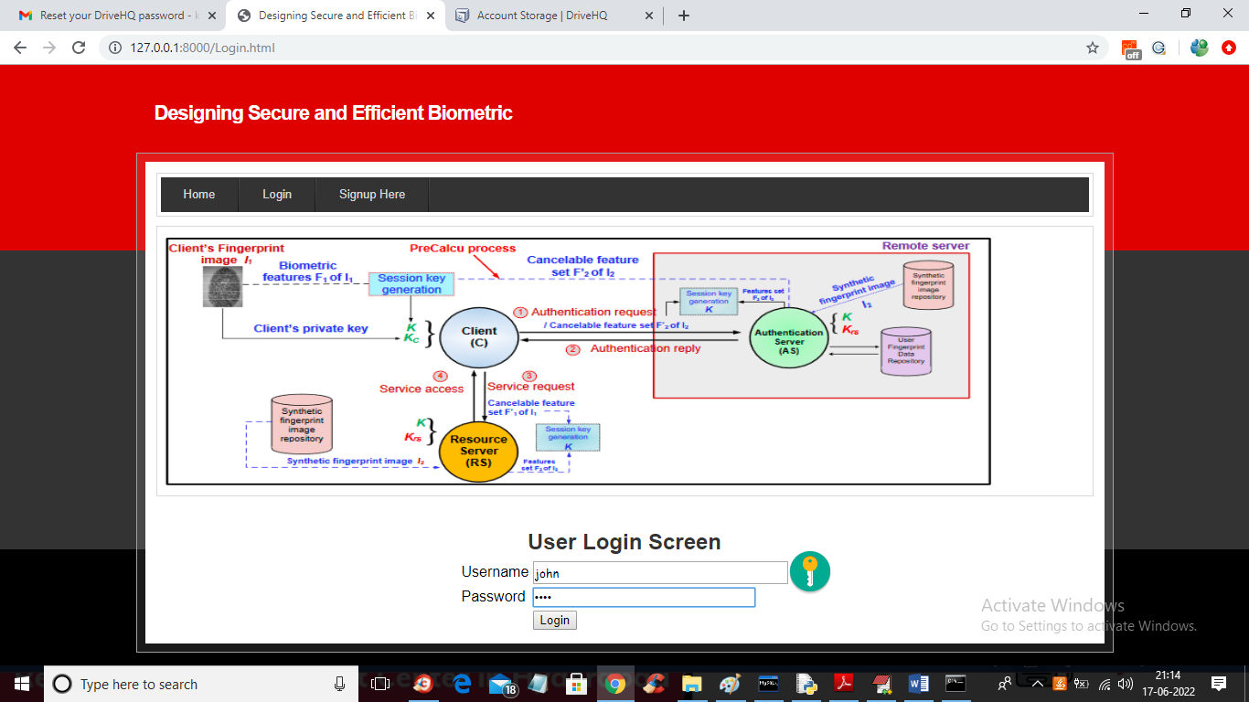
Results:

Slide 22
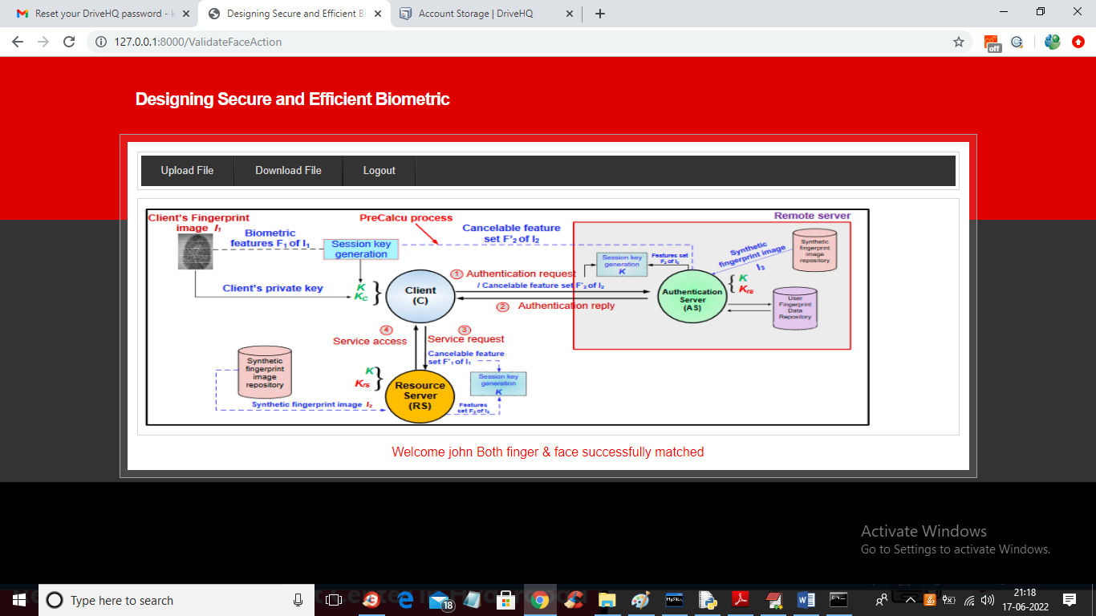

Slide 23
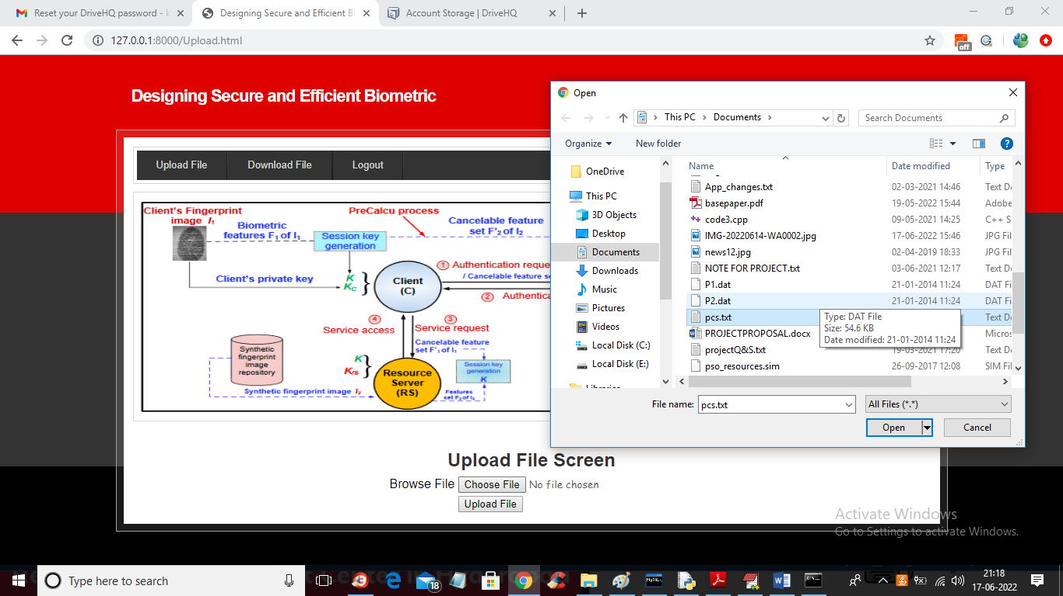

Slide 24
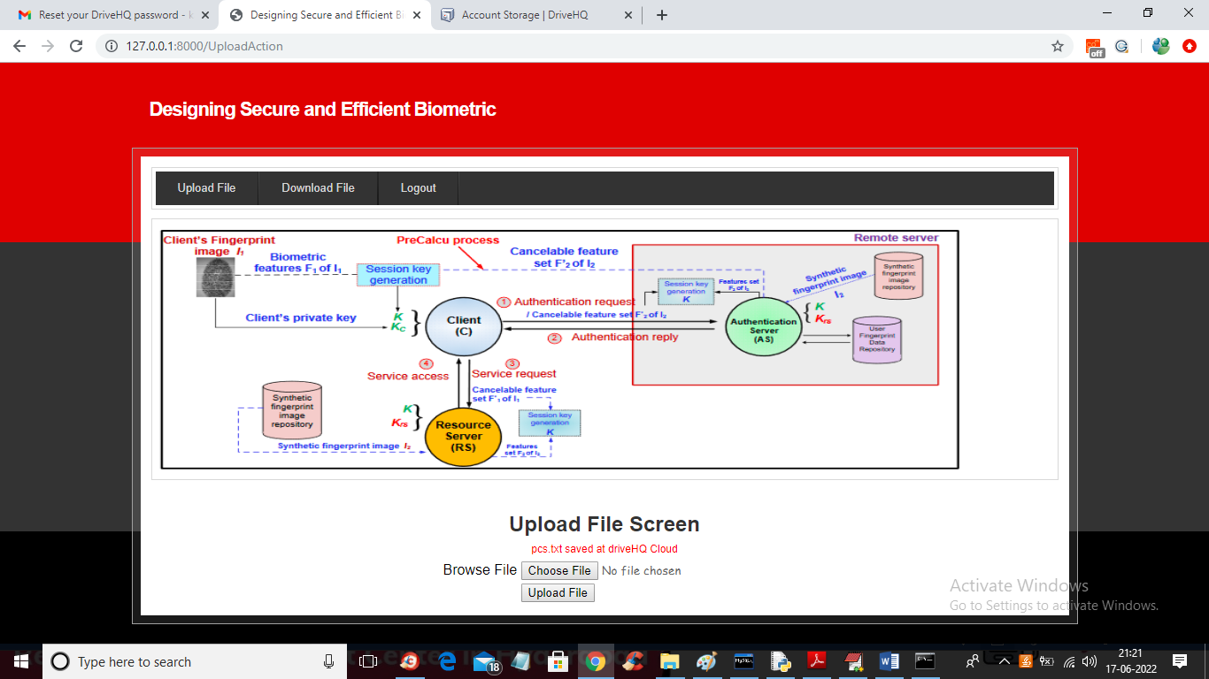

Slide 25
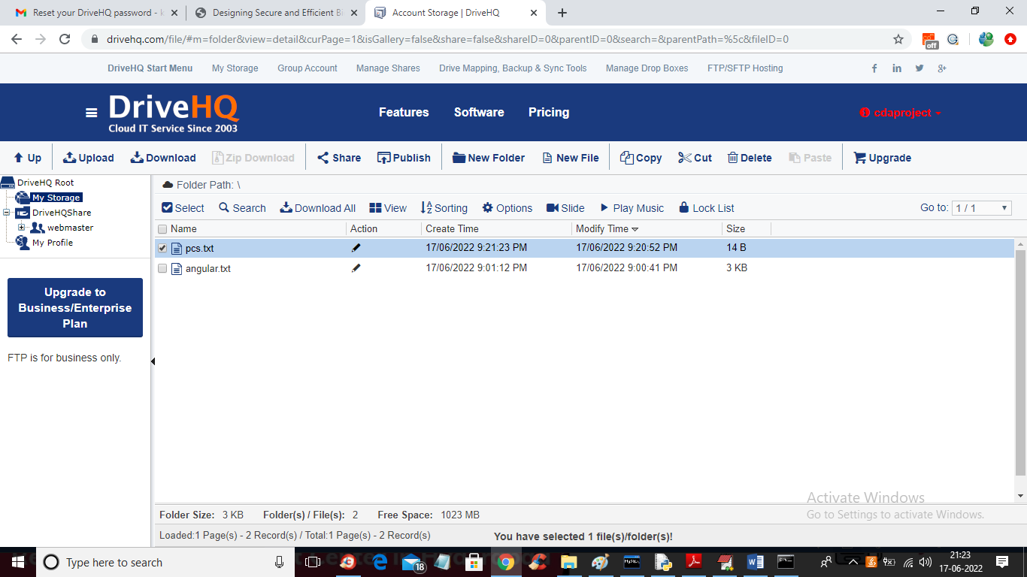

Slide 26
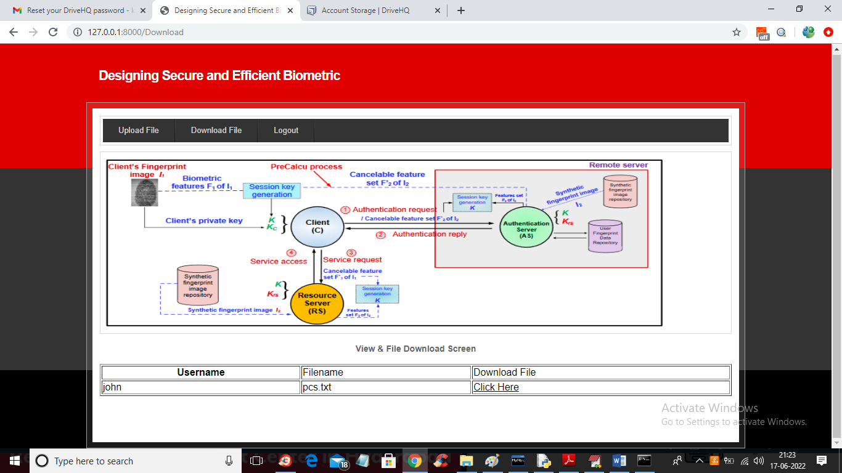

Slide 27
Conclusion:
In this project, we introduced a biometric-based security system for cloud services, focusing on fingerprint data and face recognition data.
Our approach provides a secure way for users to access cloud resources remotely without needing traditional passwords or tokens.
Compared to other security methods, our system is better at resisting common attacks, and with a 95.12% accuracy rate, it ensures reliable authentication.
We used DRIVEHQ for secure data storage. This allowed for scalable and efficient management of biometric data in the cloud environment
In the future, we aim to explore other biometric traits and combine multiple biometric methods for even stronger security, especially for critical areas like national security.

Slide 28
Future Scope:
Now-a-days its very important to store the data in the cloud which will be very secure and also easy data sharing and large amount of the data storage capacity.
It can be expanded to integrate multi-modal biometric systems, such as combining fingerprint, face, and recognition for more robust authentication.
The project could also explore the use of machine learning to enhance the accuracy and adaptability of biometric feature matching.
Scalability is a key area, enabling the system to support large-scale cloud deployments for industries like healthcare, finance, and e-governance.

Slide 29
References:
[1] G. Wettstein, J. Grosen, and E. Rodriguez, “IDFusion: An open architecture for Kerberos based authorization,” Proc. AFS and Kerberos Best Practices Workshop, June
[2] S.Zhu, S.Setia, and S.Jajodia, “LEAP: efficient security mechanisms for large-scale distributed sensor networks,” Washington D.C., USA, October 2003, pp. 62–72. .
[3] Q Jiang,J. Ma, X. Lu, and Y. Tian, “An efficient two-factor user authentication scheme with unlinkability for wireless sensor networks,” Peer-to-Peer Networking and Applications, vol. 8, no. 6, pp. 1070–1081, 2015.
[4] O.Althobaiti, M. Al-Rodhaan, and A. Al-Dhelaan, “An efficient biometric authentication protocol for wireless sensor networks,” International Journal of Distributed Sensor Networks, vol. 2013, pp. 1–13, 2013, Article ID 407971, http://dx.doi.org/ 10.1155/2013/407971.
[5] W. Yang, S. Wang, J. Hu, G. Zheng, and C. Valli, “Security and Accuracy of FingerprintBased Biometrics: A Review,” Symmetry, vol. 11, no. 2, 2019. [Online]. Available:https://www.mdpi.com/2073-8994/11/2/141.
[6] D. Kang, J. Jung, H. Kim, Y. Lee, and D. Won, “Efficient and Secure Biometric-Based User Authenticated Key Agreement Scheme with Anonymity,” Security and Communication Networks,vol.2018,pp.1–14,2018, Article ID 9046064, https://doi.org/10.1155/2018/9046064

Slide 30
Github Link:
https://github.com/akshithkethireddy/Secure-Biometric-Access-for-Cloud-Services

Slide 31
THANK YOU
\

