Slide 1






AI Blockchain Query Agent Chatbot
AI INNOVATIONS INC.
Revolutionizing Crypto Interactions with Seamless Query Solutions

Slide 2


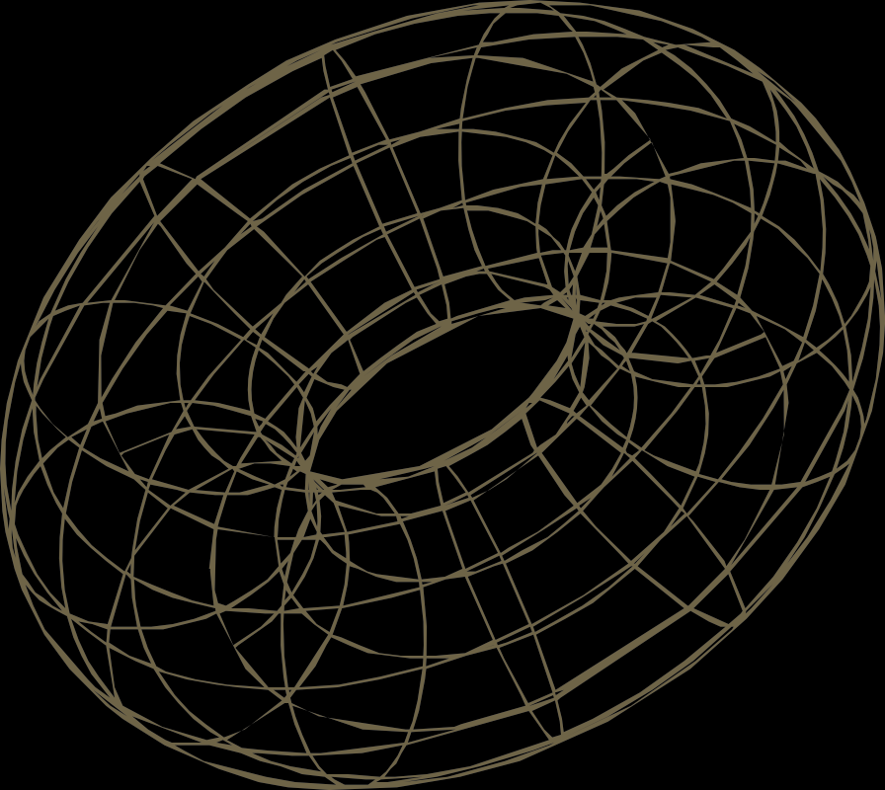




AI Blockchain Query Agent: Revolutionizing Queries
The AI Blockchain Query Agent chatbot simplifies user interactions with blockchain data. By providing quick answers to key inquiries, it empowers users to manage their assets and understand their transactions easily, enhancing overall accessibility.

Slide 3






Introducing the AI Blockchain Query Agent
01
02
03
A user-friendly chatbot designed to simplify blockchain data access for everyone.
Offers key features like balance inquiries and transaction history at your fingertips.
Utilizes MeshJS for Cardano queries, but authentication is not yet implemented in this version.

Slide 4




Key Features of the Chatbot
Explore the powerful functionalities of our AI Blockchain Query Agent:
Wallet balance queries for instant information
Retrieve transaction history easily and quickly Real-time data updates for accurate results User-friendly interface for effortless navigation
Multi-chain support for diverse blockchain networks

Slide 5

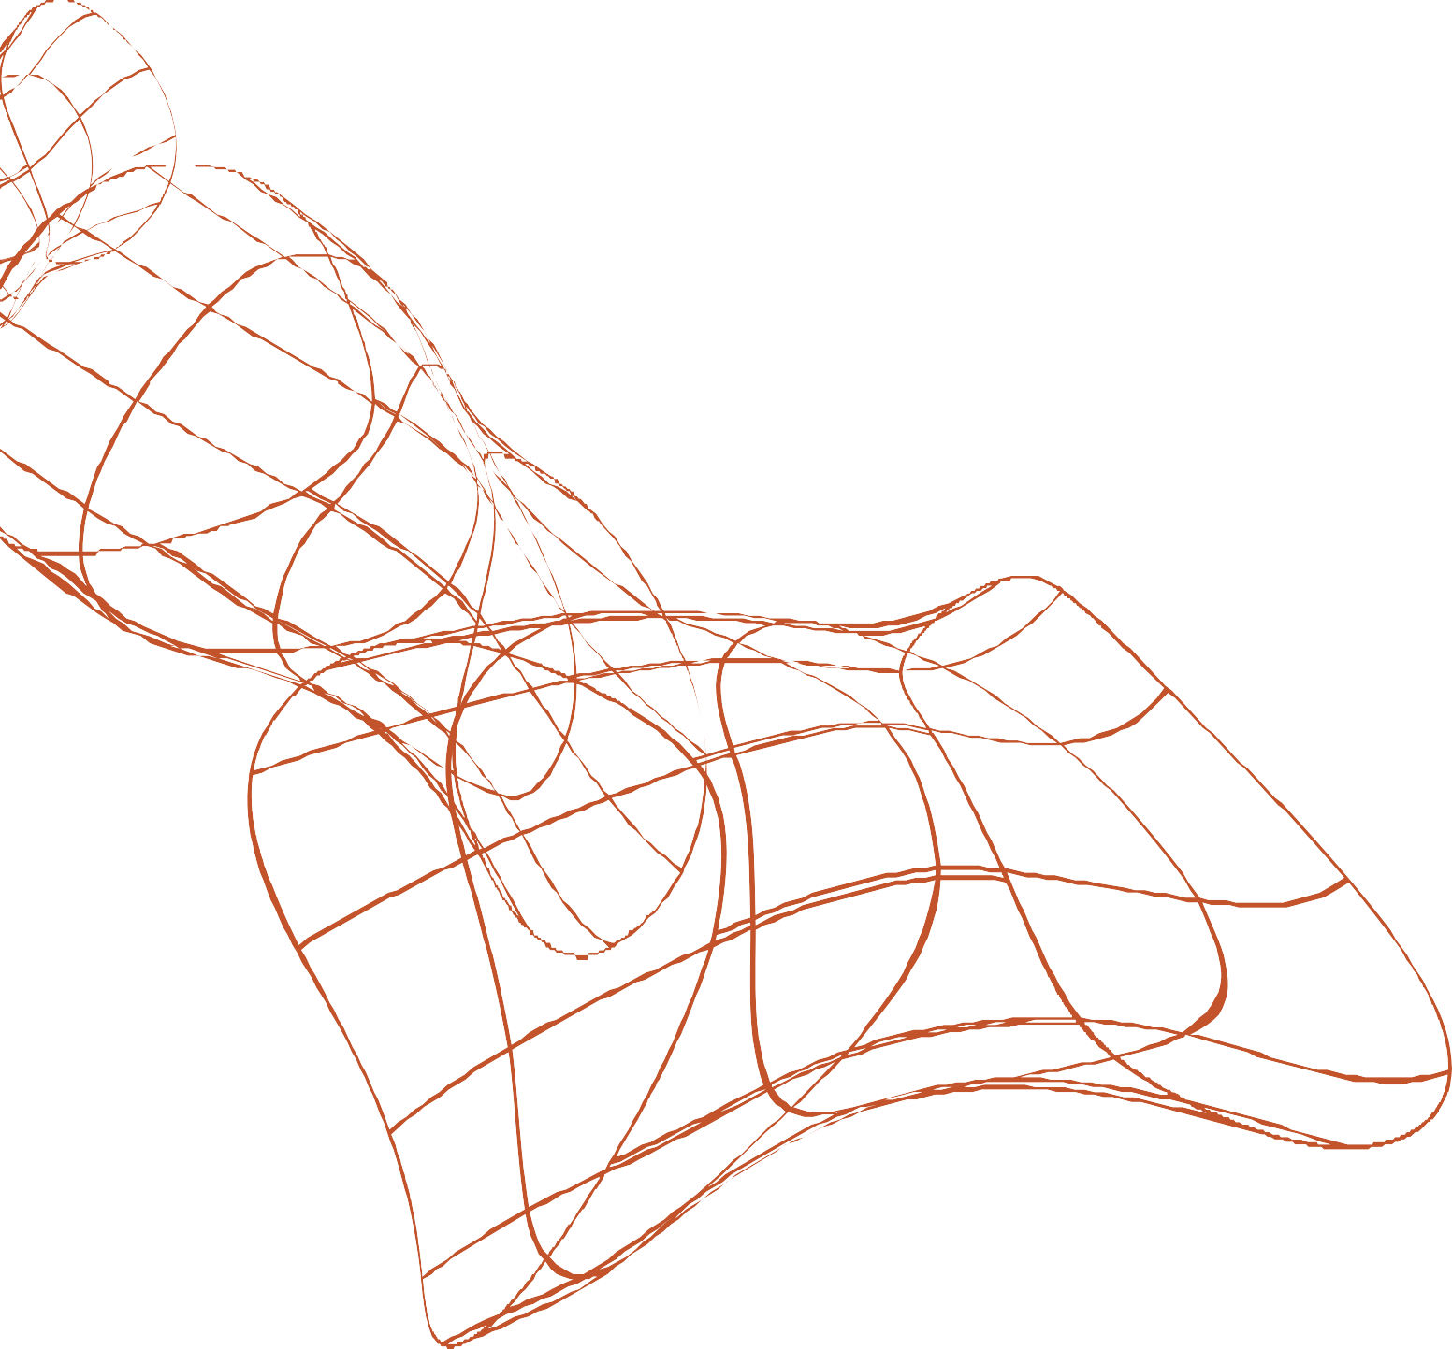
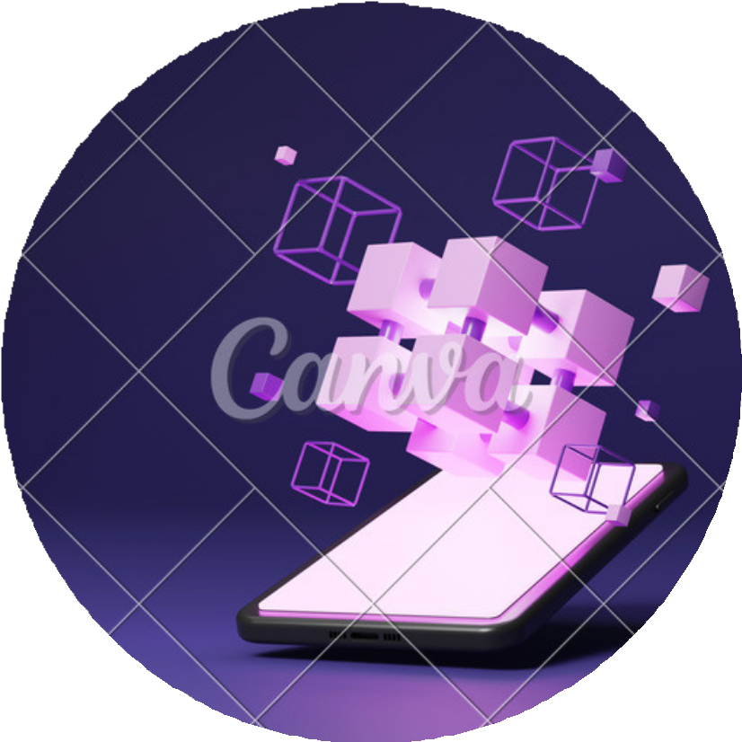


How the Chatbot Works
Utilizing MeshJS for seamless Cardano queries
The AI Blockchain Query Agent uses MeshJS to facilitate Cardano queries, enabling users to interact with the blockchain effectively. Note: Authentication is not yet implemented in this version, ensuring ease of access for all user queries.

Slide 6


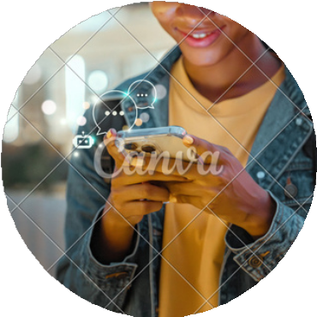


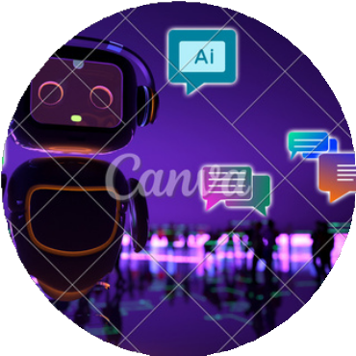
Wallet Balance
Easily inquire about your current wallet balance with a simple question.
Recent Transactions
Retrieve your last 5 transactions by asking the chatbot for detailed information.
Example User Questions
Quick Responses
Get instant answers to your queries, improving your overall user experience.

Slide 7
Unlocking the Future of Blockchain Queries
The AI Blockchain Query Agent chatbot provides quick access to wallet information and enhances user experience. It streamlines queries, making blockchain interactions more efficient and transparent for all users, even without authentication.

Slide 8





THANK YOU

