Slide 1
Employee Management System (EMS)
A Role-Driven Enterprise Web Application
Presented By:
Akshit Jain, Shweta, Nikita
Technology: Django | Db.sqlite3 | Chart.js

Slide 2
Executive Summary
Project Overview
Employee Management System (EMS) is a secure web-based enterprise solution designed to manage:
Employee lifecycle
Attendance tracking & HR verification
Task assignment & monitoring
Leave management workflow
OTP-based authentication
Real-time dashboards & analytics
The system centralizes workforce management and ensures operational transparency.

Slide 3
Business Objectives
Primary Goals
Automate HR operations
Improve attendance compliance
Enhance productivity monitoring
Key KPIs (Key Performance Indicator)
Attendance accuracy rate
Task completion rate
Leave approval turnaround time
Strategic Impact
Reduced manual errors
Improved data visibility
Better workforce planning

Slide 4
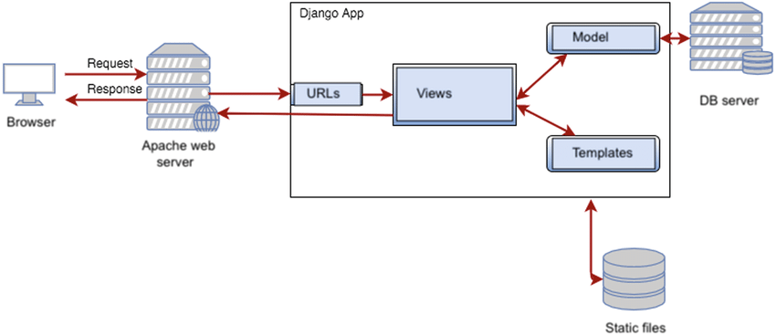
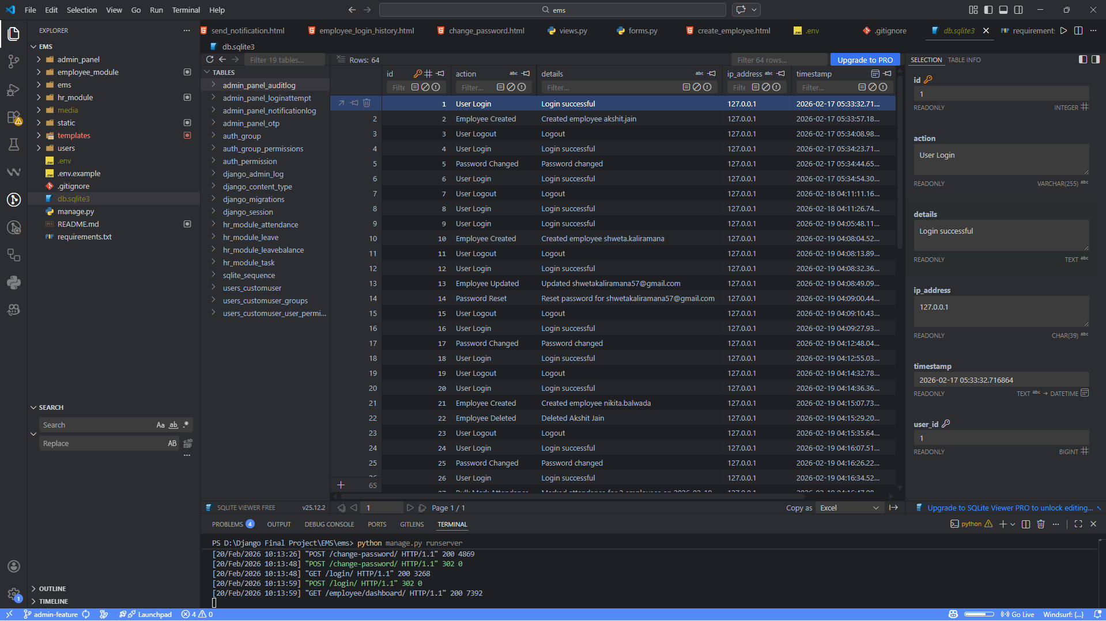
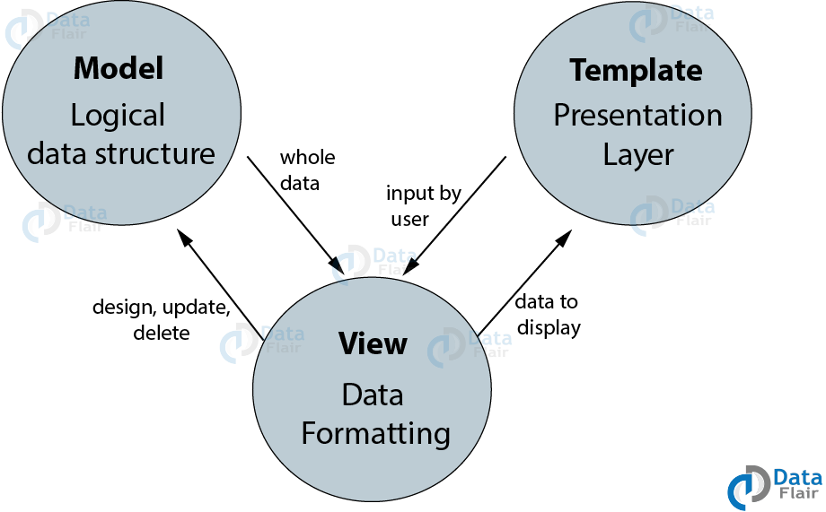
System Architecture
Architecture Overview
Backend: Django
Database: Db.Sqlite3
Frontend: Bootstrap / Tailwind CSS
Charts: Chart.js
Background Tasks: Celery + Redis
Email: SMTP Backend
Follows modular app-based Django structure..

Slide 5
User Roles & Access Control
Role-Based Access Control (RBAC)
1. Admin
Full system control
Employee creation & management
Organization analytics
2. HR
Attendance verification
Task assignment
Leave
3. Employee
Submit attendance
Apply leave
View salary & tasks
Strict middleware protection prevents unauthorized access.

Slide 6
Authentication & Security
Features
Email-based login
Secure password hashing
OTP verification (6-digit, 5-minute validity)
Account lock after 5 failed attempts
Password reset via email
Audit logging
Security is enforced through Django authentication system and middleware.

Slide 7
Admin Module
Capabilities
Add Employee / HR
Auto-generate Employee ID
Send OTP email
Activate/Deactivate accounts
View attendance & salary summaries
Organization-level dashboards
Admin Dashboard Includes
Total Employees
Department Distribution
Salary Expense Summary
Monthly Attendance Trends

Slide 8
HR Module
Task Management
Assign tasks with deadline & priority
Track lifecycle (Assigned → Completed)
Attendance Verification
Approve / Reject attendance
Modify hours
Auto-mark absent
Leave Management
Approve / Reject leave
Prevent date overlap

Slide 9
Employee Module
Dashboard Features
Today’s Attendance Status
Active Tasks
Leave Balance
Salary Summary
Panels
Task Panel (Accept/Reject/Upload work)
Attendance Panel
Leave Panel
Salary Panel (Download Payslip)

Slide 10
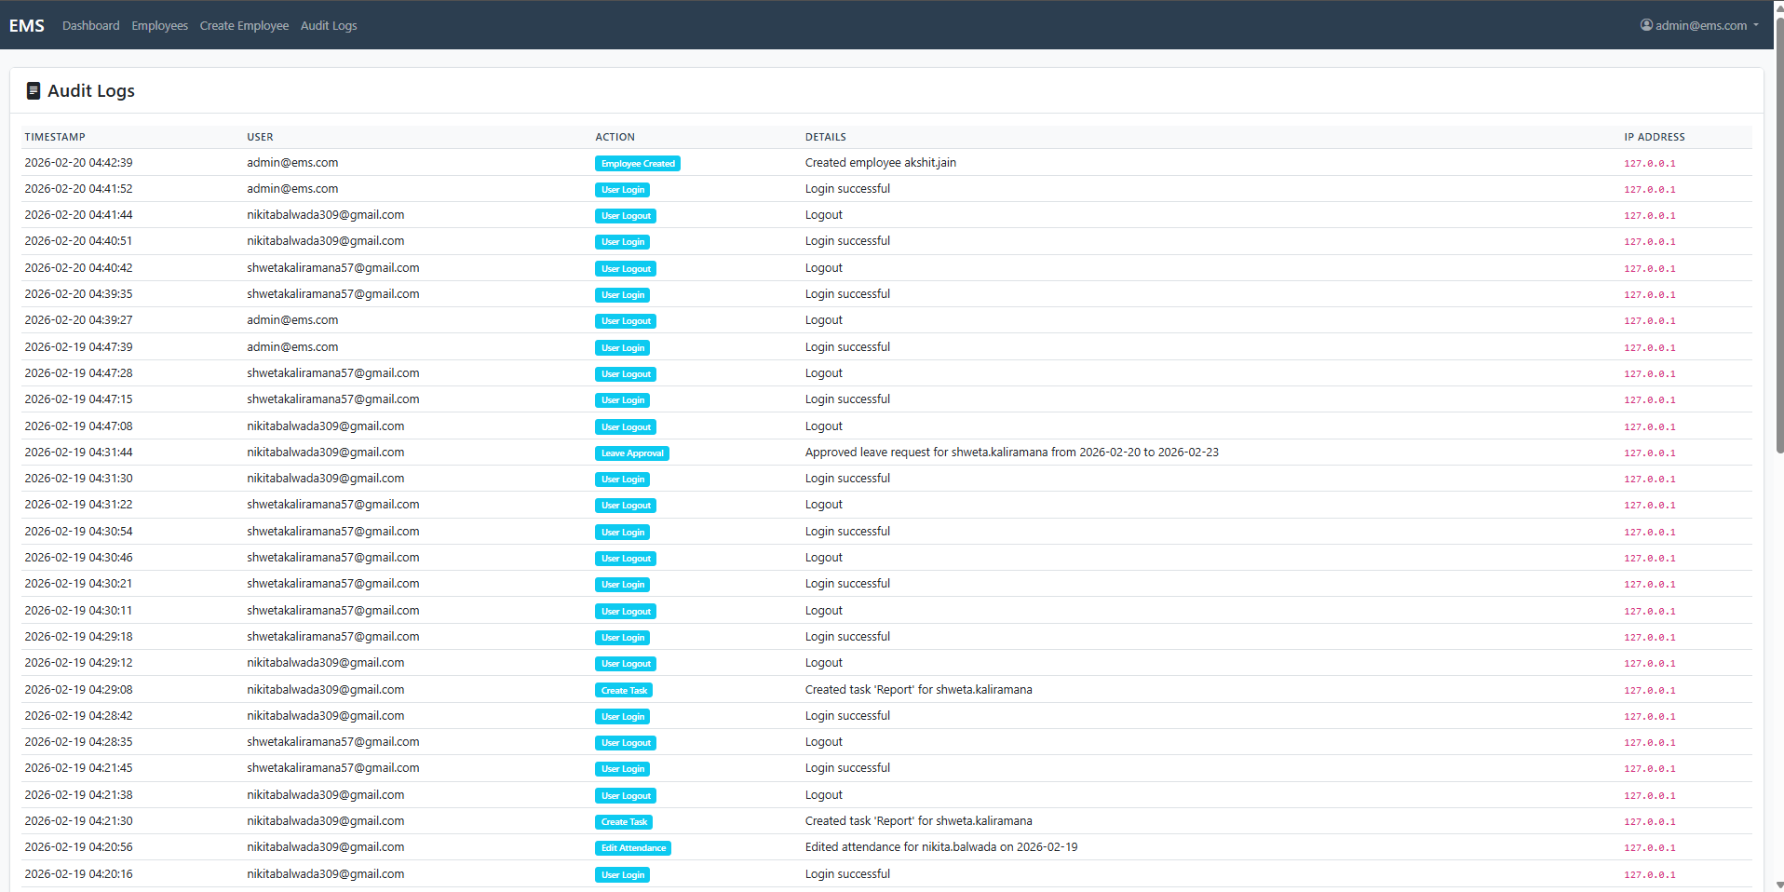
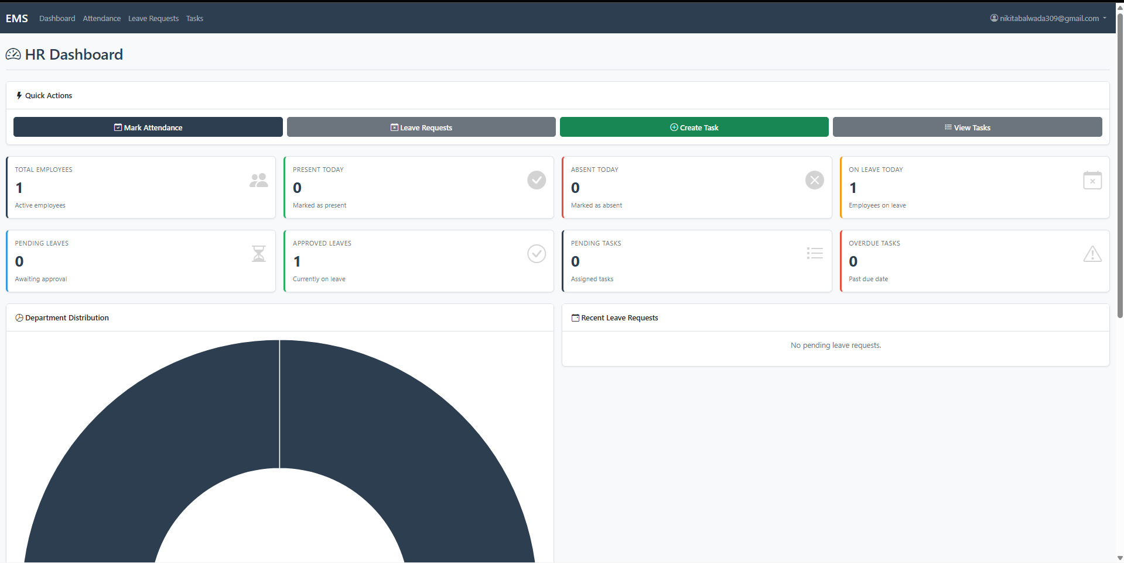
Real-Time Dashboard Analytics
Charts Implemented
Task Status Pie Chart
Attendance Trend Graph
Department Distribution
Leave Trends
Dashboard updates dynamically without full reload.

Slide 11
Database Design
Core Models
CustomUser
OTPVerification
Attendance
Leave
Task
NotificationLog
AuditLog
Database Features
Foreign key constraints
Unique attendance per employee per date
Leave overlap validation
Cascading deletes

Slide 12
Notification System
Automated Email Notifications for:
Account creation
OTP verification
Task assignment
Leave approval/rejection
Attendance approval
notifications are logged for auditing purposes.

Slide 13
Implementation Plan
Phase 1 – Authentication & Admin Setup
Phase 2 – HR Workflow Development
Phase 3 – Employee Dashboard & UI
Phase 4 – Testing & Optimization
Phase 5 – Deployment
Deployment Model
Web-based application
HTTPS enabled
Database backup configured

Slide 14
Risk Management
Identified Risks
Unauthorized access
Data inconsistency
Email delivery failures
Performance bottlenecks
Mitigation Strategies
Role-based middleware
Audit logging
OTP expiration logic
Database constraints
Performance testing

Slide 15
Business Impact & Future Enhancements
Business Impact
Reduced HR manual workload
Improved employee transparency
Faster payroll operations
Data-driven decision making
Future Enhancements
Biometric Integration
AI-based performance scoring
Mobile App Version
Multi-branch support
SMS notifications

