Slide 1

E Commerce And AI Implementation
Akshit Jain
Ajatshatru Singh Jodha
Ayush Rai
Aditya Pinjare
Anshu Ranjan Maurya

Slide 2
About the Sector
Rapid Growth: Expansion of online shopping through websites and mobile applications.
Digital Transactions: Increasing use of UPI, digital wallets, cards, and online payment systems.
Complex Supply Chains: Inventory management, warehousing, logistics, and last-mile delivery are critical operational activities.
High Competition: Businesses compete on price, product availability, delivery speed, and customer loyalty.
Role of AI and Analytics: Demand forecasting, recommendation systems, route optimization, and customer retention analytics support better decisions.

Slide 3




Major Challenges of the Sector
Inefficient Supply Chain
Poor Inventory Management
Low Customer Retention

Slide 4
AI-POWERED E-COMMERCE SUPPLY CHAIN
Transforming logistics through intelligent automation and predictive analytics
Key Problems
Inefficient delivery routes
Warehouse bottlenecks
Poor inventory coordination
Unpredictable delivery delays
Underutilized vehicles and staff
AI Solutions
Route optimization algorithms
Predictive analytics for warehouses
Demand forecasting
ML-based delivery time prediction
Intelligent resource allocation
Collect Data
Predict
Improve
Optimize
Monitor
Expected Impact & Success Metrics
↓ Delivery time and logistics cost ↑ On-time delivery rate
↓ Order fulfilment time ↑ Vehicle capacity utilization

Slide 5
AI-Powered E-commerce Inventory Management
Predicting demand, preventing stockouts, and optimizing replenishment
Key Problems
Stockouts: Lost sales and customer dissatisfaction.
Overstocking: Higher storage costs and unsold products.
Uncertain demand: Difficulty estimating future sales.
Seasonal fluctuations: Demand spikes can cause shortages.
AI Solutions
Supervised ML: Predicts stockout risk.
Regression: Estimates units likely to sell.
Time-series forecasting: Predicts trends and seasonal demand.
Reinforcement learning: Improves reorder decisions over time.
Historical Data
Predict Stockout Risk
Forecast Demand
Optimize Reorders
Learn & Improve
Expected Business Impact
↓ Stockouts and lost sales ↑ Product availability during seasonal peaks
↓ Storage and excess inventory costs ↑ Replenishment accuracy and working-capital efficiency

Slide 6
AI-Powered E-commerce Customer Retention
Turning customer insights into personalized experiences and long-term loyalty
Key Problems
High customer churn
Generic experiences.
Poor engagement
Customer dissatisfaction
Missed loyalty opportunities
AI Solutions
Churn prediction
Recommendation systems
Customer segmentation
Sentiment analysis
Personalized campaigns
Collect Customer Data
Analyse Behaviour
Measure & Improve
Predict Churn
Personalize Offers
Expected Business Impact & KPIs
↓ Customer churn rate ↑ Customer lifetime value (CLV)
↑ Customer satisfaction and engagement
↑ Repeat purchase rate

Slide 7
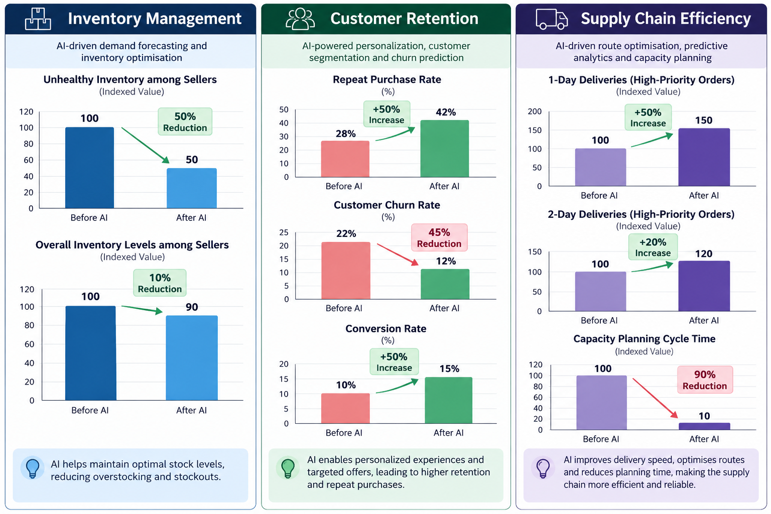
AI impact on the E Commerce Sector

Slide 8
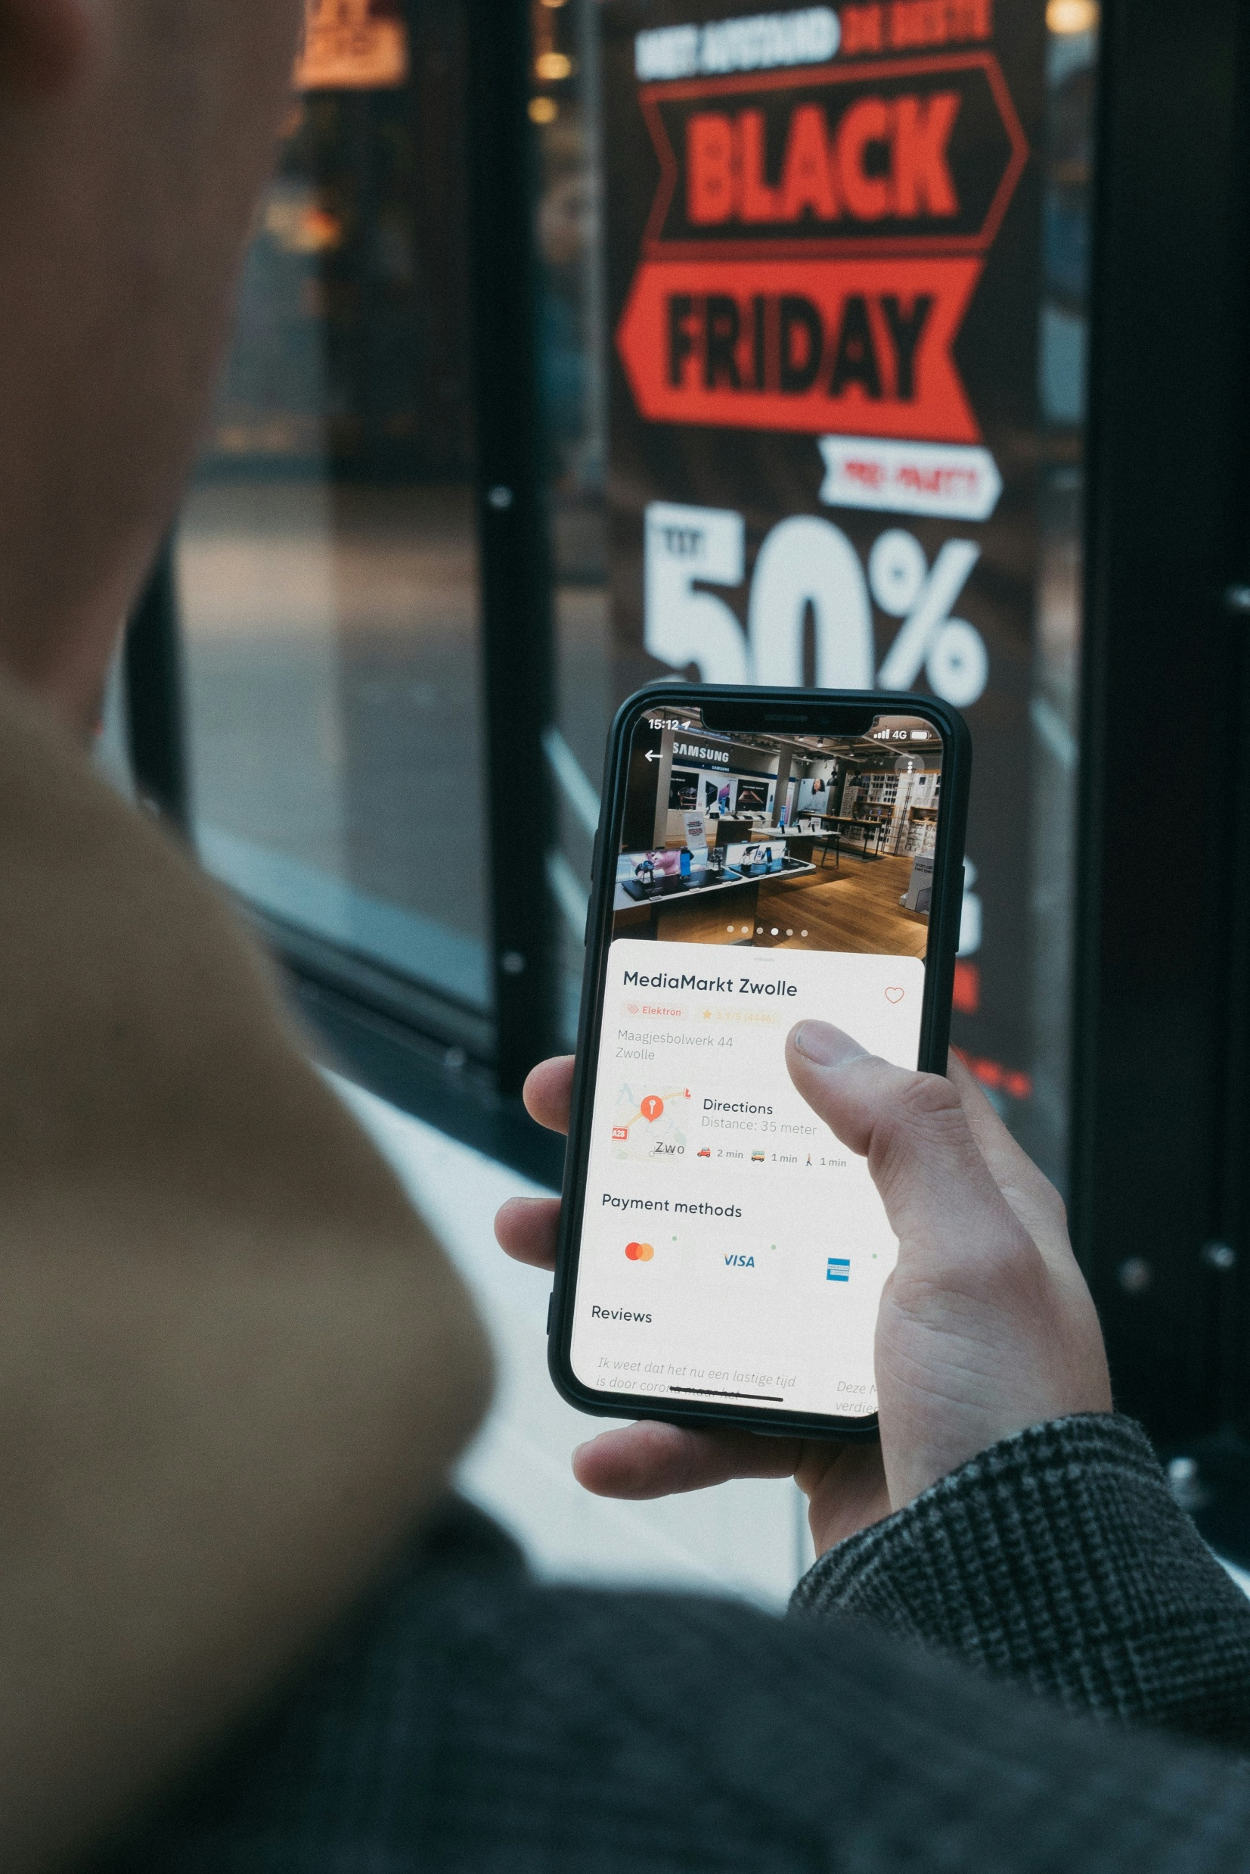
Conclusion
AI Transformation: Smarter, data-driven decisions.
Efficient Operations: Lower costs and faster deliveries.
Customer Loyalty: Better personalization and retention.
Higher Profitability: Improved efficiency and growth.
Continuous Improvement: KPI-based performance monitoring.

Slide 9

Thank You

