Slide 1


Neural Proximal/Trust Region Policy Optimization Attains Globally Optimal Policy
Achieving Global Convergence in Deep Reinforcement Learning
Submitted To: Dr Arghyadip
Submitted By:
Akshit Singh

Slide 2
Introduction
Background on PPO and TRPO:
Proximal Policy Optimization (PPO) and Trust Region Policy Optimization (TRPO) are prominent methods in deep reinforcement learning.
They have achieved significant empirical success in various applications like gaming and robotics.
Importance of Global Convergence in Reinforcement Learning:
Ensuring convergence to the optimal policy is crucial for reliable performance.
Theoretical guarantees bridge the gap between empirical success and foundational understanding.
Challenges:
Non-convexity of the expected total reward over the infinite-dimensional policy space.
Non-convexity due to neural network parametrization of policy and action-value functions.

Slide 3
Problem Statement
Convergence of PPO/TRPO to the Optimal Policy:
How do these algorithms ensure convergence despite non-convexity?
Accuracy of Action-Value Function Approximation:
How accurately can neural networks approximate the action-value function during iterations?
Convergence of Policy Improvement via Stochastic Gradient Descent (SGD):
How does SGD help in converging to an improved policy based on approximate action-value functions?

Slide 4

Markov Decision Process (MDP)
Components:
States (S): The set of all possible states in the environment.
Actions (A): The set of all possible actions the agent can take.
Transition Kernel (P): The probability distribution of moving from one state to another given an action.
Reward Function (r): The immediate reward received after transitioning from one state to another via an action.
Discount Factor (): The factor by which future rewards are discounted.
Definitions:
Q-function (Qπ): Measures the expected total reward for taking action a in state s under policy ℼ.
V-function (Vπ): Measures the expected total reward for being in state s and following policy ℼ.
Advantage Function (Aπ):

Slide 5

Proximal Policy Optimization (PPO)
Describe the PPO Update Rule:
PPO optimizes a surrogate objective(typically 0.8) to improve stability and reliability of policy updates.
Update Formula:
The clipping function clip(rt​(θ),1−ϵ,1+ϵ) ensures that the probability ratio rt(θ) stays within the range [1−ϵ,1+ϵ]. This mechanism prevents large deviations from the old policy, promoting stable learning.This mechanism ensures that updates are not too drastic.
Objectives of Policy Improvement and Policy Evaluation:
Policy Improvement: Update the policy to improve performance.
Policy Evaluation: Estimate the value function accurately to inform policy improvement.

Slide 6
How PPO Works :
Interaction with Environment: The agent interacts with the environment using the current policy, collecting data in the form of states, actions, and rewards.
Policy Update: Using the collected data, PPO updates the policy by maximizing the clipped surrogate objective. This involves computing the gradients of the objective function and adjusting the policy parameters accordingly.
Repeat: This process is repeated many times. The agent continues to interact with the environment and update its policy, gradually improving its performance.
Advantages of PPO
Stability: The clipping mechanism helps in maintaining stable and reliable policy updates.
Simplicity: PPO is relatively easy to implement compared to other advanced algorithms like Trust Region Policy Optimization (TRPO).
Efficiency: PPO often performs well with fewer hyperparameters to tune, making it more user-friendly.

Slide 7


Trust Region Policy Optimization (TRPO)
TRPO Update Rule:
TRPO uses a trust region constraint to ensure that the new policy is not too far from the old one.
It maximizes the expected improvement while ensuring the Kullback-Leibler (KL) divergence between the new and old policies is within a certain limit.
TRPO formulates opt- subject to :
Trust Region Constraints:
A trust region is a subset of the parameter space within which the optimization step is confined.
Ensures that each policy update is safe and stable, avoiding large, destabilizing updates.
Comparison with PPO:
TRPO directly enforces a hard constraint on the KL divergence, whereas PPO uses a clipped surrogate objective as a softer penalty.
TRPO is theoretically motivated by the need for a monotonically improving policy.
PPO is simpler to implement and often achieves similar performance in practice through its clipped objective function.

Slide 8

HOW TRPO WORKS?
Initialize Policy Network: Start with an initial policy parameterized by θ.
Collect Trajectories: Interact with the environment using the current policy to collect trajectories of states, actions, and rewards.
Estimate Advantages: Compute the advantage function A(s_{t}, a_{t}) for each state-action pair using methods like Generalized Advantage Estimation (GAE): A(s_{t}, a_{t}) = ∑​_{t}γ^{t}’δ_{t}​ where δ_{t}=r_{t}+γV(s_{t+1})−V(s_{t})
Surrogate Objective Function: Define the surrogate objective function:
Where πθ(a∣s)is the probability of taking action a in state s under the current policy.
Compute the gradient of the surrogate objective function with respect to
θ: ∇_{θ}L^{CPI}(θ)=Et[∇_{θ}log⁡(π_{θ}(a_{t}∣s_{t}))A(a_{t ,} s_{t})]
Estimate the Fisher Information Matrix (FIM) to approximate the constraint
Solve the constrained optimization problem to find the step direction Δθ
Use the conjugate gradient method to solve the above constrained optimization problem and find Δθ.
Update Policy Parameters
Update the policy parameters θ\thetaθ using the computed step direction: θ_{new}=θ_{old}+αΔθ
Iterate the process by collecting new trajectories, estimating advantages, and updating the policy until convergence or satisfactory performance is achieved.

Slide 9
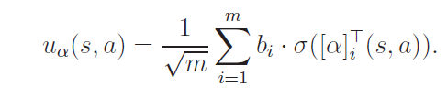
Neural PPO
Neural Proximal Policy Optimization (Neural PPO) is an advanced reinforcement learning algorithm that leverages neural networks to represent policy and value functions.
The policy network determines action probabilities for given states, while the value network estimates expected rewards.
two-layer neural network.
Here m is the width of the neural network, bi ∈ {−1, 1} (i ∈ [m]) are the output weights,
σ(·) is the rectified linear unit (ReLU) activation, and α = ([α]⊤1 , . . . , [α]⊤
m)⊤ ∈ R^{md} with [α]i ∈ R^{d} (i ∈ [m]) are the input weights.
Bi i.i.d. ∼ Unif({−1, 1}), [α(0)] i.i.d. ∼ N(0, Id/d), for all i ∈ [m].
Neural PPO excels in handling high-dimensional state and action spaces, making it suitable for complex tasks like robotics and game playing.

Slide 10
Neural PPO
HOW NEURAL PPO Works?
Sure, here's a concise step-by-step description of how Neural Proximal Policy Optimization (Neural PPO) works, with each point in a single line:
1. Initialize Neural Networks: Define the policy network and value network.
2. Interact with Environment: Use the policy network to collect trajectories of states, actions, and rewards.
3. Calculate Advantages: Compute the advantage function using collected trajectories and the value network.
4. Compute Probability Ratios: Calculate the ratio of the new policy probabilities to the old policy probabilities for actions taken.
5. Apply Clipping: Clip the probability ratios to be within a specified range to ensure stable updates.
6. Surrogate Objective: Define the clipped surrogate objective function to maximize.
7. Policy Network Update: Perform gradient ascent on the surrogate objective to update the policy network parameters.
8. Value Network Update: Minimize the mean squared error between predicted and actual returns to update the value network parameters.
9. Repeat: Continue the process iteratively until convergence or satisfactory performance is achieved.

Slide 11
Policy Network Update:
The formula for updating the policy network parameters θ is given by:
θ_{k+1}​=θ_{k}​+α∇θ​L(θ_{k}) where :θ_{k} and θk+1​ are the policy network parameters at iteration k and k+1, respectively.
α is the learning rate.
L(θ_{k}) is the surrogate objective function that guides the policy update.
Value Network Update:
The value network is updated using Temporal Difference (TD) learning to minimize the error in value estimation. The formula for updating the value network parameters ω is given by:
ω_{k+1}​= ω_{k}​ + β∇ω​(V_{target}−VNN​(s , a ; ω_{k}​))²
where : ω_{k}​ and ω_{k+1} are the value network parameters at iteration k and k+1, respectively.
β is the learning rate for the value network update.
V_{target} is the target value for the state-action pair.
VNN​(s,a;ωk​) is the value estimated by the neural network with parameters ω_{k}​.

Slide 12
Neural PPO
Policy Improvement
actions with higher advantages. The formula for policy improvement is given by:
ℼ _{k+1}​(a ∣ s)= ℼ_{k}(a ∣ s)exp(σk​A(s , a)​)
where: ℼ _{k}(a ∣ s) and ℼ _{k+1}​(a ∣ s) are the policy distributions at iteration k and k+1, respectively.
A(s , a) is the advantage of taking action a in state s.
σk​ is a parameter controlling the step size of the policy update.

Slide 13
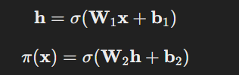

Neural Network Parametrization
Two-Layer Neural Network Structure:
Commonly used in PPO and TRPO, but can be deeper for more complex tasks.
The general structure:
Random Initialization of Weights:
Weights initialized using
Role of Over-Parameterization:
Increases network capacity to fit complex patterns.
Helps escape local minima and saddle points.
Benefits in Optimization:
Accurate policy and value function approximations.
Better generalization in capturing data patterns.

Slide 14
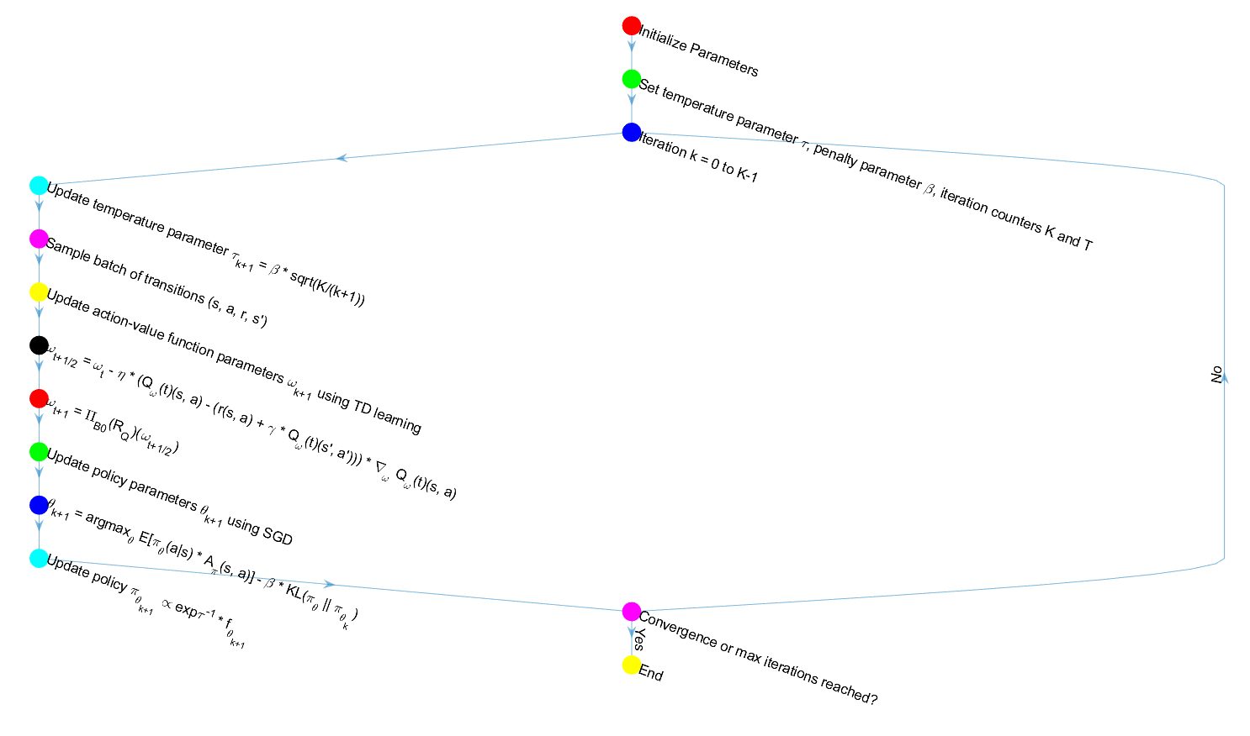

Slide 15
Neural PPO Algorithm
1. Initialize parameters:
- Initialize policy parameters θ₀ and action-value function parameters ω₀.
- Set temperature parameter τ, penalty parameter β, and iteration counters K and T.
2. For each iteration k = 0, ..., K-1:
a. Update temperature parameter τ_(k+1) = β√(K/(k+1)). τ controls the level of exploration in the policy.
b. Sample a batch of transitions (s, a, r, s') from the environment.
c. Update action-value function parameters ω_(k+1) using Temporal Difference (TD) learning:
- ω_(t+1/2) = ω_t - η * (Q_ω(t)(s, a) - (r(s, a) + γ * Q_ω(t)(s', a'))) * ∇_ωQ_ω(t)(s, a)
- ω_(t+1) = Π_B0(R_Q)(ω_(t+1/2))
(where η is the learning rate, and Π_B0(R_Q) is a projection operator)
d. Update policy parameters θ_(k+1) using Stochastic Gradient Descent (SGD):
- θ_(k+1) = argmax_θ E[π_θ(a|s) * A_π(s, a)] - β * KL(π_θ||π_θ_k)
(where A_π is the advantage function, and KL is the Kullback-Leibler divergence)
e. Update policy:
- π_θ_(k+1) ∝ exp{τ^(-1) * f_θ_(k+1)}

Slide 16
Neural PPO Algorithm Flow Chart
3. Repeat steps 2a-2e until convergence or a maximum number of iterations is reached.
Parameters Changing What:
The policy parameters θ determine the policy π_θ, which is the probability distribution over actions given states.
The action-value function parameters ω determine the action-value function Q_{w}, which estimates the expected return of taking a given action in a given state.
The temperature parameter τ influences the policy update by controlling the entropy of the policy, making the policy more or less random.
The penalty parameter β is used in the PPO update rule to balance the objective between improving the policy and satisfying the KL divergence constraint.
The learning rate η controls the step size of the SGD updates for the action-value function parameters.

Slide 17
Brief Description:
The Neural PPO algorithm iteratively updates the policy and action-value function parameters using neural networks to approximate these functions. The policy is updated to maximize the expected return while constraining the change in policy to ensure stable learning. The action-value function is updated using TD learning to estimate the expected return more accurately. The algorithm uses overparametrized neural networks to ensure global convergence to the optimal policy at a sublinear rate.
Policy Parameter (θ): This parameter defines the policy πθ, which is a function that maps states to a probability distribution over actions. The policy is what the agent uses to make decisions.
Action-Value Function Parameter (ω): This parameter defines the action-value function Qω, which estimates the expected return of taking a given action in a given state. It's used to evaluate the quality of actions taken by the policy.
Penalty Parameter (β): This parameter is used in the PPO and TRPO updates to balance the objective between improving the policy and satisfying the Kullback-Leibler (KL) divergence constraint. It helps to ensure that the policy does not change too much in each update, which can lead to more stable learning.
Temperature Parameter (τ): This parameter influences the policy by controlling the entropy of the policy distribution. A higher τ leads to more exploration (more randomness in action selection), while a lower τ leads to more exploitation (greedier action selection).
KL Divergence (KL(πθ(s)|πθk(s))): This is a measure of how much the new policy πθ differs from the old policy πθk. It's used to constrain the policy updates to prevent large changes that could destabilize learning.
Advantage Function (Ak(s, a)): This function estimates how much better taking a particular action is compared to the average action taken by the current policy. It's used to guide the policy towards better actions.
Trust Region Radius (δ): In TRPO, this parameter defines the size of the trust region, which limits the policy update to ensure that the new policy is not too different from the old policy.

Slide 18
Neural Network Widths (mf and mQ): These parameters determine the size of the neural networks used to parametrize the policy and action-value functions. Overparameterization (using larger networks than necessary) is key to the theoretical guarantees proviPolicy Parameter (θ): This parameter defines the policy πθ, which is a function that maps states to a probability distribution over actions. The policy is what the agent uses to make decisions.
Action-Value Function Parameter (ω): This parameter defines the action-value function Qω, which estimates the expected return of taking a given action in a given state. It's used to evaluate the quality of actions taken by the policy.
Number of Iterations (K and T): These parameters control the number of times the policy is updated (K) and the number of SGD and TD iterations within each policy update (T).
Projection Radii (Rf and RQ): These parameters are used in the context of projected gradient descent to ensure that the parameters of the neural networks remain within certain bounds.

Slide 19
Mirror Descent
Mirror Descent is a smarter way to do gradient descent when dealing with complex shapes or constraints. Instead of directly following the gradient, it first transforms the space where the optimization happens using a mirror map, making the updates more natural and efficient for the problem's geometry. After updating in this new space, it then converts the solution back to the original space. This method helps in situations where the variables have specific constraints, like probabilities or non-negative values, ensuring faster and more accurate convergence compared to traditional gradient descent.
Function: The mirror map transforms the gradient updates in a way that respects the geometry of the problem.

Slide 20



Mirror Map
Here's how the mirror map is used in the mirror descent algorithm:
Gradient Computation: Compute the gradient of the loss function in the original parameter space.
Mapping to Dual Space: Use the mirror map ψ to transform the current point in the parameter space to a point in the dual space. This is done using the gradient of ψ, denoted as
Update in Dual Space: Perform the gradient descent step in the dual space. This involves updating the dual variables based on the computed gradient of the loss function.
Mapping Back to Primal Space: Use the inverse of the gradient of ψ to map the updated point in the dual space back to the original parameter space.

Slide 21
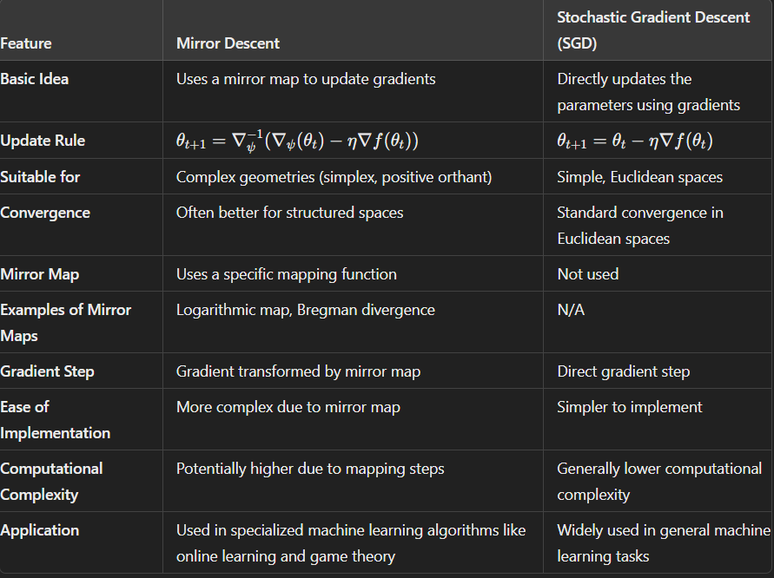
Comparison between SGD and Mirror Descent

Slide 22
Why SGD but not Mirror Descent in Policy Training
Theoretical vs. Practical Implementation: Mirror descent is used in the theoretical analysis to understand the convergence properties of the policy updates in the infinite-dimensional policy space. In practice, however, we work with finite-dimensional parameter spaces, and SGD is a well-established method for optimizing these parameters.
Computational Efficiency: SGD is a highly efficient method for training neural networks, especially when dealing with large datasets or complex models. It allows for online or mini-batch updates, which are crucial for scaling up to the size of problems typically encountered in deep reinforcement learning.
Practicality and Convenience: SGD is widely supported by deep learning frameworks and has been extensively studied in the context of neural network training. It is well-understood and has a vast array of tools and techniques for tuning and improving its performance.
Mirror Descent as a Theoretical Tool: The document uses mirror descent as a theoretical tool to analyze the convergence of the policy updates. It helps to establish the global convergence of the algorithm under certain conditions, but it is not directly used as an optimization algorithm in the implementation of Neural PPO.
SGD remains the method of choice for practical policy training due to its efficiency, scalability, and widespread support in deep learning frameworks.

Slide 23
Why SGD is not used but Mirror Descent in Convergence Analysis
Theoretical Framework: Mirror descent is better suited for analyzing convergence in infinite-dimensional spaces, providing a more general understanding of the algorithm's behavior.
Handling Nonconvexity: Mirror descent effectively addresses nonconvex objectives, which is crucial for policy optimization with neural networks.
Primal-Dual Perspective: It offers a primal-dual perspective, useful for analyzing policy evaluation and improvement errors.
Global Convergence: Mirror descent helps establish global convergence towards the optimal policy under one-point monotonicity.
Error Characterization: It aids in characterizing primal and dual errors from neural network approximations.
In contrast, SGD is practical for finite-dimensional spaces and is used in the actual implementation of Neural PPO, but not for theoretical analysis.

Slide 24


Infinite-Dimensional Mirror Descent
Concept of Mirror Descent:
Generalizes gradient descent for large or infinite-dimensional spaces.
Iterative update rule
where Dψ(w || wt) is a Bregman divergence.
One-Point Monotonicity:
Ensures that the expected total reward satisfies a specific monotonicity:
Key to guiding policies toward global optimality despite non-convexity.
Role of Neural Networks:
Neural networks approximate gradients and iterates in the mirror descent framework.
Over-parameterization helps to accurately represent these updates:

Slide 25
Convergence Analysis
Section 4 of the document focuses on the main results of the research, specifically the global convergence of neural Proximal Policy Optimization (neural PPO). The section is structured to first establish the necessary assumptions and then present the main theorems and their implications.
Assumptions:
Assumption 4.1 (Bounded Reward): There is a constant 𝑅𝑚𝑎𝑥such that the reward 𝑟(𝑠,𝑎) is bounded for any state-action pair. This assumption ensures that the rewards do not grow unboundedly, which is important for the stability of the learning process.
Assumption 4.3 (Action-Value Function Class): The action-value function 𝑄𝜋(𝑠,𝑎) belongs to a function class 𝐹𝑅𝑄,𝑚𝑄 for any policy 𝜋. This assumption ensures that the action-value function is well-behaved and can be approximated by the function class used in the algorithm.
Assumption 4.4 (Regularity of Stationary Distribution): The stationary state-action distribution 𝜎𝜋σπ​ has a density that is upper bounded by a constant 𝑐. This condition is necessary for the regularity of the policy's state-action distribution.

Slide 26
Convergence Analysis
Theorems and Results:
Theorem 4.5 (Policy Improvement Error): This theorem provides a bound on the error induced by the policy improvement step. It states that the error decays at a certain rate with the number of SGD iterations 𝑇and the width of the neural network mQ​.
Theorem 4.6 (Policy Evaluation Error): Similarly, this theorem gives a bound on the error induced by the policy evaluation step, also showing a decay rate with respect to the number of TD iterations 𝑇T and the width of the neural network 𝑚𝑄.
Theorem 4.10 (Global Rate of Convergence of Neural PPO): This is the central result of the section, which establishes the global convergence of neural PPO. It provides a bound on the difference between the performance of the optimal policy and the policy obtained by the algorithm after a certain number of iterations. The convergence rate is given in terms of the number of iterations 𝐾, the number of SGD and TD iterations 𝑇, and the widths of the neural networks 𝑚𝑄and 𝑚𝑓.

Slide 27
Convergence Analysis
Impact and Conclusion:
The assumptions ensure that the policy and action-value functions are well-behaved and that the rewards are bounded, which is essential for the convergence analysis.
Theorems 4.5 and 4.6 characterize the primal and dual errors in the policy improvement and evaluation steps, respectively. These errors decay with the number of iterations and the width of the neural networks, indicating that the algorithm is stable and converges over time.
Theorem 4.10 ties everything together by providing a global convergence rate for the algorithm. It shows that the algorithm converges to the optimal policy at a sublinear rate, which is a significant result for understanding the performance of neural PPO

Slide 28

Convergence Analysis
Sublinear Convergence Rate:
Proof that the variant of PPO converges to the globally optimal policy at a rate of , where K is the number of iterations.
Policy Evaluation Using TD Learning:
Temporal Difference (TD) learning minimizes the Mean Squared Bellman Error (MSBE).
Neural networks provide accurate approximations, ensuring sufficient accuracy in evaluating action-value functions.
Policy Improvement Using SGD:
Stochastic Gradient Descent (SGD) minimizes the Mean Squared Error (MSE) to find an improved policy.
Over-parametrization aids in achieving sublinear convergence to the improved policy.
Importance of Accurate Approximations:
The dual and primal errors (arising from TD and SGD, respectively) converge to zero at a sublinear rate.
Accurate approximations ensure that errors do not compound, maintaining the overall convergence of PPO.

Slide 29
Contribution and Significance
First Non-Asymptotic Global Convergence Rate:
Establishes the first non-asymptotic global convergence rate for PPO/TRPO with neural networks.
Practical Implications:
Reliability and robustness in deep reinforcement learning applications.
Impact on Applications:
Healthcare: Enhanced decision-making in treatment plans, resource allocation, and patient care.
Autonomous Driving: Improved policy optimization for navigation, obstacle avoidance, and driving strategy.

Slide 30
Conclusion and Future Work
Summary of Key Findings:
PPO and TRPO achieve global optimality with over-parametrized neural networks.
Established sublinear convergence rate and thorough theoretical analysis.
Open Questions and Future Research:
Impact of neural network architectures on convergence rates.
Applicability to more complex and varied environments.
Potential Improvements and Applications:
Refining algorithms for reduced computational complexity.
Extending theoretical analysis to other RL frameworks and applications.

Slide 31
Thank You

