Slide 1
IBM University Engagement | AICTE × IBM Edunet Internship 2026
SkillSync AI
AI-Powered Interview Trainer Agent
Problem Statement No. 22 | IBM Granite | watsonx.ai Runtime
Python • Streamlit • FAISS • Pandas • Scikit-learn • PyMuPDF • Plotly
Presented by: Aksh Kantiwal
Notes:
Title slide – SkillSync AI, Problem Statement No. 22, AICTE × IBM Edunet Internship.

Slide 2

SkillSync AI | Problem Statement No. 22
Project & Student Details
Student Name: Aksh Kantiwal
Email ID: akshkantiwal6@gmail.com
Mobile [WhatsApp]: +91 9509978436
Institution: Swami Keshvanand Institute of Technology, Management & Gramothan ,
Jaipur
Internship: AICTE × IBM Edunet
Domain: Education & Career Development
Problem Statement: No. 22 – Interview Trainer Agent
Project Title: SkillSync AI – AI-Powered Interview Trainer Agent
Tech Stack: · Python · Streamlit · IBM Granite · watsonx.ai · FAISS · Pandas · Plotly · PyMuPDF
· Scikit-learn
Dataset: job_resume_fit.csv — 2,385 records (10 columns)
Notes:
Replace all bracketed placeholders with your actual details. Insert your passport photo in the photo box.

Slide 3
SkillSync AI | Problem Statement No. 22
Problem Statement No. 22 – Interview Trainer Agent
The Objective
The Challenge
Build an AI-powered Interview Trainer Agent that:
• Extracts skills from uploaded resumes (PDF / DOCX)
• Generates personalised Technical, HR, Behavioral & Project-based questions
•Runs interactive mock interviews with automated answer evaluation and feedback
• Evaluates answers with scores, detailed feedback, and improvement suggestions
• Performs skill-gap analysis against 2,385 job-resume records
• Delivers a performance dashboard with actionable insights
Millions of job seekers face interviews unprepared. Generic preparation material does not account for the specific job role, candidate background, or skill gaps. There is no personalised, interactive system that evaluates real answers, identifies weaknesses, and provides actionable coaching — all in one place.
Students and fresh graduates particularly struggle due to lack of mock interview practice, unclear skill-gap awareness, and no feedback on their actual answers.
Notes:
This slide defines the problem. Interview preparation is generic and not personalised. Our solution addresses every aspect of this gap.

Slide 4
SkillSync AI | Problem Statement No. 22
Technology Stack
IBM Granite (ibm/granite-13b-instruct-v2)
LLM integration for personalized question generation, answer evaluation, and feedback through IBM watsonx.ai Runtime. Live responses require API credentials.
Streamlit
Full-stack Python web framework delivering a multi-page UI with session state management, file upload, text input, and Plotly chart rendering — all in pure Python.
Pandas + Scikit-learn
Dataset ingestion of 2,385 job-resume records. TF-IDF vectorisation for skill matching, cosine similarity for candidate benchmarking and dataset-based skill matching.
FAISS + Sentence-Transformers
Vector store for RAG. Interview KB embedded with all-MiniLM-L6-v2 (384-dim). Top-k semantically similar Q&A pairs retrieved to ground every Granite prompt.
PyMuPDF (fitz) + python-docx
Parse PDF and DOCX resumes. Extract raw text, then regex + heuristics identify skills, years of experience, contact info, and education sections.
Plotly
Dark-themed interactive charts — bar scores per question, radar chart of category performance, pie chart of skill coverage, trend lines — all in the Dashboard page.
Notes:
All technology choices are production-grade. IBM Granite is the mandatory AI component. FAISS provides RAG. The dataset drives skill-gap analysis.

Slide 5
SkillSync AI | Problem Statement No. 22
IBM Granite & watsonx.ai Integration
Model: ibm/granite-13b-instruct-v2 | Platform: IBM watsonx.ai Runtime | Region: us-south | Authentication : IAM Bearer Token | Credentials: Environment Variables
Task 1 – Question Generation
Generates personalized technical, HR, behavioral, and project-based interview questions using resume details, job requirements and relevant knowledge-base context.
Task 2 – Answer Evaluation
Evaluates candidate answers based on relevance, clarity, structure . Provides scores(0-10), strengths, weakness and improvement suggestions. Demo Mode uses rule-based evaluation.
Task 3 – Skill-Gap Analysis
Compares candidate with job requirements using 2,385 dataset records. Identifies matched and missing skills and provides personalized improvement recommendations.
Notes:
IBM Granite is used for three distinct tasks. Credentials loaded from .env. Demo fallback is transparent and fully functional.

Slide 6
SkillSync AI | Problem Statement No. 22
RAG Pipeline – Retrieval-Augmented Generation
STEP 1
Knowledge Base
(interview_kb.py)
15 curated Q&A entries across 5 domains
STEP 2
Embedding
(all-MiniLM-L6-v2)
384-dimensional vectors per entry
STEP 3
FAISS Index
(L2 similarity)
In-memory store, top-k retrieval
STEP 4
Retrieved context is added to the prompt to support relevant, context-aware responses.
➜
➜
➜
Why RAG?
• Provides relevant interview knowledge through retrieval.
• Improves question relevance for specific job roles.
• Updates the knowledge base without model retraining.
Notes:
RAG pipeline built in rag_engine.py using FAISS and sentence-transformers. Knowledge base in interview_kb.py has 15 entries. RAG context is injected into every Granite prompt.

Slide 7
SkillSync AI | Problem Statement No. 22
System Architecture
UI LAYER
Streamlit app.py – Dark-Navy Multi-Page App – 5 Pages: Setup → Questions → Interview → Skill Gap → Dashboard
MODULE LAYER
resume_parser.py | question_generator.py | evaluator.py | skill_gap.py | dataset_loader.py | dashboard.py
granite_client.py (IBM Granite / demo mode) | rag_engine.py (FAISS) | knowledge_base/interview_kb.py
AI CORE LAYER
data/job_resume_fit.csv (2,385 rows, 10 columns, read-only) + .env (IBM credentials, gitignored)
DATA LAYER
Data Flow:
User uploads resume → Resume Parser extracts skills → Question Generator creates personalized questions → User answers mock interview questions→ Evaluator scores answers and provides feedback → Skil-gap module identifies missing skills → Dashboard displays results
Notes:
Layered architecture: UI → Modules → AI Core → Data. All modules are decoupled and independently testable.

Slide 8
SkillSync AI | Problem Statement No. 22
Role of Agentic AI in SkillSync AI
SkillSync AI uses an AI-assisted to coordinate resume analysis, question generation, answer evaluation, and skill-gap identification for personalized interview preparation.
Autonomous Reasoning
The system processes resume details and job requirements to generate relevant questions and evaluate candidate responses.
Context Awareness
The agent maintains session context — job role, resume skills, answers given so far — and adapts question difficulty and feedback accordingly.
Multi-Task Coordination
Coordinates resume parsing, knowledge retrieval, question generation, answer evaluation, and skill-gap analysis in one workflow.
Goal-Driven Behaviour
The system pursues the goal of interview readiness — each evaluation step pushes the candidate toward closing specific skill gaps identified from the dataset.
Transparent AI Governance
All IBM credentials secured in .env. Evaluation mode always surfaced to user (Live AI vs demo mode). Scoring rubric is deterministic and documented.
Continuous Adaptation
Demo mode uses rule-based scoring, relevance checks, and answer-structure analysis to provide feedback.
Notes:
Agentic AI means context-aware autonomy — adapting, reasoning, and coordinating tasks rather than following static if-else rules.

Slide 9
SkillSync AI | Problem Statement No. 22
Dataset Integration – job_resume_fit.csv
2,385 resume–job records | 10 columns | CSV format, read-only | Loaded & validated by dataset_loader.py on startup
How it's Used:
Key Columns:
1. Skill-Gap Analysis
TF-IDF + cosine similarity matches candidate skills vs required skills for the target job role.
2. Match Score Benchmarking
Candidate compared against similar-role records for computation.
3. Missing Skills Prioritization
Skills in ≥70% of matching records but absent in candidate = high-priority gaps.
4. Study Plan Generation
Top gaps fed into recommendation module with suggested learning resources per skill.
ID
resume_text
job_text
category
job_required_skills
Resume_skill_list
Ai_matched_skills
Notes:
dataset_loader.py loads and caches the CSV. find_similar_candidates() and compute_fit_score() APIs are used by skill_gap.py.

Slide 10
SkillSync AI | Problem Statement No. 22
Application Flow – Demo Walkthrough
PAGE 1 – SETUP
• Upload resume (PDF / DOCX)
• Enter job role & job description
• Skills auto-extracted from resume
• IBM credential status displayed
• Click 'Generate Questions'
PAGE 2 – MOCK INTERVIEW
• 9–12 AI-generated questions
• Technical / HR / Behavioral / Project
• Answer each in text area
• Skip or submit per question
• Progress bar tracks completion
PAGE 4 – DASHBOARD
• Average score & grade
• Scores per question (bar chart)
• Category radar chart
• Strengths & improvements
PAGE 3 – SKILL GAP
• Candidate vs required skills
• Missing skills with priority
• Study plan per gap
• Similar candidate benchmarks
➜
➜
➜
After each answer: Score (0–10) • Strengths • Improvements • Model Answer
Scoring: 0=empty | 1=gibberish | 2–3=vague | 4–5=partial | 6–7=adequate | 8–9=good | 10=excellent
Notes:
4-page Streamlit application. Navigation uses session-state buttons with _nav_target intermediary to prevent Streamlit radio overwrite bug.

Slide 11
SkillSync AI | Problem Statement No. 22
Novelty & Uniqueness
1. Resume-Driven Personalisation
Every question set is unique to the candidate — generated from their actual resume skills, target role, and job description. No generic question banks used.
2. IBM Granite + RAG Accuracy
Combines LLM creativity with retrieval accuracy — RAG ensures factually correct interview context while Granite personalizes delivery for each candidate.
3. Transparent Rule-Based Demo Mode
Not a placeholder — the demo evaluator uses gibberish detection, behavioral STAR recognition, relevance gating, and multi-signal scoring. All 12 unit tests pass.
4. Real Dataset Integration
2,385 dataset records drive skill-gap percentile scoring and missing-skills prioritization — not simulated data or hardcoded rules.
6. Modular & Deployable Codebase
Modular Python with 4 test suites (47 assertions), .env security, requirements.txt, .gitignore, and README. Fully deployable from day one.
5. 4-Category Question Coverage
Technical + HR + Behavioral + Project questions ensure 360-degree preparation — not just coding questions like most tools.
Notes:
Six key differentiators that set this project apart from generic interview prep tools.

Slide 12
SkillSync AI | Problem Statement No. 22
GitHub Repository & Testing Results
GitHub Repository (Public): https://github.com/akshkantiwal6/SkillSync-Al
Required files in repo: app.py • requirements.txt • README.md • SkillSync_AI_Presentation.pptx
test_evaluation.py — 12 / 12 PASS
Empty=0 | Single char=0 | Fillers=0 | Gibberish=0–1 | Irrelevant≤4 | Partial 3–7 | Good≥6 | Quality order correct | STAR behavioral≥5 (scored 8) | evaluator.py integration | session stats | evaluation_mode field
test_scoring_fix.py — 8 / 8 PASS
Hash table question scoring: empty=0, gibberish=0–1, vague=1, partial=4, irrelevant=1, technically correct=8, comprehensive=9
test_pipeline.py — ALL PASS test_dataset.py — 9 / 9 PASS
Pipeline: config → resume_parser → rag_engine → granite client → question_generator → evaluator → skill_gap → dashboard
Dataset: CSV load, schema, skill parsing, similarity search, fit scoring, benchmarking — all 9 assertions pass
Notes:
47 total test assertions across 4 test suites. All pass. Paste your GitHub URL before submitting.

Slide 13
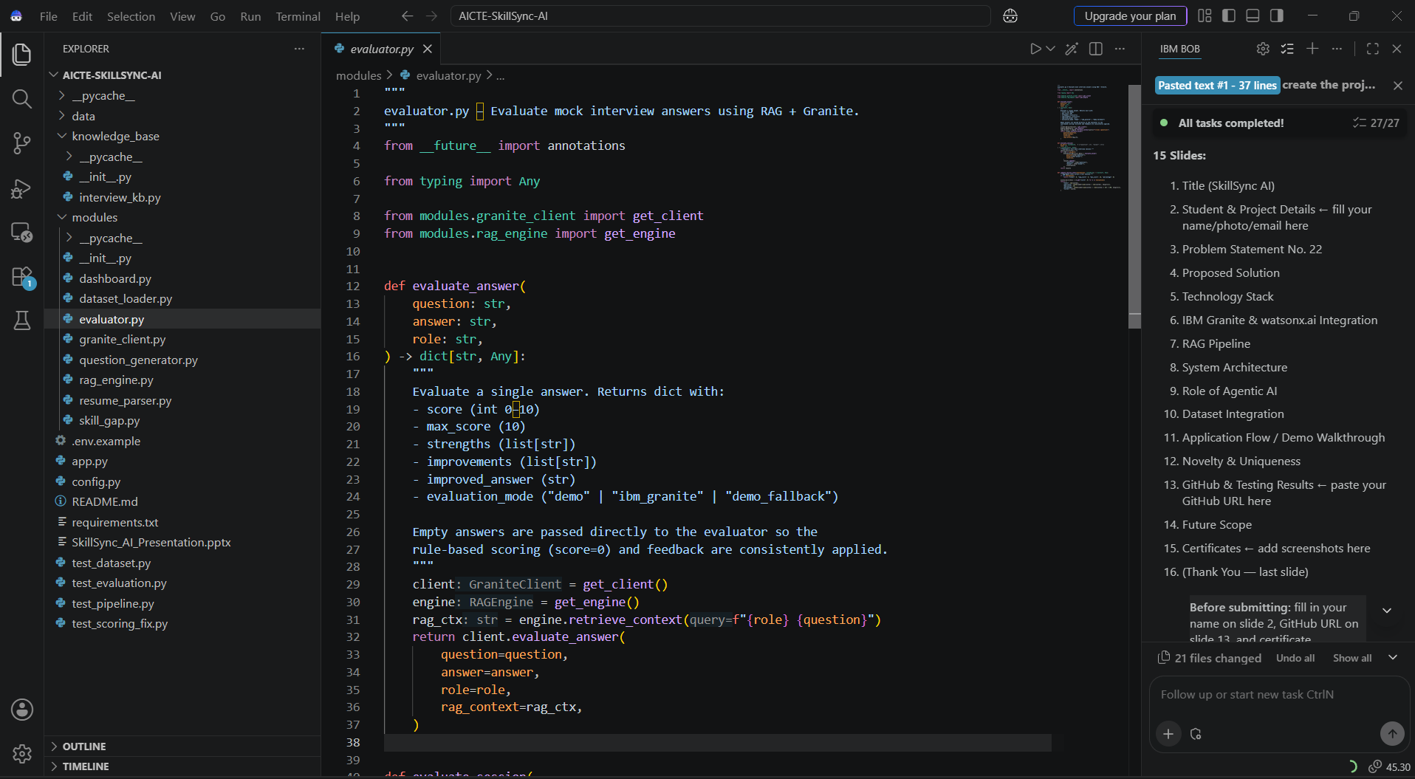
SCREENSHOT – IBM BOB

Slide 14
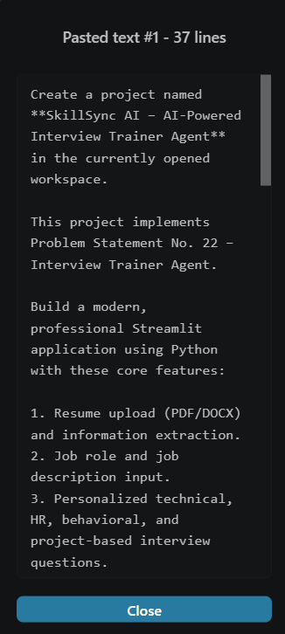
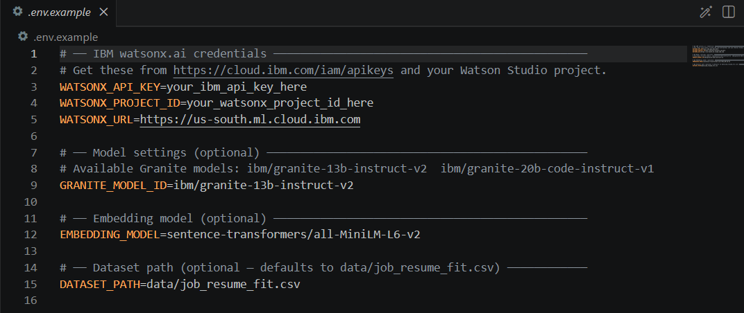
SCREENSHOT – IBM BOB

Slide 15
SkillSync AI | Problem Statement No. 22
Future Scope
1. Voice-Based Mock Interviews
Integrate speech-to-text (Whisper / Google STT) so candidates can speak answers naturally. Evaluate fluency, filler words, and pacing using IBM text-to-speech for a realistic interviewer voice.
2. Multi-Round Interview Simulation
Simulate full loops: screening → technical → system design → HR → negotiation. Track improvement across rounds and provide a final hire/no-hire prediction score.
3. Company-Specific Preparation
Provide company-specific question patterns and culture-fit coaching based on publicly available interview experiences for top companies (Google, Amazon, Infosys, TCS, etc.).
4. Responsible AI & Bias Monitoring
Add AI fairness and bias monitoring via watsonx.governance. Track evaluation consistency across demographics and flag scoring drift over time for responsible AI.
5. Personalized Learning Paths
Connect skill gaps to IBM Skills Build, Coursera, or edX course recommendations with progress tracking. Allow candidates to mark skills as learned and re-test.
6. Multilingual Interview Support
Expand beyond English — support Hindi, Tamil, Spanish using IBM Granite multilingual capabilities. Enable regional job markets and vernacular interview coaching.
Notes:
Future scope builds on IBM watsonx ecosystem. Each item is a realistic extension of the current working MVP.

Slide 16
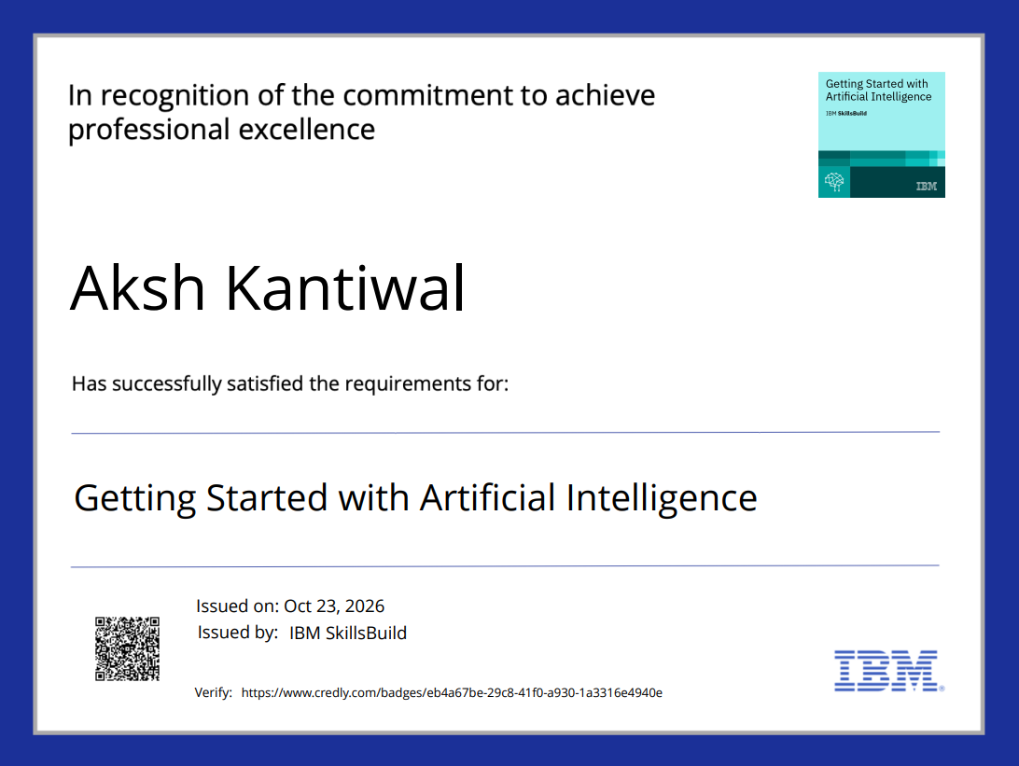
SkillSync AI | Problem Statement No. 22
Certificates Earned
Notes:
Add your IBM Credly badge and IBM Bob AI certificate screenshots before submitting the presentation.

Slide 17
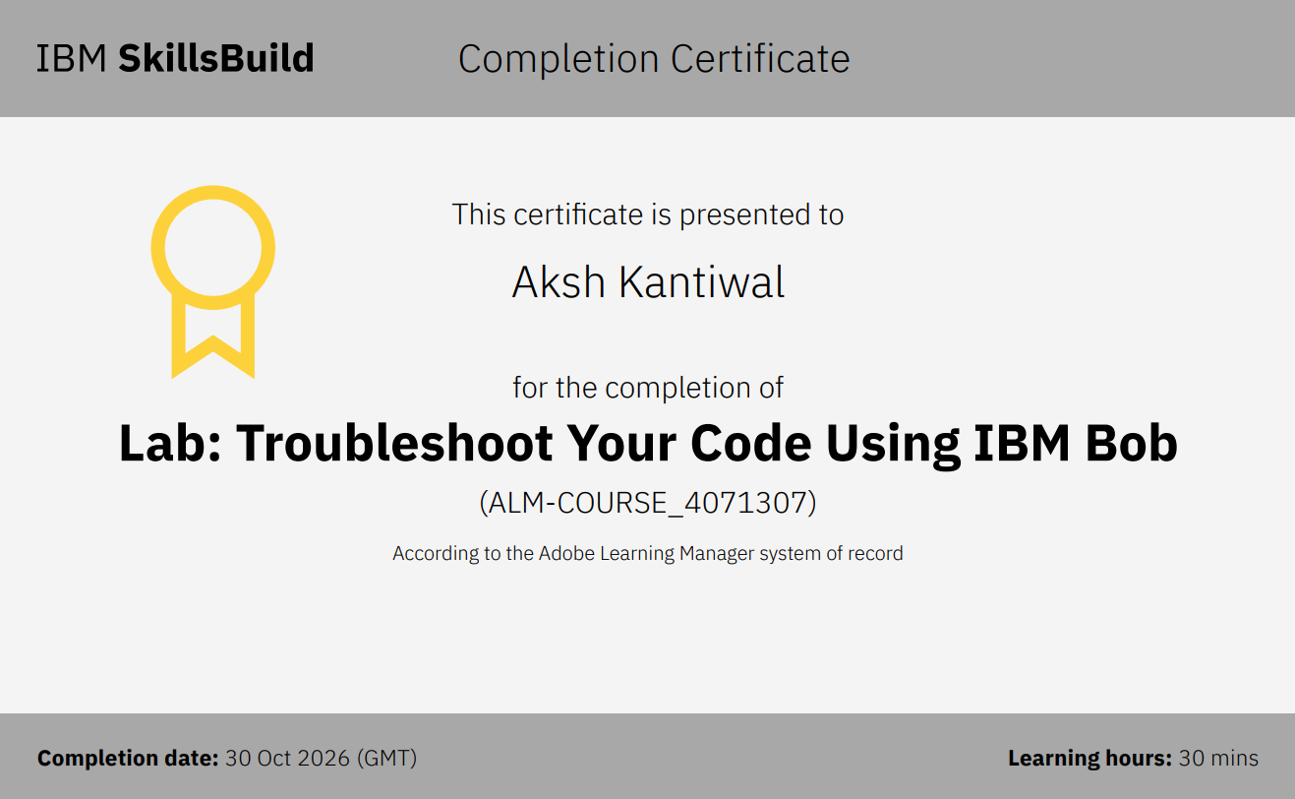
SkillSync AI | Problem Statement No. 22
Certificates Earned
Notes:
Add your IBM Credly badge and IBM Bob AI certificate screenshots before submitting the presentation.

Slide 18
IBM University Engagement | AICTE × IBM Edunet Internship 2024–25
Thank You
SkillSync AI – AI-Powered Interview Trainer Agent
AICTE × IBM Edunet Internship • Problem Statement No. 22 • IBM Granite • watsonx.ai Runtime
Python • Streamlit • FAISS • Pandas • Scikit-learn • PyMuPDF • Plotly
Notes:
Thank you slide. 16 total slides covering all required submission sections.

