Slide 1
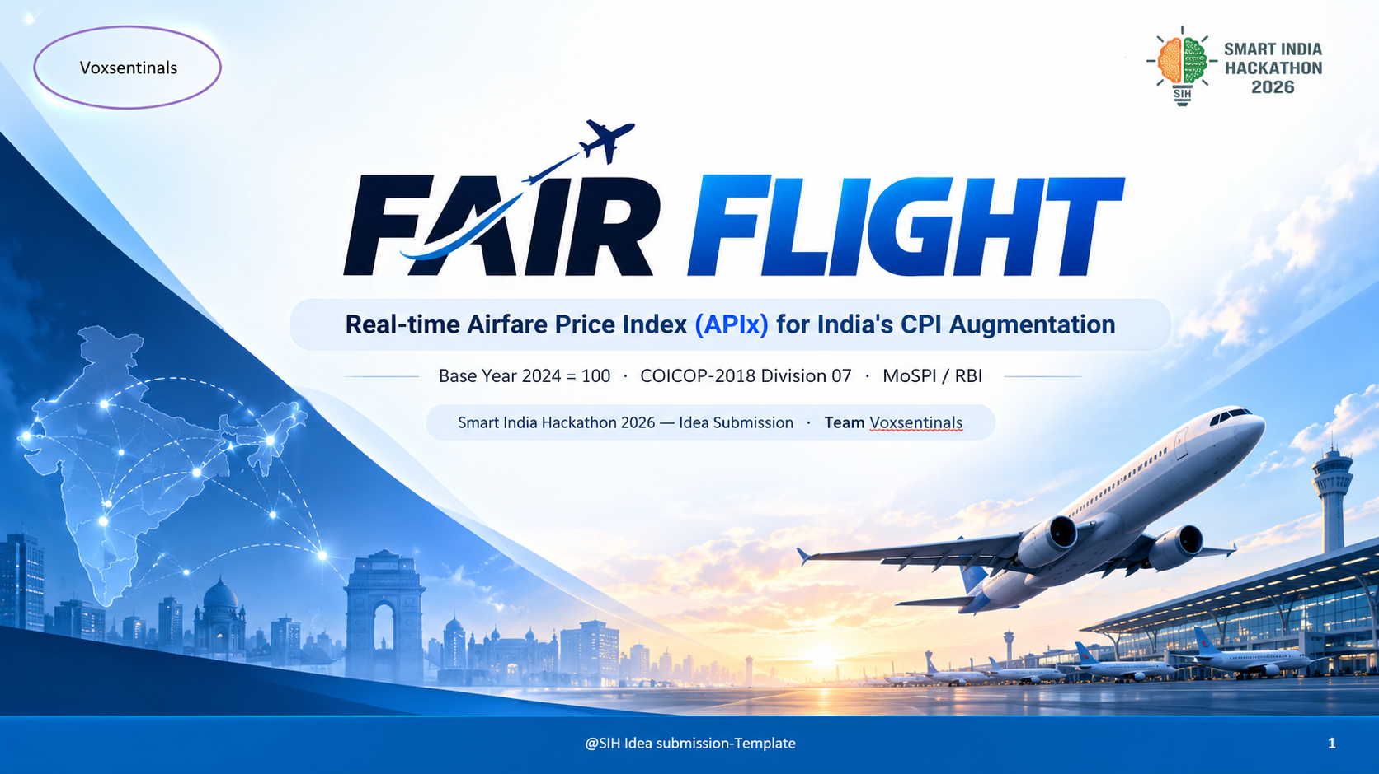

Voxsentinals
FAIR FLIGHT
Real-time Airfare Price Index (APIx) for India's CPI Augmentation
Base Year 2024 = 100 · COICOP-2018 Division 07 · MoSPI / RBI
Smart India Hackathon 2026 — Idea Submission · Team Voxsentinals
@SIH Idea submission- Template
1
Notes:
Cover: team Voxsentinals, SIH 2026. One line: FAIR FLIGHT publishes India's national airfare price index daily, aligned to the new CPI Base Year 2024=100.

Slide 2
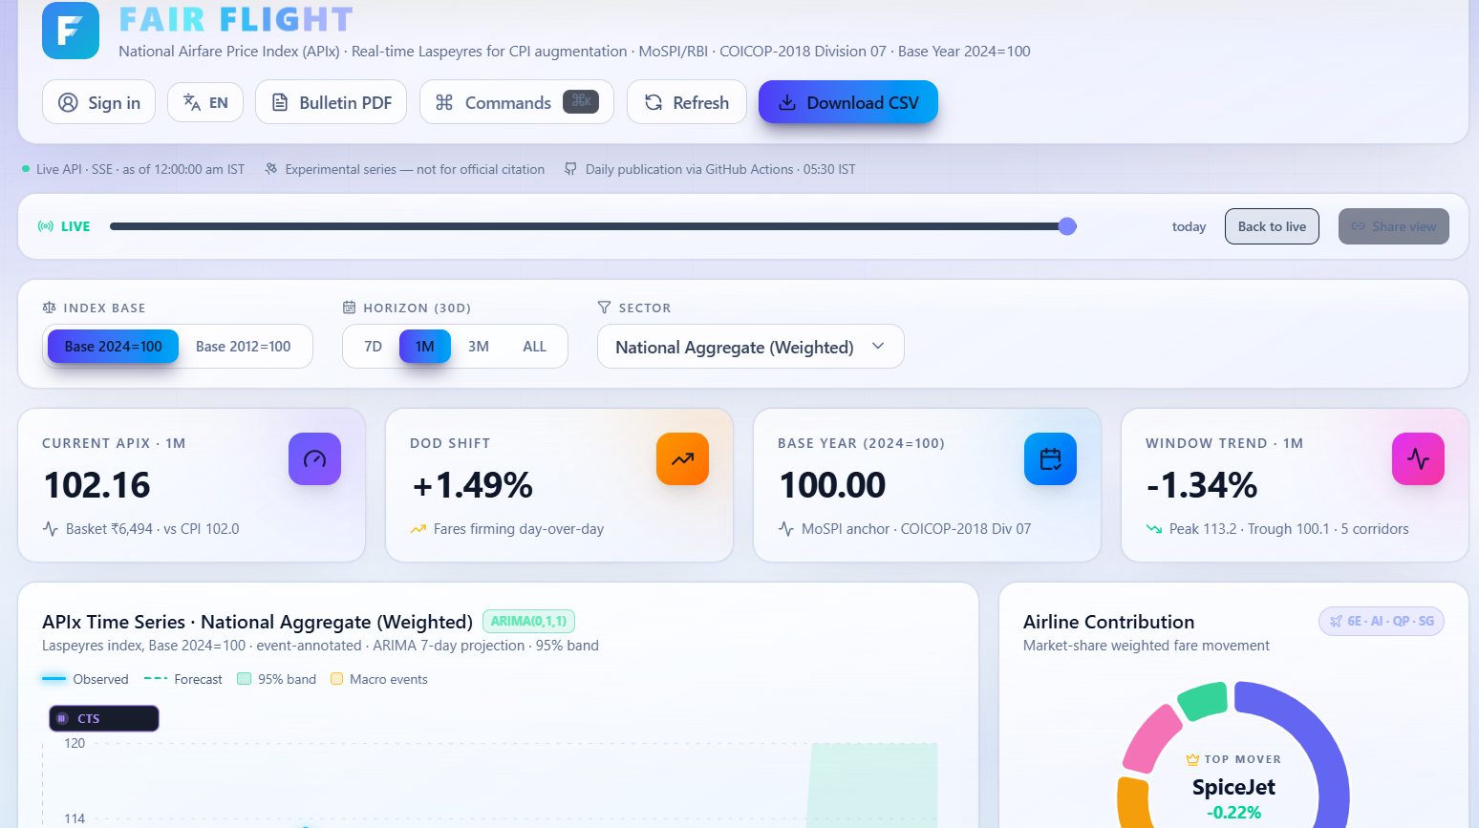
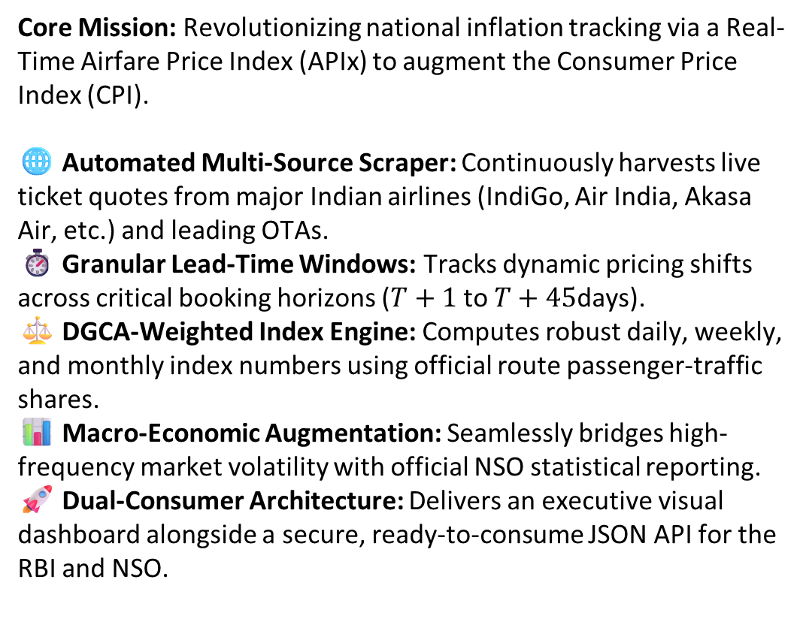
Voxsentinals
❖ Proposed Solution (Describe your Idea/Solution/Prototype)
Core Mission: Revolutionizing national inflation tracking via a Real-Time Airfare Price Index (APIx) to augment the Consumer Price Index (CPI).
🌐 Automated Multi-Source Scraper: Continuously harvests live ticket quotes from major Indian airlines (IndiGo, Air India, Akasa Air, etc.) and leading OTAs.
⏱️ Granular Lead-Time Windows: Tracks dynamic pricing shifts across critical booking horizons ($T+1$ to $T+45$days).
⚖️ DGCA-Weighted Index Engine: Computes robust daily, weekly, and monthly index numbers using official route passenger-traffic shares.
📊 Macro-Economic Augmentation: Seamlessly bridges high-frequency market volatility with official NSO statistical reporting.
🚀 Dual-Consumer Architecture: Delivers an executive visual dashboard alongside a secure, ready-to-consume JSON API for the RBI and NSO.
@SIH Idea submission- Template
2
Notes:
Open with the mandate: CPI 2024=100 / COICOP-2018 requires web-scraped prices for dynamic services; airfares are the textbook case. Then the six content bullets. Close: 'Official CPI tells you what airfares did last month. FAIR FLIGHT tells you what they are doing today — and what they will do next week.'

Slide 3
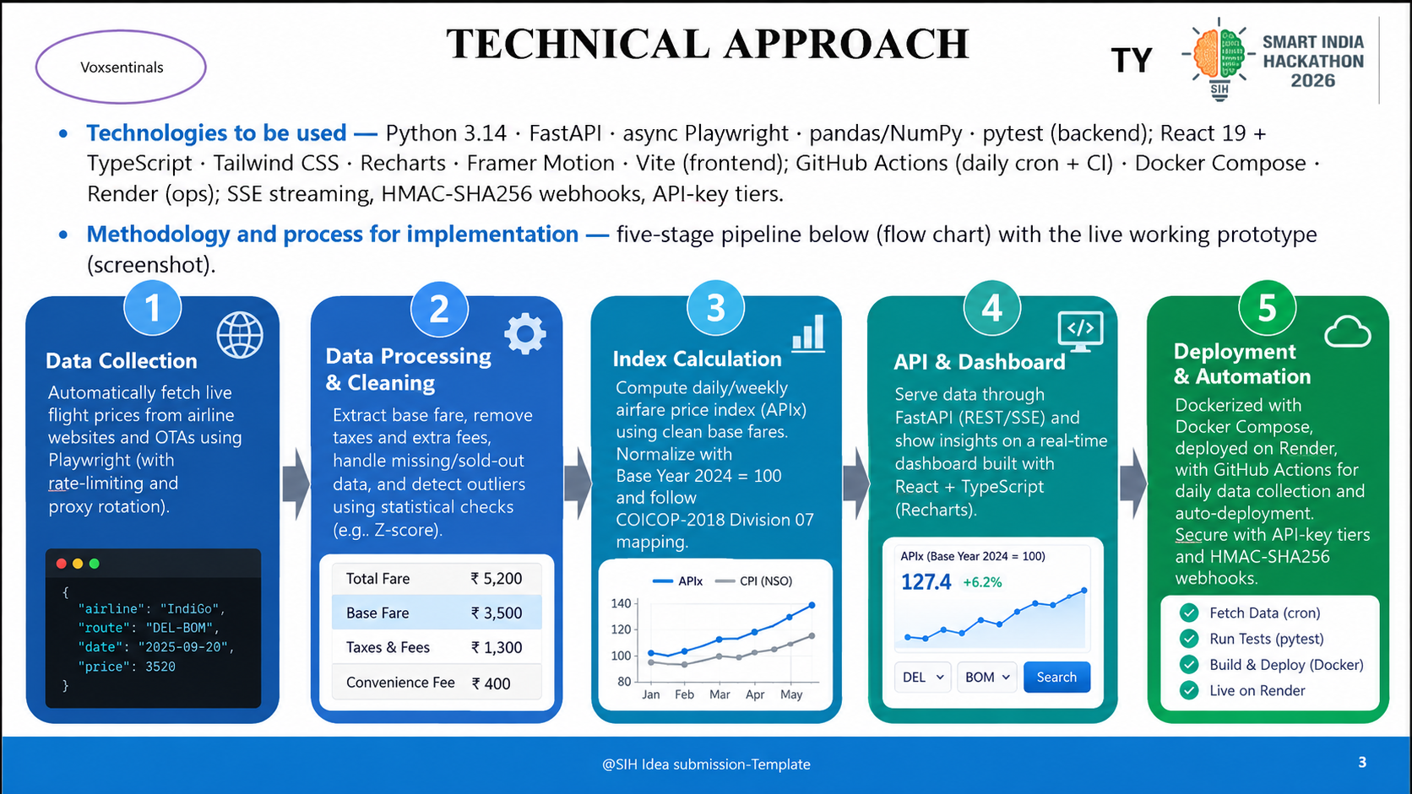
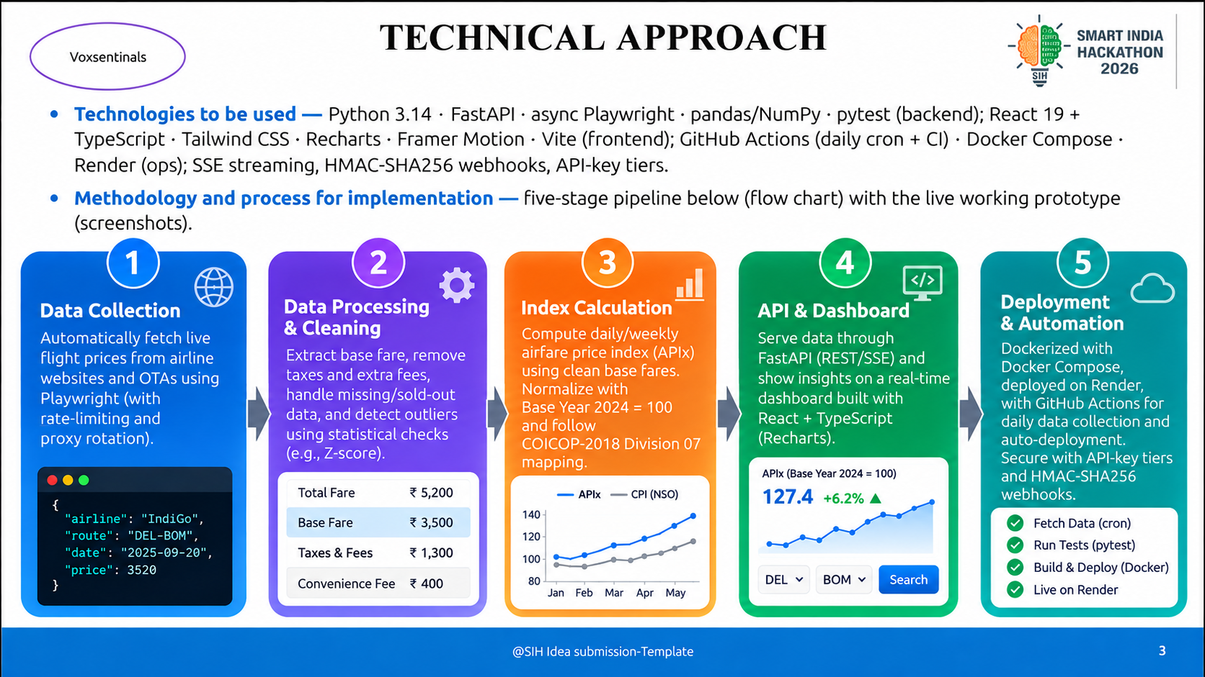

TECHNICAL APPROACH
Voxsentinals
Technologies to be used — Python 3.14 · FastAPI · async Playwright · pandas/NumPy · pytest (backend); React 19 + TypeScript · Tailwind CSS · Recharts · Framer Motion · Vite (frontend); GitHub Actions (daily cron + CI) · Docker Compose · Render (ops); SSE streaming, HMAC-SHA256 webhooks, API-key tiers.
Methodology and process for implementation — five-stage pipeline below (flow chart) with the live working prototype (screenshot).
@SIH Idea submission- Template
3
Notes:
Left-to-right: collect, clean, aggregate, publish, analyse. Emphasise the never-fail scraper and that the screenshot is the live working prototype, not a mock-up.

Slide 4
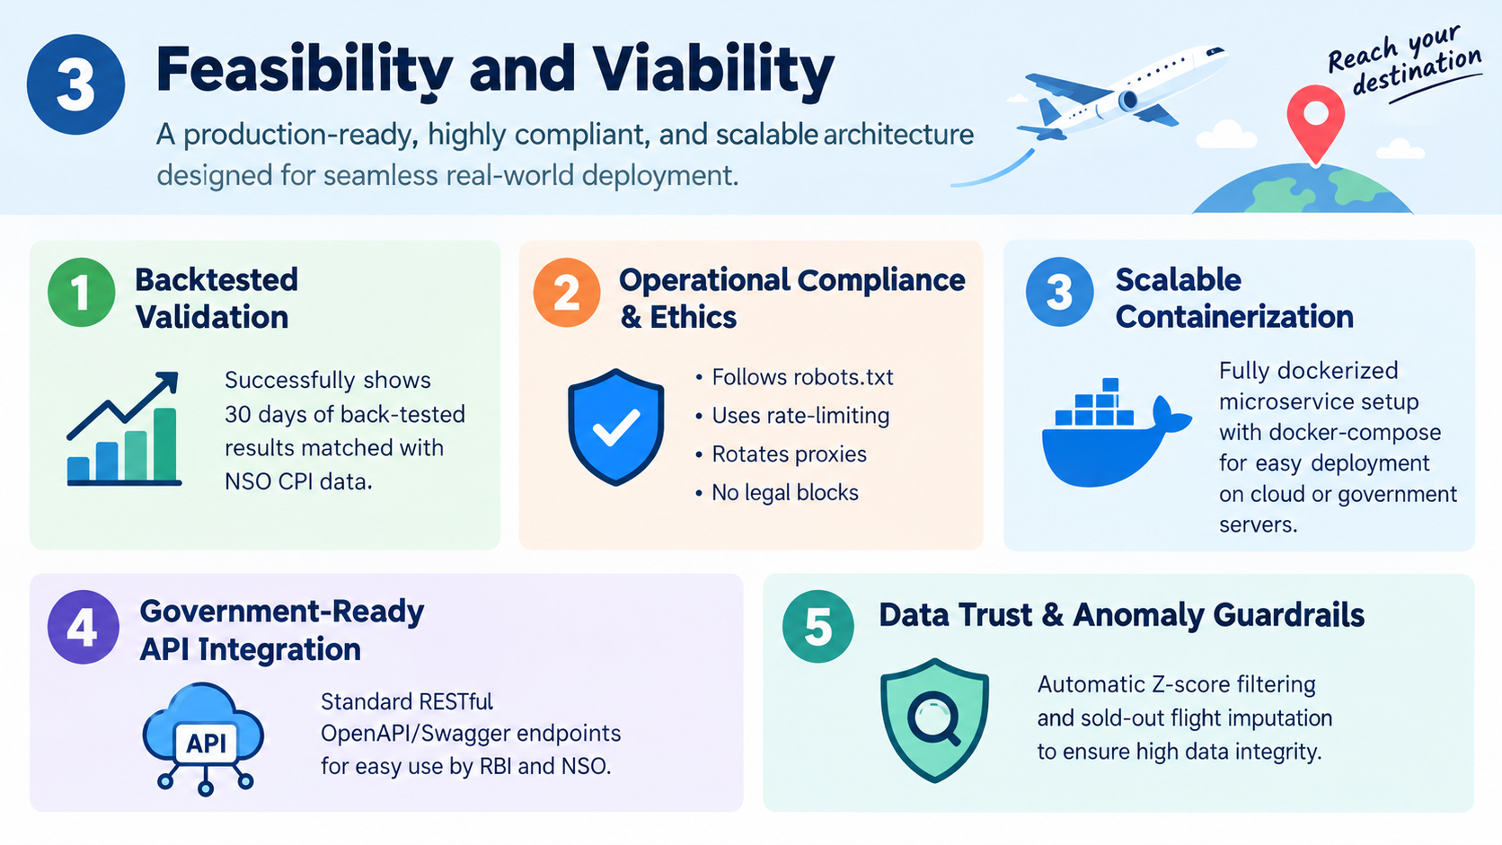
FEASIBILITY AND VIABILITY
Voxsentinals
Here is the creative, concise content and the custom visual graphic for Slide 3: Feasibility and Viability of "Reach your destination".
Slide Content: Feasibility and Viability
Core Takeaway: A production-ready, highly compliant, and scalable architecture designed for seamless real-world deployment.
📈 Empirical Backtested Validation: Successfully demonstrates 30 days of back-tested results mapped against historical National Statistical Office (NSO) CPI baseline data.
🛡️ Operational Compliance & Ethics: Built-in robots.txt awareness, ethical rate-limiting, and proxy rotation to ensure zero disruption or legal blocks.
⚙️ Scalable Containerization: Fully dockerized microservice architecture (docker-compose) for instant, error-free deployment across cloud or government servers.
🔌 Government-Ready API Integration: Standardized RESTful OpenAPI/Swagger endpoints allowing immediate consumption by the RBI and NSO.
🔍 Data Trust & Anomaly Guardrails: Automatic Z-score outlier filtering and sold-out flight imputation to guarantee high data integrity.
@SIH Idea submission- Template
4
Notes:
Feasibility is proven, not promised — demo the live system. Risks are the honest ones (anti-bot, quality, scale); each has a concrete mitigation already implemented.

Slide 5
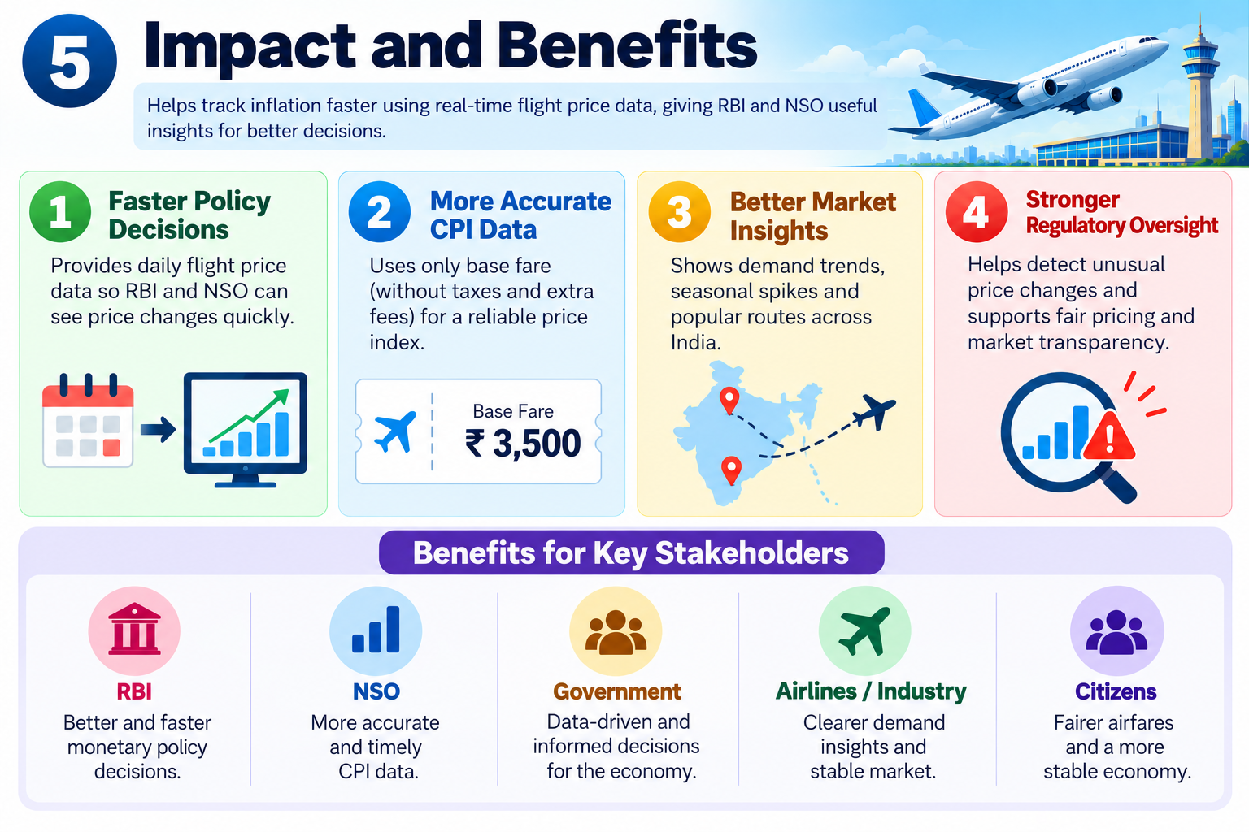
IMPACT AND BENEFITS
Voxsentinals
Core Takeaway: Transforming national inflation tracking by replacing delayed retrospective data with real-time, actionable aviation market intelligence.
⚡ Real-Time Policy Visibility: Eliminates reporting lag by providing the RBI and NSO with daily, high-frequency visibility into sectoral price pressures.
📊 Independent CPI Augmentation: Isolates pure base fares from volatile statutory taxes and convenience fees to ensure precise national index benchmarking.
🗺️ Granular Market Intelligence: Uncovers seasonal demand spikes, lead-time elasticity shifts, and capacity constraints across India's busiest aviation corridors.
🛡️ Enhanced Regulatory Oversight: Equips authorities with transparent, data-driven tools to monitor pricing caps, anomalies, and market fairness proactively.
@SIH Idea submission- Template
5
Notes:
Lead with the policymaker impact, then the quantified economic benefit (0.61 % basket weight, +2.3 bps demo), then social/institutional and environmental benefits.

Slide 6
RESEARCH AND REFERENCES
Voxsentinals
Details / Links of the reference and research work —
MoSPI — CPI Base Year 2024=100 revision & COICOP-2018 adoption — mospi.gov.in
UN Statistics Division — COICOP-2018 classification (07.3.1.2 Passenger transport by air) — unstats.un.org
e-Sankhyiki portal — API conventions mirrored by the project's endpoints — esankhyiki.mospi.gov.in
DGCA — domestic sector traffic data used for route weights — dgca.gov.in
PPAC — ATF price series feeding the policy simulator — ppac.org.in
CPI Manual (ILO / IMF / OECD / UN / World Bank) — Laspeyres index methodology
Box & Jenkins — ARIMA time-series modelling; walk-forward validation literature
Stack documentation — FastAPI · Playwright · React · Recharts · Tailwind CSS (official docs)
Project artifacts — docs/architecture.svg · docs/screenshots/ · DEPLOY.md · DEMO_SCRIPT.md (in repository)
@SIH Idea submission- Template
6
Notes:
All primary sources are official and public — the methodology is standard NSO practice (Laspeyres, COICOP) applied to a new high-frequency data channel.

