Slide 1
Explainable and Drift-Aware Predictive Maintenance for IoT-Monitored Industrial Equipment
A machine learning study on the NASA C-MAPSS turbofan engine dataset
Course: Data Science (Prof. Simeon)
Group 2
Presenters: Shrestha Akshovya & Nguyen Thien Phu
Notes:
Hello, everyone. Our project is called Explainable and Drift-Aware Predictive Maintenance for IoT-Monitored Industrial Equipment. It is about predicting when a machine will break, before it actually happens. We use sensor readings to warn early, explain why the warning was raised, and stay accurate even when operating conditions change.

Slide 2
The problem and our goals
Approach | Idea
Reactive | Fix the machine after it breaks.
Scheduled | Service it at fixed times, even if it is fine.
Predictive | Use sensor data and act only when needed. This is our approach.
Our goals
1. Predict. Warn when an engine will fail within 30 cycles.
2. Explain. Show which sensors caused each alert.
3. Adapt. Keep working when operating conditions change.
Why it matters. Fixing too late causes breakdowns. Servicing too early wastes money.
Cycle. One run of the engine. We count time in cycles.
Notes:
There are three ways to look after a machine. We can fix it after it breaks. We can service it on a schedule. Or we can service it when the data says it is needed, which is our approach. Our goals are to warn about a failure up to 30 cycles ahead, explain each warning, and keep working when conditions change. A cycle is one run of the engine.

Slide 3
The dataset: NASA C-MAPSS
Subset | Training engines | Training rows | Operating conditions
FD001 | 100 | 20,631 | 1
FD002 | 260 | 53,759 | 6
What it is. A public NASA benchmark. Each row is one engine at one cycle, with 3 operating settings and 21 sensor readings.
Run to failure. Every training engine runs until it fails, so we always know how many cycles it had left.
What we kept. 14 of the 21 sensors. The other 7 never change, so they tell us nothing.
How we use it. FD001 is the main data. FD002 has six operating conditions and tests drift.
Important. This is simulated engine data used as a stand-in. Results show the method, not real power grid performance.
Notes:
We use NASA's engine dataset, a widely used public benchmark for predictive maintenance research. Every engine runs until it fails, so we know how much life it had left. Each record has 3 operating settings and 21 sensor readings, and we keep the 14 sensors that actually change. It has one operating condition for our main test and six for testing change.

Slide 4
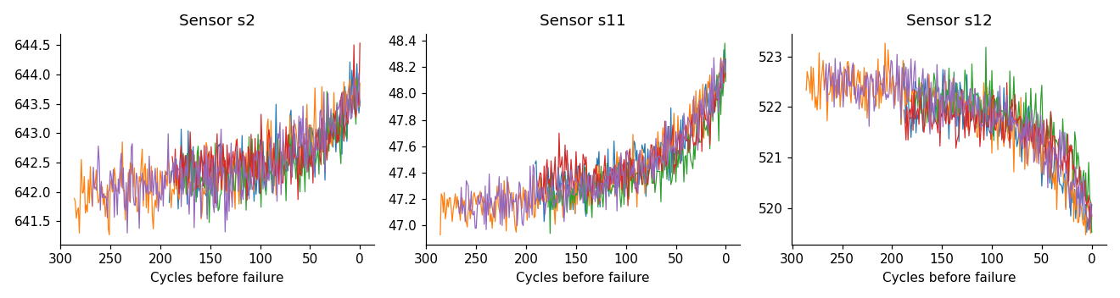
Sensors change before failure
Sensors 2, 11 and 12 for five engines. Time runs left to right, towards failure.
What we see. Each sensor drifts steadily as failure gets closer.
Why it matters. A steady drift is a pattern a model can learn, so early warning is possible.
Challenge. The readings are noisy, so we smooth them before modelling.
Notes:
This chart shows three sensors for five engines. Time runs from left to right, towards failure. The readings move steadily up or down as the engine gets closer to failing. That steady pattern is what the model learns from. The readings are also noisy, so we smooth them with a short average before modelling.

Slide 5
What we predict and what the model sees
The question
The inputs: 43 per cycle
Will this engine fail in the next 30 cycles? Yes means an alert (label 1).
Alerts are rare. Only 15% of cycles are alerts. A model that never alerts would still be 85% right, so plain accuracy is misleading.
Remaining useful life. The number of cycles left before failure.
Current reading of each of the 14 sensors.
10-cycle average of each sensor, to smooth out noise.
10-cycle change of each sensor, to show the trend.
Engine age in cycles.
No peeking. Sensors are scaled using training data only, and every input uses past data only.
Notes:
We turn this into one yes or no question: will this engine fail in the next 30 cycles? If yes, that cycle is an alert. For each cycle, the model sees the current sensor readings, their recent average and trend, and the engine's age.

Slide 6
How we tested
Test | How it works | Why
Held-out engines | 70 engines to train, 15 to tune, 15 to test. | Tests on engines the model never saw.
Cross-validation | Repeat the test 5 times with different engines. | More reliable with few engines.
NASA official test | NASA's own 100 test engines. | An independent check.
Split by engine. Cycles from the same engine look almost identical. Mixing them between training and testing would give fake high scores.
Alert threshold. We pick the score at which an alert is raised using the tuning engines, then keep it fixed for the final test.
Notes:
We tested in three ways. First, on 15 engines the model never saw. Second, by repeating the test five times with different engines, which is more reliable when you have few engines. Third, on NASA's own test engines. Each engine is used either for training or for testing, never both, because its cycles look almost the same. We also fixed the alert threshold before the final test.

Slide 7
Methods compared and key terms
Method | Idea
Age rule | Alert when the engine is old. Like scheduled service.
Sensor rule | Alert when one key sensor is high.
Logistic Regression | A simple model that draws one straight boundary.
Random Forest | Many decision trees that vote together.
XGBoost | Trees that fix each other's mistakes.
Key terms
Precision. Of our alerts, how many were right.
Recall. Of the real failures, how many we caught.
PR-AUC. An overall score that combines the two. Higher is better. A random guess scores 0.15.
Cost. 10 per missed alert plus 1 per false alarm. This is our assumption.
Notes:
We compare five methods. Two are simple rules: one alerts when the engine is old, like scheduled service, and one alerts when a single key sensor is high. Three are machine learning models. Precision is how many of our alerts were right. Recall is how many real failures we caught. PR-AUC combines both into one score, and higher is better. A random guess scores about 0.15.

Slide 8
Results: machine learning beats the rules
Machine learning wins. 0.94 to 0.96, against 0.88 to 0.91 for the sensor rule and 0.53 to 0.71 for the age rule.
Simple is enough. Logistic Regression is as good as XGBoost.
Stable. Cross-validation gives the same ranking. A random guess scores 0.15.
Notes:
Higher is better. The three machine learning models score about 0.94 to 0.96. The best single-sensor rule scores about 0.88 to 0.91, and the age rule scores much less, between 0.53 and 0.71. A simple model, Logistic Regression, does as well as the complex ones, so extra complexity adds little. Repeating the test gave the same ranking, so the result is stable.

Slide 9
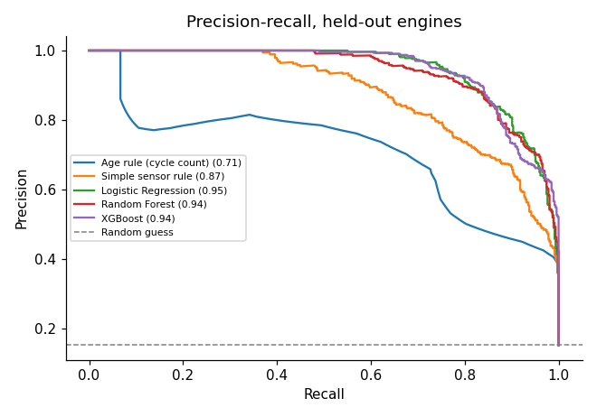
Precision and recall, and NASA's test
How to read it. Each point is a different alert threshold. Further up and to the right is better.
What we see. The machine learning curves stay highest. The age rule is lowest.
NASA's official test. Same ranking: 0.94 to 0.95 for machine learning, 0.89 for the sensor rule and 0.51 for the age rule.
Held-out engines. The legend shows each score.
Notes:
On this chart, each point is a different alert threshold. Higher means fewer false alarms, and further right means more failures caught. So further up and to the right is better. The machine learning lines are the highest, and the age rule is the lowest. We also checked NASA's own test engines, and the ranking was the same.

Slide 10
Alerts, false alarms and cost
Method | Precision | Recall | False alarms | Missed | Cost
Age rule | 0.57 | 0.75 | 260 | 117 | 1,430
Sensor rule | 0.71 | 0.83 | 159 | 79 | 949
Logistic Regression | 0.75 | 0.93 | 147 | 34 | 487
Random Forest | 0.63 | 0.97 | 270 | 13 | 400
XGBoost | 0.64 | 0.97 | 257 | 14 | 397
No model | n/a | 0.00 | 0 | 465 | 4,650
Early warning. XGBoost's first alert came a median of 35 cycles before failure (range 22 to 113). All 15 test engines were warned.
How to read. Counts are per cycle on 15 test engines (465 alert cycles). Cost = 10 per missed alert + 1 per false alarm (our assumption).
Takeaway. XGBoost's cost is under a third of the age rule's.
Notes:
This table shows what the team would experience. The best model, XGBoost, caught 97 percent of the failing cycles and missed only 14 out of 465, with some false alarms. Its first warning came about 35 cycles before failure, and every test engine was warned. Using our assumed costs, ten for a miss and one for a false alarm, its total cost is under a third of the age rule's.

Slide 11
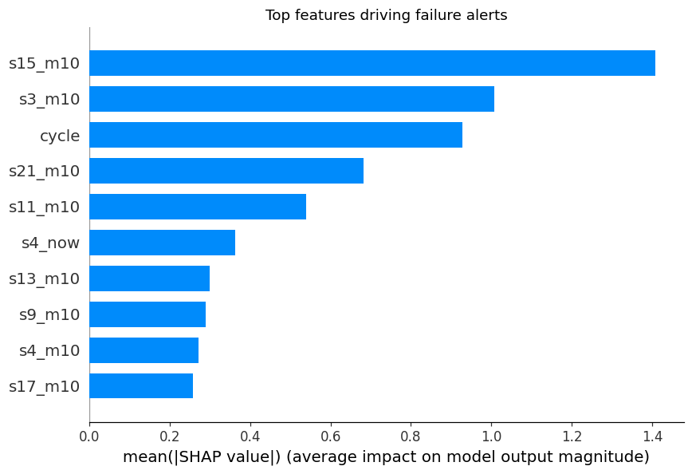
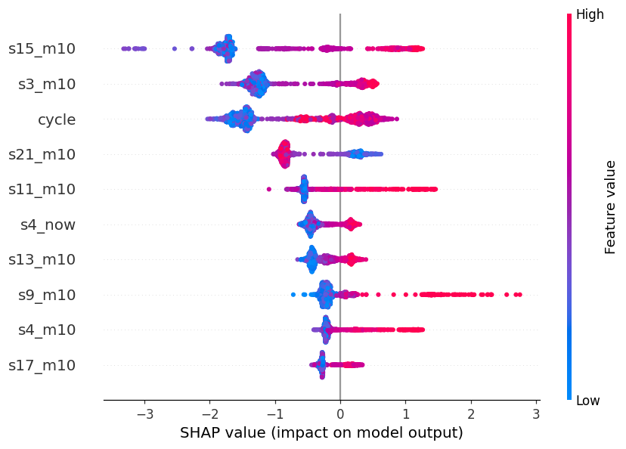
Explaining the alerts
What matters most. SHAP shows what pushed each prediction. The 10-cycle averages of sensors 15, 3, 21 and 11, and engine age, matter most.
Which way. Dots to the right raise the risk, and high values usually do. Example: engine 13, cycle 162, risk 1.00, one cycle before failure.
Notes:
This shows why the model raised an alert. The left chart shows which inputs matter most: the averages of sensors 15, 3, 21 and 11, and the engine's age. On the right, each dot is one cycle. Dots to the right mean higher risk, and high sensor values usually raise it. For example, engine 13 got a risk of about 1.00, one cycle before it failed.

Slide 12
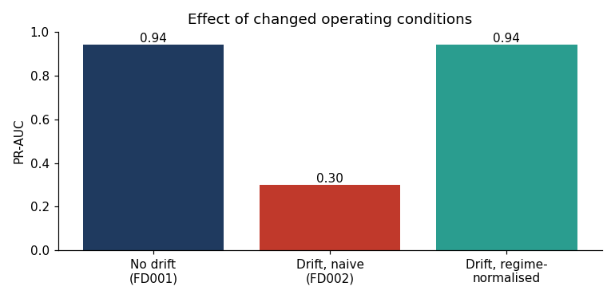
Drift: when conditions change
FD001 model, tested on all 260 FD002 engines.
Drift. The data changes after deployment. FD002 has six operating conditions instead of one, so sensors shift even for healthy engines (shift score 0.80 out of 1).
Damage. Recall fell to 0.04, so the FD001 model almost never raised an alert.
Fix. Scale each condition separately. The shift falls to 0.04 and PR-AUC returns to 0.94 without retraining. Retraining gives 0.96.
Notes:
Drift means the data changes after the model is deployed. When we moved to engines with six operating conditions, the sensor readings shifted, even for healthy engines. The model almost stopped raising alerts, and its recall fell to 0.04. We fixed this by grouping the data into the six conditions and scaling each one separately. The score went back to 0.94 without retraining, and retraining gave 0.96.

Slide 13
Findings and conclusion
1. Machine learning beats the rules. Scores of 0.94 to 0.96, against 0.88 to 0.91 for the best sensor rule.
2. Warnings come early and cost less. A median of 35 cycles of warning, at under a third of the age rule's cost.
3. Simple models are enough. Logistic Regression matched XGBoost.
4. Alerts can be explained. Sensors 15, 3, 21, 11 and engine age drive the predictions.
5. Drift is large but fixable. Recall fell to 0.04 under new conditions and returned to 0.94 after scaling each condition separately.
Predictions guide inspections. Engineers make the final decision.
Notes:
To summarise. Machine learning beat the simple rules. Warnings came early, a median of 35 cycles ahead, and cost less. A simple model was enough. We can explain each alert. And drift was large but fixable. Predictions guide inspections, and engineers make the final decision.

Slide 14
Limitations and next steps
Limitations
Next steps
Simulated data. These are engines, not grid equipment.
Small test. Only 15 held-out engines in the main test.
Assumptions. The 30-cycle window and the cost ratio are our choices.
Scope. One kind of drift and no LSTM.
Real data. Repeat this on real transformer sensor data.
LSTM. Compare a sequence model.
Drift check. Run it automatically and flag when to retrain.
Experts. Set the window and costs with maintenance engineers.
Notes:
Our limits: the data is simulated, only 15 engines were held out for the main test, and some settings, like the 30-cycle window and the costs, are our assumptions. Next, we want to try real transformer data and an LSTM, run the drift check automatically, and set the warning window with maintenance engineers. Thank you.

