Slide 1

Autoscaling
Akshat gupta

Slide 2
AutoScaling in AWS
AWS Auto Scaling monitors your applications and automatically adjusts capacity to maintain steady, predictable performance at the lowest possible cost. Using AWS Auto Scaling, it’s easy to setup application scaling for multiple resources across multiple services in minutes.

Slide 3
Benefits of Auto Scaling
Auto Scaling your application leads to the following benefits:
Better fault tolerance
High availability of resources
Better cost management
High reliability of resources
The high flexibility of resources

Slide 4
Snapshots vs. AMI
AWS provides a data storage service along with the Amazon EC2 instance, namely, Elastic Block Store (EBS)
EBS has Snapshots for data storage, whereas AMI is primarily associated with aws ec2. Now, let’s take a look at the following table to understand how snapshots are different from AMIs.

Slide 5
Snapshots | AMI
It is used as a backup of a single EBS volume attached to the EC2 instance | It is used as a backup of an EC2 instance
Opt for this when the instance contains multiple static EBS volumes | This is widely used to replace a failed EC2 instance
Here, pay only for the storage of the modified data | Here, pay only for the storage that you use
It is a non-bootable image on EBS volume | It is a bootable image on an EC2 instance

Slide 6
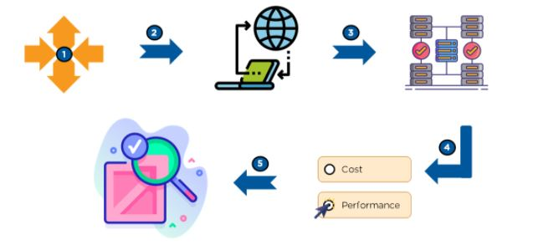
How Does AWS Auto Scaling work?

Slide 7
Configure a single unified scaling policy per application source.
Explore the application and create a system that adds and removes EC2 instances in response to the requirement.
Choose the service that you want to scale up or down.
Select what to optimize. Based on a schedule, scale your application in response to predictable load changes.
Keep tracing the scaling load and maintain a steady count of instances.

Slide 8
What Are the Different Scaling Plans?
A scaling plan helps a user to configure a set of instructions for scaling based on software requirements.
Scaling strategy guides the service of AWS Auto Scaling on how to optimize resources in an application.
With a scaling strategy, users can create their own strategy based on the required metrics and thresholds.

Slide 9
Types of Scaling Plans
Manual scaling - This scaling helps in managing the task of building or terminating EC2 instances on its own.
Scaling based on a schedule - Developers can predict future traffic and can schedule the time for executing AWS Auto Scaling.
Scaling based on demand - This scaling lets developers define required scaling in response to client demand.
Maintaining the current instance-level - Developers configure an Auto Scaling group for managing running instances.

Slide 10
Lets check the LAB

Slide 11
Check the userguide :
https://docs.aws.amazon.com/autoscaling/ec2/userguide/GettingStartedTutorial.html
Lets check this practically on the lab

