Slide 1

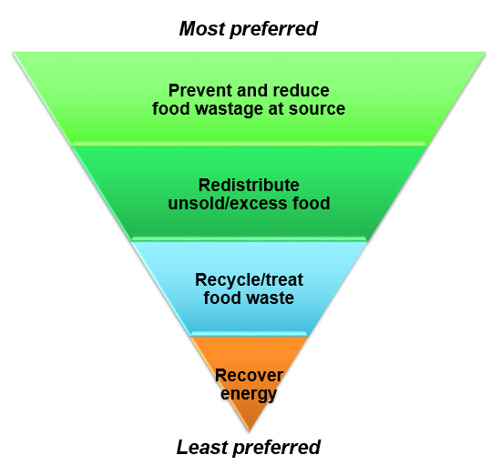






Current Solutions
Outreach Programmes
Education
Largely ineffective
Food sharing
Food bank
Donations
Onsite waste treatment
Composting
Biogas
Landfill
Incineration
Worst case scenario
Source: National Environmental Agency
Notes:
Thousands of people in the UK are increasingly reliant on food banks, the use of which has increased fourfold since 2012. Yet UK households threw away 7.3m tonnes of food in 2015, according to the environment, food and rural affairs committee.
Tesco uses an app, FoodCloud, developed by two Trinity College Dublin graduates, to itemise the surplus food in each store at the end of the day. This information is then shared with local charities that collect the food.

