Slide 1


DOCVERIFY
AI-BASED IDENTITY DOCUMENT
FORGERY DETECTION
Project / Idea: DocVerify — AI-Based Identity Document Forgery Detection Problem Statement ID: 26188 Problem Statement Title: AI-Based Fake Identity & Document Screening System Organization: Ministry of Home Affairs Department: Sashastra Seema Bal (SSB), Police II Division Category: Software Theme: Blockchain & Cybersecurity Team ID: Team Name: Hexa Tree
Notes:
Source: project master presentation and implemented prototype details from the project discussion.

Slide 2
DOCVERIFY — EXPLAINABLE DOCUMENT SCREENING
DocVerify
AI-assisted screening for Aadhaar and passport images, with document-specific checks, field localization, forensic signals, and human-readable reasons for review.
1
UPLOAD
2
CLASSIFY
3
ANALYZE
4
FORENSICS
5
ASSESS
JPG / PNG
→
Aadhaar / Passport
→
OCR + validation
→
ELA + copy-move + metadata
→
Forgery class + decision
HOW IT ADDRESSES THE PROBLEM
INNOVATION & UNIQUENESS
• Screens document images before manual review.
• Combines document-specific checks with image forensics.
• Localizes key fields and exposes confidence/evidence for review.
• Produces a recommended next step rather than only a binary result.
• One layered pipeline connects classification → document analysis → forensics → decision.
• Six classes: genuine, splice, retype, recompress, copy-move, double-compress.
• Evidence-oriented output combines field confidence, forensic signals and reasons.
• Modular design allows additional document types and forensic models.
Notes:
Source: project master presentation and implemented prototype details from the project discussion.

Slide 3
TECHNICAL APPROACH
DocVerify
END-TO-END ANALYSIS PIPELINE
Input
Document Classifier
Document Analysis
Forensics
Forgery Model
Decision
→
→
→
→
→
Document image
ResNet18
YOLOv8n + OCR Passport MRZ validation
ELA • Copy-Move • Metadata Image Quality • Compression
Random Forest 6 classes
Genuine / Suspicious / Likely Forged + reasons
AI / CV
OCR / Validation
Forensic Analysis
Backend / Integration
PyTorch • TorchVision Ultralytics YOLOv8n OpenCV
Tesseract / pytesseract Regex + field checks Passport MRZ checksum
PIL / OpenCV ELA • feature matching EXIF + image quality
Python + FastAPI JSON response to React UI Local end-to-end flow
Controlled prototype results: document classifier 99.72%; forgery classifier 91.67% on a controlled synthetic dataset.
Prototype/test-set metrics only; they do not represent real-world or forensic certification. Model confidence is predicted-class confidence, not probability of forgery.
Notes:
Source: project master presentation and implemented prototype details from the project discussion.

Slide 4
FEASIBILITY AND VIABILITY
DocVerify
FEASIBLE MVP
KEY CHALLENGES
MITIGATION
• React upload UI and FastAPI backend communicate through /api/analyze.
• Modular Python inference pipeline processes JPG/PNG.
• Aadhaar and passport branches run document-specific checks.
• Results page renders classifier, forensic and decision outputs.
• OCR can fail or slow down on blur, tilt and low-quality photos.
• Global ELA/compression artifacts can create false positives.
• Copy-move analysis needs stronger independent validation.
• Development data remains small and controlled.
• Expose confidence and request clearer images when needed.
• Treat forensic features as supporting signals, not proof.
• Route uncertain cases to human review.
• Expand permitted independent evaluation data and calibrate thresholds.
Current stage: local React + FastAPI prototype.
Next: secure storage, observability, queues and authorized integrations.
Notes:
Source: project master presentation and implemented prototype details from the project discussion.

Slide 5
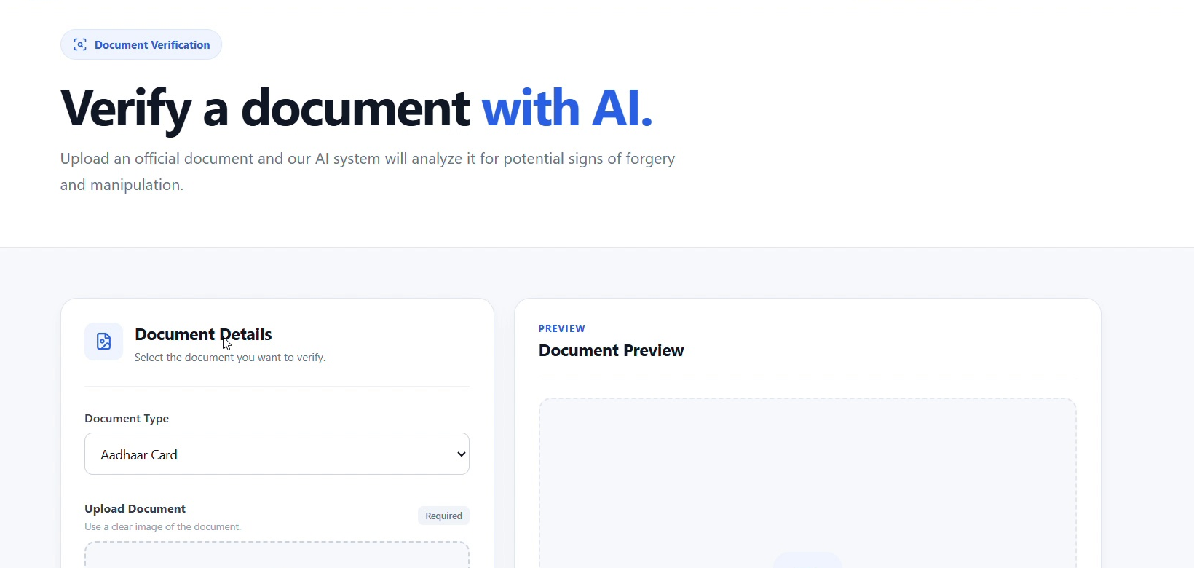
IMPACT AND HUMAN REVIEW
DocVerify
TARGET USERS & BENEFITS
• KYC and banking: first-level screening support.
• Border, airport and hospitality: faster document triage.
• Investigators and reviewers: visible forensic evidence and reasons.
• Organizations: API-ready integration path.
UPLOAD → ANALYZE → REVIEW
DESIGNED FOR HUMAN-IN-THE-LOOP REVIEW
DocVerify presents signals, field evidence and recommendations.
An authorized reviewer makes the final decision.
Notes:
Source: project master presentation and implemented prototype details from the project discussion.

Slide 6
RESEARCH AND REFERENCES
DocVerify
TECHNICAL REFERENCES
PROTOTYPE EVIDENCE
• ICAO Doc 9303 — Machine Readable Travel Documents (passport MRZ standard).
• MIDV-500 / MIDV-2020 — mock identity-document research datasets.
• Ultralytics YOLO — Aadhaar field-detection framework.
• OpenCV — image processing and feature analysis.
• FastAPI — local API layer between React and the Python pipeline.
• Tesseract OCR — text extraction and field recognition.
• ResNet18 classifier: Aadhaar / Passport.
• Controlled test: 355 images; 99.72% accuracy.
• Random Forest: 12 handcrafted forensic features.
• Controlled forgery data: 480 usable images across 6 classes.
• Controlled test: 96 images; 91.67% accuracy.
• Classes: genuine, splice, retype, recompress, copy-move, double-compress.
Notes:
Source: project master presentation and implemented prototype details from the project discussion.

