Slide 1
IBM University Engagement Project Submission
“Exploring the Power of Agentic AI with IBM Granite and LangFlow”

Slide 2

Project Tile – LearnMate: Personalized Course Pathways Agent
Domain of Project – Education
Student Name | Recent Passport Photo | Email ID | Mobile number [WhatsApp]
Akshya Anand |  | akshyaanand07@gmail.com | 9496414100

Slide 3
Problem Statement -
Problem Statement : LearnMate: Personalized Course Pathways Agent
The Challenge
Students often struggle to identify the right learning path that aligns with their interests, current skill level, and long-term career goals. With thousands of online courses, certifications, and learning resources available, learners frequently experience confusion, lack of direction, and inconsistent progress.
Traditional academic guidance is often generalized and cannot provide personalized recommendations for every student. As a result, students may spend significant time on irrelevant courses or fail to build the skills required for their desired careers.
Without personalized and adaptive learning guidance, students face difficulties in selecting the right courses, tracking progress, and achieving career objectives efficiently.
The Objective
Build an AI-powered Personalized Course Pathways Agent that provides customized learning roadmaps and career-oriented guidance for students. The solution should:
• Profile Analysis – Understand student interests, educational background, career goals, and learning preferences.
• Skill Assessment – Evaluate current knowledge levels and identify skill gaps.
• Personalized Learning Roadmaps – Generate structured learning pathways tailored to student goals.
• Learning Resource Retrieval (RAG) – Retrieve and recommend relevant courses, documentation, tutorials, and practice platforms from trusted educational resources.
• Progress Guidance – Suggest milestones, projects, and certifications for continuous learning.
• Multi-Agent System
Profile Analysis Agent (collects learner information)
Skill Assessment Agent (evaluates current proficiency)
Roadmap Generation Agent (creates personalized learning pathways)
Learning Resource Agent (recommends courses and resources)
• Learning Dashboard – Display recommended roadmap stages, completed milestones, skill progress, and future learning objectives.

Slide 4
Technology Used
I used LangFlow + IBM watsonx.ai + IBM Granite Models

Slide 5
Proposed Solution -
LearnMate – AI-Powered Personalized Course Pathways Agent
The proposed solution is LearnMate, a multi-agent AI-powered Personalized Course Pathways Agent built using LangFlow, IBM watsonx.ai, and IBM Granite Models. The system helps students identify the most suitable learning path based on their interests, current skill level, and long-term career goals.
At its core, the solution uses a Retrieval-Augmented Generation (RAG) pipeline to fetch relevant learning resources, course information, certification details, and educational content from trusted sources. These resources are indexed in a vector database, allowing IBM Granite models to retrieve and recommend the most relevant learning materials.
The system consists of four key agents:
Profile Analysis Agent – Collects and analyzes student interests, educational background, learning preferences, and career aspirations.
Skill Assessment Agent – Evaluates the learner’s current proficiency level and identifies knowledge gaps.
Roadmap Generation Agent – Creates personalized learning pathways with milestones, recommended topics, and project suggestions aligned with career goals.
Learning Resource Agent – Recommends courses, tutorials, documentation, practice platforms, certifications, and project-based learning resources.
The solution includes an interactive dashboard that visualizes learning progress, completed milestones, recommended next steps, skill development trends, and career readiness indicators.
LangFlow is used to orchestrate the multi-agent workflow, while IBM watsonx.ai provides model deployment, governance, and AI services. IBM Granite models power reasoning, recommendation generation, and personalized roadmap creation.
Overall, LearnMate acts as an intelligent AI mentor that provides adaptive learning guidance, helping students make informed decisions and achieve their educational and career objectives efficiently.

Slide 6
Langflow component Used -
1) Chat Input – Interface where students enter their interests, skill level, academic background, learning preferences, and career goals.
2) IBM watsonx AI Agent – Processes student inputs using IBM Granite models and coordinates the generation of personalized learning pathways and recommendations.
3) Name of IBM Granite Model – Granite-4.0-8B-Instruct → Fast and efficient for educational guidance, reasoning, roadmap generation, and personalized recommendations.
4) Chat Output – Displays AI-generated learning roadmaps, skill-gap analysis, recommended courses, certifications, project suggestions, and career guidance.
5) File Component – Stores and retrieves learning resources, course catalogs, educational documents, certification information, and reference materials for RAG-based recommendations.
6) Prompt Template Component – Structures and standardizes prompts sent to the IBM Granite model to generate personalized learning pathways based on student goals and skill levels.

Slide 7
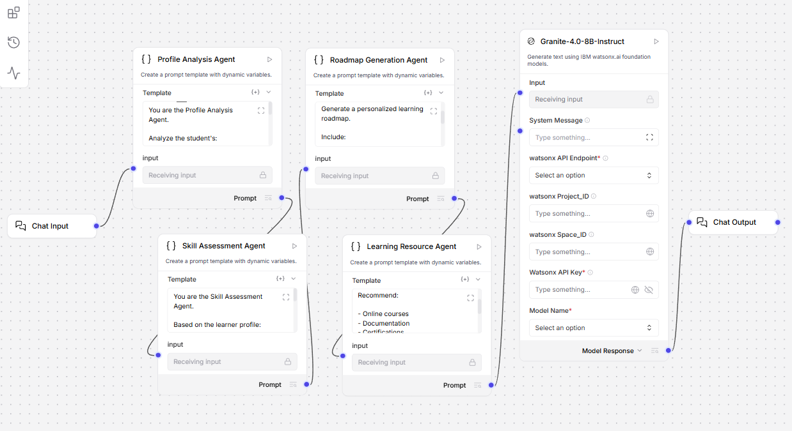
Langflow workflow -

Slide 8
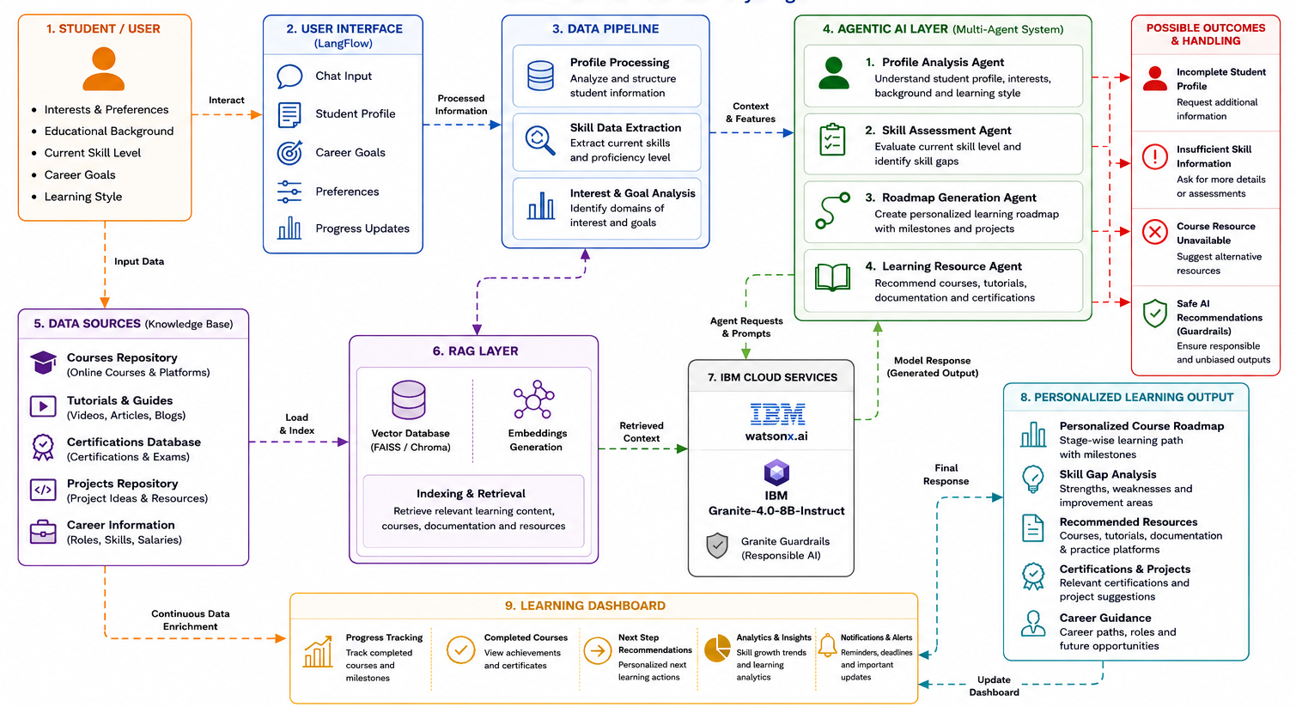
Architecture blueprint

Slide 9

Role of Agentic AI in the solution
Intelligent Learning Companion
LearnMate acts as an AI-powered learning mentor that continuously understands student interests, skill levels, and career goals to provide personalized educational guidance.
Profile Analysis & Understanding
The AI analyzes student preferences, educational background, learning style, and career aspirations to build a comprehensive learner profile.
Skill Gap Assessment
Agentic AI evaluates the student's current proficiency level, identifies strengths and weaknesses, and determines the skills required to achieve desired career goals.
Personalized Roadmap Generation
Based on learner profiles and skill assessments, the AI dynamically creates customized learning pathways with milestones, timelines, and project recommendations.
Smart Resource Recommendation
Using Retrieval-Augmented Generation (RAG), LearnMate retrieves relevant courses, tutorials, documentation, certifications, and practice resources tailored to individual learning needs.
Adaptive Learning Guidance
The system continuously refines recommendations based on learner progress, completed courses, feedback, and evolving interests to ensure an effective learning journey.
Career-Oriented Decision Support
LearnMate aligns learning pathways with industry trends, job roles, certifications, and future career opportunities, helping students make informed decisions.
Responsible AI with IBM Granite
IBM Granite models and Granite Guardrails ensure reliable, explainable, and safe recommendations while maintaining transparency and reducing biased outputs.

Slide 10
Technology Used
LangFlow
Visual AI workflow orchestration platform
IBM watsonx.ai
Enterprise AI development platform
IBM Granite-4.0-8B-Instruct
Foundation model for personalized recommendations
RAG
Retrieval-Augmented Generation for contextual responses
Vector Database (FAISS/Chroma)
Stores and retrieves educational resources
Multi-Agent AI System
Profile Analysis, Skill Assessment, Roadmap Generation & Learning Resource Agents

Slide 11
Novelty and Uniqueness
Multi-Agent Intelligence
Multiple AI agents collaborate to provide personalized educational guidance.
Career-Oriented Learning
Focuses on career goals instead of generic course recommendations.
RAG-Based Recommendations
Retrieves relevant educational content for accurate guidance.
Skill Gap Driven Planning
Generates roadmaps based on identified skill deficiencies.
Adaptive Learning Paths
Continuously evolves recommendations based on learner needs.
IBM Granite Integration
Uses IBM Granite models for reliable and responsible AI decision-making.
LearnMate transforms traditional course recommendation systems into an intelligent AI mentor that understands learner goals, identifies skill gaps, and creates personalized career-focused learning pathways.

Slide 12
Git Hub Link
Repository URL:
akshyaanand-tech/LearnMate-Agentic-AI
·
·
·

Slide 13
Future Scope
1. Real-Time Progress Tracking & Adaptive Learning LearnMate can continuously track completed courses, certifications, and project milestones. Based on learner performance and feedback, the system can dynamically update learning pathways and provide personalized recommendations to support long-term career goals.
2. AI-Powered Voice Assistant & Multilingual Support Future enhancements can include voice-based interaction and multilingual support, allowing students to receive guidance, roadmap updates, and recommendations in their preferred language, making the platform more accessible and user-friendly.
3. Learning Management System (LMS) Integration LearnMate can be integrated with platforms such as Moodle, Coursera, Udemy, and Google Classroom. This will enable automatic progress tracking, certification updates, and seamless synchronization of learning activities.
4. Industry Skill Mapping & Placement Readiness The system can analyze industry trends, job requirements, and emerging technologies to recommend relevant skills, certifications, and projects that improve employability and placement readiness.
5. Collaborative Learning & Peer Recommendations Future versions can support study groups, peer mentoring, and collaborative projects by connecting learners with similar interests and career aspirations, creating a more engaging learning ecosystem.
·
·
·

Slide 14


