Slide 1
The Everyday
Fatality Pattern
2,714 Australians died on our roads between 2024 and Jan 2026 — most during ordinary daytime travel.
Where Australia should target road safety funding first
Prepared for the Federal Transport Minister reviewing national road safety funding priorities
BITRE ARDD 1989–2026 · ABS Population Data · Open-Meteo Weather API
DVN — Group 18

Slide 2
ABOUT THE DATA
Three sources. One integrated story.
PRIMARY DATASET
ENRICHMENT 1
ENRICHMENT 2
BITRE — Australian Road Deaths Database
ABS — Population Data
Open-Meteo — Historical Weather API
1989–Jan 2026 · Monthly updates
State-year estimated resident population
State-month context · Not crash-day causation
Crash Location
Time of Death
Road Type
User Group
Converts Death into per-capita risk
Enables fair state comparison
Adds seasonal context
Not used for crash causation
By combining these datasets, we moved from raw crash counts to intervention-focused insight.
Data collected and integrated by DVN — Group 18 · 36104 Data Visualisation and Narratives · May 2026

Slide 3
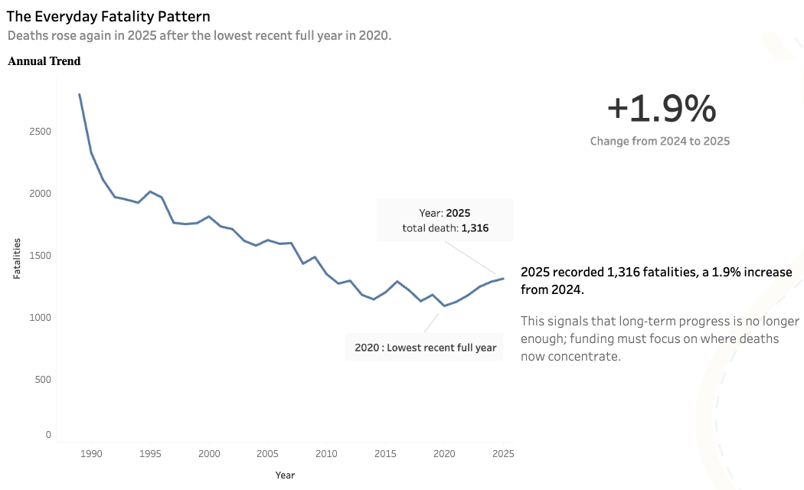
Live Tableau Story Prototype
We now move from the data sources to the interactive narrative: where road safety funding should go first.
Open Tableau Story: https://public.tableau.com/app/profile/shameel.zeshan.khader.sheriff/viz/RoadDeathsAreNotRandomAustraliasPreventableFatalityPattern/FinalDashboard
Data collected and integrated by DVN — Group 18 · 36104 Data Visualisation and Narratives · May 2026

Slide 4
THE SCALE
Fatalities are rising again after a decade of progress
2,714
+1.9%
37.4
70.8%
Total fatalities
(2024–Jan 2026)
Change from
2024 to 2025
NT deaths per
100k population
Deaths concentrated in just two intervention theatres
“But the issue isn’t only how many people die – it’s where those deaths are concentrated”

Slide 5
THE WHERE
Where Australians live dramatically changes their likelihood of surviving the road system
37.4
deaths per 100,000
in the Northern Territory
4.2
deaths per 100,000 in the ACT
Source: BITRE ARDD + ABS Population Data (population-adjusted rates)

Slide 6
THE CONCENTRATION
Most fatalities are concentrated in two predictable road environments
Deaths by road type
Who is dying, by road type
Different environments require different intervention strategies
But the biggest surprise appeared when we analyzed timing patterns
Source: BITRE ARDD 2024–Jan 2026

Slide 7
THE PATTERN
Most Deaths occur during ordinary daytime movement – not late night extremes
Late night
Morning
Daytime
Evening
Night
Sunday
Daytime:
198 deaths
Mon
50
39
145
55
61
Tue
31
46
107
62
67
Wed
41
39
127
68
84
The highest single
cell in the dataset.
Routine daytime travel is the dominant fatality pattern.
Thu
58
47
161
72
69
Fri
61
47
158
75
96
Sat
62
27
153
61
91
Sun
79
38
198
67
72
This means fatalities are not random – which also means prevention is possible

Slide 8
THE OPPORTUNITY
A modest 5% intervention could prevent 136 deaths.
96
Lives saved by intervention theatre
potential lives saved
With targeted intervention
target across all theatres
Regional roads deliver the greatest impact per intervention dollar
So the policy response should be targeted, measurable and immediate
Source: BITRE ARDD dashboard what-if parameterisation · DVN Group 18

Slide 9
THE ASK
Three targeted actions. One funding commitment.
01
Prioritize Regional Roads in next Funding cycle
Regional roads carry 39% of all deaths — the highest of any theatre — yet receive the smallest share of safety investment. NT, WA and QLD are the priority states. The largest single-theatre fatality reduction opportunity in this scenario.
02
Protect Urban Pedestrians and Cyclists before Fatalities rise further
Major-city streets account for 30% of deaths, overwhelmingly affecting pedestrians and cyclists. Targeted urban speed reduction and infrastructure upgrades will address the city-specific risk profile.
03
Turn the Dashboard into a National Accountability Tracker
The dashboard is already built and live on Tableau Public. Commission it as an official quarterly monitoring tool. Transparent public reporting is what sustains political will across election cycles.
The evidence is already visible. The remaining question is whether action follows.
DVN — Group 18 · BITRE ARDD + ABS Population + Open-Meteo · May 2026

Slide 10
THE DECISION IS YOURS.
Road fatalities are no longer a mystery problem. The data now shows exactly where intervention saves the most lives.
2,714
fatalities in scope (2024–Jan 2026)
70.8%
of deaths in two addressable theatres
96
Thank You
lives saved at just 5% targeted intervention
BITRE ARDD + ABS Population + Open-Meteo · DVN Group 18

