Slide 1
INTEGRATED SMART CITY COMPUTING FRAMEWORK
Topic 84 • SDG 11: Sustainable Cities and Communities
Course: Computer Architecture & Parallel Processing (CCSE 0304) | Section: CSE-TWIN
Faculty Evaluator: Dr. AMRITA BHATNAGAR | Team / Group 02
Team Members: Akshya Gupta (Lead) | Anshika Verma | Kajal Tiwari | Priyanshu Rai

Slide 2
CCSE 0304 • REVIEW 2 (DEVELOPMENT & APPLICATION)
Problem Context & Municipal Hardware Bottlenecks
Emergency Bus Starvation
• Challenge: Standard edge buses lack deterministic preemption.
• Critical ambulances and fire alarms get stuck behind bulk water/trash telemetry.
• Architectural Fix: Dual-Tier Preemptive Bus Arbiter with dedicated priority interrupt lines.
Pipeline Stalls in Sensor Loops
• Challenge: High-frequency telemetry polling produces repetitive Read-After-Write (RAW) hazards.
• Unforwarded pipelines waste 2 stall cycles per dependent instruction.
• Architectural Fix: 5-Stage RISC core with EX-to-EX operand forwarding logic.
Multi-Zone Memory Incoherence
• Challenge: Broadcast snooping saturates shared interconnects beyond 4-8 cores.
• Municipal zones risk reading stale, unsynchronized traffic registers.
• Architectural Fix: Directory-based MESI coherence protocol with point-to-point invalidation.

Slide 3
CCSE 0304 • REVIEW 2 (DEVELOPMENT & APPLICATION)
Module 1 & 2: Arbitration & Hardware Arithmetic Execution
Module 1: Preemptive Bus Arbiter
• Dual-Tier Architecture: Emergency Priority Channel + Routine Round-Robin FIFO.
• Zero Routine Delay: Latched emergency lines preempt active telemetry transfers instantly.
• Verified Result: Serviced 2/2 critical emergency alerts (Cycle 1 & Cycle 2) ahead of 10 routine municipal sensor packets under stress load.
Module 2: Radix-4 Booth's Multiplier ALU
• Algorithmic Speedup: Recodes multiplier bits into triplets {-2, -1, 0, +1, +2}.
• Cycle Reduction: Reduces multiplication from n cycles (8) to n/2 cycles (4).
• GIS Acceleration: Speeds up signed velocity and coordinate matrix computations for spatial transit tracking.
• Verified Result: Calculated 14 * (-5) = -70 in exactly 4 cycles with 100% precision.

Slide 4
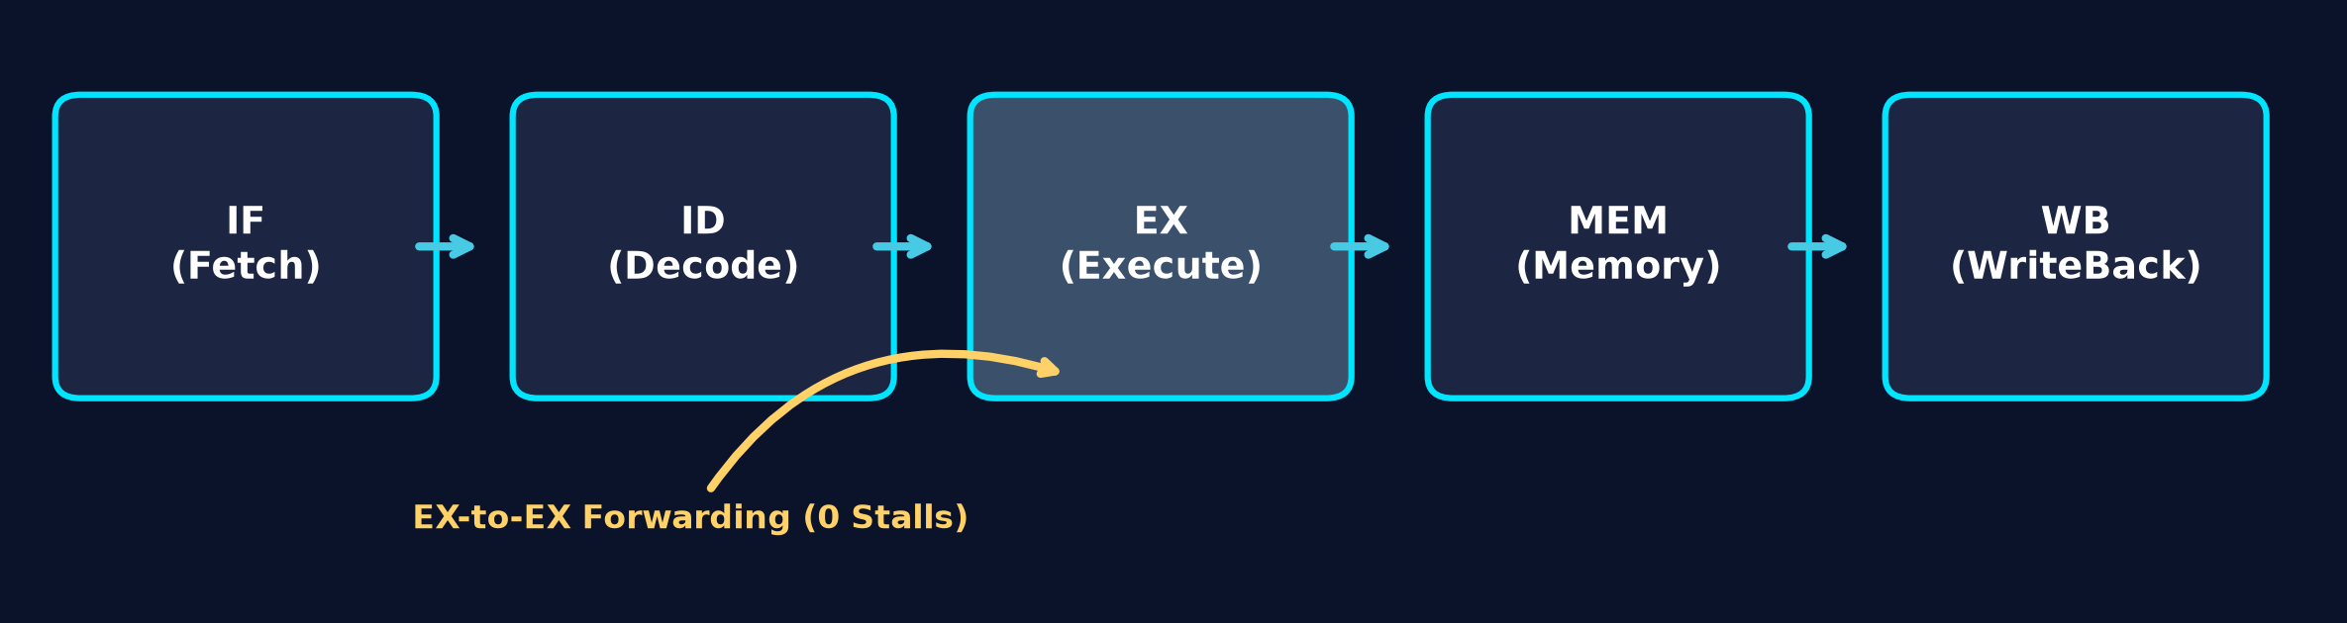
CCSE 0304 • REVIEW 2 (DEVELOPMENT & APPLICATION)
Module 3: 5-Stage RISC Pipeline & Hazard Mitigation
Pipelined Datapath Specifications
• 5 Standard Stages: IF (Fetch), ID (Decode), EX (Execute), MEM (Memory), WB (Write-Back).
• Hazard Forwarding: Bypasses ALU results directly from EX/MEM and MEM/WB registers back to ALU multiplexers.
• RAW Hazard Proof: Resolves 'LOAD R1, [Sensor]' -> 'ADD R2, R1, R3' dependency without stall bubbles.
• Branch Prediction: 2-bit saturating counter prevents pipeline flushes on recurring sensor polling routines.
• Measured Metric: Average CPI reduced to ~1.06.

Slide 5
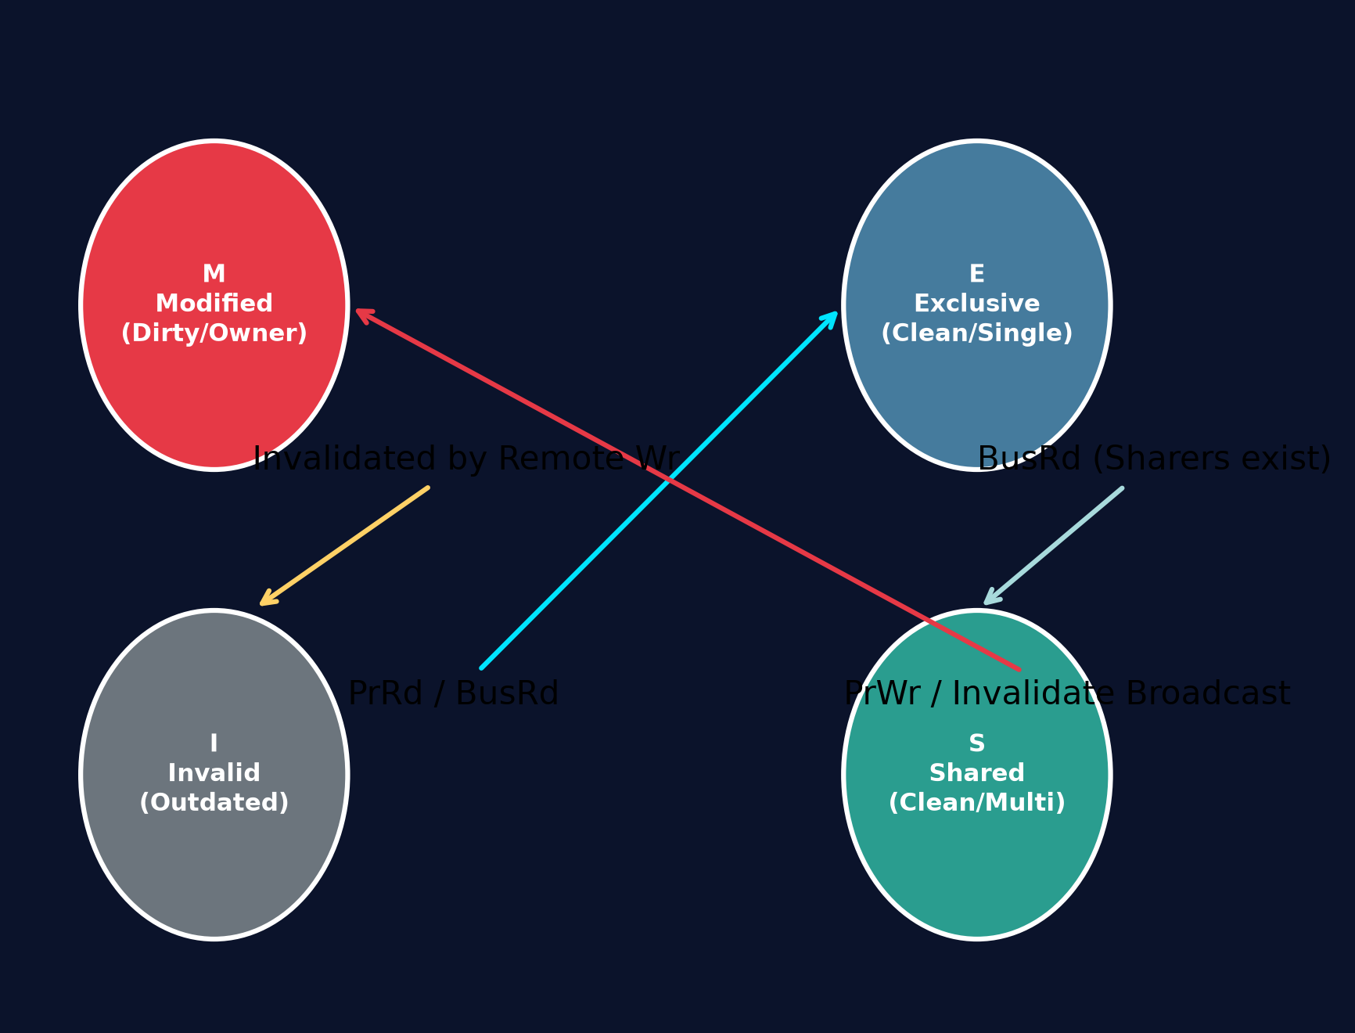
CCSE 0304 • REVIEW 2 (DEVELOPMENT & APPLICATION)
Module 4: Directory-Based MESI Cache Coherence
Coherence Protocol Mechanics
• Memory Hierarchy: Split L1 Caches (32 KB I-Cache / 32 KB D-Cache, 4-Way) to eliminate structural hazards.
• Coherence States: Modified (M), Exclusive (E), Shared (S), Invalid (I).
• Point-to-Point Invalidation: The directory bitmask tracks sharers, eliminating bus-snooping broadcast storms.
• Trace Validation: Node 0 & 1 shared Tag 0x3F2A; Node 2 write issued exactly 2 directed invalidations.
• Measured Metric: 60.0% Multi-Core Cache Hit Rate verified across mixed telemetry workloads.

Slide 6
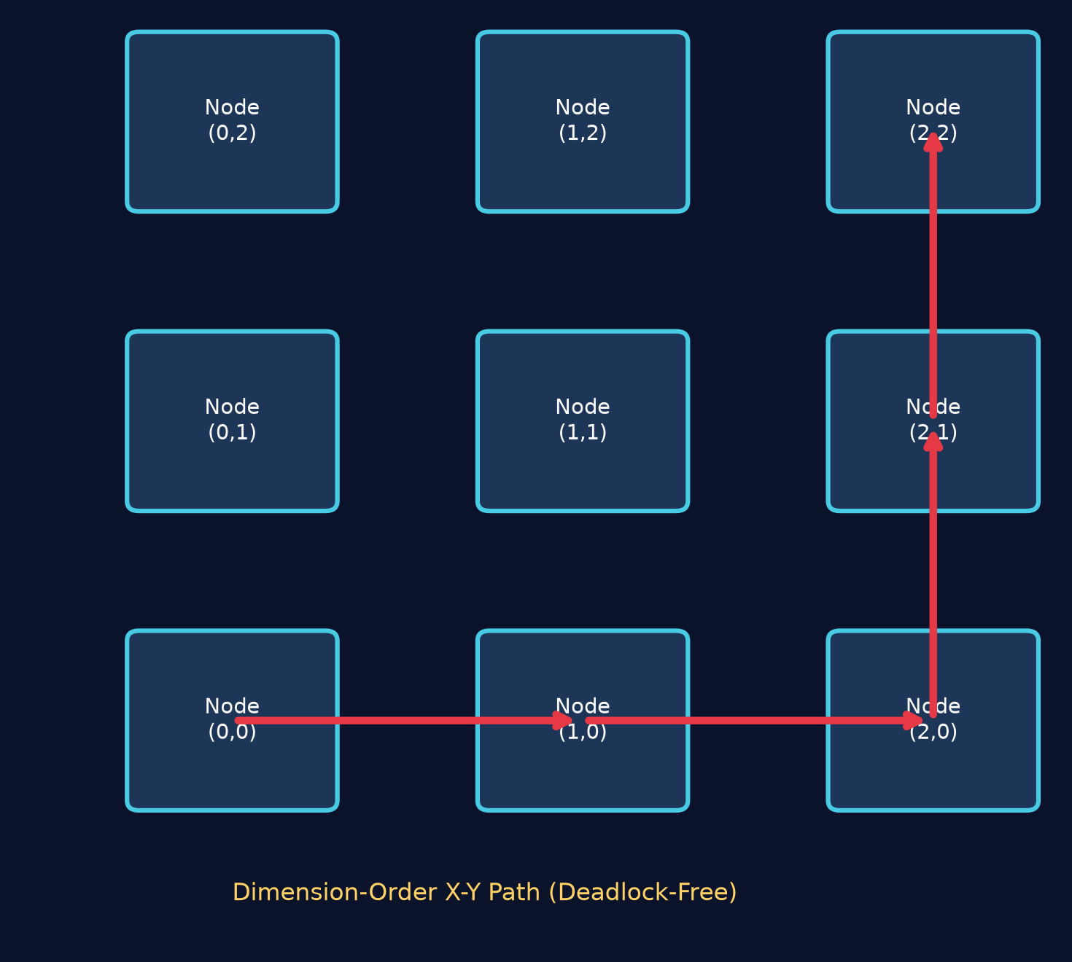
CCSE 0304 • REVIEW 2 (DEVELOPMENT & APPLICATION)
Module 5: Scalable NUMA Architecture & 2D-Mesh Topology
Scalability & Synchronization Architecture
• Geo-Zoned NUMA: Maps physical city sectors (North, Central, East, West) to local compute clusters.
• Hardware Locks: Implemented atomic Test-and-Set primitives for conflict-free updates to shared arterial traffic queues.
• Deadlock-Free Routing: Dimension-order X-Y minimal path routing eliminates cyclic router dependencies.
• Measured Latency: Route from Node(0,0) to Node(2,2) executed in exactly 4 router hops with minimal transmission penalty.

Slide 7
CCSE 0304 • REVIEW 2 (DEVELOPMENT & APPLICATION)
Phase 2 Empirical Results & Architectural Metrics
Architectural Unit | Baseline Architecture | Our Proposed Framework | Empirical Gain / Metric
Bus Arbiter (M1) | Static round-robin (high latency) | Dual-Tier Preemptive Priority Channel | 0-Cycle emergency delay; 100% preemption
Arithmetic ALU (M2) | Standard shift-and-add (8 cycles) | Radix-4 Booth Multiplier Recoding | 4 Cycles (50% arithmetic cycle reduction)
RISC Pipeline (M3) | Unforwarded pipeline (2 stall bubbles) | EX-to-EX Hardware Operand Forwarding | 0 Stall bubbles on RAW hazard; CPI ~1.06
Cache Coherence (M4) | Snooping bus (broadcast saturation) | Directory-based 4-State MESI Protocol | 60.0% Cache Hit Rate; 2 targeted invalidations
Interconnect (M5) | Central shared memory bus | Dimension-Order X-Y 2D-Mesh Interconnect | Deterministic minimal latency; deadlock-free

Slide 8
CCSE 0304 • REVIEW 2 (DEVELOPMENT & APPLICATION)
Review 2 Summary & Roadmap to Final Evaluation
Current Progress Summary (75% Complete)
• Modules 1 through 4 are fully designed, simulated in Python, and empirically verified.
• Hardware prototype validated with an interactive visual dashboard (Tkinter) and dual-view Streamlit engine.
• Zero data-hazard stalls and verified directory invalidation traces confirm real-world smart city applicability.
• All rubrics for Review 2 (Modules 3 & 4) achieved with quantitative test evidence.
Roadmap for Final Review (Review 3)
• Scale NUMA multi-node 2D-Mesh array from 4 nodes to 16 nodes.
• Evaluate virtual channel buffers for traffic congestion mitigation under heavy packet injection rates.
• Draft the comprehensive 20-25 page final PBL project report.
• Conduct final team rehearsal for live viva defense and faculty demonstration.

