Slide 1

Automated Entry-Exit System using Image Processing
DA526 : Project
Akshay Bhosale 234101006
Ritik Koshta 234101044
Rumit Gore 234101045
Group 3

Slide 2
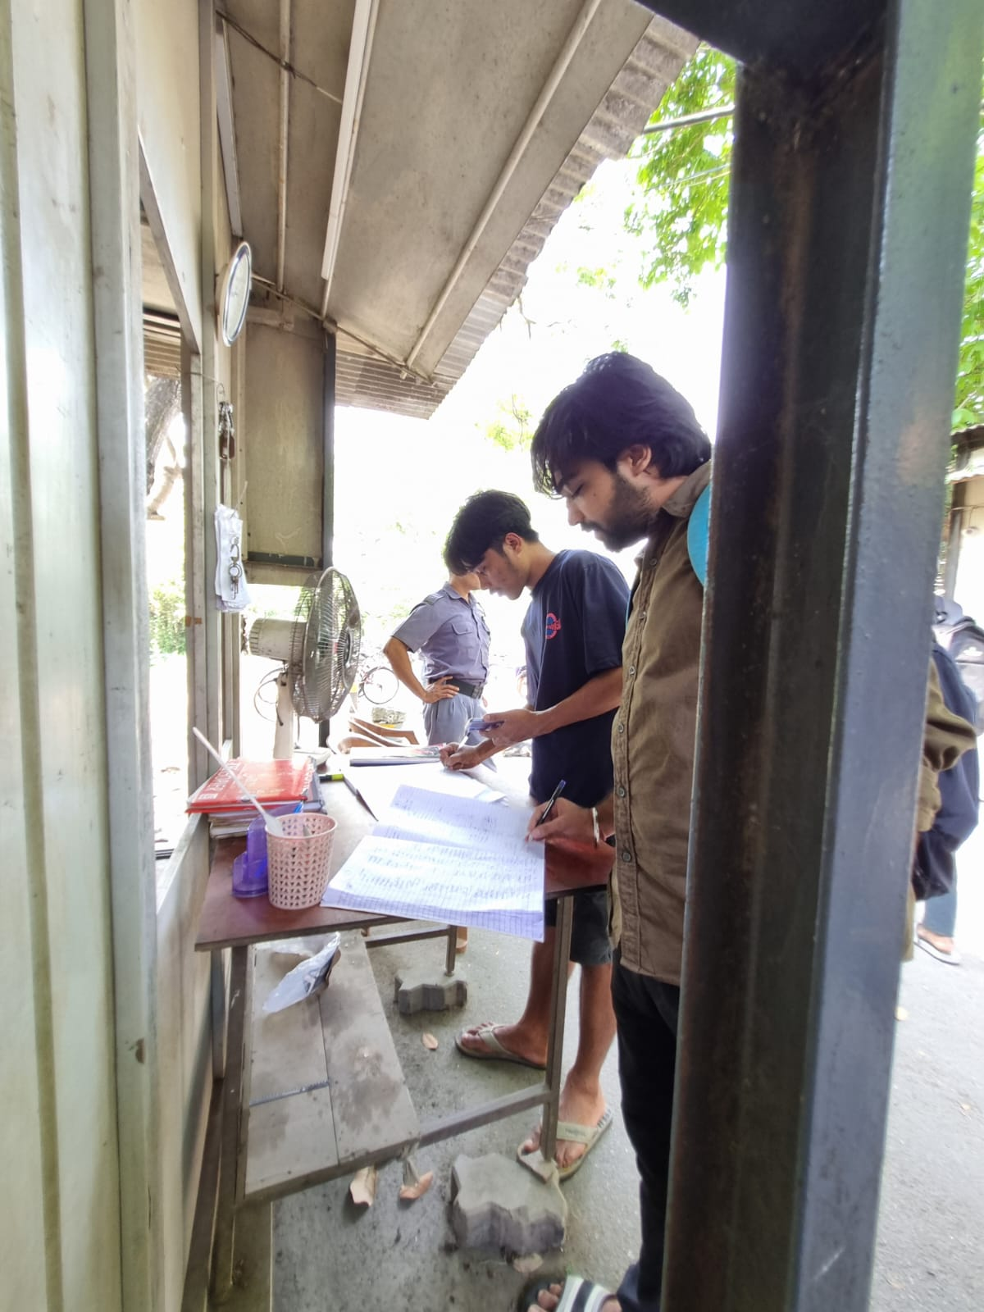
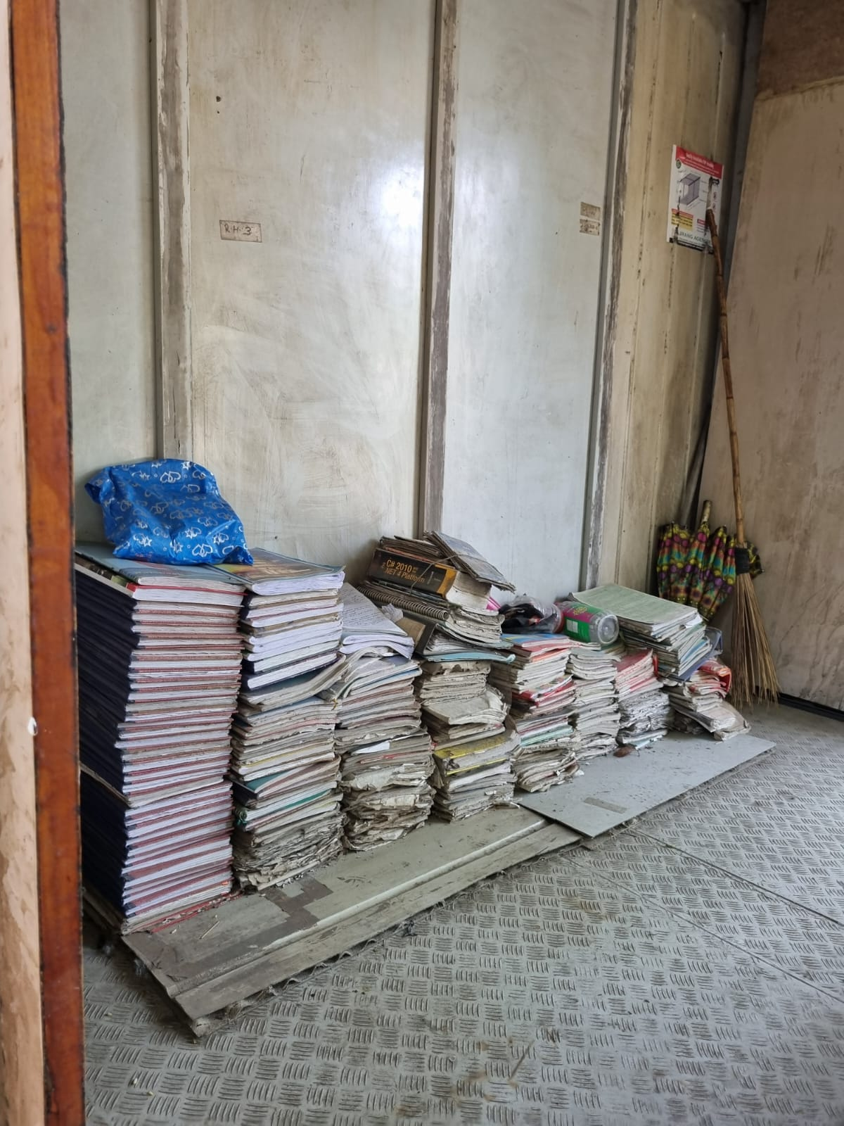
Problem Statement
The current entry and exit process at Khokha gate is manual, causing long queues, paper wastage, and issues like fake entries and missed exits. Our system needs an upgrade to match today's digital era.
Manual entry
Log books of just this week

Slide 3
Proposed Solution
We are introducing an automated entry and exit system using image processing technology. This system will capture ID card photos and use image processing algorithms to automatically log entry and exit times, along with details like name and ID.
Additionally, we aim to create a centralized system that allows entry through one gate and exit through another, further streamlining the process.

Slide 4
Method
Object Detection using YOLO (ID Card detection).
Getting an ID Card image.
Processing the image.
Classifying ID - ID Card, Aadhar Card, Driving License ( ML Classification model).
Extracting Students image from ID card (Image Processing).
Checking if Live student image matches with that of ID card (Face Recognition).
Extracting required text from ID Card (Text Extraction).
Checking the data with maintained Database.
Marking the Entry/ Exit.
Time limit Alert.

Slide 5
Demo

Slide 6
Dataset
We have used our own Custom dataset which included photos of IITG student ID cards.
It has been used for training
YOLO Object detection Model.
Classification Model.
We are also maintaining a database which has information about IITG students to verify their details.

Slide 7
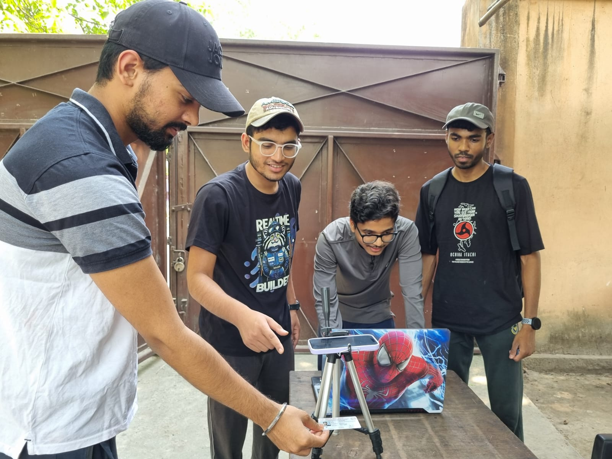
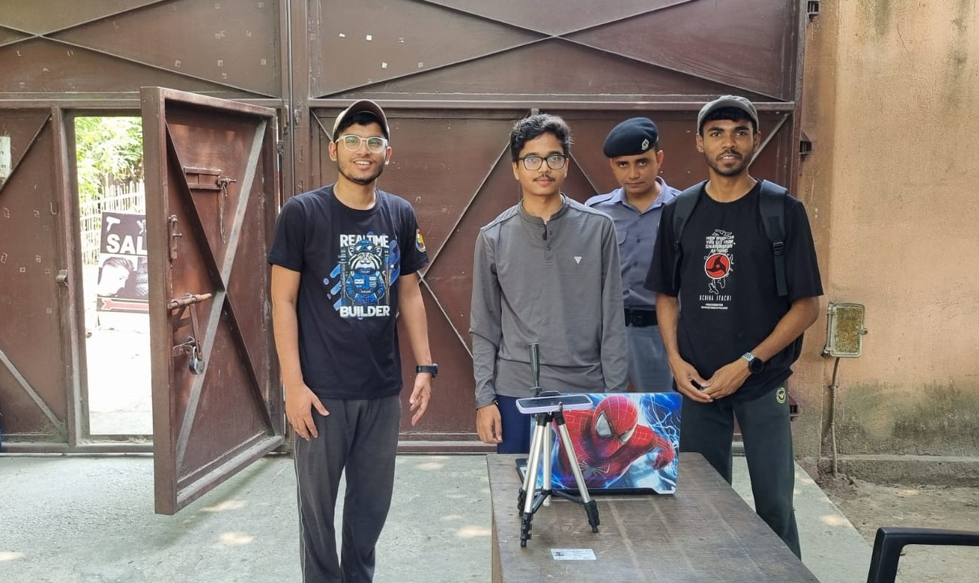
Experiments
We tested our System in the Real Environment.
Received positive feedback from both Guards and Students passing by.

Slide 8
Challenges
Dependency issues.
Solved using virtual environment.
Importing errors.
Had to install and import manually (eg. dlib for face recognition).
Integration issues.
Debugged and resolved each error.
Processing time.
Working on most relevant data.
Videos/ Image resolution.
Used better cameras.

Slide 9
Conclusion
Improved efficiency and accuracy.
Reduced long queues, minimized paper wastage, and addressed issues related to fake entries and missed exits.
The system becomes more seamless and reliable for logging entry and exit times.
The centralized system for entry and exit through separate gates further streamlines the process, enhancing overall user experience.
This project serves as a stepping stone towards a more advanced and efficient entry and exit management system, paving the way for future technological advancements in campus security and administration.

Slide 10
THANK YOU
Akshay Bhosale 234101006
Ritik Koshta 234101044
Rumit Gore 234101045

