Slide 1
DENTALVISION
END-TO-END SEGMENTATION
Automated Tooth Segmentation for Dental Diagnostics
X-RAY
Vision Transformer + CNN decoder
↓
ViT
Abhishek Kumar Singh • M23CSA503
↓
M.Tech. Artificial Intelligence Department of Computer Science & Engineering Indian Institute of Technology Jodhpur
MASK
Research & educational prototype Not clinically validated

Slide 2
01 • MOTIVATION
02
Why automate tooth segmentation?
Dental X-rays contain rich structural information, but manual identification can be time-consuming and dependent on expert annotation.
PROJECT OBJECTIVE
Build an automated tool that segments teeth in dental X-ray images and presents the result through an accessible web app.
MANUAL WORK
CONSISTENCY
ACCESSIBILITY
Expert annotation is slow and repetitive.
Automated masks provide a repeatable workflow.
A Streamlit UI makes inference easy to test.
Core deliverable
ViT encoder → CNN decoder → binary mask
DentalVision • ViT-based tooth segmentation
IIT Jodhpur

Slide 3
02 • OVERVIEW
03
System at a glance
INPUT
PREPROCESS
ENCODE
DECODE
OUTPUT
Dental X-ray
→
RGB • 224×224 16×16 patches
→
ViT 196 patch tokens
→
CNN + upsampling
→
Binary segmentation mask
ABSTRACT IN ONE SENTENCE
DentalVision demonstrates an end-to-end research prototype for automated tooth-region segmentation, from human-annotated X-rays and model training to interactive Streamlit inference.
Prototype scope: research / educational — not a clinically validated diagnostic system.
DentalVision • ViT-based tooth segmentation
IIT Jodhpur

Slide 4
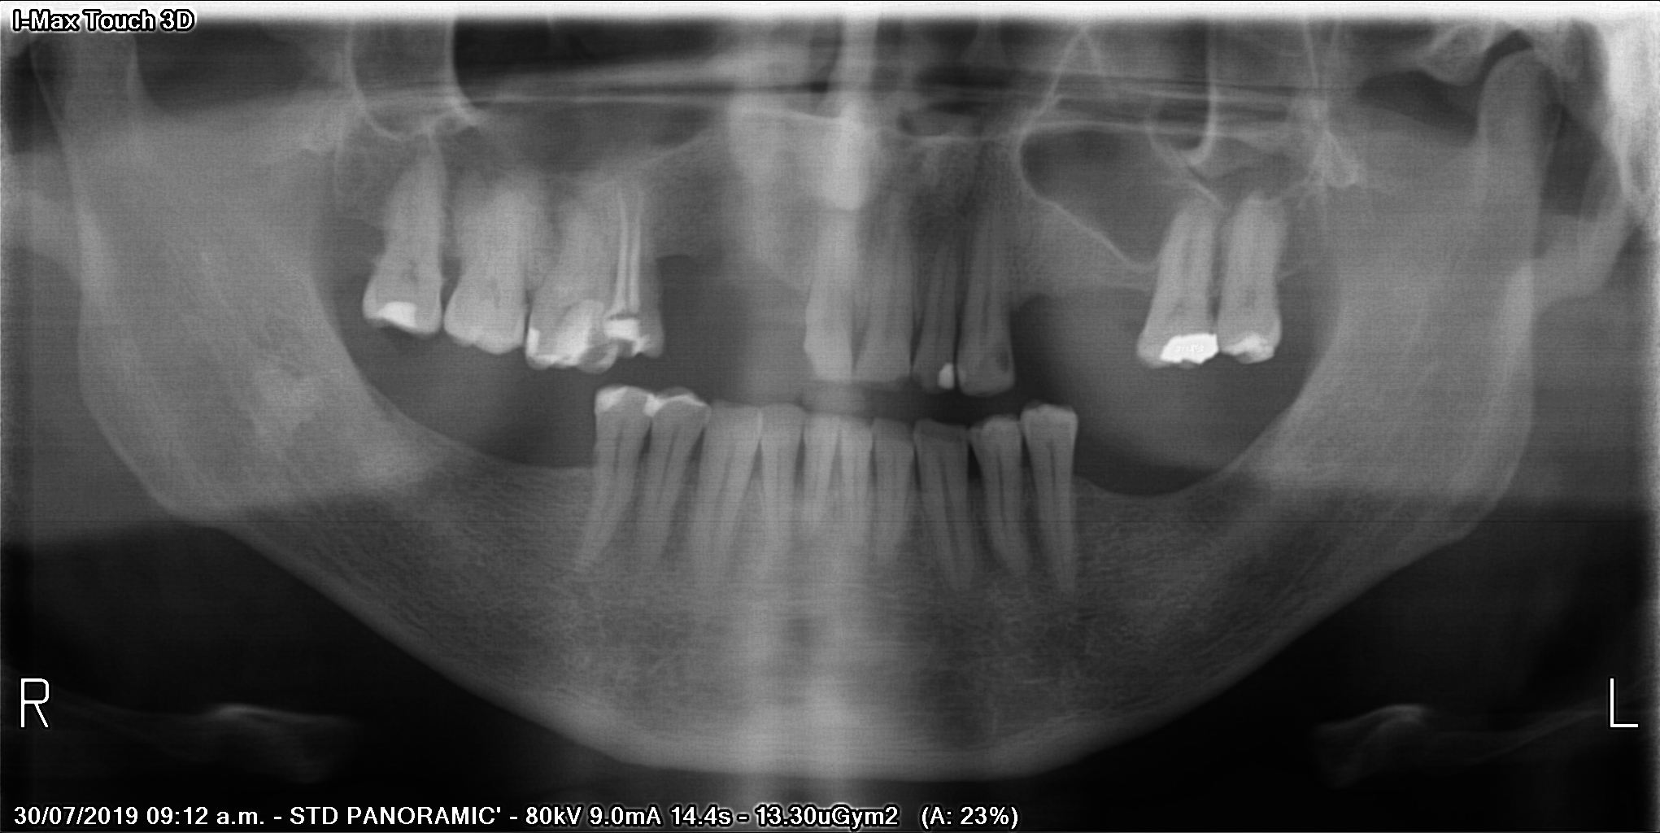
03 • DATA
04
Dataset & preprocessing
DATASET
Humans in the Loop Teeth Segmentation on Dental X-ray Images
CONTENT
• Panoramic dental X-rays
• Human-annotated segmentation masks
• Separate image / mask data
PREPROCESSING
RGB conversion • 224 × 224 • 16 × 16 patches • binary thresholding
DentalVision • ViT-based tooth segmentation
IIT Jodhpur

Slide 5
04 • MODEL
05
ViT–CNN segmentation architecture
X-RAY 224×224 RGB
PATCHIFY 16×16 patches 196 + 1 token
ViT ENCODER 6 layers hidden size 768
RESHAPE 14×14 feature map
CNN DECODER
→
→
→
→
SIGMOID + THRESHOLD 0.5 → ONE-CHANNEL BINARY MASK
Decoder components
Conv2D • ReLU • ConvTranspose2D • upsampling
Class token is removed before spatial reconstruction.
DentalVision • ViT-based tooth segmentation
IIT Jodhpur

Slide 6
05 • TRAINING
06
Training & evaluation setup
BCE
Adam
1e−4
8
Loss function
Optimizer
Learning rate
Batch size
ABSTRACT / PROJECT WORKFLOW
REPORT CONFIGURATION
• 80/20 train–validation split
• Maximum 50 epochs
• Best validation Dice checkpoint
• 80/20 train–validation split
• 5 epochs
• Batch size 4
Source materials contain these two configuration descriptions; the presentation keeps them explicit rather than silently reconciling them.
DentalVision • ViT-based tooth segmentation
IIT Jodhpur

Slide 7

06 • RESULTS
07
Segmentation performance
0.82
0.89
REPORTED OUTCOME
Accurate mask overlays on unseen X-rays
IoU • Intersection over Union
Dice coefficient
Input panoramic X-ray
Predicted binary mask
DentalVision • ViT-based tooth segmentation
IIT Jodhpur

Slide 8
07 • DEPLOYMENT
08
From trained model to interactive inference
1
UPLOAD
2
INFER
3
DISPLAY
→
→
JPG / PNG
ViT–CNN
Predicted mask
Model checkpoint: vit_teeth_segmentation.pth
LIVE STREAMLIT APP
The selected model is loaded for prediction and the app displays the resulting mask.
dentalvision-vitonet.streamlit.app
GitHub: github.com/akshziitj/dentalvision-vitonet
DentalVision • ViT-based tooth segmentation
IIT Jodhpur

Slide 9
08 • ENGINEERING
09
Project structure & reproducibility
CODEBASE
REPRODUCIBILITY CHECKLIST
dentalvision-vitonet/ ├── model/ │ └── vit_teeth_segmentation.pth ├── sample_data/ │ ├── sample_image_01.jpg │ └── sample_result.jpg ├── DentalVision_CV_Project.ipynb ├── streamlit_app.py ├── utils.py ├── requirements.txt └── README.md
• Training notebook captures the pipeline
• Saved checkpoint supports repeatable inference
• requirements.txt defines Python dependencies
• Streamlit app provides a simple delivery layer
Model + data + UI are separated into clear project components.
DentalVision • ViT-based tooth segmentation
IIT Jodhpur

Slide 10
09 • NEXT STEPS
10
What should improve next?
CURRENT LIMITATIONS
FUTURE WORK
• Research / educational prototype
• No clinically validated diagnostic claim
• Need a separate held-out test set
• Spatial reconstruction can be improved
• Uncertainty is not yet visualized
• Instance segmentation for individual teeth
• Anomaly detection: cavities / missing teeth
• REST API for clinical integration
• Compare against standard U-Net baselines
• Explore Swin Transformer or SAM
• Investigate hybrid quantum-classical / QUBO refinement
DentalVision • ViT-based tooth segmentation
IIT Jodhpur

Slide 11
DENTALVISION
Key takeaway
A compact ViT–CNN pipeline can turn panoramic dental X-rays into useful binary tooth-region masks, with a practical Streamlit interface for interactive inference.
0.82
0.89
RESEARCH PROTOTYPE
IoU
Dice
Clear path toward stronger validation and clinical-grade evaluation.
Thank you
Questions & discussion

