Slide 1
A Brief Introduction to Python
Prepared by Assil Ksiksi

Slide 2
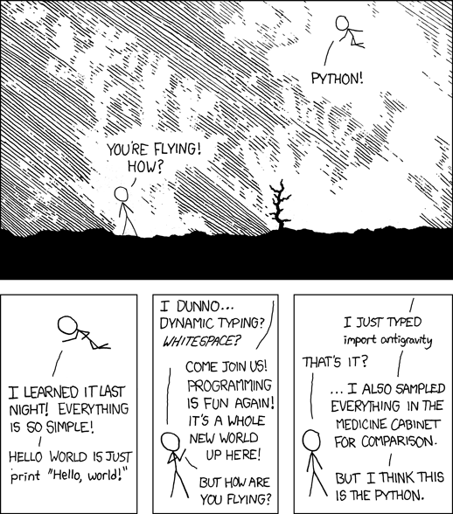
About the Presenter
3rd year Electrical Engineering
IEEE member
Self-taught programmer
Started with C and C++
Python for 3 years
Next is Scala
Projects
http://jadawil.herokuapp.com/
http://www.github.com/Cyph0n
Twitter: @Cyph0n
http://xkcd.com/353/

Slide 3
What is Python?
According to Wikipedia:
"Python is a widely used general-purpose, high-level programming language. Its design philosophy emphasizes code readability, and its syntax allows programmers to express concepts in fewer lines of code than would be possible in languages such as C. The language provides constructs intended to enable clear programs on both a small and large scale.
Python supports multiple programming paradigms, including object-oriented, imperative and functional programming or procedural styles. It features a dynamic type system and automatic memory management and has a large and comprehensive standard library."

Slide 4
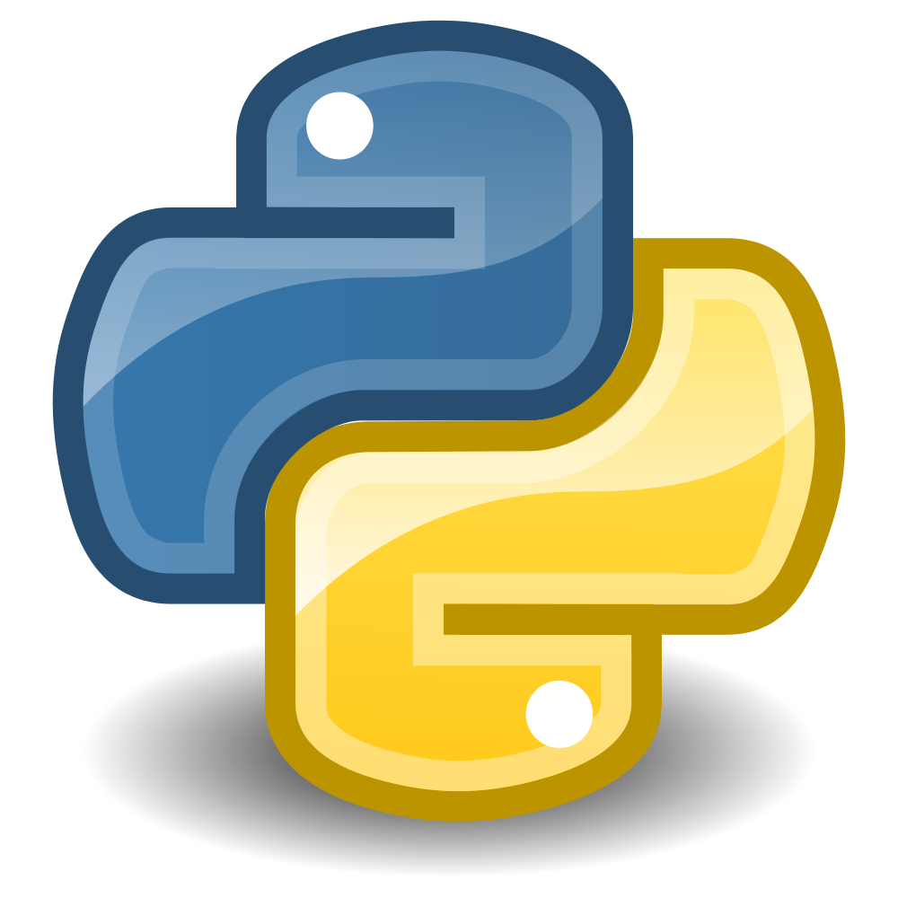
What is Python?
General purpose
High-level
Readable code
Dynamic type system
Multiple programming paradigms
Large standard library
Python
fruits = [‘apple’, ‘banana’, 10]
for fruit in fruits:
print(fruit)
fruits = [‘apple’, ‘banana’]
for fruit in fruits:
print(fruit)
Java
String[] fruits = {“apple”, “banana”};
int i;
for (i = 0; i < fruits.length; i++)
System.out.println(fruits[i]);
String[] fruits = {“apple”, “banana”, 10};
int i;
for (i = 0; i < fruits.length; i++)
System.out.println(fruits[i]);
Solution: use ArrayList<T>. Syntactically messy though.

Slide 5





Python in the Real World

Slide 6
Workshop Content
Project: Webpage Downloader
Variables, Types, and Input
What is Python?
Imports and The Standard Library
Functions and File I/O
Branching and Looping
Progression

Slide 7
Workshop Materials
bit.ly/pyuaeu

Slide 8
Let’s start the workshop, folks!
Please: type every single letter and do not copy anything from the outline!

