Slide 1
Workshop: Introduction to Python
ISET Medenine
July 16th 2019
Assil Ksiksi

Slide 2
Workshop Overview
Introduction
Session 1: Setting Up Python
Session 2: Basics of Python
Session 3: Object-Oriented Programming (OOP)
Session 4: The Python Standard Library
Session 5: Using Python Packages
Session 6: Jupyter Notebooks

Slide 3
Introduction

Slide 4



About Me
BSc in Electrical Engineering, UAE University – Al Ain, UAE
MSc in Electrical and Computer Engineering, Georgia Tech – Atlanta, GA
Software Engineer, Cisco Systems – Raleigh-Durham, NC
Writing C for IOS XR and the ASR-9000 edge router
Built an automated router testing framework in Python
Now working on Cisco’s next-generation core router platform…

Slide 5
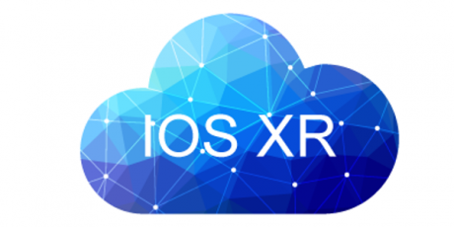

About Me
BSc in Electrical Engineering, UAE University – Al Ain, UAE
MSc in Electrical and Computer Engineering, Georgia Tech – Atlanta, GA
Software Engineer, Cisco Systems – Raleigh-Durham, NC
Writing C for IOS XR and the ASR-9000 edge router
Built an automated router testing framework in Python
Now working on Cisco’s next-generation core router platform…

Slide 6
Contact Me
Website: https://assil.me/
Email: aksiksi@cisco.com
Linkedin: https://www.linkedin.com/in/aksiksi/
GitHub: https://github.com/aksiksi
Twitter: @aksiksi

Slide 7
What is Python?
According to Wikipedia:
"Python is a widely used general-purpose, high-level programming language. Its design philosophy emphasizes code readability, and its syntax allows programmers to express concepts in fewer lines of code than would be possible in languages such as C. The language provides constructs intended to enable clear programs on both a small and large scale.
Python supports multiple programming paradigms, including object-oriented, imperative and functional programming or procedural styles. It features a dynamic type system and automatic memory management and has a large and comprehensive standard library."

Slide 8
What is Python?
General purpose
High-level
Readable code
Dynamic type system
Multiple programming styles
Large standard library

Slide 9
What is Python?
General purpose
High-level
Readable code
Dynamic type system
Multiple programming styles
Large standard library
Python
fruits = [“apple”, “banana”, 10]
for fruit in fruits:
print(fruit)
Java
String[] fruits = {“apple”, “banana”, 10};
int i;
for (i = 0; i < fruits.length; i++)
System.out.println(fruits[i]);
Solution: use ArrayList<T> with type Object

Slide 10
What is Python Used For?
Web development (Flask, Django, Pyramid)
Data visualization (Matplotlib, Bokeh)
Mathematics (NumPy)
Scientific computing (SciPy)
Machine learning and data analysis (scikit-learn, pandas, PyTorch, TensorFlow)
GUI development (PyQT, wxPython)
Scripting and automation
And more…

Slide 11
Note: Python 2 and Python 3
Python 3 was released in 2008
Not backwards compatible!
Main changes: print function, Unicode strings, iterators
See: https://docs.python.org/3.0/whatsnew/3.0.html
Took a while for libraries to move to Python 3
Many libraries still support both 2 and 3…
Python 3.x is the future!
Python 2.7 will receive no support after 2020

Slide 12
For the Audience
Q1: Why are you attending this workshop?
Q2: How good are you at coding/programming?
Q3: How familiar are you with Python?
Q4: What other programming languages have you used?
Q5: What topics are you interested in using Python for?
http://etc.ch/6CnP

Slide 13
Questions?
Feel free to ask a question at any time
We need to make this interactive ☺

Slide 14
Session 1: Setting Up Python

Slide 15
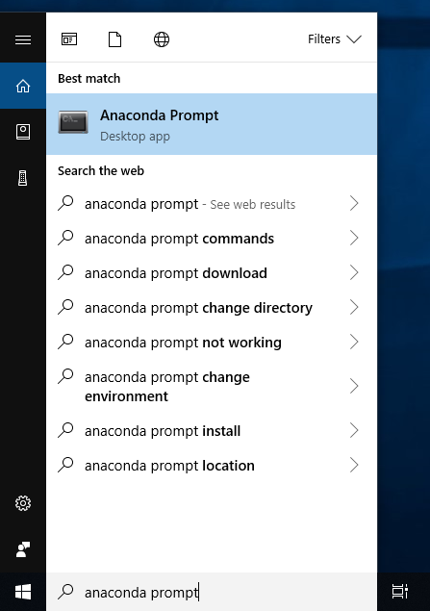
Option 1: Anaconda
Anaconda is a Python distribution
Includes a lot of popular packages
Better Windows support
Go to: https://www.anaconda.com/distribution/
Download the 3.7.x version

Slide 16
Option 2:Official Python Installer
Base Python installation
No external packages are included
Available for all platforms
Go to: https://www.python.org/downloads/
Download 3.7.x version

Slide 17
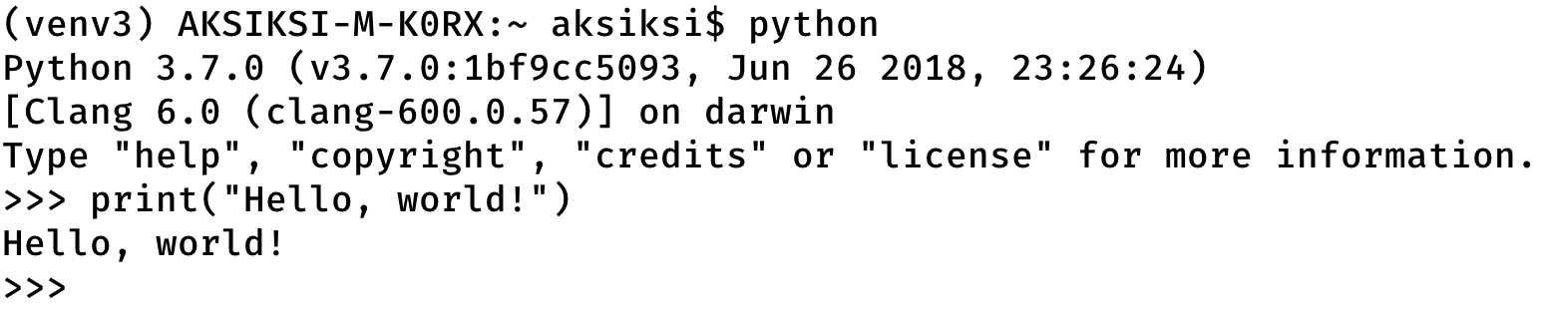
Verify the Installation

Slide 18
Choosing an Editor
Visual Studio Code
Lightweight editor, great Python support
Download: https://code.visualstudio.com/
PyCharm (Community Edition)
Full IDE experience (like Eclipse)
Better debugging support, good for larger projects
Download: https://www.jetbrains.com/pycharm/download/
Spyder IDE
Designed for scientific development
Included with Anaconda!
Use your own (Vim, Emacs, Notepad++, etc.)

Slide 19
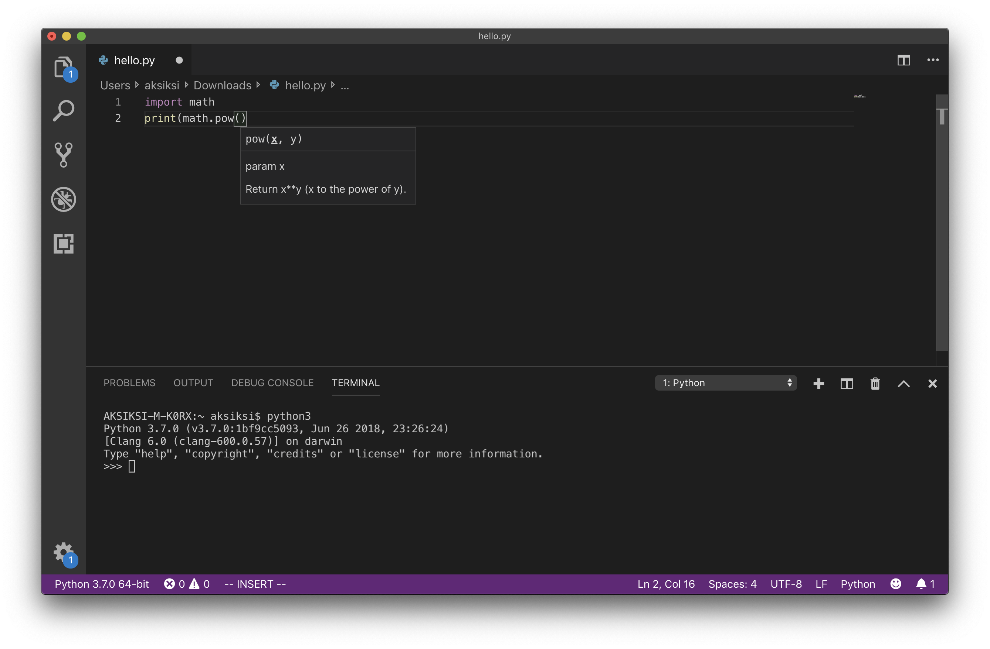
Visual Studio Code

Slide 20
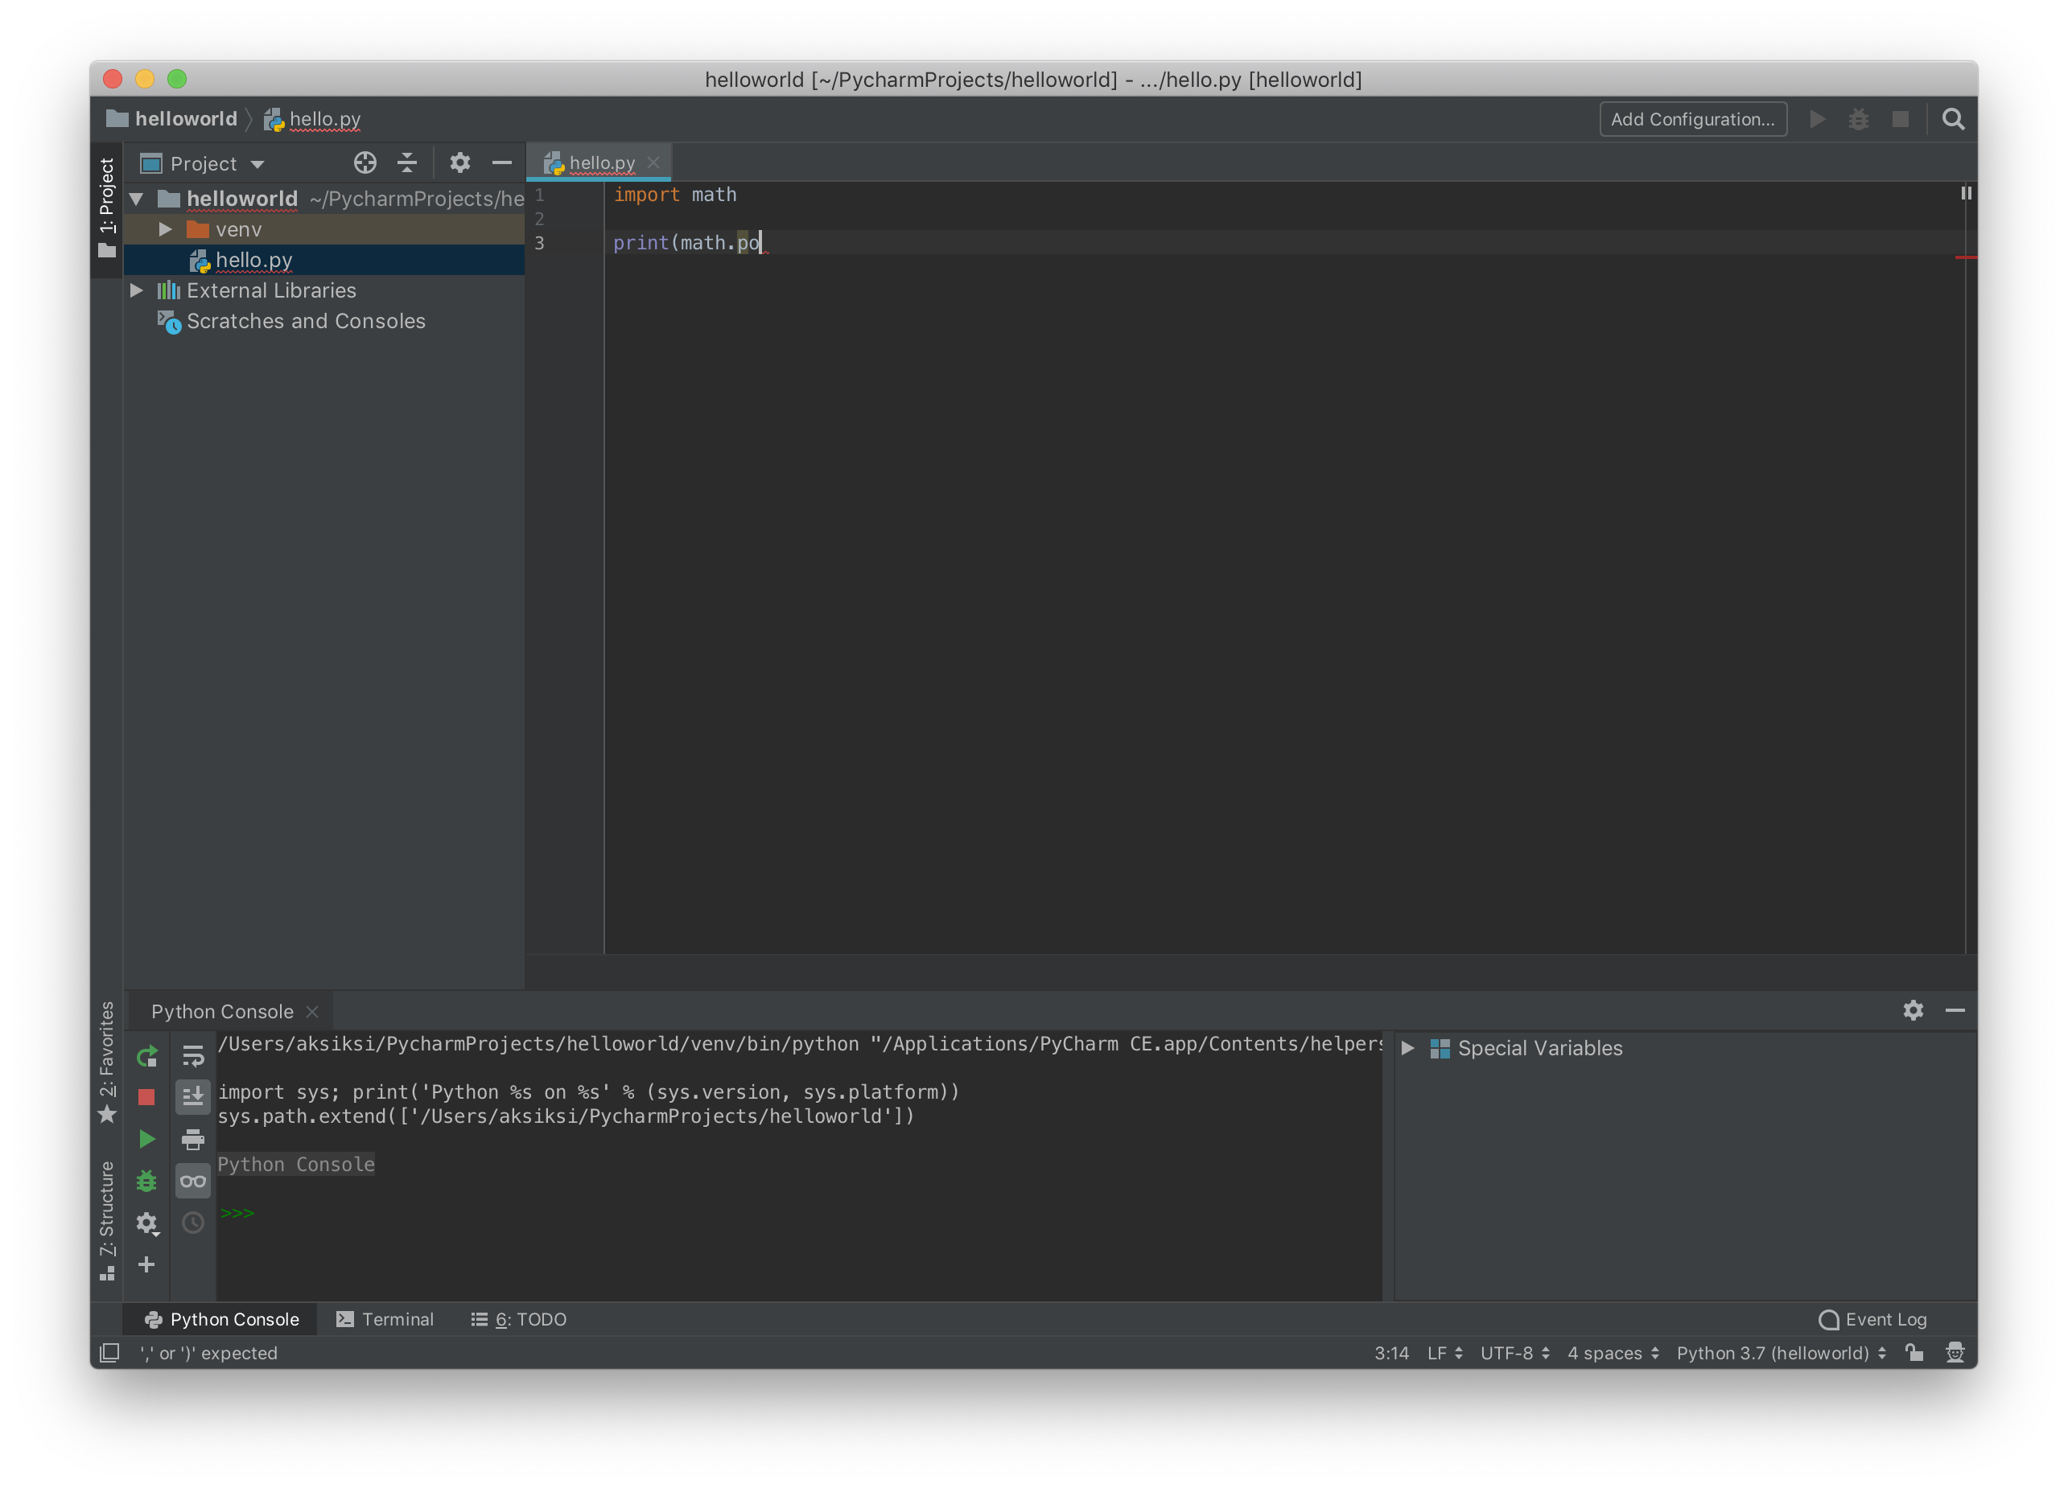
PyCharm

Slide 21
Using VS Code
Open VS code
Install Python extension (done)
File > Open Workspace…
Create a new folder to use as a workspace
Create a file in the workspace called “workshop.py”
We will use this file to write and run code during the workshop
Write some basic code and run the file to make sure it works

Slide 22
Session 2: Basics of Python
https://bit.ly/2LW6xvo

Slide 23
Interactive session

Slide 24
Session 3: Object-Oriented Programming (OOP)

Slide 25
Example: Facebook User
A Facebook user has:
Email
Password
First name
Last name
Zero or more posts
Zero or more photos

Slide 26
Example: Facebook User
A Facebook user has:
Email
Password
First name
Last name
Zero or more posts
Zero or more photos

Slide 27
Example: Facebook User
User
email: str
password: str
first_name: str
last_name: str
photos: Photo

Slide 28
Example: Facebook User
User
email: str
password: str
first_name: str
last_name: str
photos: Photo
Photo
user: User
date: str
url: str
size: float

Slide 29
Session 4: The Python Standard Library

Slide 31
Session 5: Using Python Packages

Slide 33
Session 6: Jupyter Notebooks

