Slide 1
Enumerating Trees in Graph with a Constant Maximum Degree
Prasanth R U4CSE10142
Swamy T U4CSE10060
Kaushik S U4CSE10056
Sushanth M U4CSE10129
Nakul K U4CSE10027
Evaluator: Internal Mentor:
Suhas Kurup M Dr. Bhadrachalam C
Lecturer, CSE Asst. Professor, CSE

Slide 2
Introduction
Identifying the copies of a particular structure in a given protein structure is of fundamental significance in structural biology.
This helps one establish relations among pairs of proteins.
The substructures of interest are called motifs.
The search of structural motifs that specify the spatial arrangement of polypeptide segments i.e. secondary structure elements or simply SSEs is preferred over other methods such as structural superposition in comparing protein structures.

Slide 3
Problem Definition
To implement an efficient divide-and-conquer algorithm to find all the copies of a tree Q(a query graph) in the graph G by conquering Q using a minimum dominating set.

Slide 4
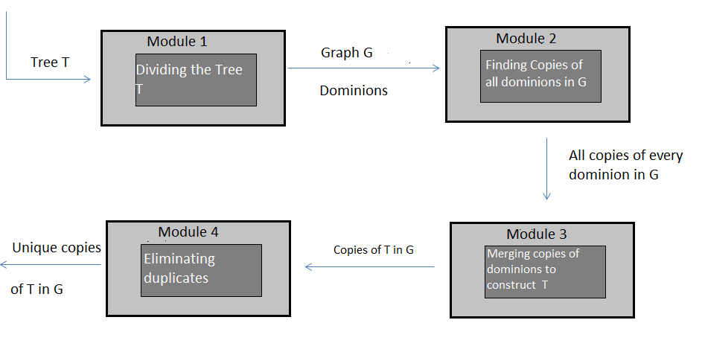
Architecture Design

Slide 5
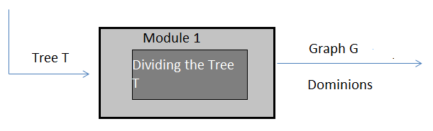
Detailed Design Specification and Algorithm
We have 4 modules in this project.
MODULE – 1:
This module takes a Tree T as input and divides them into
dominions.

Slide 6
Algorithm CDE:
We divide the tree into minimum number of dominions using the algorithm CDE.
For every node in Tree T, we calculate three values C, D, E.
C(v) mean Dominion number for sub tree rooted at node v.
D(v) mean Dominion number for sub tree rooted at node v, where v is included.
E(v) mean Dominion number for sub tree possibly excludes v.
C(v) =

Slide 7
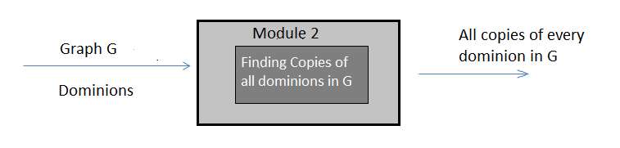
MODULE – 2:
In this module, the divided dominions are taken as input along with the given Graph G.
The output is that all the copies of every dominion present in the Graph G is found.

Slide 8
Algorithm
Here, we compare the degree of the root of every dominion to the degree of each of the nodes in Graph G.
If, the degree of roots of two different dominions are same, then the following process is done only once. Meaning , its only done for unique degrees of root.
If a node has degree greater than or equal to the degree of the root of dominion, then a copy of the dominion exists at the particular node with the node as root.
If the degree of node is greater than the degree of the root of dominion, then all combinations of its adjacent nodes with count (degree) are valid copies of dominion.
This process is continued until all the nodes of G are exhausted for a particular dominion.
The above process is done for every unique degree of root.

Slide 9
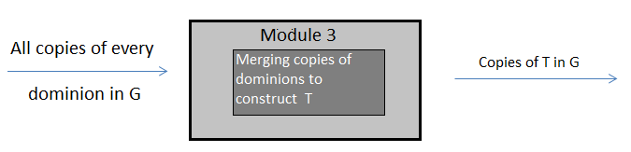
MODULE – 3:
In this module, the copies found for each dominion is taken as input.
The output is complete copies of T in G.

Slide 10
Algorithm
Here, the individual copies of dominions are merged .
In-order traversal on the dominion set is used to merge them.

Slide 11
Project Timeline

Slide 12
Challenges Faced

