Slide 1

AWS Kinesis

Slide 2



Agenda
Introduction
AWS kinesis
Services in AWS kinesis
Components in AWS kinesis
Creation of AWS kinesis data stream, fire house
Sending data to kinesis stream(producer)
Sending data to s3 bucket from kinesis data stream fire house (consumer)
Conclusion

Slide 3


Introduction
Streaming data is data which is generated continuously from thousands of data sources, and these data sources can send the data records simultaneously and in small size.
Purchases from online stores, Stock prices, Game data, Social network data, iOT Sensor Data

Slide 4

AWS Kinesis
Kinesis is a platform on AWS that sends your streaming data. It makes it easy to analyze load streaming data and also provides the ability for you to build custom applications based on your business needs.
AWS Kinesis
Kinesis streams
Kinesis Firehose
Kinesis Analytics

Slide 5
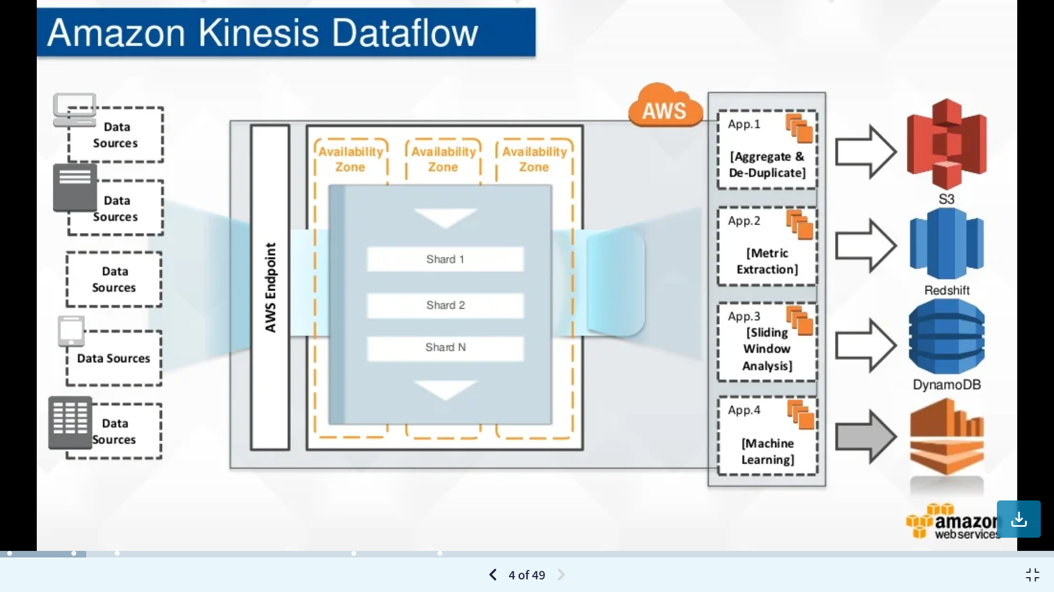
Aws Kinesis Data flow

Slide 6
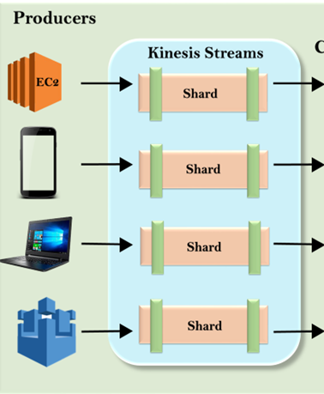
Kinesis streams
Kinesis streams consist of shards.
Shards provide 5 transactions per second for reads, up to a maximum total data read rate of 2MB per second and up to 1,000 records per second for writes up to a maximum total data write rate of 1MB per second.
The data capacity of your stream is a function of the number of shards that you specify for the data stream. The total capacity of the Kinesis stream is the sum of the capacities of all shards.

Slide 7
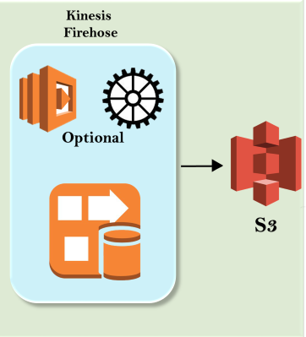
Kinesis Firehouse
Kinesis Firehose is a service used for delivering streaming data to destinations such as Amazon S3, Amazon Redshift, Amazon Elasticsearch.
With Kinesis Firehouse, you do not have to manage the resources..

Slide 8
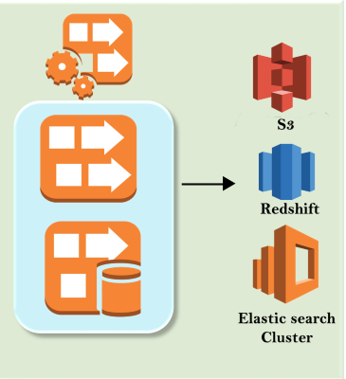
Kinesis Analytics
Kinesis Analytics is a service of Kinesis in which streaming data is processed and analyzed using standard SQL.

Slide 9
AWS Kinesis Components
Streams
Shards
Partition Key
Sequence

Slide 10
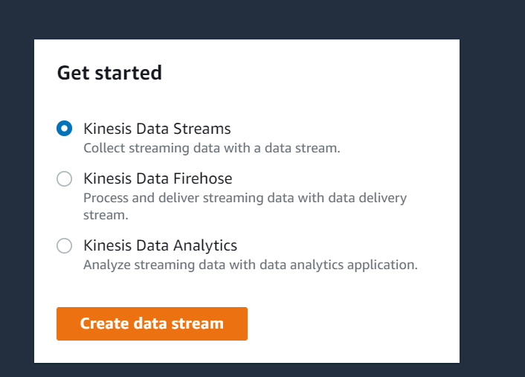
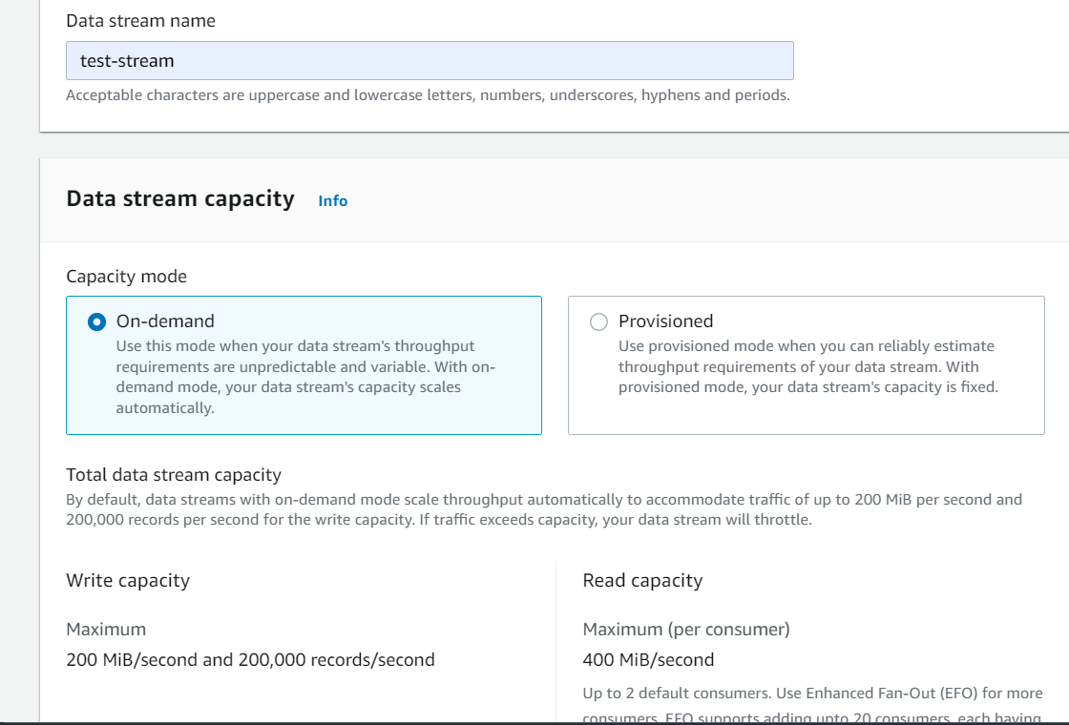
Creating AWS kinesis Data Stream

Slide 11
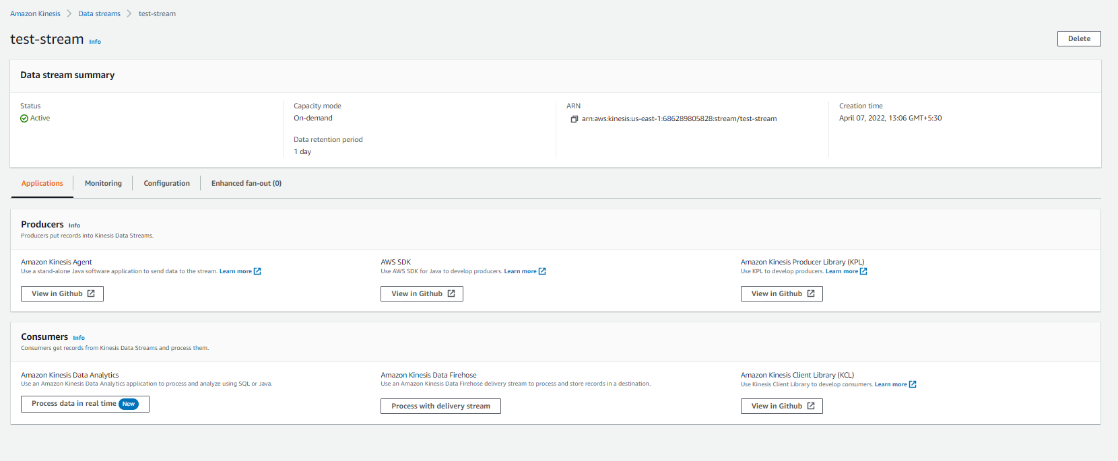
Creating AWS kinesis Data Stream

Slide 12
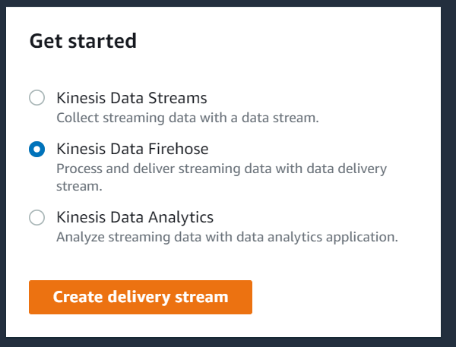
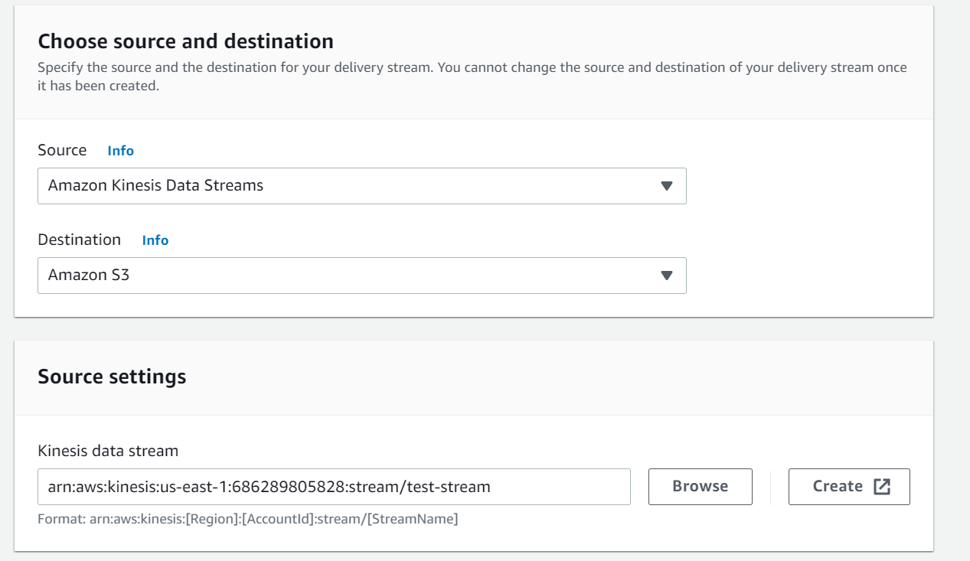
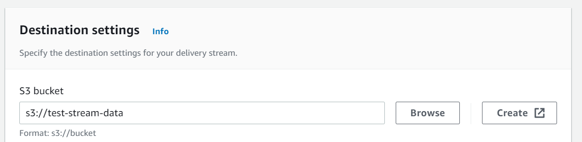
Creating AWS kinesis Data Firehose

Slide 13
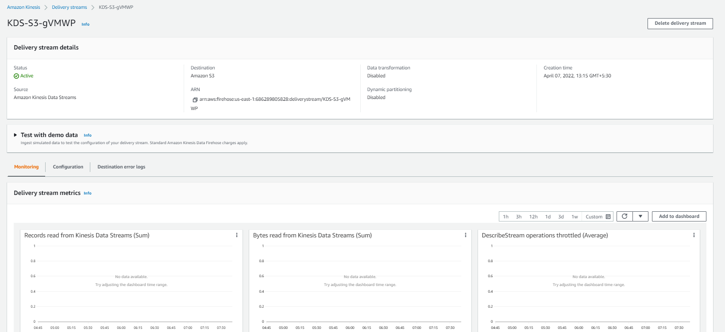
Creating AWS kinesis Data Firehose

Slide 14
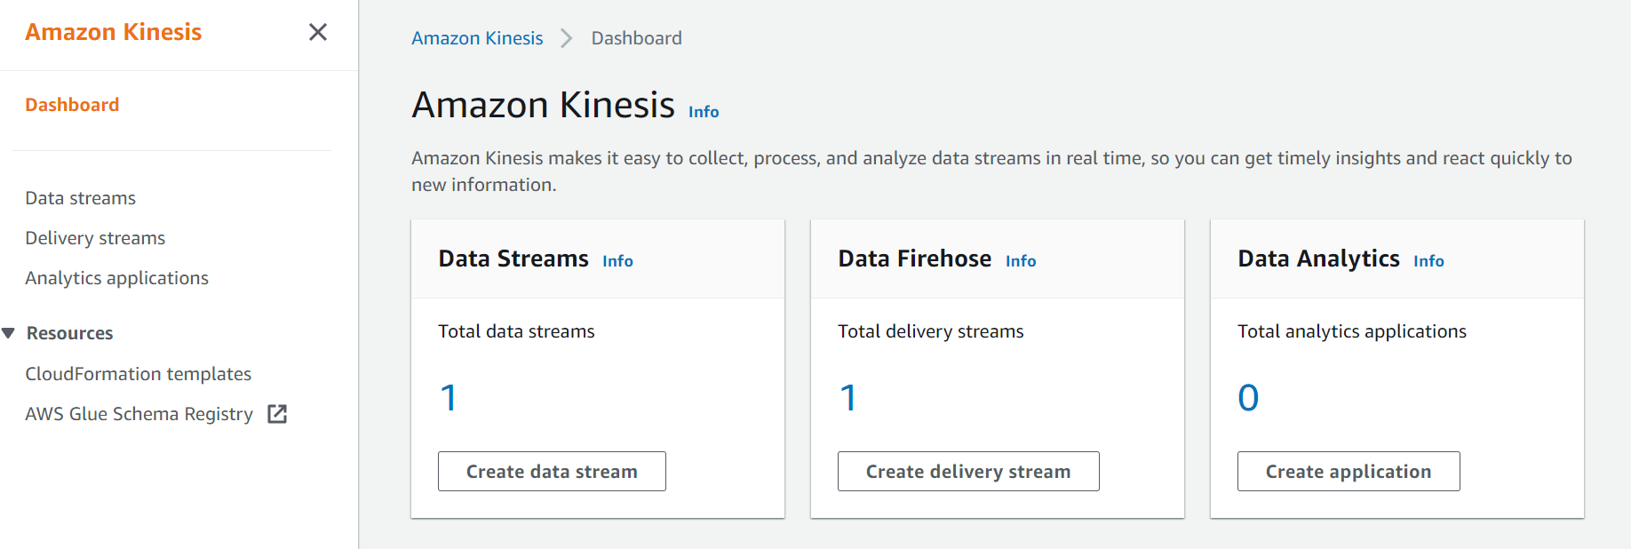
Aws Kinesis Dashboard

Slide 15
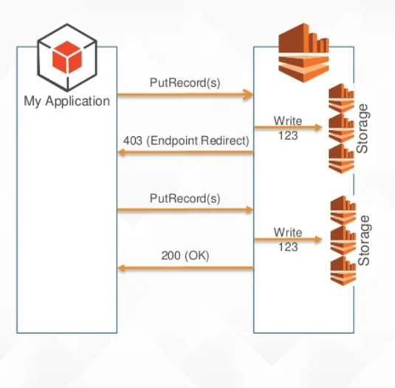
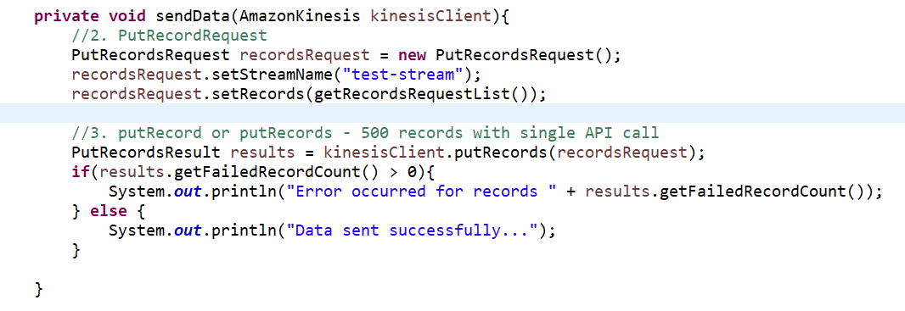
My Application to Kinesis

Slide 16
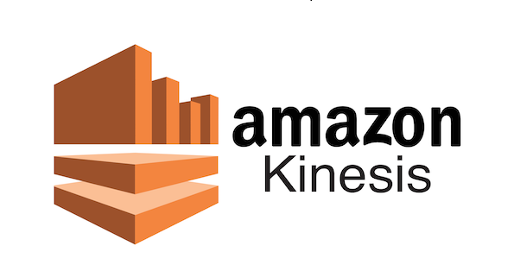
Conclusion
Amazon Kinesis Data Streams is a serverless streaming data service that makes it easy to capture, process, and store data streams at any scale.
You can use Amazon Kinesis Data Streams to collect and process large streams of data records in real time. You can create data-processing applications, known as Kinesis Data Streams applications. A typical Kinesis Data Streams application reads data from a data stream as data records

Slide 17


Thank You
Any Queries ?

