Slide 1
Tech Stack Information
&
POC on ActiveMQ with Spring boot
(uses Angular App to send/receive messages)

Slide 2

Development Tech Stack
User Interface
Html
Typescript
Backend Service
Java
Spring boot
Database
Sql Server
My Sql
Css/scss
Angular
Primeng
Material
ActiveMQ
JMS
Hibernate
Spring Data JPA
Jwt tokens
No SQL’s
Mongo Db etc
Tomcat Server
Spring Web
Maven
Other Libs (Spring security, log 4j, swagger, gjson etc)
Npm
3rd party libs based on requirements (file saver, pdf viewer, socket etc.)

Slide 3
Reasons to Select these tech stack
Spring Boot | Spring
Spring Boot is a module of Spring Framework. It allows us to build a stand-alone application with minimal or zero configurations. It is better to use if we want to develop a simple Spring-based application or RESTful services. | Spring Framework is the most popular application development framework of Java. The main feature of the Spring Framework is dependency Injection or Inversion of Control (IoC). With the help of Spring Framework, we can develop a loosely coupled application. It is better to use if application type or characteristics are purely defined.
Angular Over React
Angular is a full-fledged framework, while React is a library. React. js uses virtual DOM and one-way data binding while Angular operates on real DOM & two-way data binding. There's also a difference in bundle size (React's smaller) and speed (React works a bit faster).
Active MQ over Kafka
ActiveMQ is used for traditional messaging, Kafka is used as streaming platform (messaging + distributed storage + processing of data). And, here we are using Active MQ as integration purpose. And to sync with existed system we preferer Active MQ than Kafka

Slide 4
POC on Active MQ with Spring Boot
Sending Messages to Active MQ
Receiving Messages from Active MQ
Tech Stack for POC
Html, scss, TypeScript , Angular, Primeng , Material
Active MQ
Java, Spring boot, Spring web, Spring WebSocket etc…

Slide 5
Sending/Producing Messages
To ActiveMQ
Active MQ
Web/ Mobile
Angular App
Spring boot App
Spring boot App
Angular App
Web/
Mobile
User
Ui app
Backend Service
Ui app
User
Request
Http
Response

Slide 6
Receiving/Consuming Messages
From ActiveMQ Via WSS
Producer
Active MQ
Web/ Mobile
Angular App
Spring boot App
Spring
boot App
Angular App
Web/
Mobile
User
Ui app
Backend Service
Ui app
User
Request
wss
Response

Slide 7
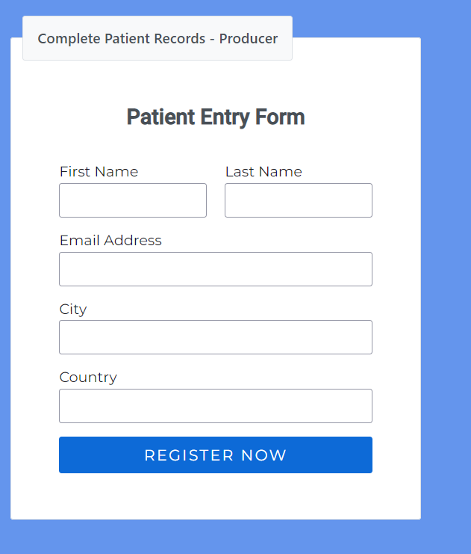
Produces Message from UI
Created an UI Application which generates or sends message to Active MQ via Spring boot.
Eg: created patient entry form as an example to send message from UI (Web/Mobile)

Slide 8
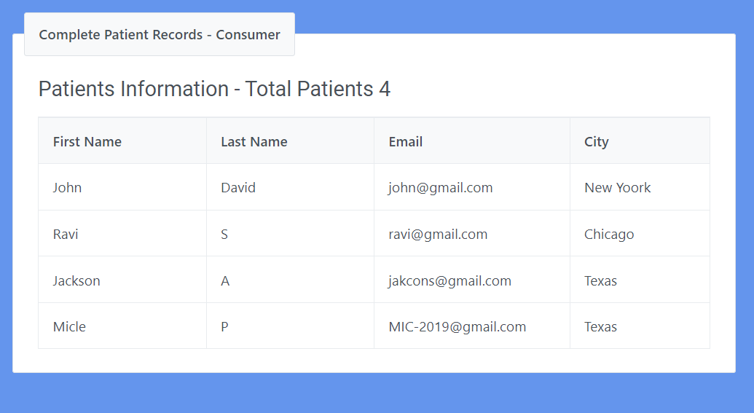
Receives Message from Active MQ to UI
Created an UI Application which receives message from Active MQ via Spring boot with WebSocket.
Eg: created patient list table which receives data from Active MQ (Spring boot). when user sends Information form Other UI App(Web/Mobile) this table will get that data without refresh

Slide 9
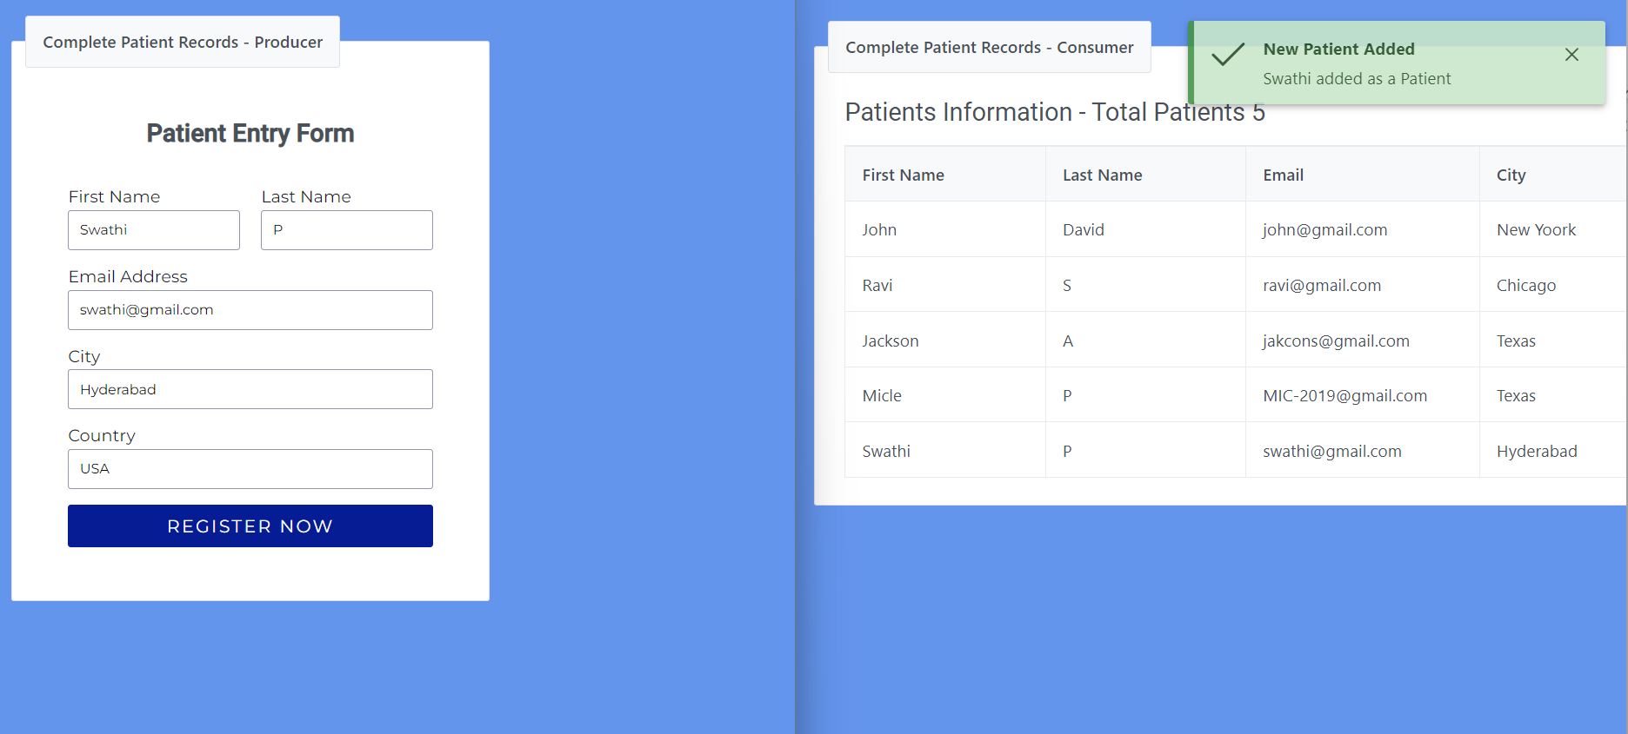
Sending and Receiving Data
http://localhost:4200
http://localhost:4200/cpm-consumer

Slide 10

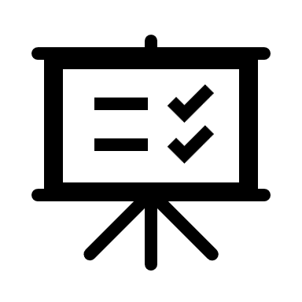
Let’s
See
Demo

