Slide 1
POD
Management System
User Interface

Slide 2
Name | Technology
Angular 13 | Framework
Typescript | Scripting Language
Html | Markup Language
SCSS | Styling
Primeng, Angular Material | UI Tool Kit – in build components
Bootstrap | Css Lib
Tech Stack

Slide 3
/login
Login
Top Menu Comp
Index.html
App Module
App Component
Side Nav Comp
/dashboard
Dashboard
/course
Course Details
.
.
.
.
.
.
Architecture

Slide 4
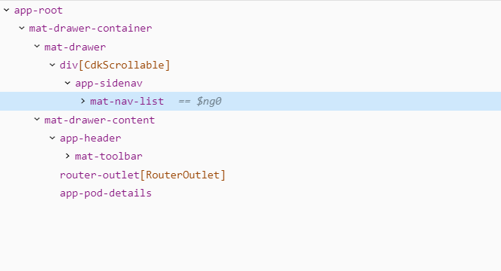
Component flow Structure

Slide 5
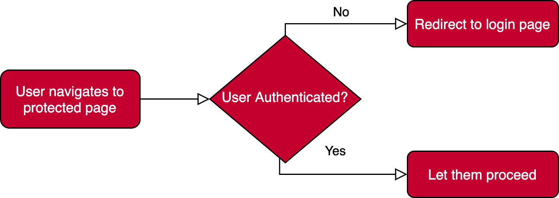
Auth guard
/dashboard
/course
.
.
.
Security Flow in UI for Other screens

Slide 6
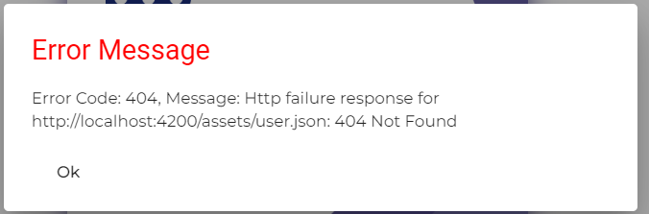
Valid Credentials
/dashboard
Login
Http Interceptor
Error Message Comp
Invalid Credentials
Global Error Handler

Slide 7


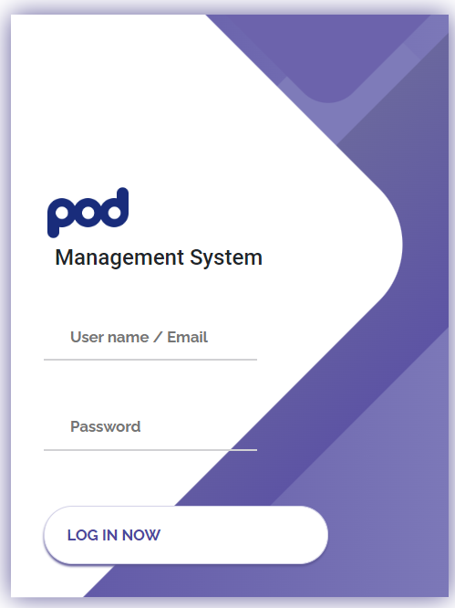
Login Screen

Slide 8
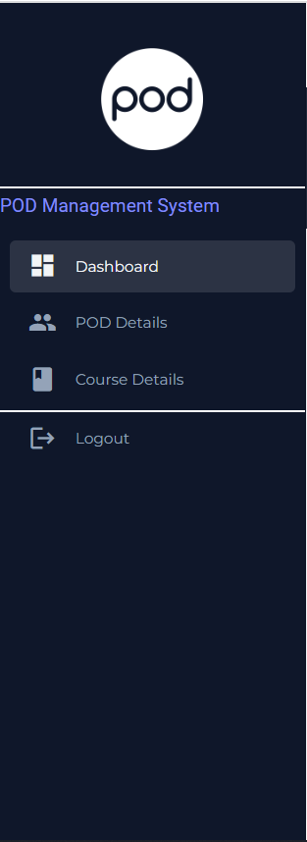
Side Menu

Slide 9
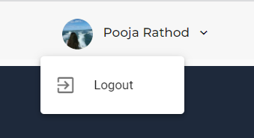
Top Menu
Profile Picture and Name with Logout

Slide 10
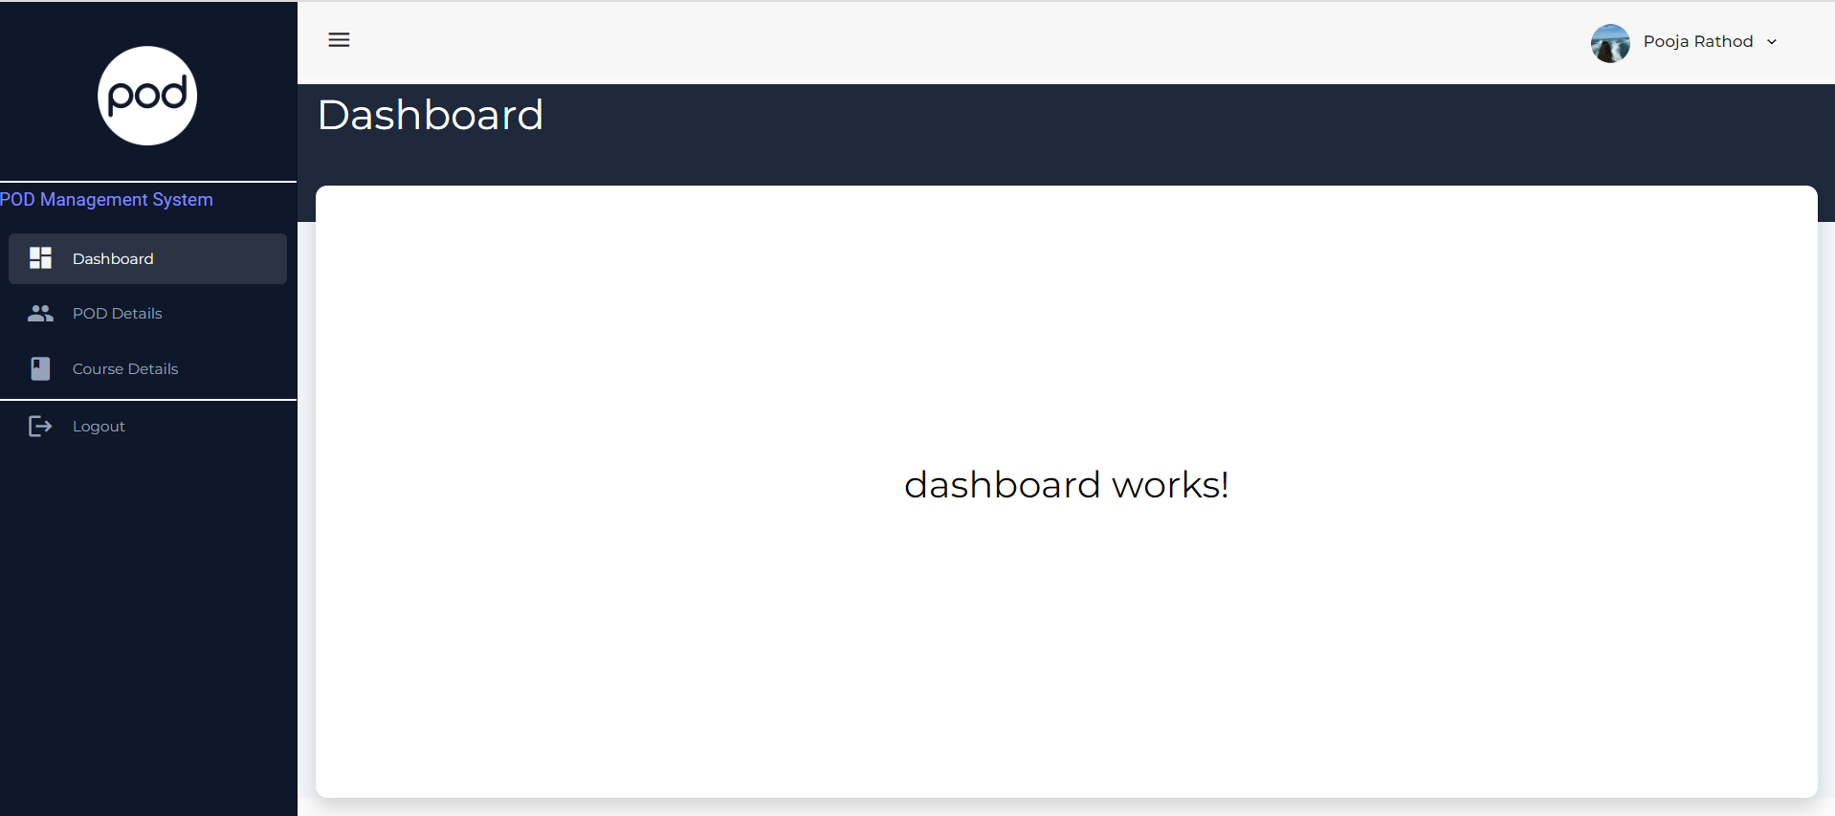
Dashboard

Slide 11
Any Questions
???
Thank You
Pooja Rathod

