Slide 1

Front-End Bootcamp with Angular
Kamil KAPLAN

Slide 2

Front-End Bootcamp with Angular
Kamil KAPLAN

Slide 3
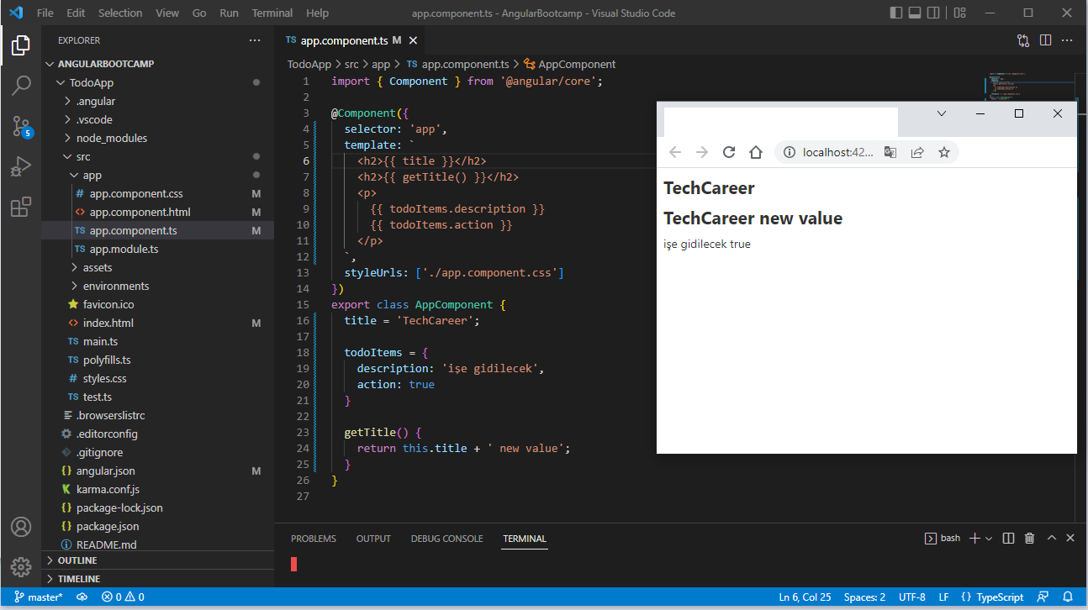
Geçen Hafta Hatırla - Templates

Slide 4
Styles
app.component.css : ilgili component ve onun altındaki componentleri etkiler
styles.css : uygulama genelini etkiler
Bootstrap Add :
https://getbootstrap.com/
(1) <link href="https://cdn.jsdelivr.net/npm/bootstrap@5.2.0-beta1/dist/css/bootstrap.min.css" rel="stylesheet" integrity="sha384-0evHe/X+R7YkIZDRvuzKMRqM+OrBnVFBL6DOitfPri4tjfHxaWutUpFmBp4vmVor" crossorigin="anonymous">
(2) npm install bootstrap@5.2.0 and styles.css > @import url("~bootstrap/dist/css/bootstrap.min.css");
(3) npm install bootstrap@5.2.0 and angular.json "styles": ["node_modules/bootstrap/dist/css/bootstrap.min.css"]

Slide 5
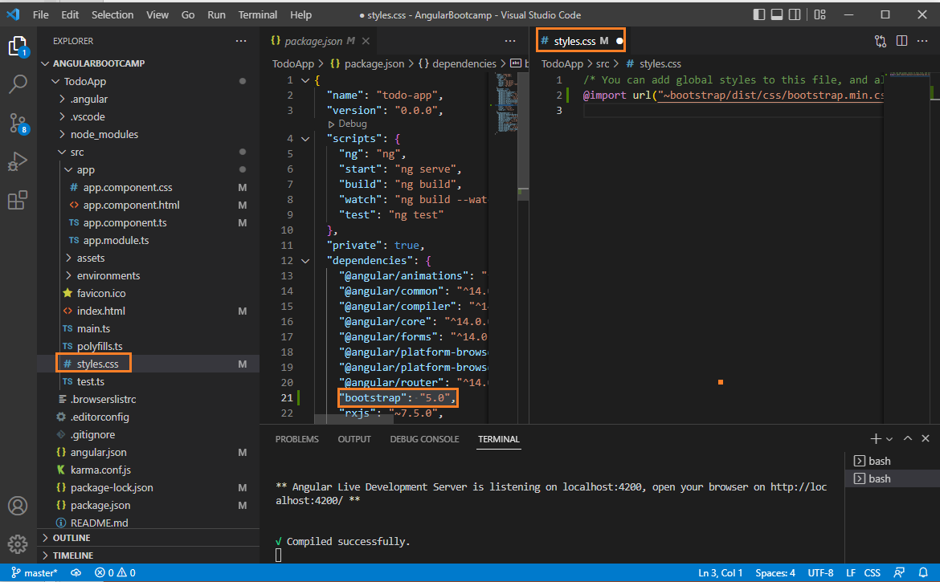
Styles

Slide 6
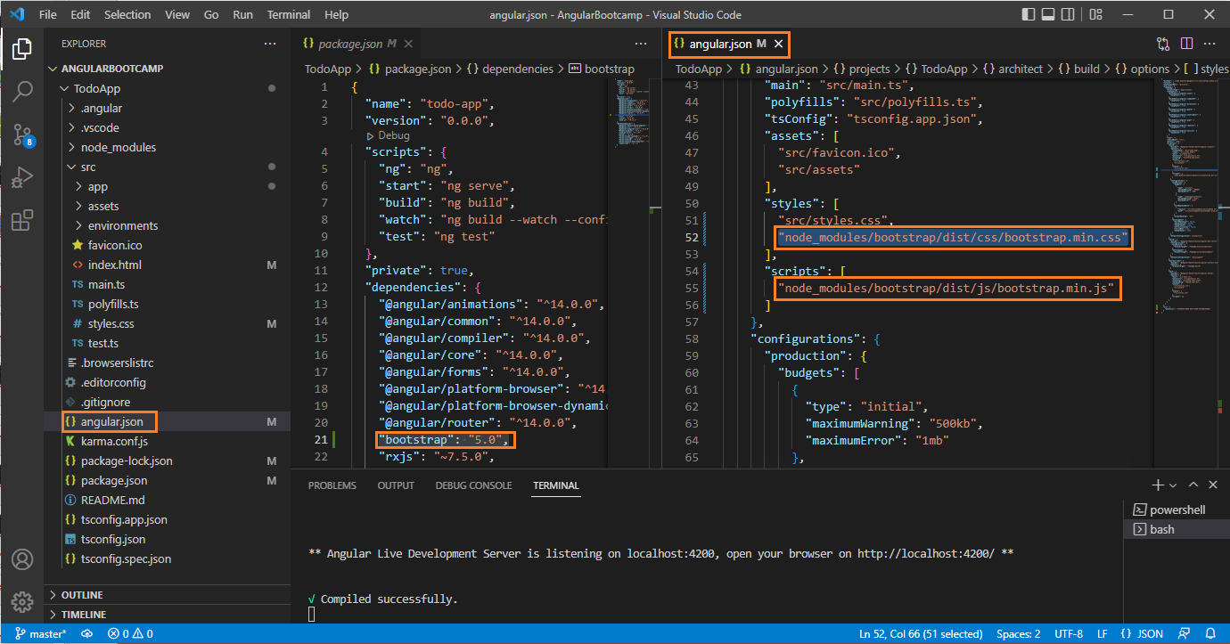
Styles

Slide 7
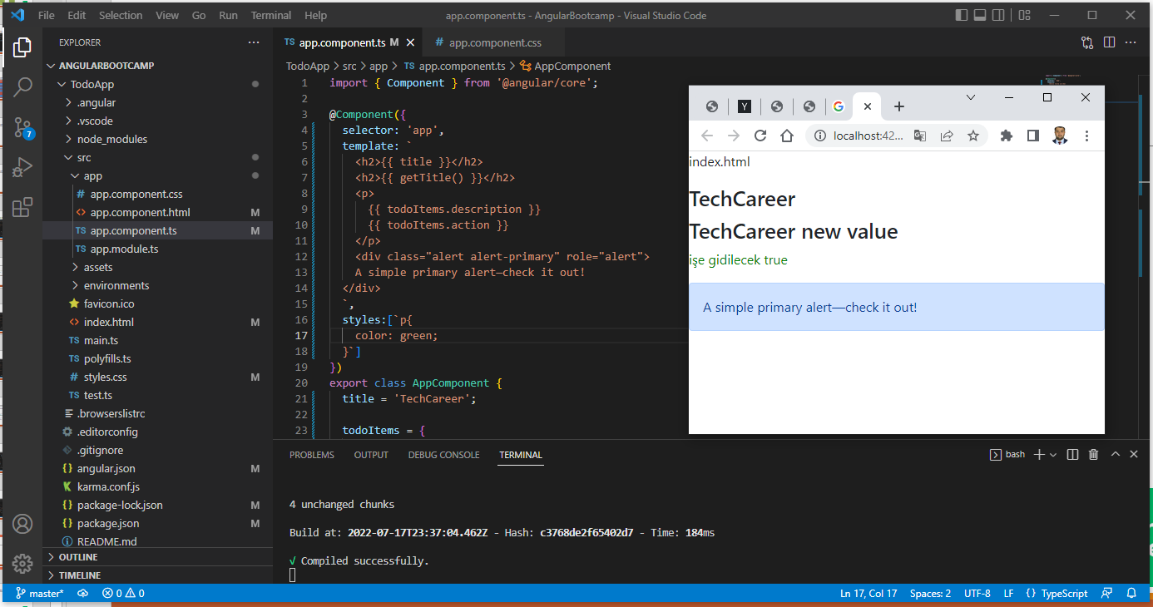
Styles

Slide 8
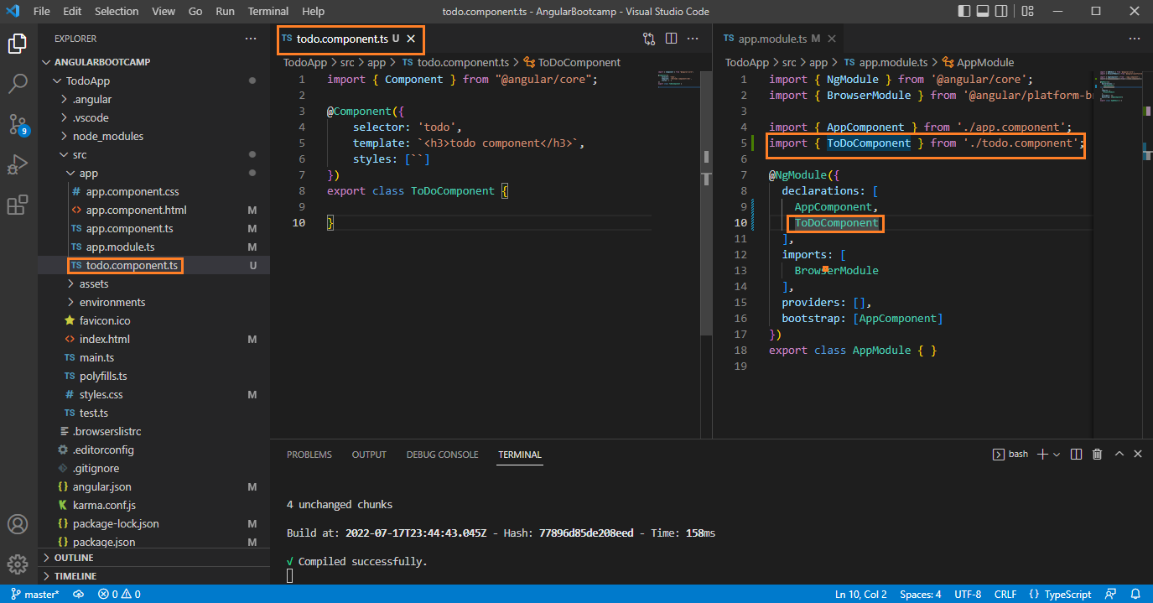
Component Ekleme

Slide 9
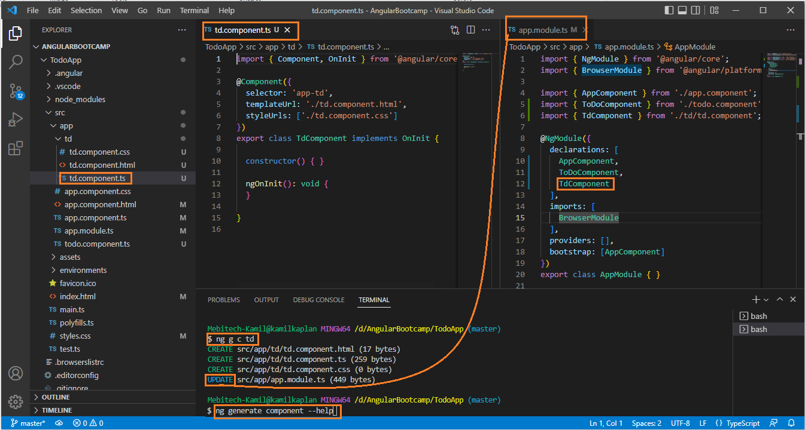
Component Ekleme

Slide 10
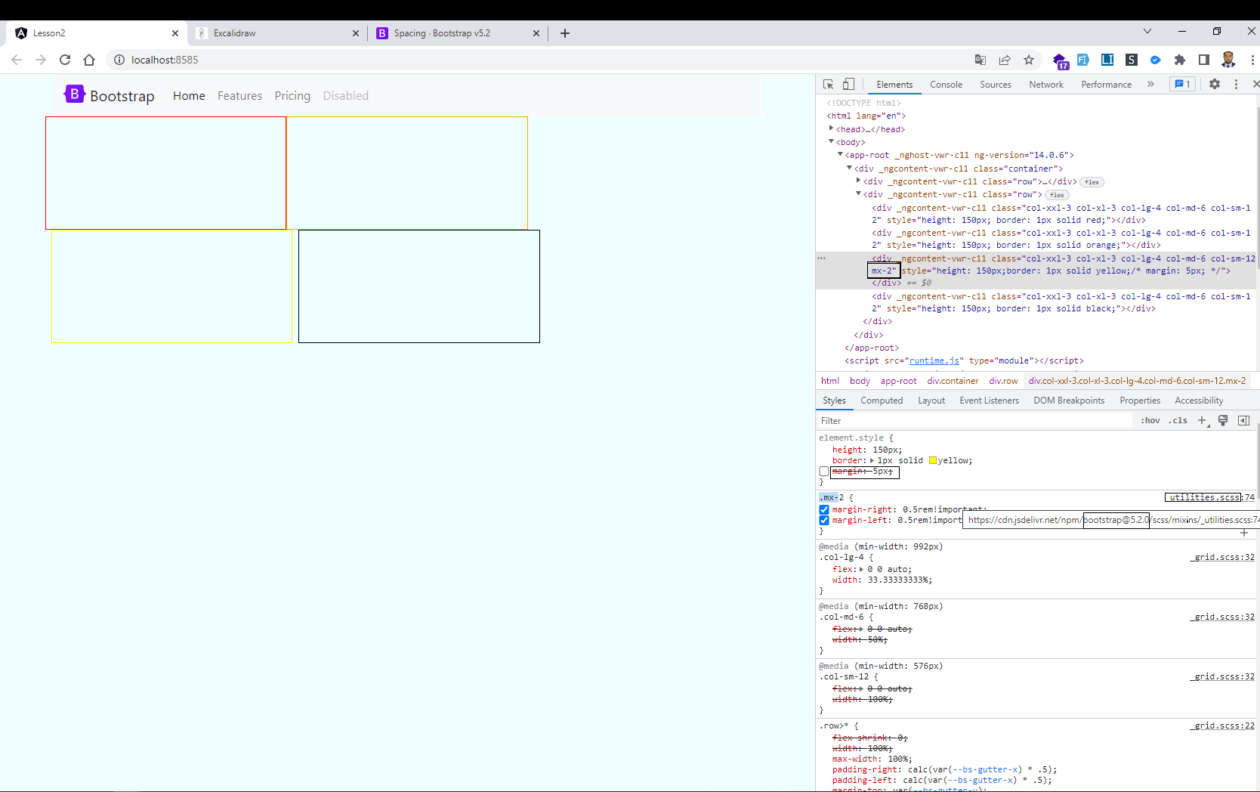
Ders - İçerik 1

Slide 11
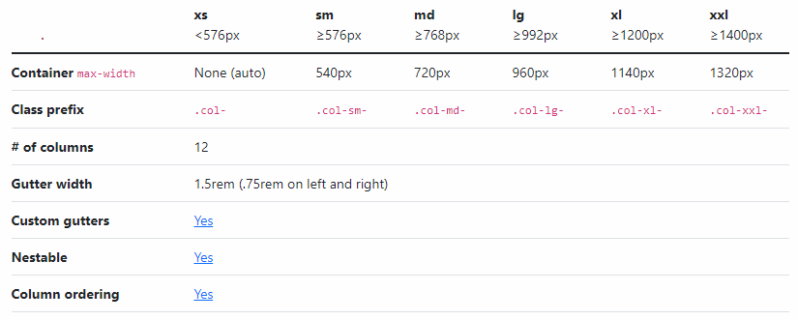
Ders - İçerik 2

Slide 12
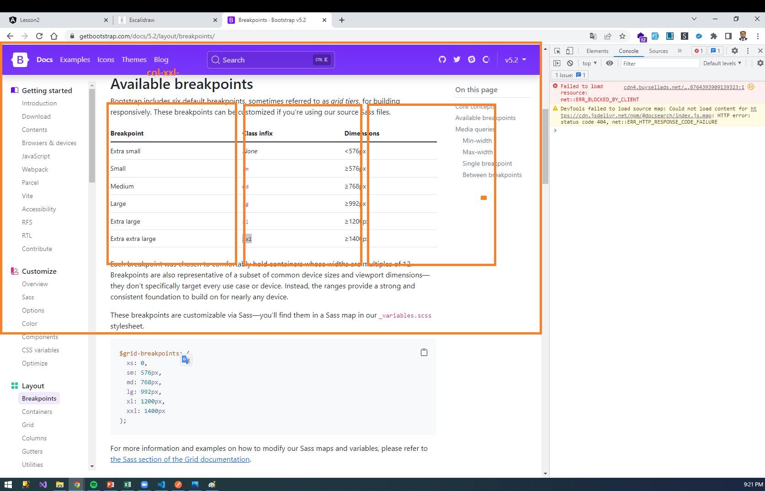
Ders - İçerik 3

Slide 13
Ders - İçerik 4
Kullanmayı düşündüğümüz paketler
https://loading.io/button/
https://alertifyjs.com/
https://www.npmjs.com/package/northwind-back-end
Chrome Extensions
https://chrome.google.com/webstore/detail/json-formatter/bcjindcccaagfpapjjmafapmmgkkhgoa?hl=tr
JSON Formatter

