Slide 1
diabetes_questions.csv
Input Question
diabetes_article_sections.csv
Process Questions
non-diabetes_article_sections.csv
N = #Questions
Merger of all questions
in a single string
List of questions
Merge
Query Generation
Answer Types
Focus
Target
Parts of Speech tags for words In the question
articles.csv
Passage ranking and Information Extraction
ANSWER

Slide 2
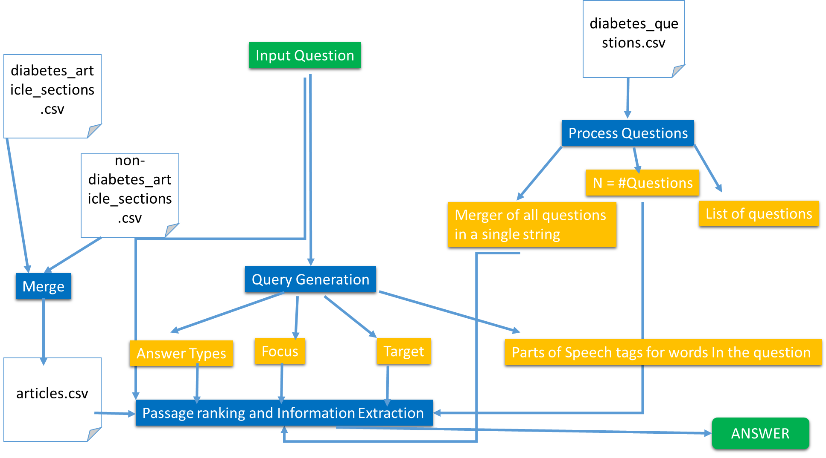

Slide 3
f(prefix + “diabetes” + suffix , target)
f is among
Intro
Symptoms
Exams and tests
Suppport groups
Prevention
Treatment
Function
Contact a medical professional
Prefix could be an adjective immediately before or after “diabetes”
Or
A verb or number within 3 words before “diabetes”
Suffix is a verb within 3
words after “diabetes”
Target is all nouns and verbs and words containing
“no” (like not, nothing, etc.) except
“diabetes”

Slide 4
