Slide 1
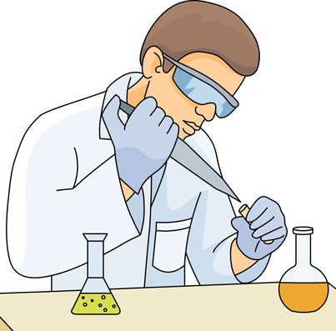







To quickly analyze our DNA using computers
Wet Lab
Chemical DNA molecule
must be first converted into
Chopped DNA Fragments
Sample
Collection
Sequencing
Library Preparation
Dry Lab (computational, what ALSER Lab contributes to)
Digital data that computers understand
String over an alphabet of four letters A, C, G, and T representing adenine, cytosine, guanine, and thymine, respectively
A | G | C | G | T | A | C | G | T
G | G | C | T | T | A | C | C | T
CCTCCTCAGTGCCACCCAGCCCACTGGCAGCTCCCAAACAGGCTCTTATTAAAACACCCTGTTCCCTGCCCCTTGGAAAGAAATCAAGAA…
A | A | A | G | T | G | G | G | G
Reads
Randomized fragments
of a genome
Raw Sequencing Data
Images, videos, or squiggles
Genomic Analyses
Since 1945, we are unable to do such conversion Due to technological & chemical barriers
But this is how we do it instead!

Slide 2

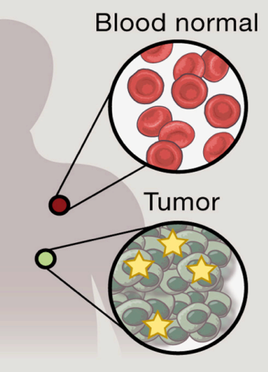








How to build back our complete DNA sequence?
A Difficult Puzzle
When we compare two unsolved puzzles
(e.g., reads from tumor cells compared to reads from healthy cells)
Reads need to be assembled to build back our complete DNA sequence, which is similar to solving a puzzle
A | A | A | G | T | G | G | G | G
G | G | C | T | T | A | C | C | T
A | A | A | G | T | G | G | G | G
T | A | C | C | T | G | G
Solving the Puzzle
By locating each read based on its similarity
with subsequences of a reference genome
A Very Difficult Puzzle
When we do not know the sample donor, we cannot determine which reference genome to be used. We end up using a huge database of all know reference genomes
Reference genome
Reads

Slide 3
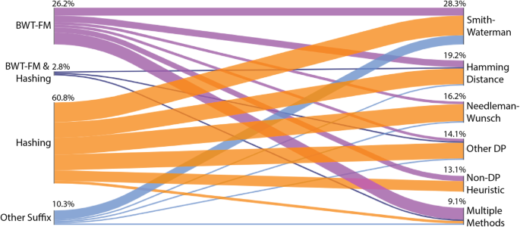
Our Research Goal
Genomic Data
Algorithms
Enable efficient computational genomic analyses
by rethinking the complete compute stack
Software
Hardware
Our Achievements Along with Collaborators in Genomic Analyses
Basecalling
Read Mapping
Sequence
Alignment
Pre-alignment
Filtering
Taxonomy Profiling
Review Papers & Critical Assessments
✓
organization
translation
cold
hacked
hold
accept
gold
Randomized
reads
Ref.
genome
✘
✓
Metagenomics sample
gold
Raw sequencing data
✘
Taxonomy report
✓
Species
A
Species
B
Species
C
Unknown
Omics Packaging and containerization
Nature Protocols 2024
SequenceLab
arXiv 2023
Critical assessment of metagenome interpretation
Nature Methods 2022
From molecules to genomic variations
CSBJ 2022
Technology dictates algorithms
Genome Biology 2021
Accelerating genome analysis
IEEE Micro 2020
Ordered reads
o | r | g | a | n | i | z | - | a | t | i | o | n
t | r | - | a | n | - | s | l | a | t | i | o | n
GateKeeper-GPU
IEEE T. Comp. 2024
SneakySnake-HLS
IEEE Micro 2021
SneakySnake
Bioinformatics 2020
Shouji
Bioinformatics 2019
GRIM-Filter
BMC Genomics 2018
GateKeeper
Bioinformatics 2017
MAGNET
IPSI Trans. 2017
80%
50%
Sequencing reads
Genome-on-Diet
arXiv 2024
GateSeeder
arXiv 2023
GenPIP
MICRO 2022
GenStore
ASPLOS 2022
AirLift
arXiv 2019
BLEND
NAR Gen. & Bio. 2023
Genome-on-Diet
arXiv 2024
MegIS
ISCA 2024
MetaFast
arXiv 2023
Demeter
IEEE Access 2022
Metalign
Genome Biology 2020
MiCoP
BMC Genomics 2019
QUETZAL
ISCA 2024
Scrooge
Bioinformatics 2023
AIM
Bioinformatics 2023
GenASM
MICRO 2020
SeGraM
ISCA 2022
RUBICON
Genome Biology 2024
RawAlign
arXiv 2023
TargetCall
AACBB 2023
GenPIP
MICRO 2022

