Slide 1
Objective:
- To automate the process of aligning skewed or rotated text in images for improved readability and OCR accuracy.
Key Techniques:
- Contour Detection:
Line Fitting:
Image Rotation:

Slide 2
Methodology
1. Contour Detection:
- Converts the image to grayscale and applies adaptive thresholding.
- Identifies contours of characters using OpenCV functions.
- Filters contours based on size to focus on significant text elements.
2. Line Fitting:
- Extracts bottom points from detected contours.
- Sorts these points by x-coordinate to establish a sequence.
- Fits a straight line through these points to determine the text baseline.
3. Image Straightening:
- Calculates the angle of the fitted line to determine the degree of rotation needed.
- Uses affine transformation to rotate the image and align the text horizontally.
- Ensures the entire image is transformed without losing information through proper padding and interpolation.
4. Validation and Testing:
- Validates the straightening process by visually inspecting marked images with contours and fitted lines.
- Tests the accuracy and effectiveness of OCR on the straightened images to verify improvements in text recognition.

Slide 3
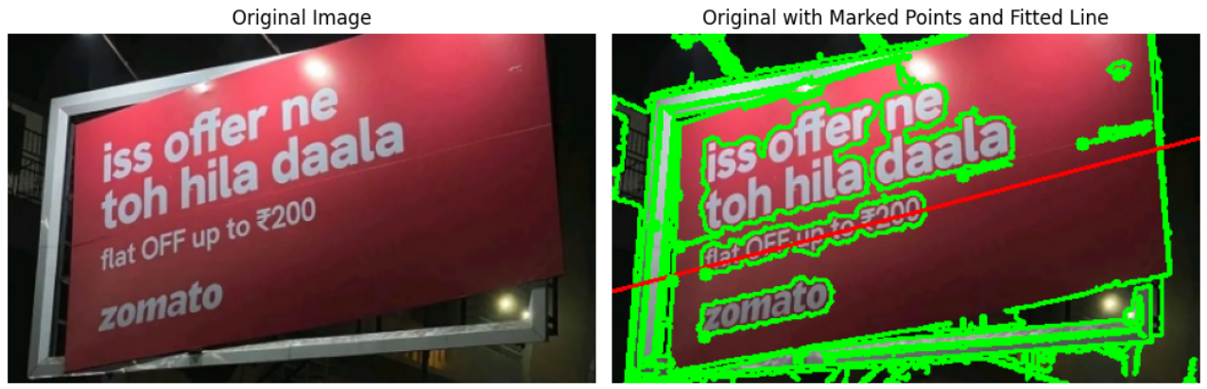
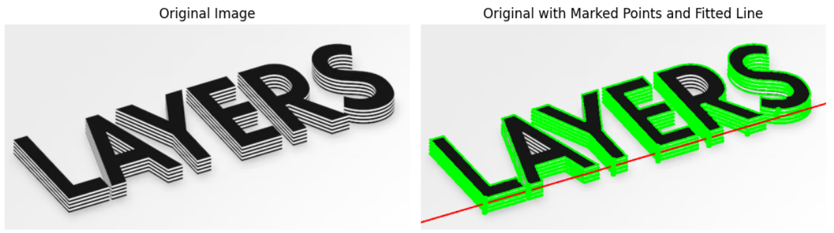
Results - Contour Detection
1. Contour Detection:
- Demonstrates the application of adaptive thresholding and contour detection on various images.
- Highlights the identification of individual characters or text regions through contour analysis.
- Visualizes the marked images with detected contours and the fitted line to illustrate the text baseline.
2. Example Visualizations:
- Displays examples of original images alongside their corresponding processed images with marked contours and fitted lines.
- Emphasizes the effectiveness of contour detection in isolating text elements for subsequent straightening and OCR.

Slide 4
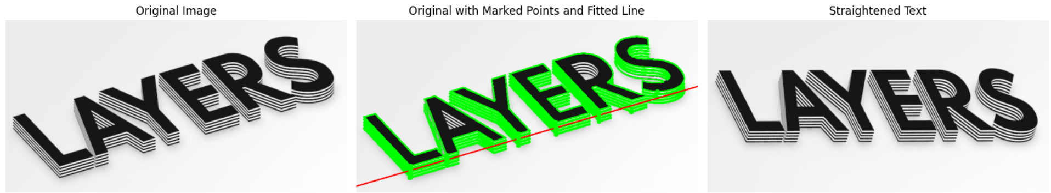
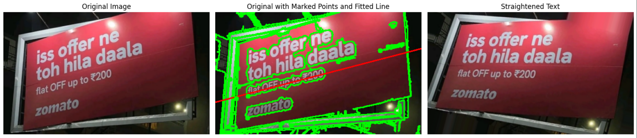

Results - Image Straightening
1. Image Straightening Process:
- Illustrates the process of aligning skewed or rotated text using the calculated angle from the fitted line.
- Shows examples of images before and after applying the rotation to straighten text horizontally.
2. Visual Comparisons:
- Displays side-by-side comparisons of original images and their corresponding straightened versions.
- Highlights the improvements in text alignment and readability achieved through image straightening.

Slide 5

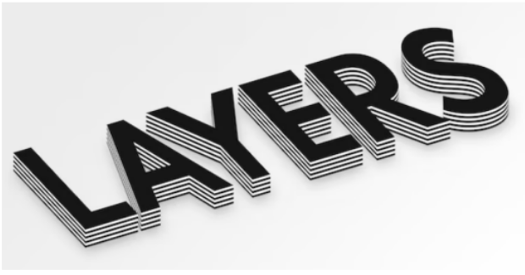


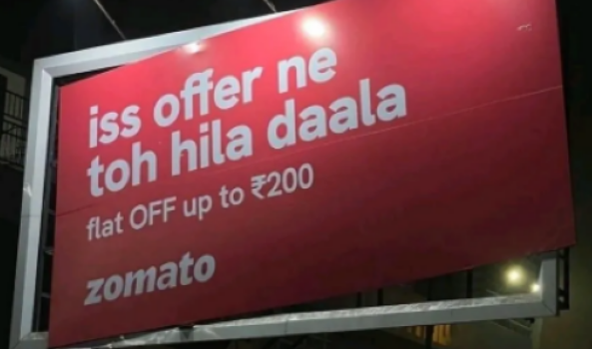

OCR Reading
Used easyOCR to extract texts from the image
Compared them before and after
Before
After

Slide 6
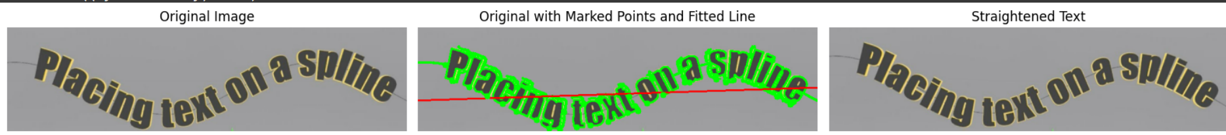
Limitations:

Slide 7
Future Improvements to be done
Curve straightening
Using the Spline approach

Slide 8
Work Done so far
Image Preprocessing Steps
1. Loading the Image:
- Use `cv2.imread` to load the image from a file path into a matrix format suitable for processing.
2. Converting to Grayscale:
- Utilize `cv2.cvtColor` to convert the loaded color image into a grayscale image, simplifying subsequent processing steps.
3. Applying Thresholding:
- Use `cv2.threshold` to transform the grayscale image into a binary image, setting a threshold value to distinguish between foreground and background pixels.
Filtered Contours
Why Filter Contours?

Slide 9
Spline Interpolation
Purpose and Application:
- Spline interpolation transforms discrete data points into a smooth, continuous curve.
- Essential in image processing for accurate representation and enhancement of curves and contours.
Centroid Calculation and Curve Drawing
Role of Centroids:
- Centroids define the central points of contours, crucial for spline interpolation.
- Calculated using `calculate_centroids` function from detected contours.
Drawing Smoothed Curves:
- Utilize spline interpolation to create smooth curves through centroid points.
- Overlay smoothed curves using `cv2.line` on the original image to enhance contour clarity.

Slide 10

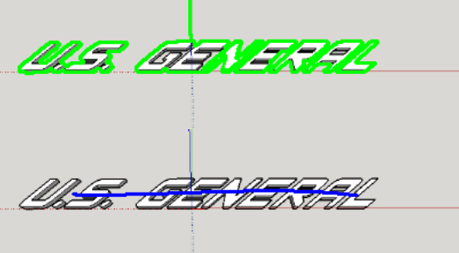
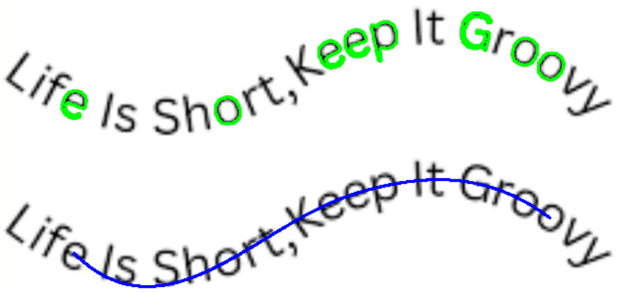
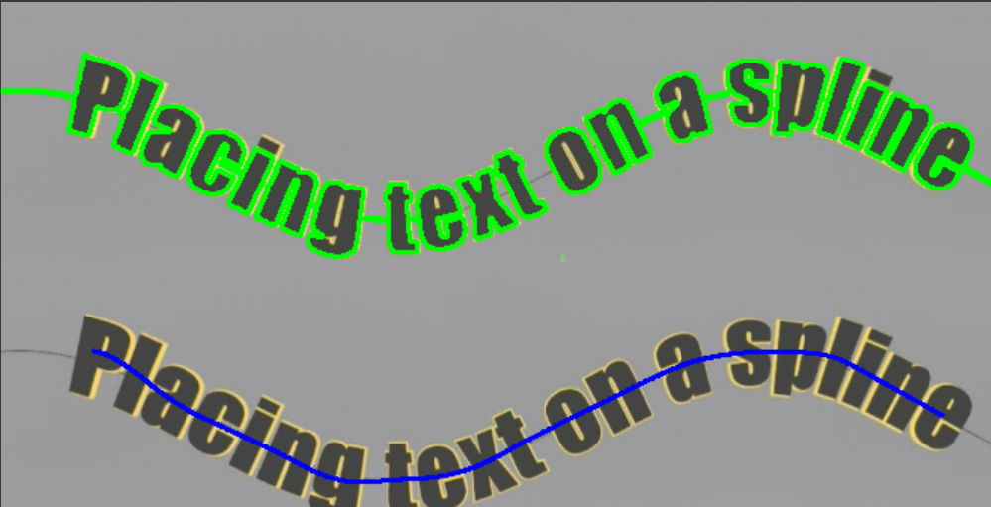
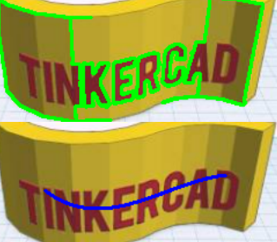
Results

Slide 11
Work To be Done in Future:
Creating the perspective transforming matrix
Rotation and testing of the model after spline straightening
Credits:
Text Perceptron: Towards End-to-End Arbitrary-Shaped Text Spotting by Liang Qiao, Sanli Tang, Zhanzhan Cheng, Yunlu Xu, Yi Niu, Shiliang Pu, Fei Wu
Reading Arbitrary-Shaped Scene Text from Images Through Spline Regression and Rectication by Long Chen, Feng Su, Jiahao Shi, and Ye Qian
Unwrapping Low-rank Textures on Generalized Cylindrical Surfaces by Zhengdong Zhang, Xiao Liang, and Yi Ma

