Slide 1

Mail Block Guided by Submitted by
Prof. Sakshi Abhishek Rai (1602913002) Anup Kumar Singh (1602913015) Archit Rastogi(1602913018) Presentation no. : 5 Group no. : LG-3 DEPARTMENT OF INFORMATION TECHNOLOGY,
KIET GROUP OF INSTITUTIONS, GHAZIABAD, UTTAR PRADESH
(AFFILIATED TO DR. A.P.J. ABDUL KALAM TECHNICAL UNIVERSITY, LUCKNOW, UTTAR PRADESH, INDIA)

Slide 2
Abstract
In today’s digital world, data is of prime importance. The data carries confidential information of the user or organization that should be completely private to the owner. But the vulnerability of today’s information system may pose dangers such as data breach and data theft.
This system can be highly useful to governments and militaries around the world that can communicate their confidential information to anyone they need to without any security-related issues. This ultra-secure messaging service aims to enhance the safety and security of data.

Slide 3
Introduction
Data breach and data theft are of prime concern today.
Data confidentiality.
Encrypted network.
Aim of the project :
Messaging service that is fast and secure.
Does not includes involvement of any third party.

Slide 4
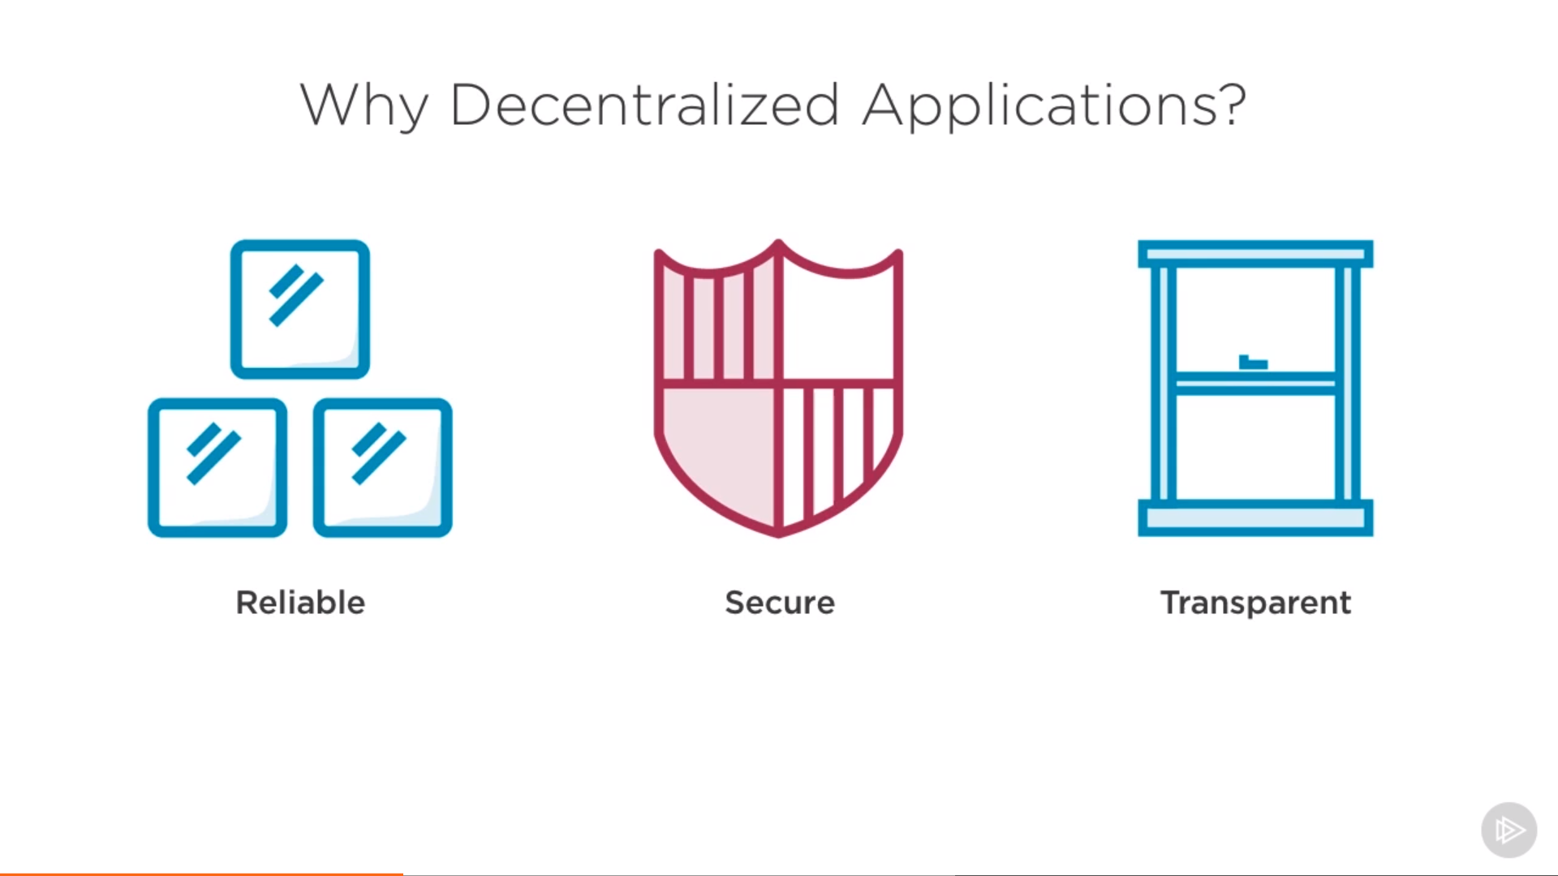
Figure 1 Why Decentralization?

Slide 5
Feasibility Study
Decentralized messaging systems are promising.
Many similar application has been developed.
Nearly impossible to breach.
Blockchain[4] is reliable.

Slide 6
Objectives
To build a decentralized and fully secure system.
End-to-end messaging service.
To enhance the fault tolerance.
Uses Blockchain for safe and fast communication.
Fast and fully secure messaging service.
To respect the privacy of user data in information systems today.

Slide 7
Data sent in the message could not be accessed by anyone.
In accordance with all the messaging standards.
Enhanced Security.
Data Confidentiality[1].

Slide 8
Technology
Python
Flask Framework
MySQL , CSS & HTML

Slide 9
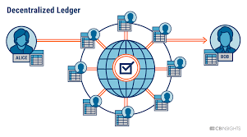
Figure 2 Decentralized Ledger

Slide 10
Mining Process
Mining requires huge amount of computing.
To solve a mathematical puzzle.
Proof-of-work algorithm[2].
Uses SHA-256 algorithm[3].

Slide 11
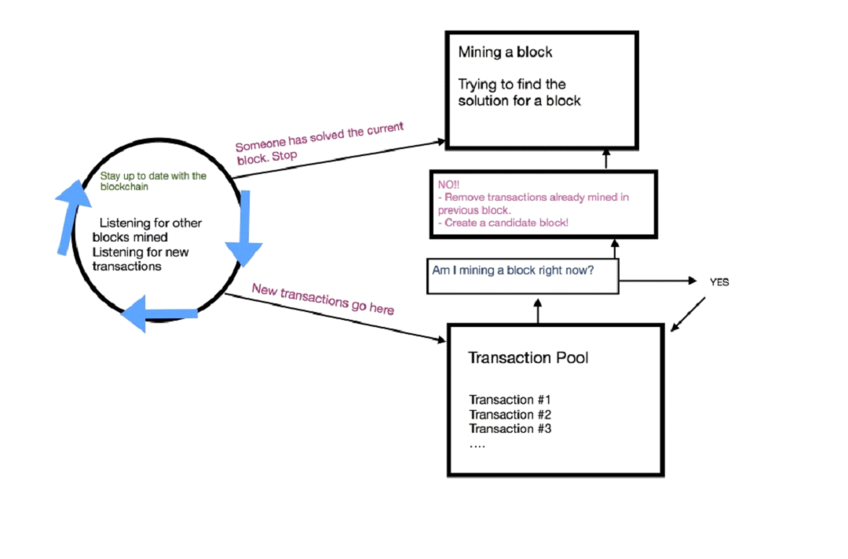
Figure 3 Mining Process

Slide 12
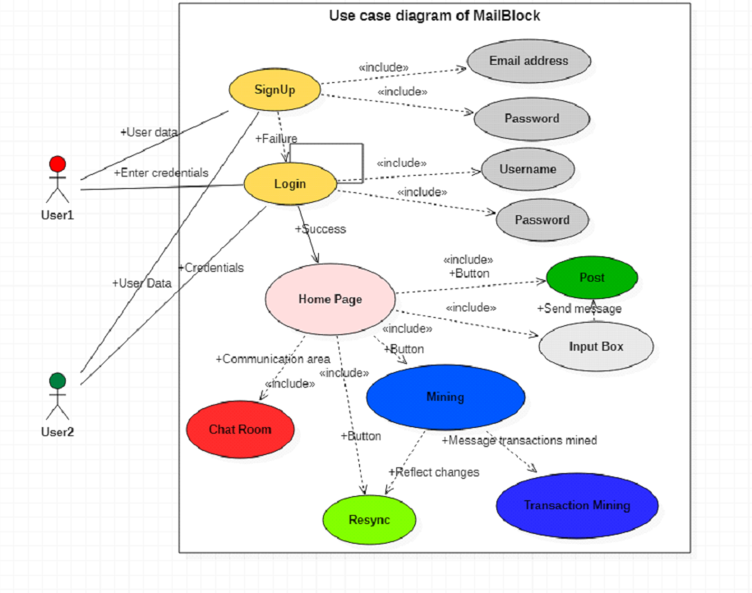
Figure 4 Use Case Diagram

Slide 13
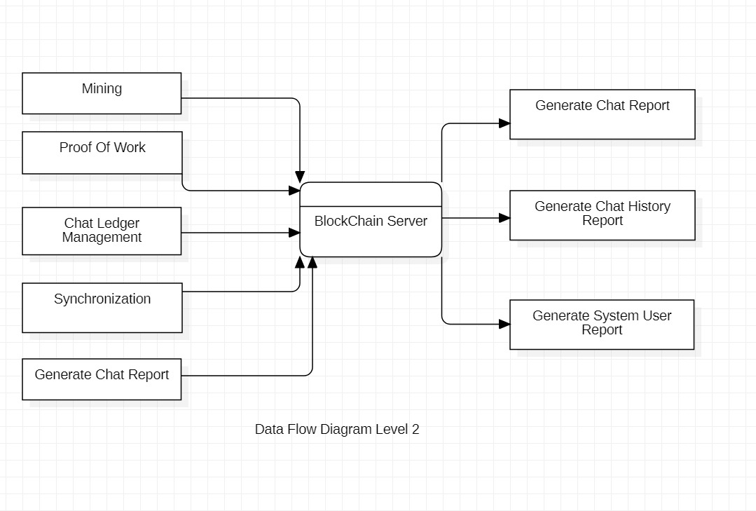
Figure 5 Data Flow Diagram

Slide 14
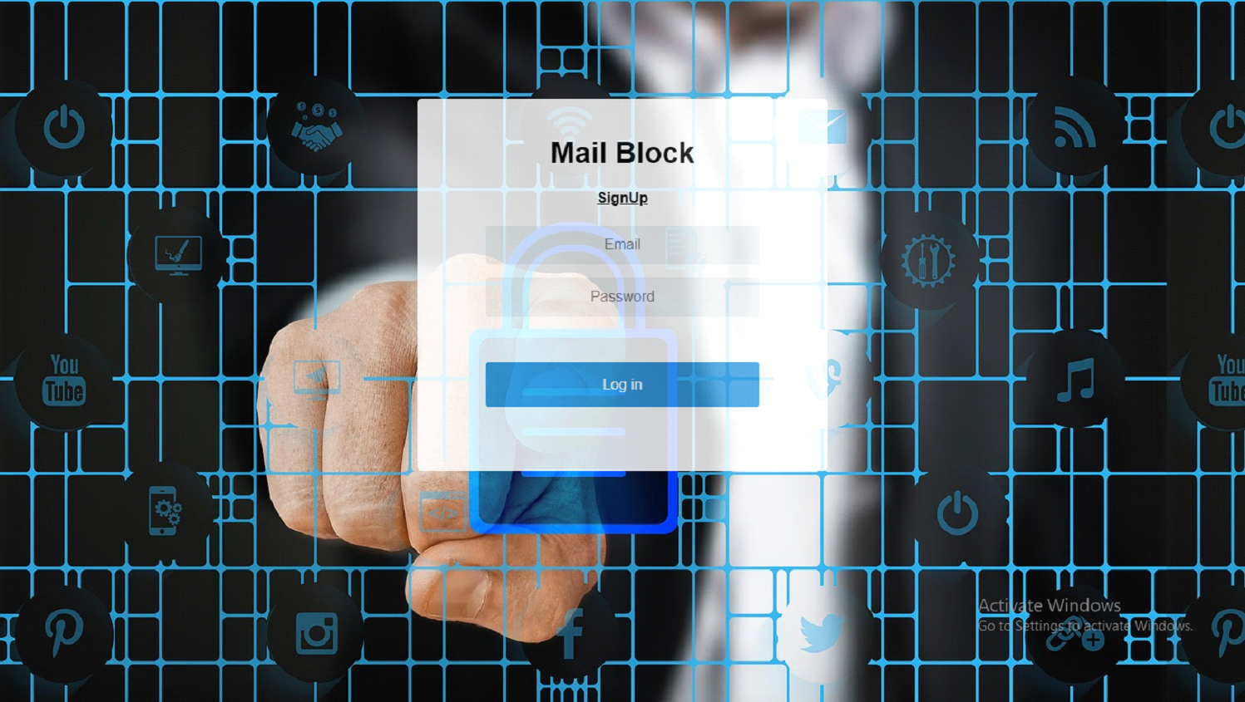
Figure 6 Login Page
18th May 2020

Slide 15
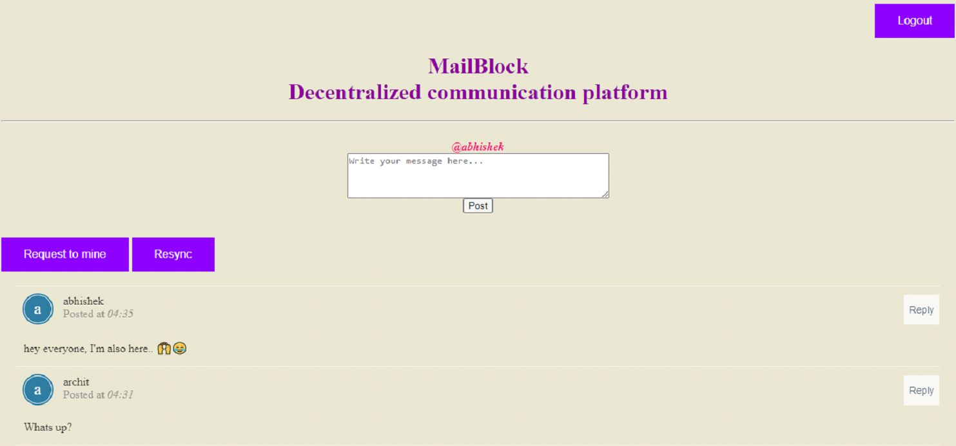
Figure 7 Home Page
18th May 2020

Slide 16
Conclusion
The project Mail Block aims to provide a safe, secure, and fast way to communicate confidential information between users.
The decentralized system uses concepts of blockchain to create an efficient network that is capable of transmitting messages.
With data privacy being more important today, such systems are highly useful to users, organizations, and governments around the world.
18th May 2020

Slide 17
References
[1] https://www.dappuniversity.com/
[2] https://bitcoin.org/bitcoin.pdf
[3] Blockchain Innovation Conference-“The Future of Blockchain and AI”, David Birch
[4] https://flask.palletsprojects.com/en/1.1.x/

Slide 18
Thank You

