Slide 1
ST: BIG DATA ANALYTICS
(CS 696-16) (FA18)
Project 2
“Classification and Clustering Analysis of Breast Cancer Wisconsin (Diagnostic) Data Set”
Submitted By
Ashok Kumar Shrestha

Slide 2
Contents
Introduction
Data Visualization
Methods
Results and Discussion
Conclusion

Slide 3
Introduction:
Data set: Breast Cancer Wisconsin (Diagnostic) data set.
Kaggle
UCI Machine Learning Repository
Sklearn
Classifiers: KNN, Logistic regression, Decision tree, Random forests, MLP and SVM.
Clustering: K-Means Clustering, Hierarchical Agglomerative Clustering and Spectral Clustering.
Preprocessing: StandardScaler.

Slide 4
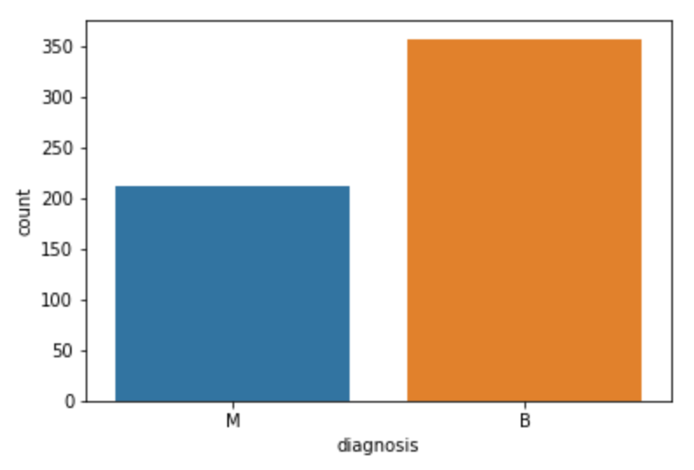
Data Visualization:
Attributes: 33 features: radius , texture, Perimeter , area, smoothness, compactness, concavity, concave points, symmetry, fractal dimension.
mean, standard error and "worst" or largest (mean of the three largest values) computed.
Class: M - Malignant, B - Benign
#Samples: 569

Slide 5
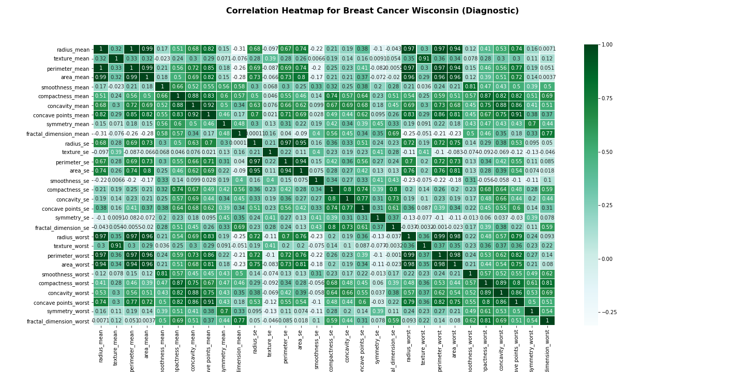

Slide 6
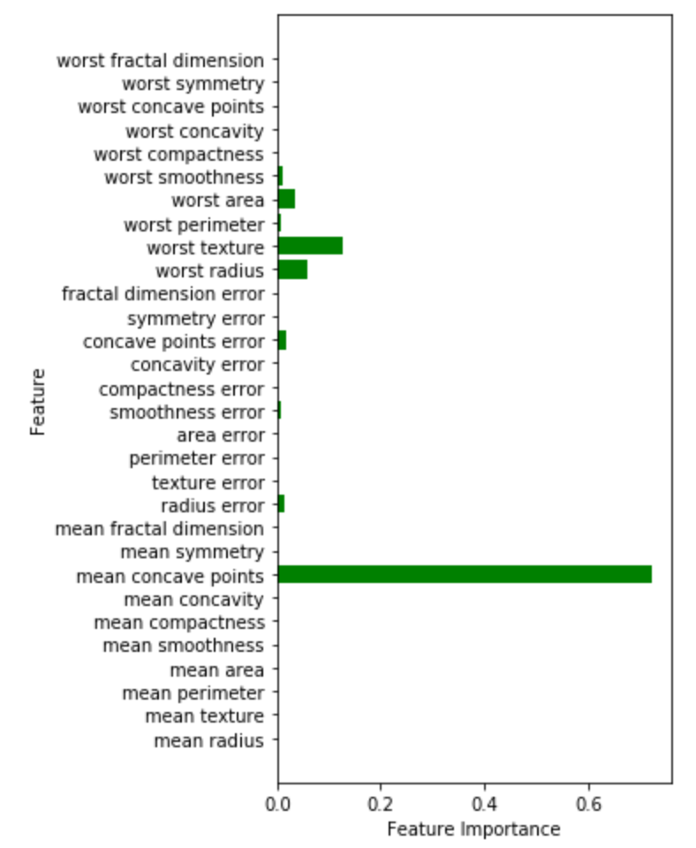
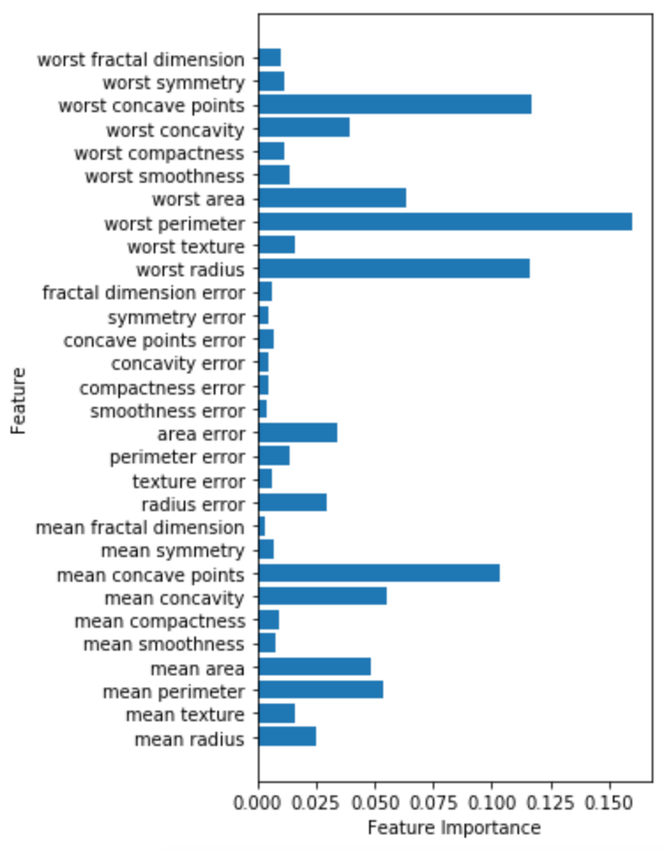

Slide 7
Methods:
Classification algorithms:
KNN
Logistic regression
Decision tree
Random forests
MLP
SVM
Clustering algorithms:
K-Means Clustering
Hierarchical Agglomerative Clustering
Spectral Clustering
Preprocessing: StandardScaler

Slide 8
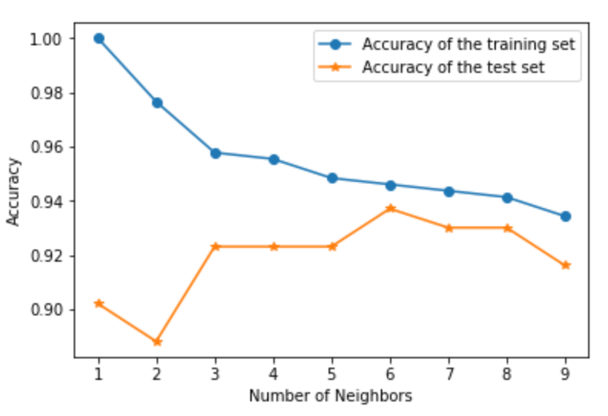
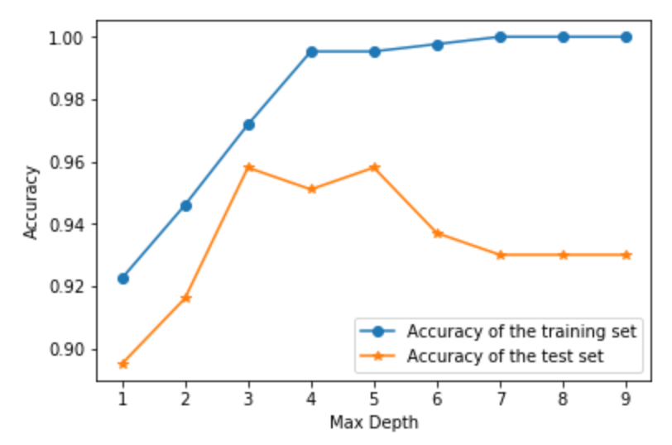
Results and Discussions:
KNN Classifier
Decision Tree

Slide 9
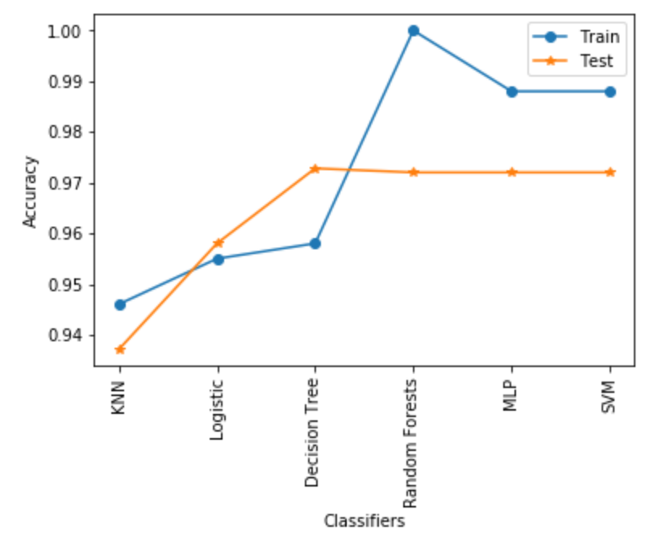
Comparing Classifiers

Slide 10
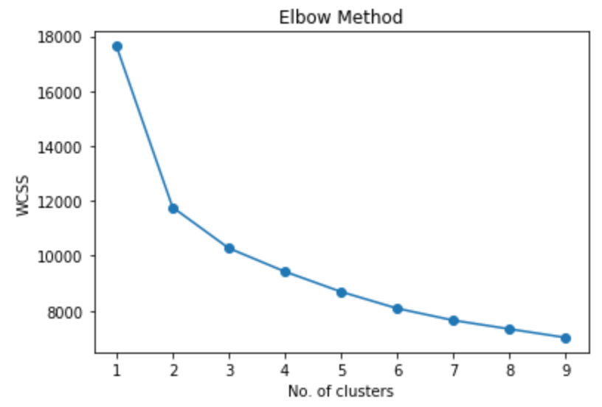
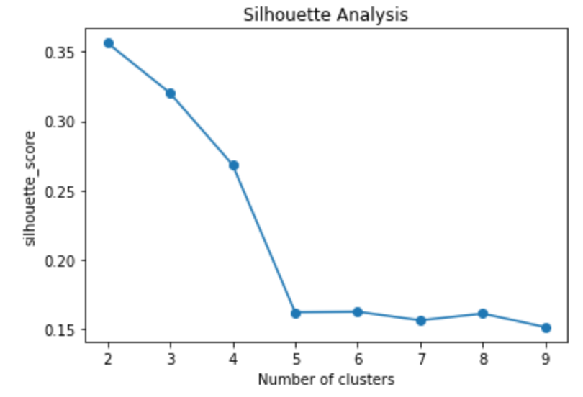
Finding optimal number of clusters

Slide 11
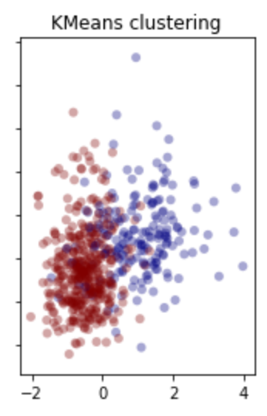
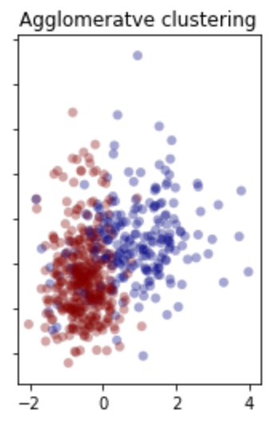
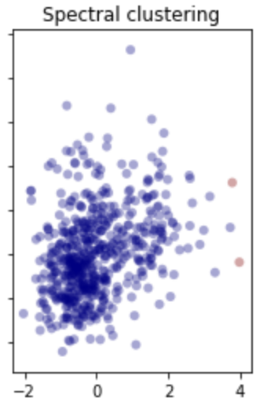
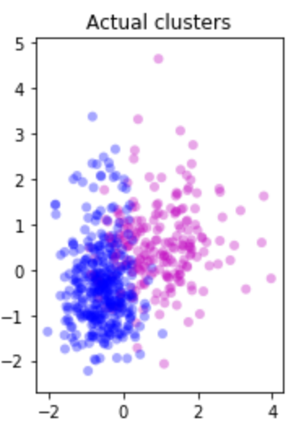
Clustering

Slide 12
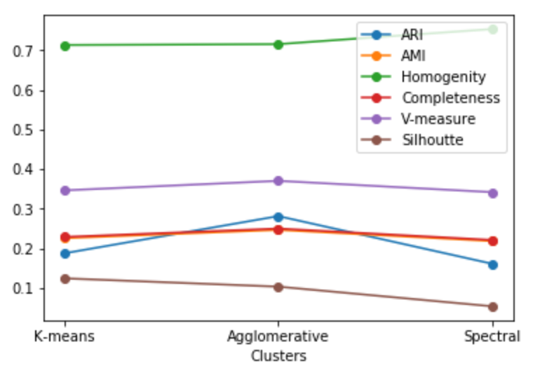
Cluster Validation

Slide 13
Conclusion:
Decision tree performs best for this data set.
Tuning hyperparameter to increase accuracy and overcome overfitting.
Data set visualized and analyzed using different clustering algorithms.
K-Means clustering performed better for this data set.

Slide 14
References:
Breast Cancer Wisconsin (Diagnostic) Kaggle challenge: https://www.kaggle.com/uciml/breast-cancer-wisconsin-data/home
UCI Machine Learning Repository: https://archive.ics.uci.edu/ml/datasets/Breast+Cancer+Wisconsin+(Diagnostic)
Sklearn data set: http://scikit-learn.org/stable/modules/generated/sklearn.datasets.load_breast_cancer.html

