Slide 1



ST: BIG DATA ANALYTICS
(CS 696-16) (FA18)
Project 3
“Credit Card Fraud Detection”
Submitted By:
Ashok Kumar Shrestha
Image source : Google

Slide 2
Contents
Introduction
Data Visualization
Methods
Results and Discussion
Conclusion

Slide 3
Introduction:
Data set: Credit Card Fraud Detection
Kaggle
Classifiers: Logistic regression, KNN, SVC and Decision tree.
Data: European customers for credit card transactions.
Dataset: highly skewed and unbalance with 0.17% of fraudulent transactions

Slide 4
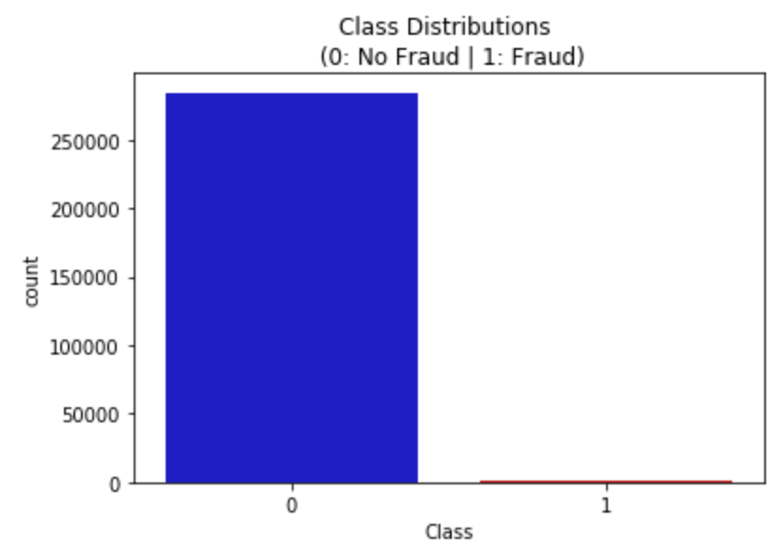
Data Visualization:
Attributes: 30 features: V1, V2, … V28, Time, Amount.
Values: PCA applied.
Class: 1 - Fraud, 0- Non fraud.
#Samples: 284315.
#fraud samples: 492.

Slide 5
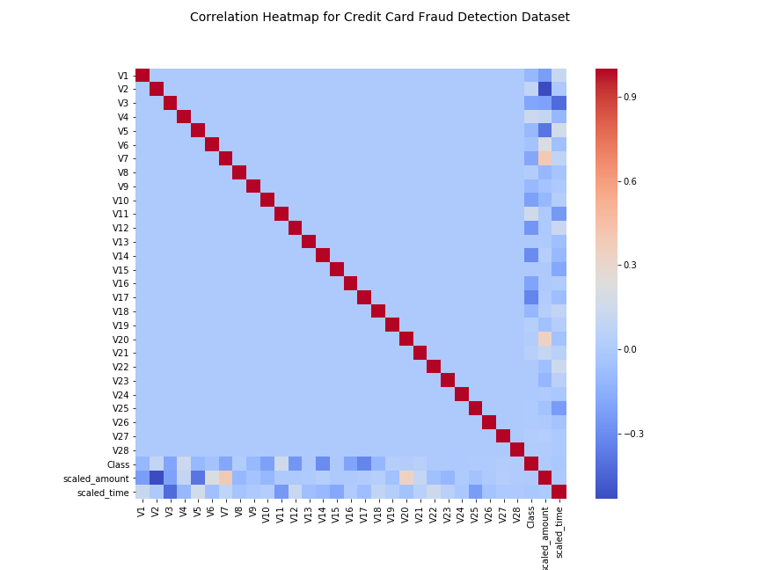

Slide 6
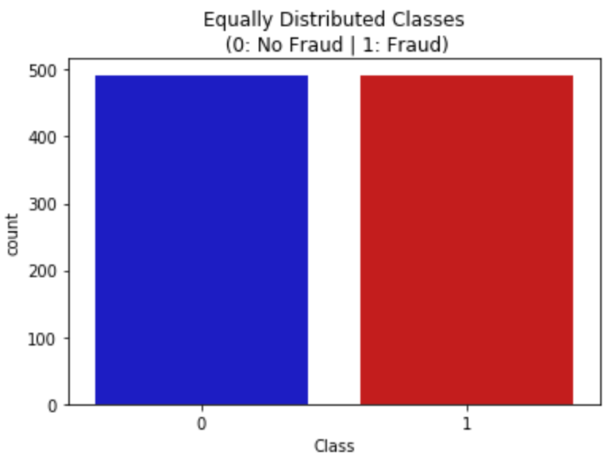
Skewed Datasets: Solutions
Collect more data
Performance Metric:
Confusion matrix
F1-score
ROC curve
Resampling:
Over-sampling
Under-sampling

Slide 7
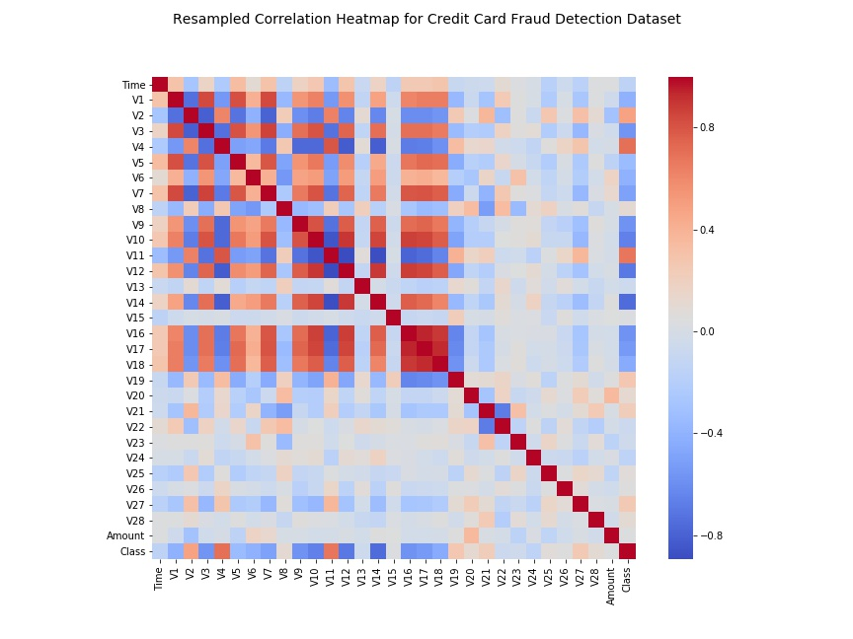

Slide 8
Methods:
Classification algorithms:
Logistic regression,
KNN
SVC
Decision tree
Preprocessing: PCA and StandardScaler

Slide 9
Random Undersampling
Equal distribution of both class.
50/50 fraud and non-fraud transactions (492 each).
Large amount of information is lost.
Might compromise the model designed.
Separate datasets for training-testing model.

Slide 10
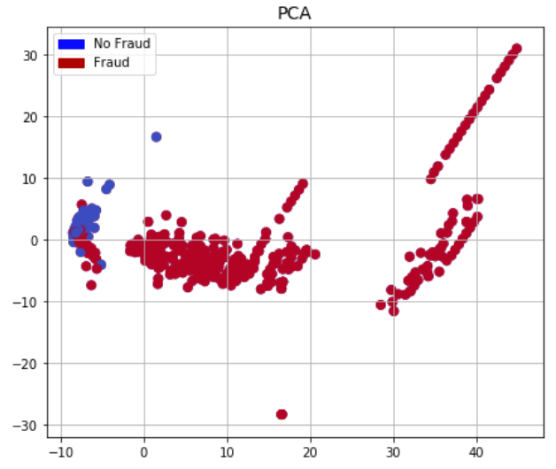
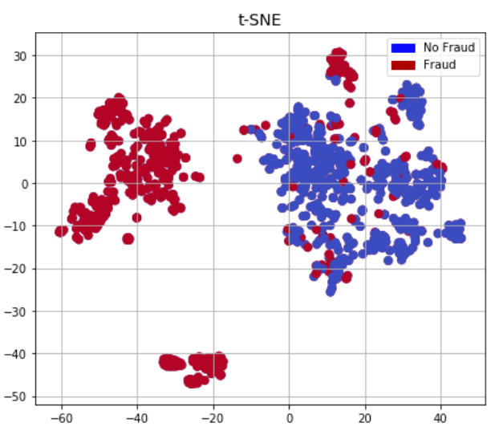
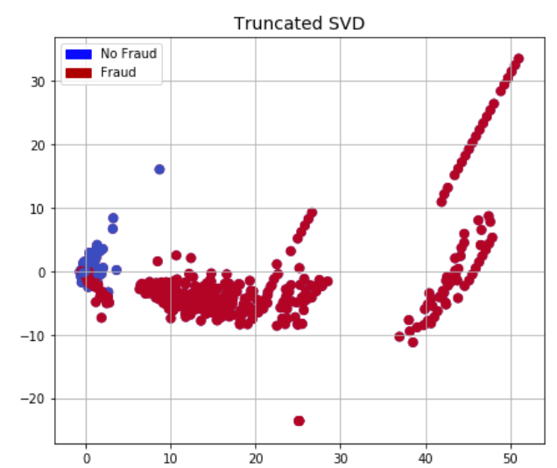

Slide 11
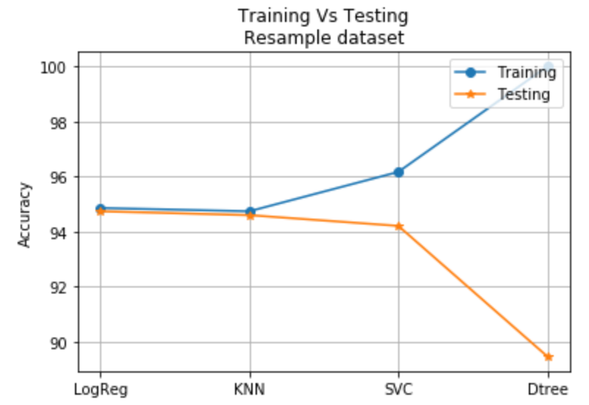
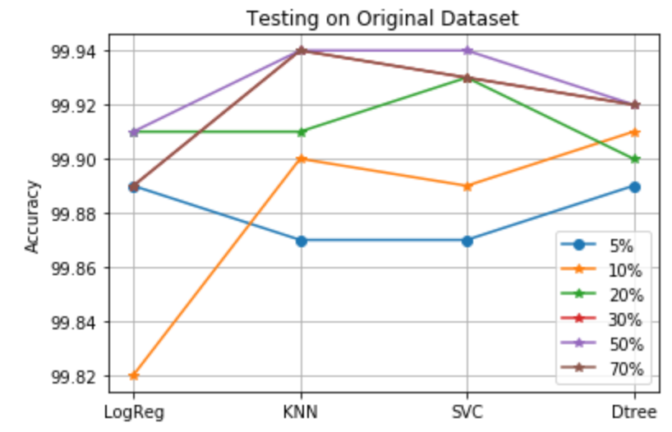
Results and Discussions:
Train:Test - 80:20, Total resampled data - 984, Outliers - 35, final samples - 949

Slide 12
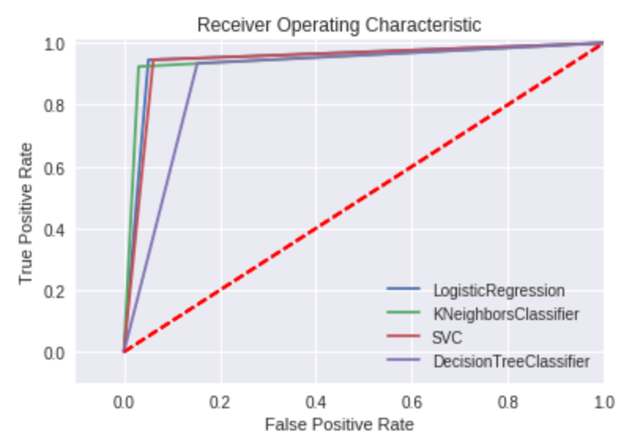

Slide 13
Conclusion:
Different classifiers were tested for highly skewed and imbalance datasets.
Solutions to skewed dataset were presented.
Tested with four classifiers: Logistic regression, KNN, SVC and Decision tree.
Side Note: Be careful while online shopping for holidays :)

Slide 14
References:
Credit Card Fraud Detection Kaggle challenge: https://www.kaggle.com/mlg-ulb/creditcardfraud/home
Sklearn Packages: http://scikit-learn.org/
Jupyter Notebook: http://jupyter.org/

