Slide 1
Analyzing Average House Prices in Scarborough Canada
Problem Statement :
Many people migrate to various states of Canada which require search of a good housing prices.
The projects aim to create an analysis of features for a neighbourhood as a comparative analysis between neighbourhoods The features include median house price. This would help people to get awareness of the places before moving to a new country, state, city or place for their work or to start a new life
Data Requirement :
We will require geo locational information about that specific borough and the neighborhoods in that borough. It is "Scarborough" in Toronto.
Dataset comprising latitude and longitude, zipcodes is already available through the link provided. The location of Scarborough would be filtered using the same.
We will be using the FourSquare API for fetching the data for each venue in every neighborhoods.
Data Preprocessing:
We need to create dataframe for all the data retrieved for Venues inside the Scarborough using FourSquare API.
When the data is completely gathered, we will perform processing on that raw data to find our desirable features for each venue. Our main feature is the category of that venue. After this stage, the column "Venue's Category" will be One-hot encoded and different venues will have different feature-columns.

Slide 2
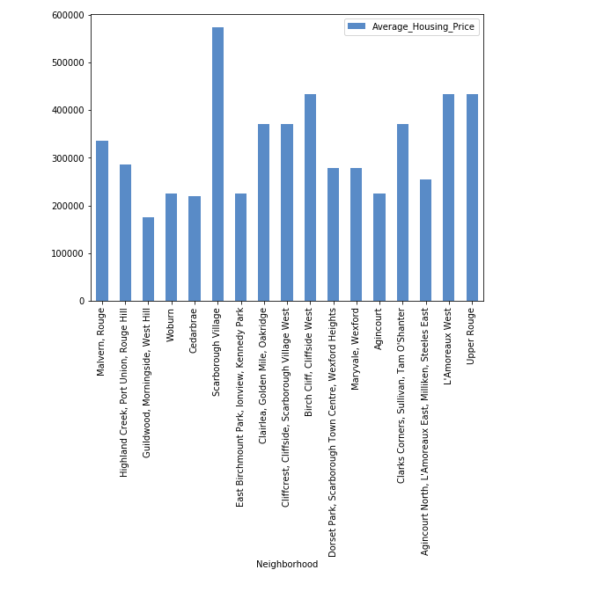
Machine Learning Technique:
We will use K-Means clustering Technique to cluster the data based on average housing prices in the neighbourhood.

Slide 3
Conclusion:
In this project, through a k-means cluster algorithm we separate the neighborhood into 03 clusters, which have similar neighborhoods around them. Using the charts above decision leading to a particular neighborhood based on average house prices can be made

