Slide 1
SRS - Software Requirements Specification for Anthropometry Model

Slide 2
Anthropometrics:
Anthropometry comes from two Greek Word Anthropos(human) & metron(measure).
It is the study of Human body measurement.
It has been used for identification, for the purposes of understanding human physical variation.

Slide 3
OBJECTIVE:
This project is aimed to provide a reliable solution for the customer to know the body measurements to get right size clothing .
PROBLEMS:
many user struggle for their size when they view a brand first time, while many other have difficulties to remember their cloth size.

Slide 4
The effort for the user to find a measuring tape and manually perform measurements adds to the number of steps prior to finalizing a purchase, and at worst, can cause frustration such that the user abandons the purchase attempt.
Functional Requirements:
The anthropometry model requires user full body images as an input to perform image processing and height of the user to generate the required dimensions.

Slide 5
Implementation Constraints :
Lighting condition of environment.
Distance between the device and the subject.
Algorithms and Dependencies:
Corrections - Affine and Metric
Segmentation - Background Segmentation.
Self-designed heuristics for automatic detection of body parts.

Slide 6
Pipeline :
Input Images
Affine and metric correction
Distance calibration
Grab Cut segmentation
Heuristics for detection
User based point correction
Pixel to real world measurements
Outputs (shoulder distance, wrist-to-shoulder length, and waist length)

Slide 7
Project based on:
This project presents an unique body measurement system based on AR & ML.
Use of Tensorflow.js & posenet(used for estimate either single pose or multiple pose)

Slide 8
POESENET DETECTS 17 PART:
NOSE 16. LEFT ANKLE
LEFT EYE 17. RIGHT ANKLE
RIGHT EYE
LEFT EAR
RIGHT EAR
LEFT SHOULDER
RIGHT SHOULDER
LEFT ELBOW
RIGHT ELBOW
LEFT WRIST
RIGHT WRIST
LEFT HIP
RIGHT HIP
LEFT KNEE
RIGHT KNEE

Slide 9
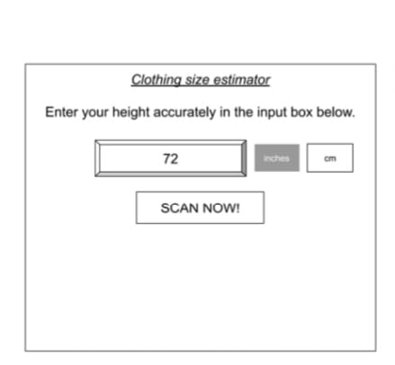
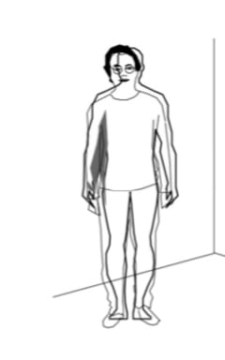
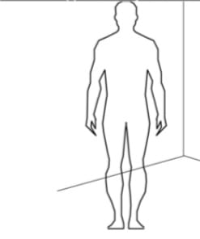
DEMO:
( I )
( II )
( III )

Slide 10
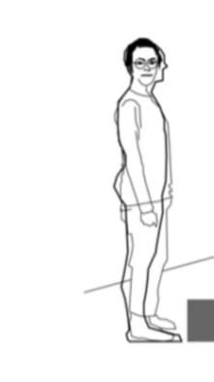
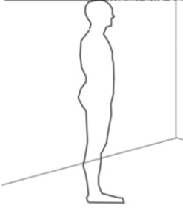
( IV )
( V )

Slide 11
In (I), the user is requested to enter their height. In (II), the camera feed captured by the
device is shown on the screen, with an outline of a human body projected therein. A request is
made to the user to stand in a manner such that they fit approximately within the outline. In (III) illustrates the user fitting almost
entirely into the outline, upon which a measurement of their clothing size is initiated. In (IV), a
follow-up request is provided to the user to stand within a side-profile outline. In (V), upon the
user standing in a manner such that they fit in the sideways outline, clothing-size measurements
are finalized and reported.

Slide 12
THANK YOU
For Your Attention
Ashish Kumar Subudhi
Sunil Kumar Nunia

Slide 13
ANY QUESTIONS?

