Slide 1

AN INTERNSHIP PRESENTATION ON FULL STACK WEB DEVELOPMENT
TOPIC:”COLLEGE IA MARKS RESULTS MANAGEMENT SYSTEM”
PRESENTED BY: Anil kumar s v
1ck21cs007
6th Sem CSE A sec
Under the guidance of : Dr. VASUDEVA R
Professor & HOD
Department of CSE
CBIT KOLAR

Slide 2
AGENDAS
ABSTRACT
INTRODUCTION
What is full stack?
LANGAUAGES USED
CODE EXPLANATION
ANY QUIRES?
CONCLUSION

Slide 3
ABSTRACT
The College Student Internal Assessment (IA) Marks Management System is a comprehensive full-stack application designed to streamline the process of recording, managing, and analyzing internal assessment marks for college students.
This system leverages modern web technologies to provide a user-friendly interface for administrators, faculty, and students.
By automating the entry and retrieval of marks, the system enhances accuracy, reduces administrative workload, and facilitates real-time performance tracking.
This project showcases the integration of a robust backend, efficient data storage, and a responsive frontend to deliver a seamless and efficient marks management experience.

Slide 4
INTRODUCTION
Managing internal assessment marks is a critical component of the academic process in colleges. Traditionally, this task involves manual entry and calculation, leading to potential errors and inefficiencies.
The College Student IA Marks Management System addresses these challenges by offering a digital solution that automates the entire process. This project employs a full-stack approach, combining a server-side application with a dynamic client-side interface to create a cohesive system.
The backend, built with PHP handles data processing and storage, while the frontend, developed using HTML provides an intuitive and interactive user experience.
The database, implemented with MongoDB, ensures secure and scalable data management. This system not only simplifies the management of IA marks but also provides analytical tools to track student performance over time.

Slide 5
What is full stack?
Full Stack: Full stack development refers to the practice of developing both the frontend (client-side) and backend (server-side) parts of a web application.
A full stack developer possesses the skills and knowledge required to work on both ends, ensuring a seamless integration and functioning of the entire application.

Slide 6
LANGUAGES USED
Frontend (Client-Side):
The frontend is the part of the application that users interact with directly.
1.HTML (HyperText Markup Language): The standard language for creating web pages and web applications.
2. CSS (Cascading Style Sheets): Used to style and layout web pages.
3. JavaScript: A programming language that enables interactive web pages

Slide 7
LANGUAGES USED
Backend (Server-Side)
The backend is the part of the application that handles business logic, database interactions, and server configuration
It is responsible for processing user requests, performing operations on the data, and sending the appropriate responses back to the frontend.
1. Server-side programming languages: Such as Node.js (JavaScript), Python, Ruby, Java, and PHP.
2. Databases: Used to store and manage data, with common examples being MySQL, PostgreSQL, MongoDB, and SQLite.
3. Web servers: Such as Apache and Nginx, which serve the web application to users.

Slide 8
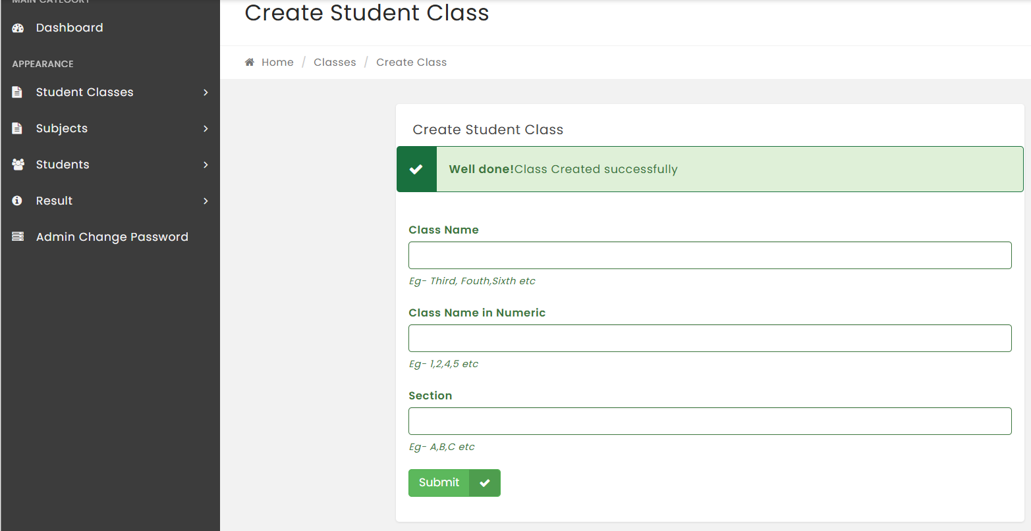
CODE EXPLANATION
ADD CLASS
In order to add classes we will look at code….

Slide 9
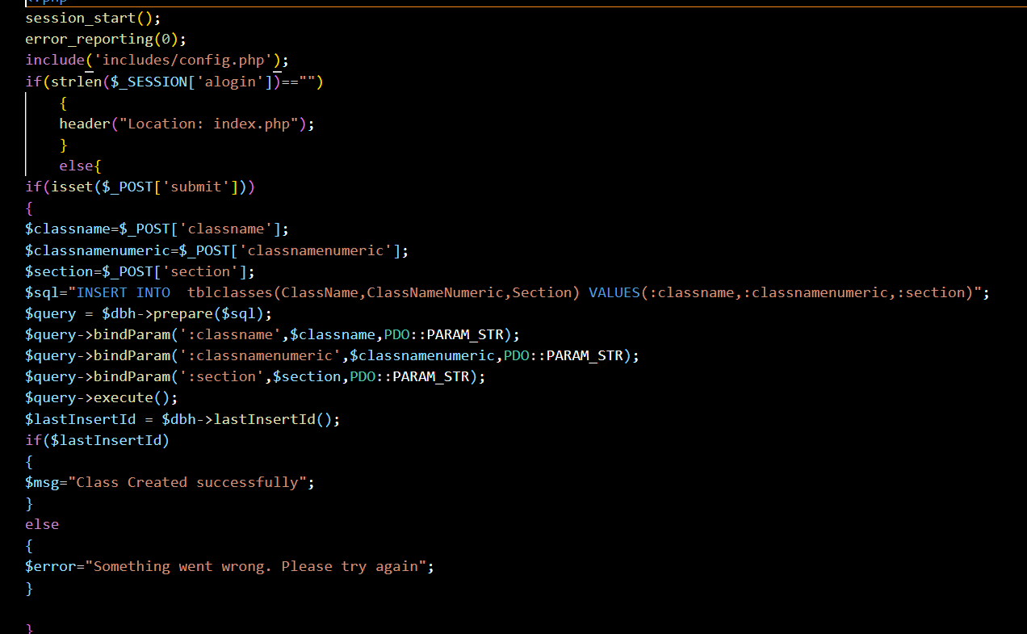
CODE EXPLANATION

Slide 10
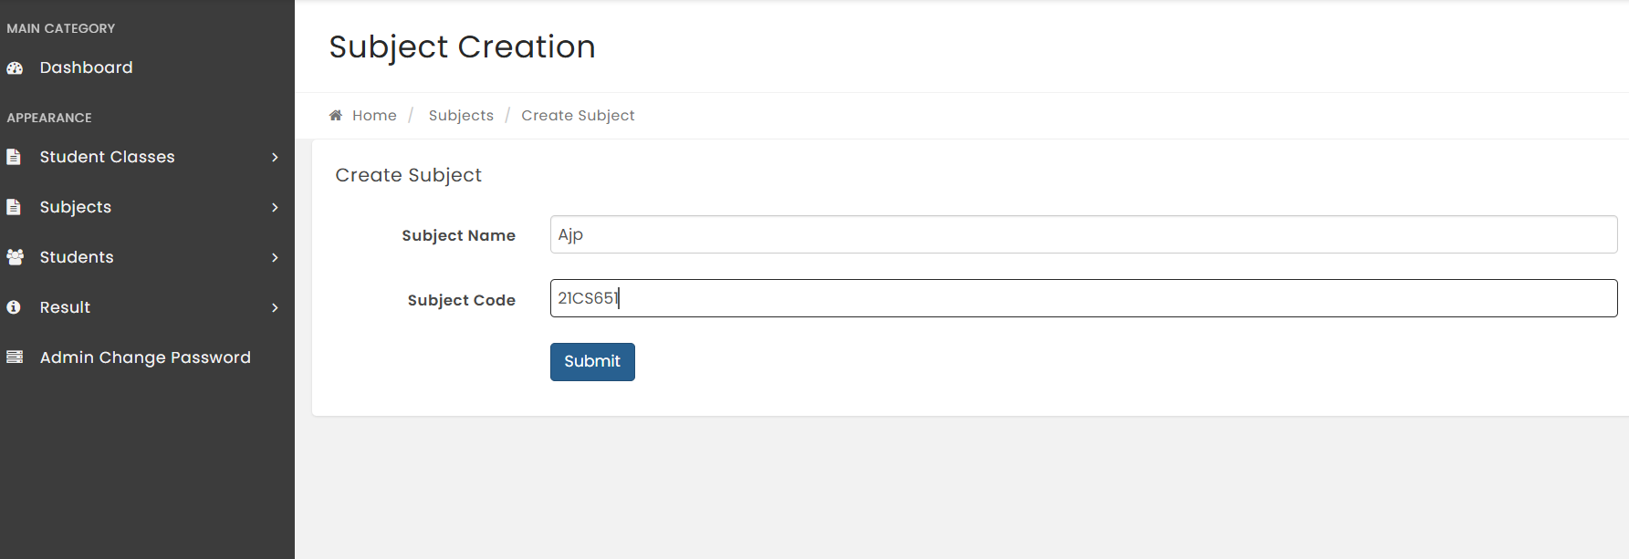
CODE EXPLANATION
CREATE SUBJECT
In order to Create subject we will look at code….

Slide 11
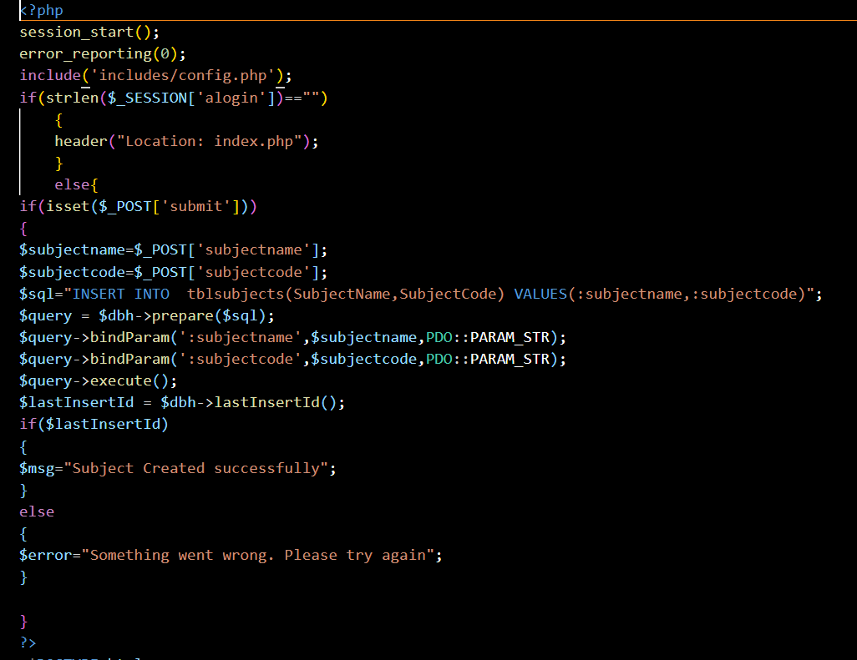
CODE EXPLANATION

Slide 12
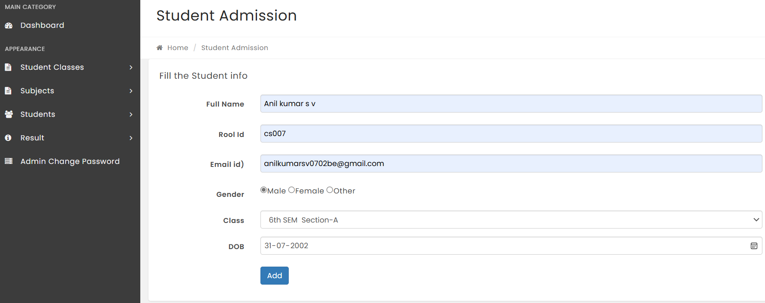
CODE EXPLANATION
ADD STUDENT
In order to add student we will look at code….

Slide 13
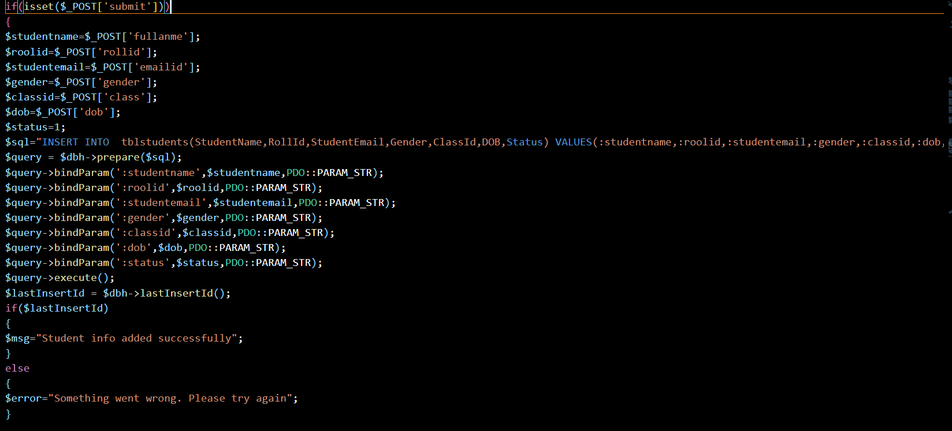
CODE EXPLANATION

Slide 14
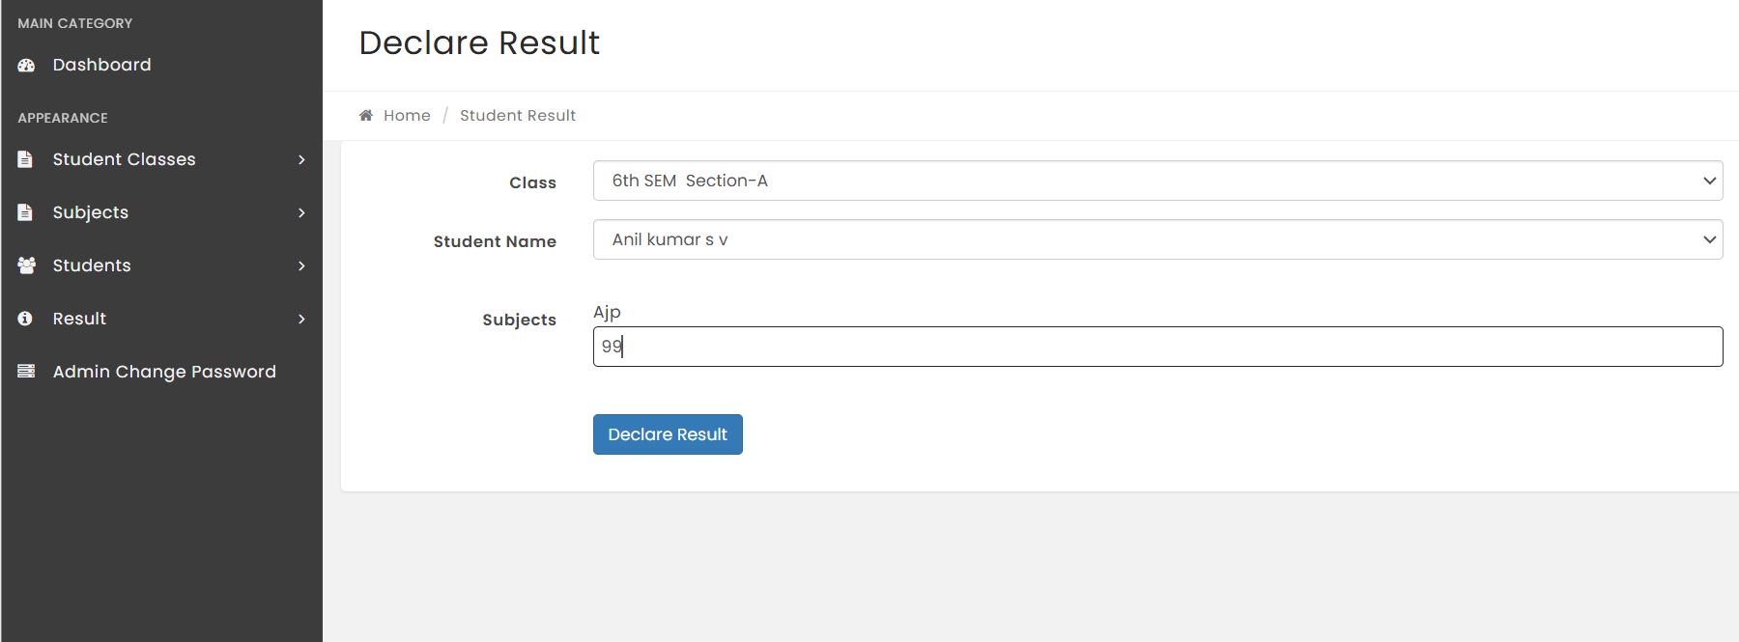
CODE EXPLANATION
DECLARE RESULT
In order to Declare Resultwe will look at code….

Slide 15
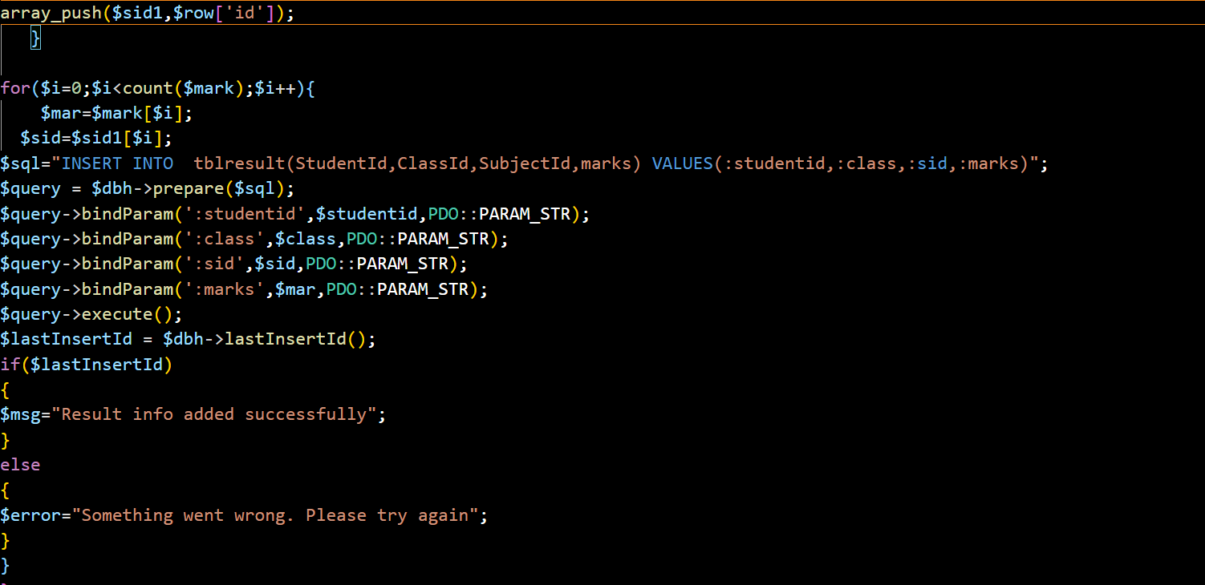
CODE EXPLANATION

Slide 16
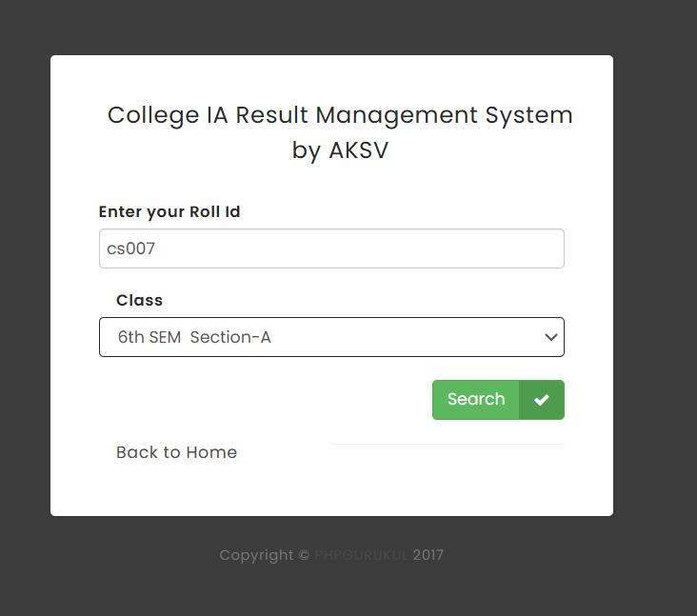
CODE EXPLANATION
SEARCH RESULT
In order to search resultwe will look at code….

Slide 17
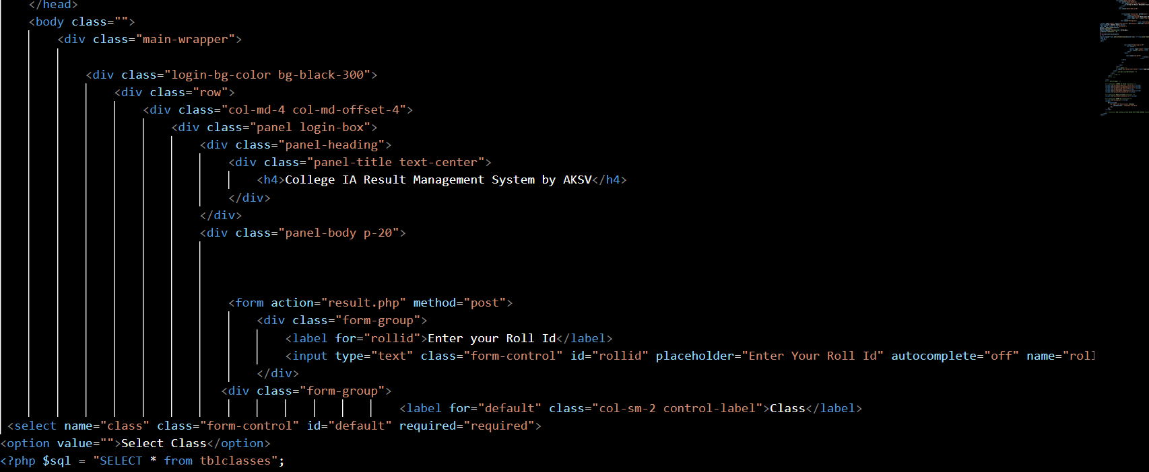
CODE EXPLANATION

Slide 18
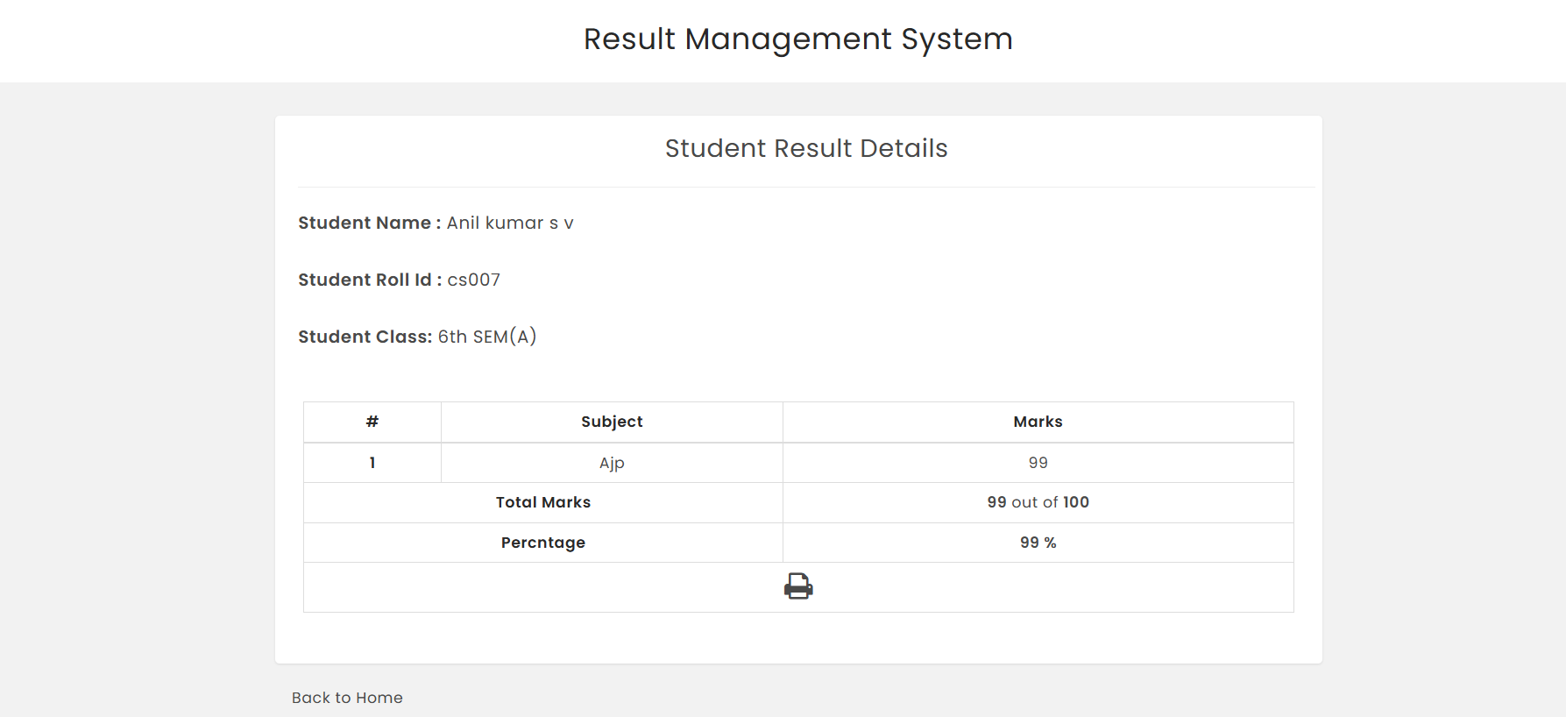
Final result sheet
RESULT SHEET

Slide 19

ANY QUERIES?
Any questions

Slide 20
CONCLUSION
The College Student IA Marks Management System demonstrates the effectiveness of a full-stack approach in solving real-world academic administration challenges.
By automating the internal assessment marks process, the system significantly reduces administrative overhead and minimizes errors.
The project illustrates the successful integration of backend and frontend technologies to create a seamless user experience. With features such as real-time data entry, performance analytics, and secure data management, the system offers a robust solution for colleges looking to enhance their internal assessment processes.
Future enhancements could include additional analytics capabilities, integration with other academic systems, and the implementation of advanced security measures to further protect student data.

Slide 21



