Slide 1

Movie Recommender
by
Abhinav Rawal
Uttam Mittal
Manjot Singh
20103008
20103056
20103075

Slide 2
Activation
Functions &
optimizers
Implementation
Final result
Comparison of various models
Model Architecture
Dataset & Raw Output
Restricted Boltzmann Machine
Introduction
References
Overview

Slide 3
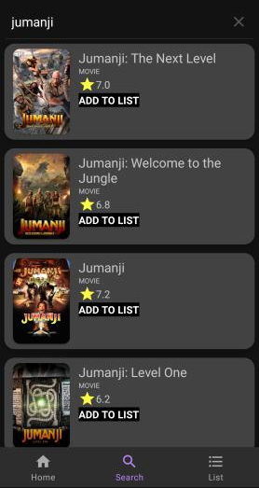

Agenda
MovieDroid App
Neural Network Model
Reccomendations
The recommendation system establishes a user product relationship where explicit ratings and tags of movies from other users and database help the user to enhance their experience and enjoy the while without any hassle.

Slide 4

MovieDroid App
Neural Network Model
Reccomendations
The recommendation system establishes a user product relationship where explicit ratings and tags of movies from other users and database help the user to enhance their experience and enjoy the while without any hassle.

Slide 5

Restricted Boltzmann Machine (RBM)
RBM is a deep learning algorithm that is constructed with the help of a generative neural network which helps in the decision making. Basically, RBM is a two-layered neural network that could recognize patterns within the dataset by reconstructing the original input.
It traces all the patterns as soon as the input is fed to the network. This capability makes it an extremely powerful technique for information retrieval, pattern recognition, and this ability is the main reason behind its state-of-the-art collaborative filtering system.

Slide 6
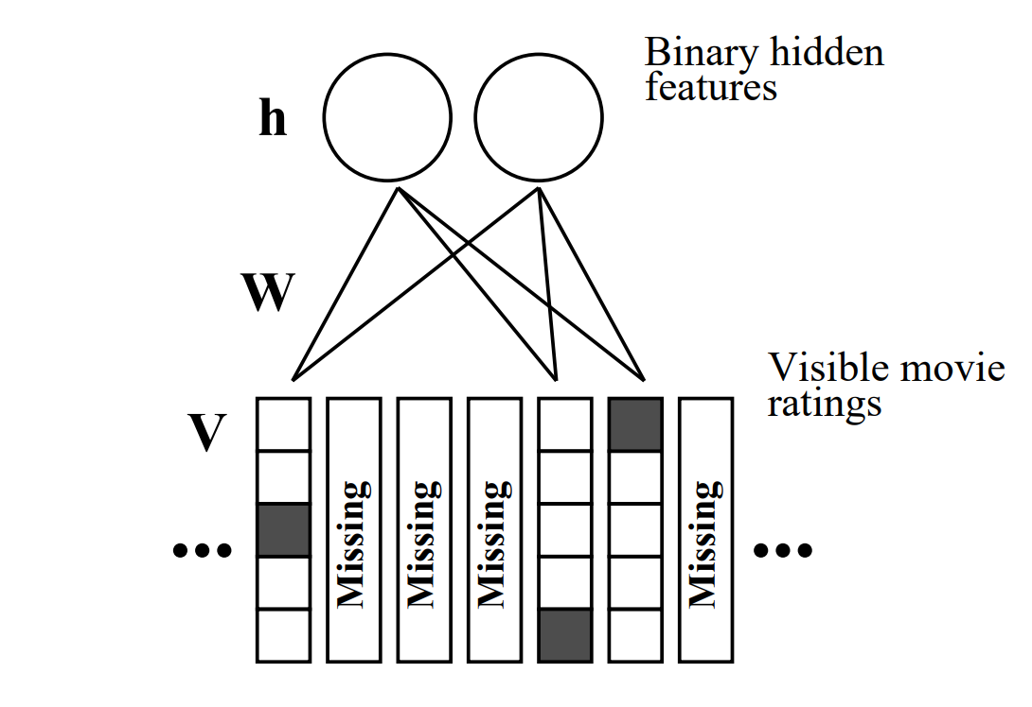
Architecture
A restricted Boltzmann machine with binary hidden units and softmax visible units. For each user, the RBM only includes softmax units for the movies that user has rated. When modeling user ratings with an RBM that has Gaussian hidden units, the top layer is composed of linear units with Gaussian noise.

Slide 7
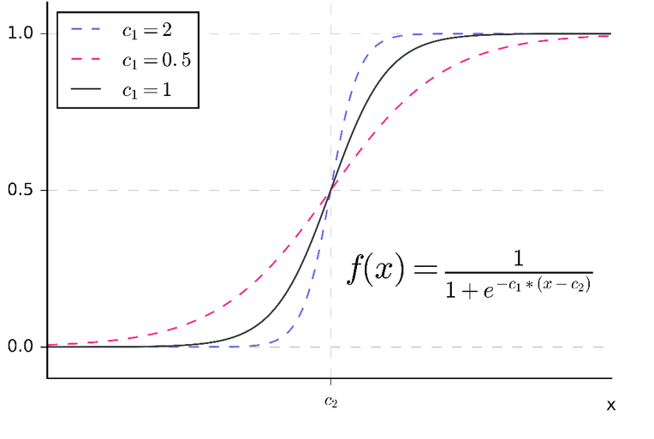
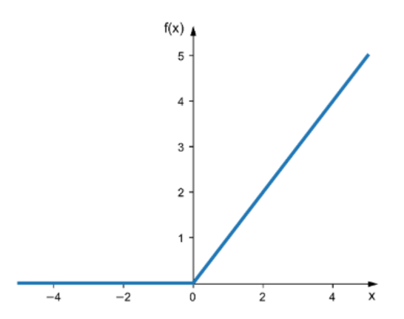
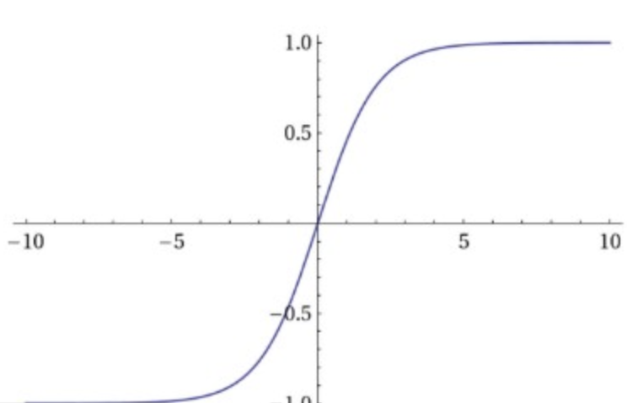
Activation functions
Optimizer
Sigmoid
RelU
Contrastive divergence is an alternative training technique to approximate the graphical slope representing the relationship between a network’s weights and its error, called the gradient.
Since most probabilistic learning algorithms try to optimize the log-likelihood value, this gradient represents the desired direction of change, of learning, for the network’s parameters.
Sigmoid is a standard activation function used in Neural Networks
It is widely used as a model that uses it is easier to train and often achieves better performance
Softmax
Softmax gives an output from 0 to 1 which is similar to a probability associated to each movie so that we could select the best movie recommendations among all

Slide 8
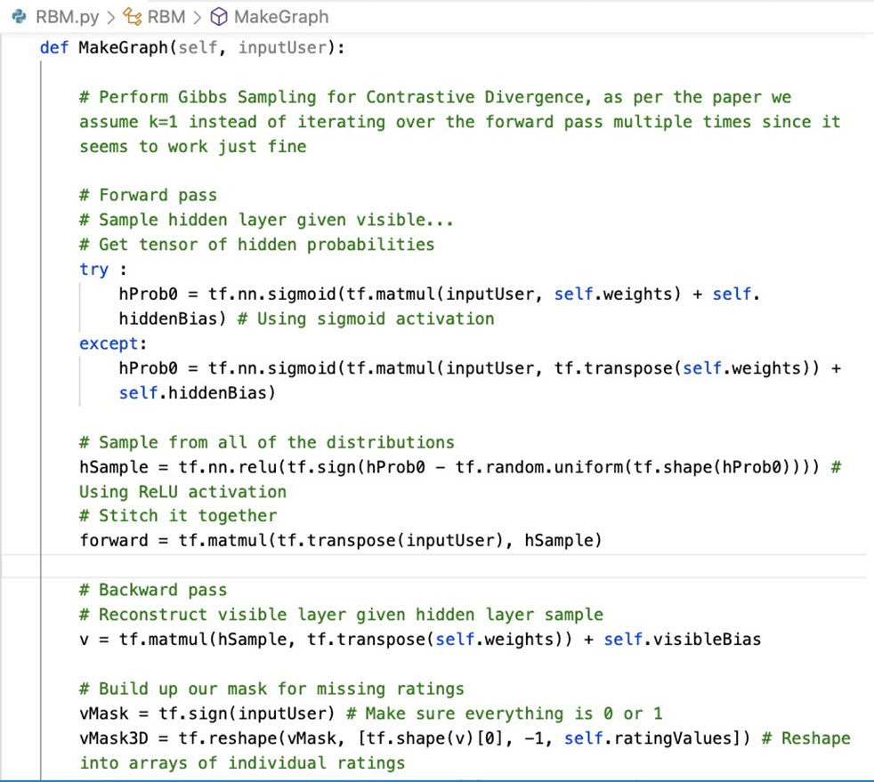

Implementation

Slide 9
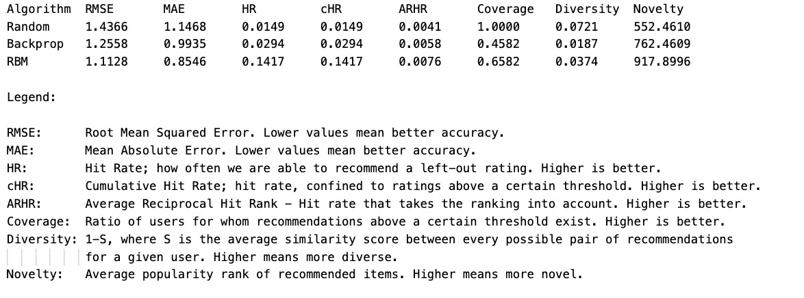
Errors

Slide 10
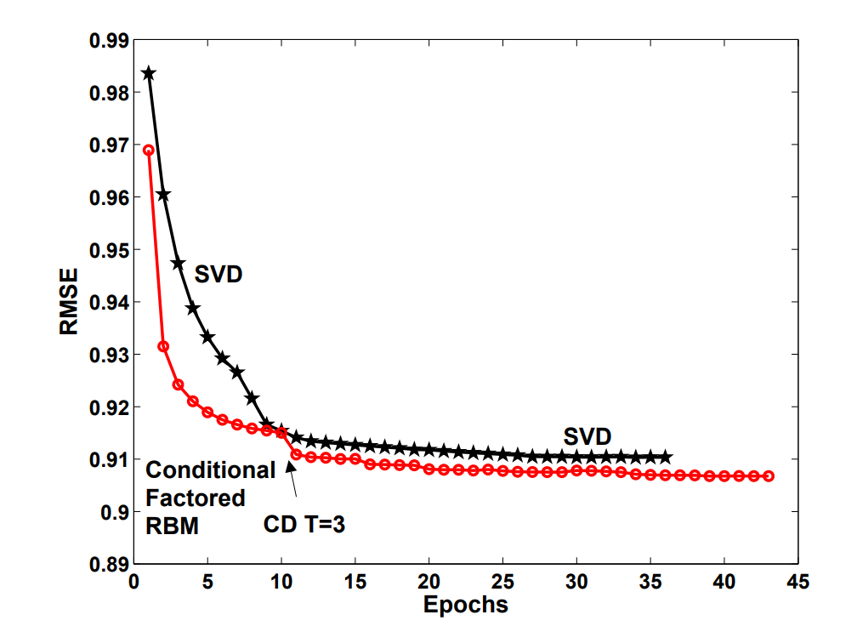
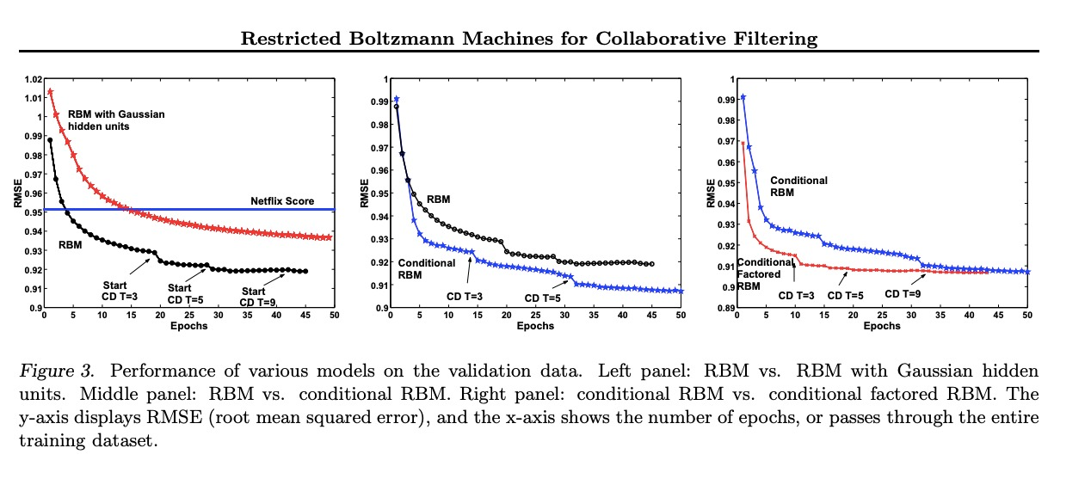
RBM vs SVD
Conditional factored RBM
Performance of various models on the validation data. Left panel: RBM vs. RBM with Gaussian hidden units. Middle panel: RBM vs. conditional RBM. Right panel: conditional RBM vs. conditional factored RBM. The y-axis displays RMSE & the x-axis shows the number of epochs.
Performance of the conditional factored RBM vs. SVD with C = 40 factors. The y-axis displays RMSE (root mean squared error), and the x-axis shows the number of epochs, or passes through the entire training datas

Slide 11
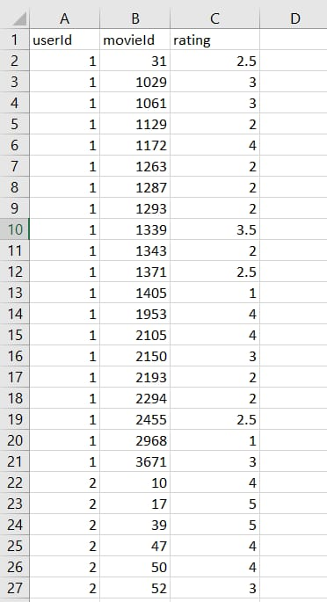
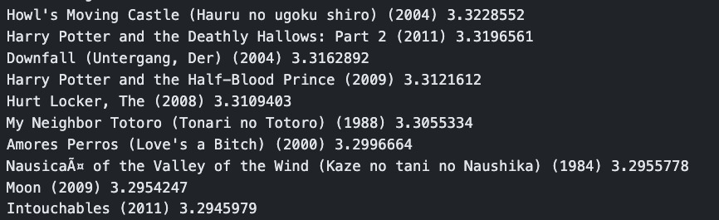
Dataset & Raw Output
IMDB dataset having 50K movie reviews for natural language processing or Text analytics. So, its used to predict recommendations for users based on their taste.

Slide 12


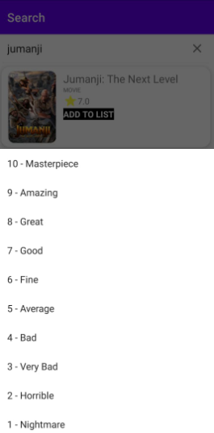
Result

Slide 13
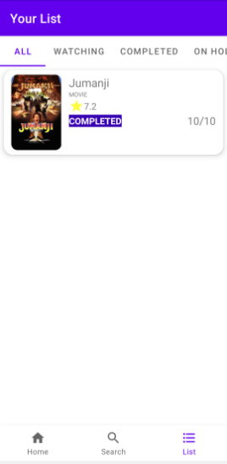
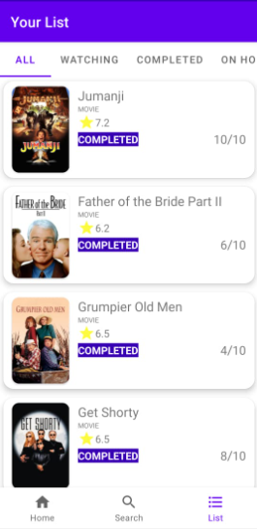


Slide 14

References
Ruslan Salakhutdinov, Andriy Mnih, Geoffrey Hinton (2014), Restricted Boltzmann Machines for Collaborative Filtering, University of Toronto, 6 King’s College Rd., Toronto, Ontario M5S 3G4, Canada.
Kaggle IMDB Dataset https://www.kaggle.com/datasets/lakshmi25npathi/imdb-dataset-of-50k-movie-reviews

Slide 15

Thank you

