Slide 1
DEPARTMENT OF COMPUTER SCIENCE, IT AND ANIMATION
Project Report On “ALGORITHM VISUALIZER”
Submitted by Mr. Akshay Mule Mr. Gaurav Sarode
BCA (Sci.) IV Semester Academic Year-2021-2022
Guided by Ms. Bhumika Chandkar Mam
Submitted To
Department of Computer Science, IT and Animation
Deogiri College, Aurangabad 431005.

Slide 2
INTRODUCTION
Our Project is on Algorithm Visualizer.
As we all know visualization is the best thing to learn anything faster than learning from books of any text form of information.
Algorithm visualizations can indeed improve understanding of the fundamental data structures and algorithms that are part of a traditional computer science curriculum.

Slide 3
Material to be Covered
Sorting by comparision:
  Bubble Sort
  Selection Sort
  Merge Sort
  QuickSort
Efficient list-based implementations
My Implementations

Slide 4
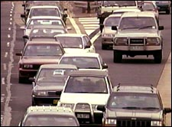
Merge Sort
MergeSort (Table [1..n])
Split Table in half
Recursively sort each half
Merge two halves together
Merge (T1[1..n],T2[1..n])
i1=1, i2=1
While i1<n, i2<n
If T1[i1] < T2[i2]
Next is T1[i1]
i1++
Else
Next is T2[i2]
i2++
End If
End While
Merging Cars by key
[Aggressiveness of driver].
Most aggressive goes first.
Photo from http://www.nrma.com.au/inside-nrma/m-h-m/road-rage.html

Slide 5

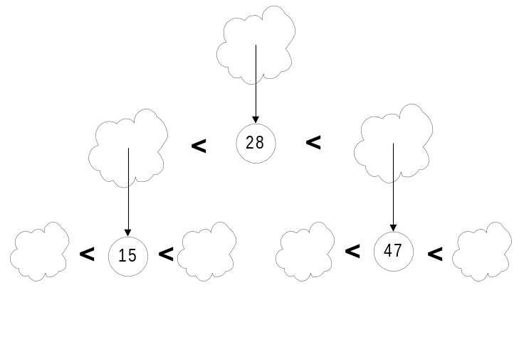
QuickSort
Picture from PhotoDisc.com
Pick a “pivot”.
Divide list into two lists:
  One less-than-or-equal-to pivot value
  One greater than pivot
Sort each sub-problem recursively
Answer is the concatenation of the two solutions

Slide 6
List-Based Implementation
All these algorithms can be implemented using linked lists rather than arrays while retaining the same asymptotic complexity
Exercise:
  Break into 6 groups (6 or 7 people each)
  Select a leader
  25 minutes to sketch out an efficient implementation
    Summarize on transparencies
    Report back at 3:00 pm.

Slide 7
My Implementations
Probably no better (or worse) than yours…
Assumes no header nodes for lists
Careless about creating garbage, but asymptotically doesn’t hurt
For selection sort, did the bubble-sort variation, but moving largest element to end rather than smallest to beginning each time. Swapped elements rather than nodes themselves.

Slide 8
My QuickSort
void QuickSort(){ // sort self
if (is_empty()) return;
Object val = Pop(); // choose pivot
b = new List();
c = new List();
Split(val, b, c); // split self into 2 lists
b.QuickSort();
c.QuickSort();
c.Push(val); // insert pivot
b.Append(c); // concatenate solutions
head = b.head; // set self to solution
}

Slide 9
My Merge Sort
void MergeSort(){ // sort self
if (is_empty()) return;
b = new List();
c = new List();
SplitHalf(b, c); // split self into 2 lists
b.MergeSort();
c.MergeSort();
head = Merge(b.head,c.head);
// set self to merged solutions
}

Slide 10
My Bubble Sort
void BubbleSort(){
int n = Length(); // length of this list
for (i=2; i<=n; i++){
ListNode cur = head;
ListNode prev = null;
for (j=1; j<i; j++){
if (cur.element>cur.next.element){
// swap values – alternative would be
// to change links instead
Object tmp = cur.element;
cur.element = cur.next.element;
cur.next.element = tmp;
}
prev = cur;
cur = cur.next;
}
}
}

Slide 11

PICTURE OF MY PROJECT
Sign-Up:

Slide 12
Sign-In:

Slide 13
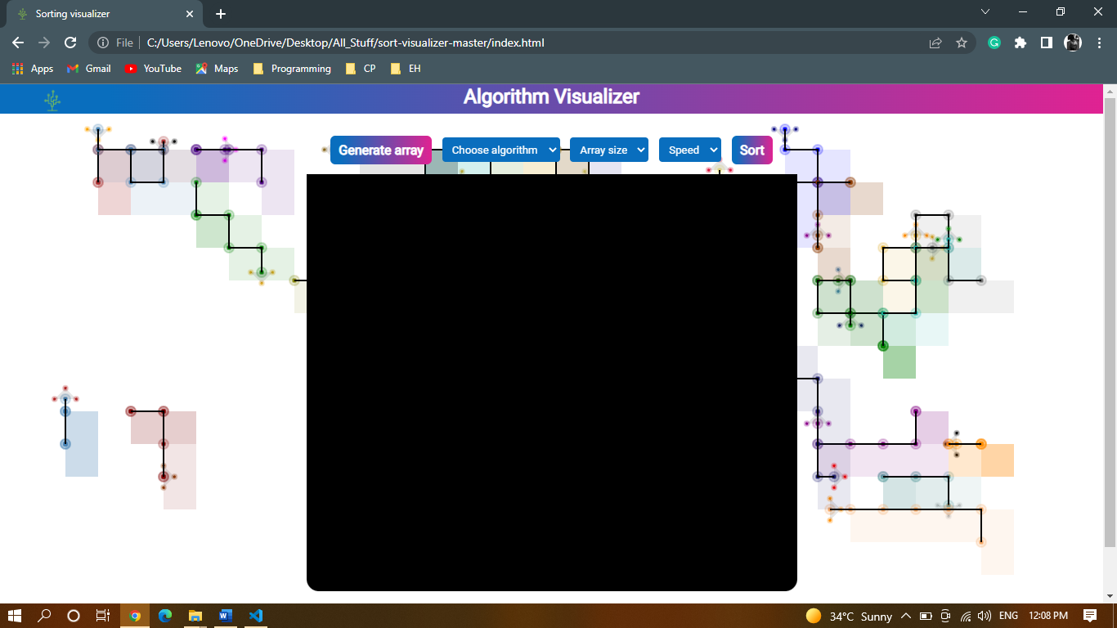
Home Page:

Slide 14
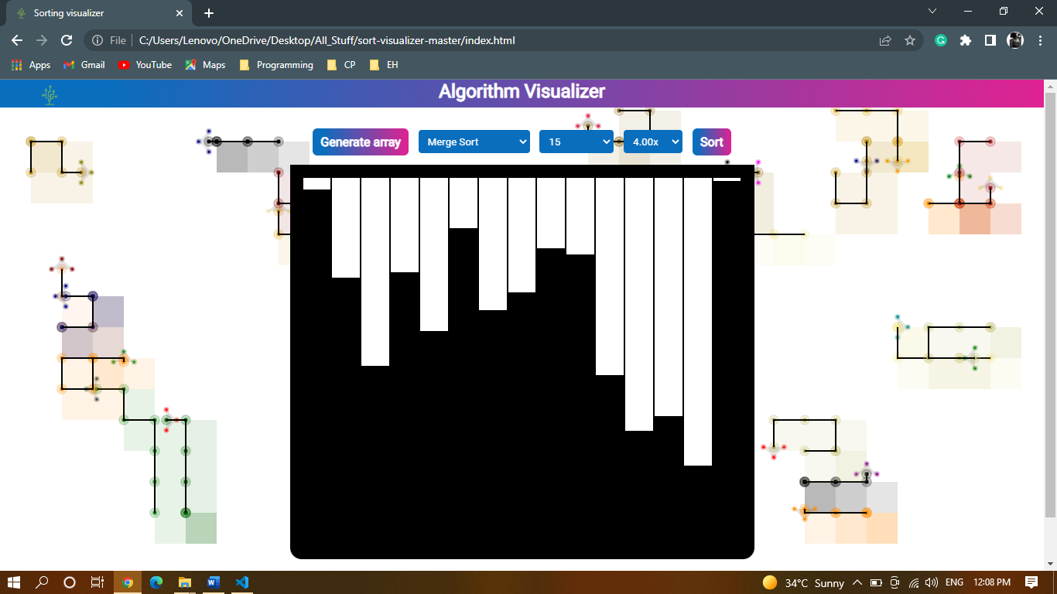
Working:

Slide 15
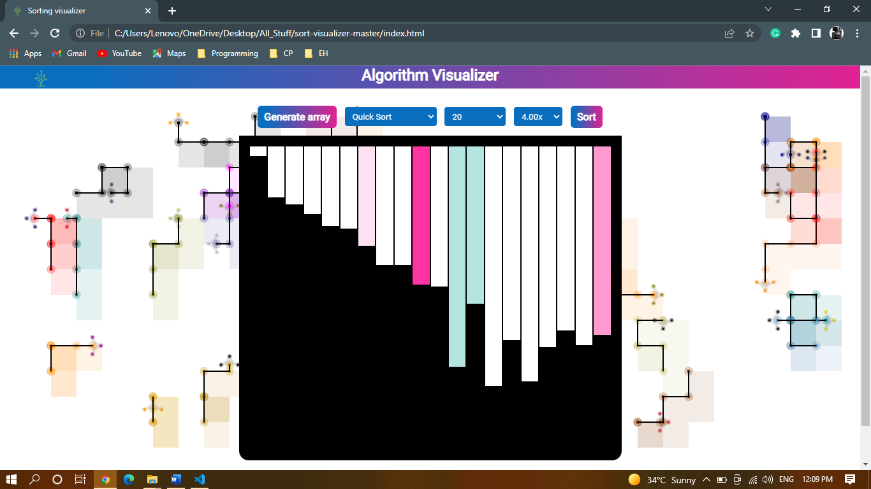

Slide 16
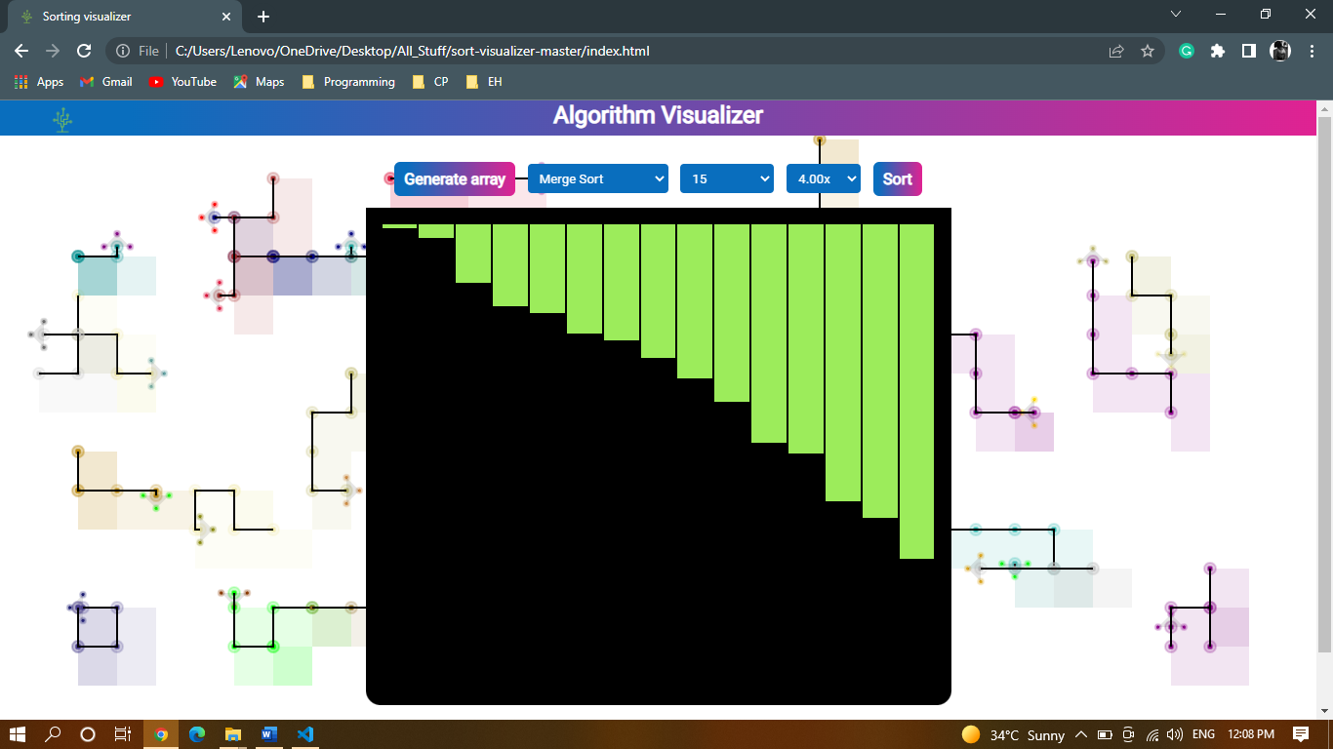

Slide 17
Scope of Project
There are two principal applications of algorithm visualization: research and education. Potential benefits for researchers are based on expectations that algorithm visualization may help uncover some unknown features of algorithms

Slide 18
Conclusions
According to our findings, algorithm visualization can be seen as a valuable supporting tool, used in addition to standard ways of education in the field of computer science.
Algorithm visualizations can help understanding the principles, but do not replace the need to implement algorithms by students is a chosen programming language.

Slide 19
THANK YOU!

