Slide 1
BUDGET SALES ANALYTICS
Domain : Retail & Sales
BY AKASH TEWARI

Slide 2
APPENDIX
Sales Overview:
Total Sales
Sales Trend
Sales by Domain
Budget vs. Sales:
Variance Analysis
Sales Performance by Product:
Top Products
Product Sales Trends
Customer Insights:
Customer Demographics
Key Metrics and KPIs:
Sales Growth Rate

Slide 3
INTRODUCTION
PROBLEM STATEMENT:
"Domain Sale" process is structured to help potential buyers purchase the domain they want immediately without the hassle of contacting the seller directly. A seller lists a domain for sale at a specific price in our Marketplace. An interested buyer sees this domain for sale and decides to buy it.
OJECTIVE OF THE ANALYSIS:
Evaluate Sales Performance: Analyze total sales, trends, and identify top-performing domains.
Conduct Variance Analysis: Compare actual sales against budgeted figures and identify deviations.
Analyze Customer Insights: Understand customer demographics and purchasing behavior.
Develop a Dashboard: Create a Power BI dashboard to visualize key metrics and support decision-making.
DATA SOURCE: LINK

Slide 4
SALES OVERVIEW
Total Sales Over Three Years (2014-2016):
Sales data shows significant increase in total sales from 2014 to 2016, with 2016 having the highest total sales of 16.47M, followed by 2014 with 7.07M, and 2015 with 5.76m.
Monthly Sales Trends:
Sales trends across 2014, 2015, and 2016 indicate fluctuations, with noticeable peaks in certain months (e.g. May 2014, May 2015, and May 2016).
Category-Wise Sales Distribution:
Data reveals category of bikes contributing 96.62% of total sales, likely attributed to a specific product line (e.g., Bikes).
Overall Sales Performance:
The cumulative total sales across all categories and years amount to 29.31M, highlighting A growing trend and strong market presence.
This overview suggests a positive growth trajectory in sales, with certain categories driving the majority of revenue, and strong performance in the year 2016.

Slide 5

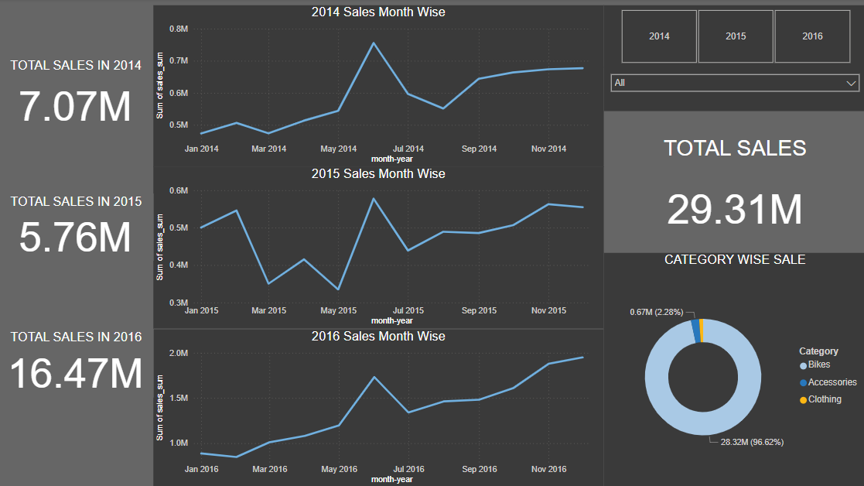

Slide 6



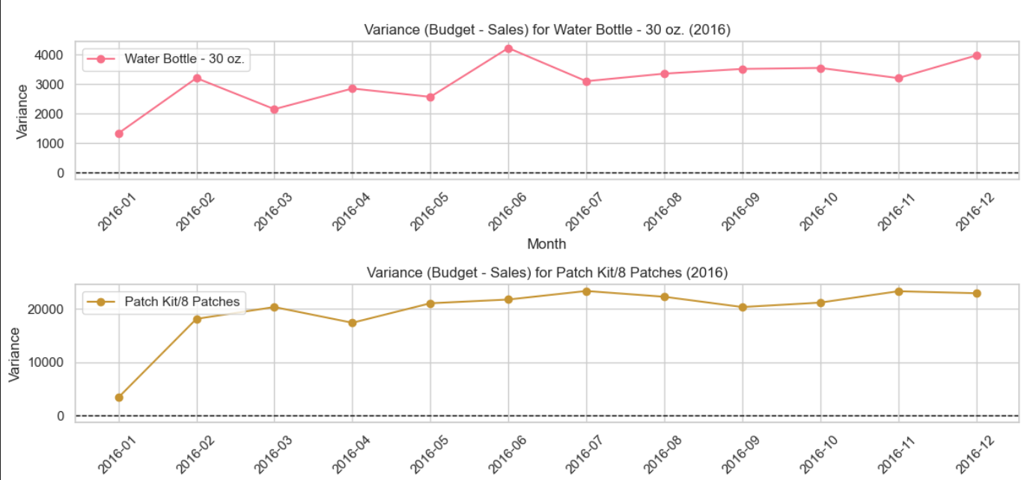

BUDGET VS SALES
VARIANCE For top products:
Budget - Sales.
Water Bottle - 30 oz.:
Stable Positive Variance: Sales consistently lower than budget, indicating possible overestimation.
Patch Kit/8 Patches:
High Positive Variance: Significant underperformance compared to budget, with the gap widening over time.

Slide 7
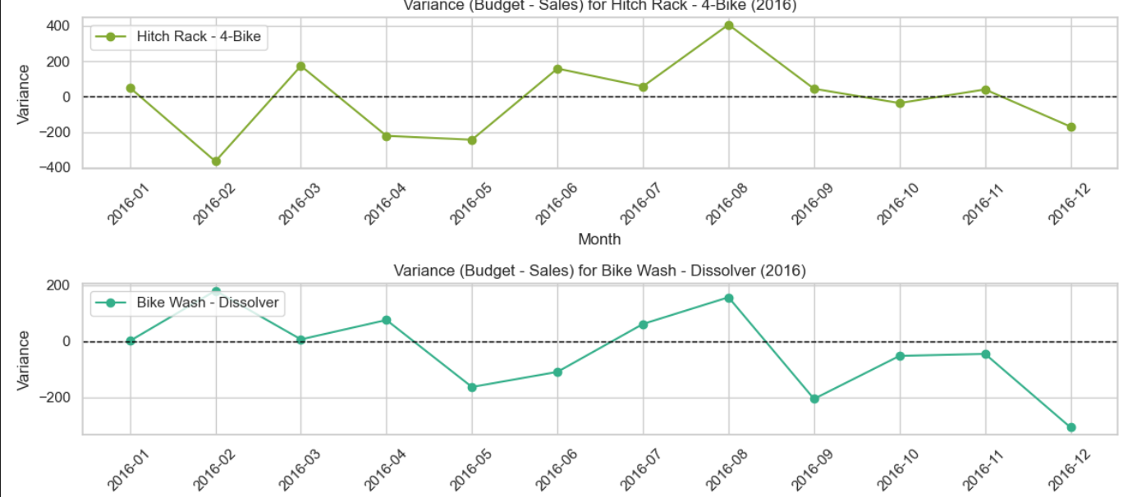
BUDGET VS SALES
Hitch Rack - 4-Bike:
Fluctuating Variance: Mixed results, with sales sometimes exceeding and sometimes falling short of the budget.
Bike Wash - Dissolver::
Aligned Budget and Sales: Small variances, indicating budget and sales are mostly in sync.

Slide 8
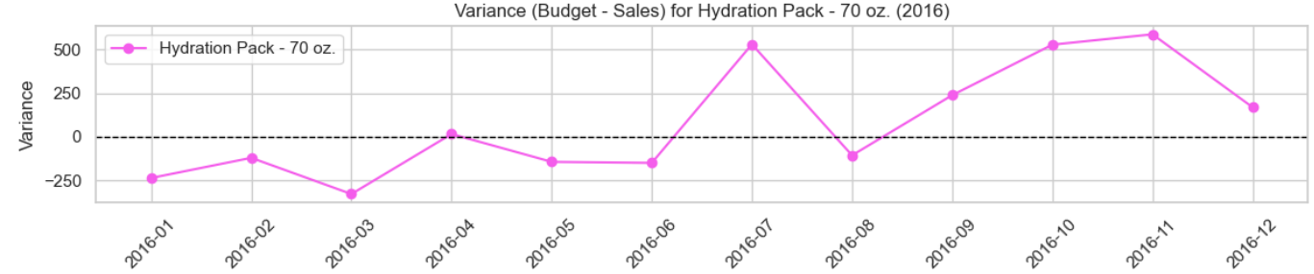
BUDGET VS SALES
Hydration Pack - 70 oz.:
Consistent Negative Variance: Sales frequently exceed budget, suggesting underestimation.

Slide 9
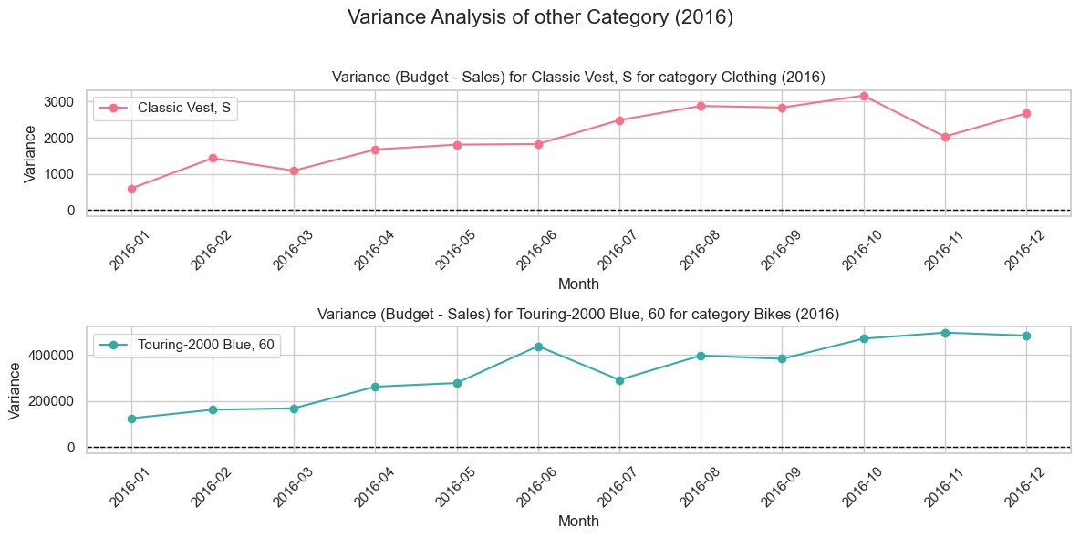

Slide 10
SALES PERFORMANCE BY PRODUCT
Top Performing Products:
The Mountain-200 Black is the leading product in terms of sales, followed closely by the Mountain-200 Silver variant.
The Road-150 Red series also shows strong performance, occupying multiple spots in the top 10 products.
Consistency in Sales:
The top products display consistent sales figures, with the difference between them being minimal. This suggests a stable demand for these products across the observed period.
Growth Opportunities:
Given the dominance of specific models, focusing marketing efforts on similar or complementary products may capitalize on existing consumer preferences.

Slide 11
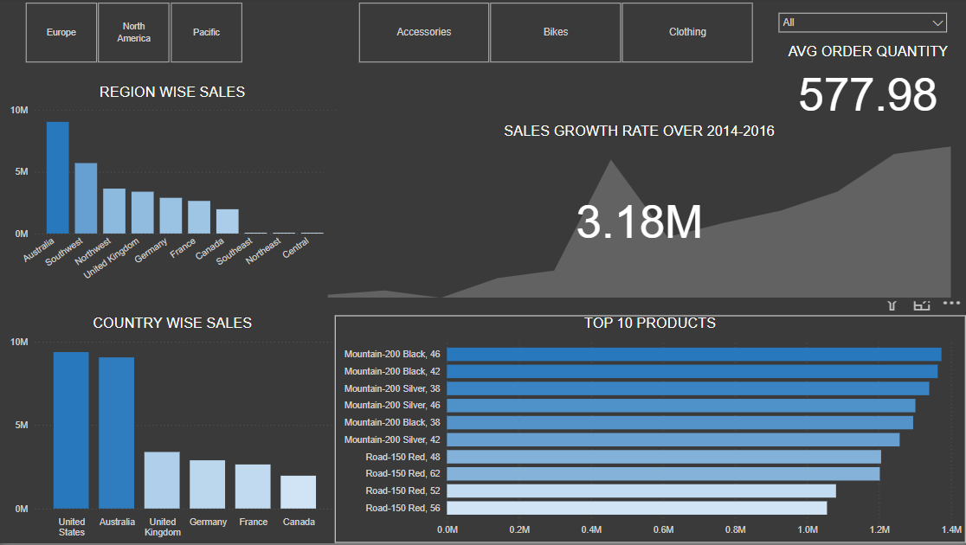

Slide 12
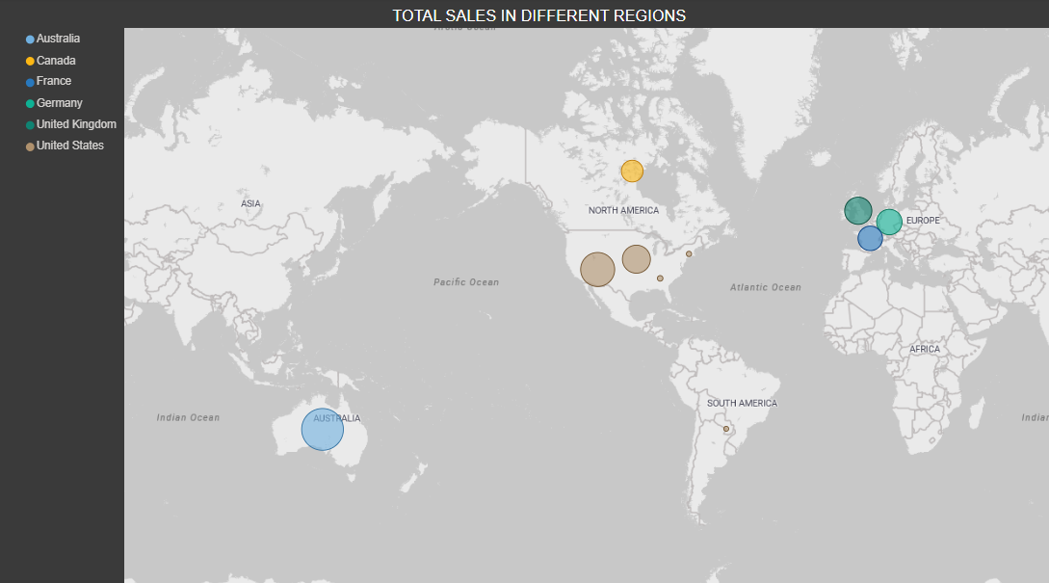
CUSTOMER DEMOGRAPHICS
Australia:
Blue circles indicate strong sales in Australia.
Canada:
Green circles represent sales in Canada.
France:
Purple circles highlight sales in France.
Germany:
Red circles denote sales in Germany.
United Kingdom:
Orange circles signify sales in the UK.
United States:
Brown circles show sales in the US.

Slide 13

KEY METRICS AND KPIS:
Growth rate over the year 2014 – 2016

Slide 14
Conclusion and Recommendations
Strong Sales Growth:
The sales trend from 2014 to 2016 shows a consistent upward trajectory, with 2016 experiencing the highest sales. Continued focus on high-performing categories can sustain this growth.
Product Focus:
The Mountain-200 series, particularly the Black and Silver variants, is a clear market leader. Expanding the product line or introducing new features within this series could drive further sales.
Budget Realignment:
Products like the Patch Kit/8 Patches and Water Bottle - 30 oz. show a significant positive variance, suggesting a need to adjust budgets to better reflect actual sales performance.
Geographical Sales Insights:
Strong sales in regions like Australia and the United States indicate market dominance. Targeted marketing strategies in these regions could further capitalize on this trend.
Strategic Investments:
Given the steady demand for top products and consistent growth in certain regions, strategic investments in marketing and inventory for these areas can enhance profitability and market share.

Slide 15

THANK YOU

