Slide 1
AGENTIC AI IN URBAN TRANSPORT DISRUPTION MANAGEMENT
• Team: Akshat, Aditya, Lakshya (B.Tech CSE, IIIT Naya Raipur)
• Mentors: Dr. Alaa DAOUD (INSA Hauts-de-France) & Dr. Srinivasa K G (IIIT-NR)
• Evaluated Foundation Model: Google Gemini API (gemini-flash-lite-latest)

Slide 2
1. Research Motivation & Primary Research Question
The Core Dilemma in Intelligent Transportation
• The Urban Crisis: Road closures, water main bursts, localized gridlock, and EV battery breakdowns require real-time dynamic rerouting.
• The Literature Hype: Recent papers aggressively propose Generative LLMs and Multi-Agent Systems for autonomous dispatch—without verifying if they beat classical math.
• The Primary Research Question: “When does multi-agent LLM coordination actually improve transport-disruption decisions compared with a single LLM agent on 2D road networks, and is the improvement worth the additional computational and financial cost?”
• Key Hypotheses Tested: H1: LLMs without guards produce non-zero violations · H2: Multi-agent costs scale predictably · H3: Complexity crossover exists · H4: Monolithic LLMs suffer context collapse.

Slide 3
2. Critical Literature Audit: What Current Papers Get Wrong
• Flaw 1: 'Prompt Slicing' Masquerading as Multi-Agent: It is just sequential prompt decomposition without independent agency.
• Flaw 2: Forcing Probabilistic LLMs to do Graph Theory: They hallucinate non-existent roads and illegal turns.
• Flaw 3: Complete Absence of Physical Safety Verification: Existing literature lacks deterministic validators to verify if an EV runs out of battery mid-route or if vehicles are illegally double-booked.
• Our Scientific Differentiation: We implement Neuro-Symbolic Tool Calling (Dijkstra tools for routing) + a Deterministic Non-LLM Safety Guard + Multi-baseline benchmarking against classical SOPs.

Slide 4
3. Under-the-Hood System Architecture
A Verifiable Neuro-Symbolic Testbed
• Urban Road Network (`network.py`): 4×4 Manhattan grid (16 named nodes N0–N15, 24 edges with capacities, travel times, and named streets like Elm Street and Grand Ave).
• Graduated Disruption Spectrum (`scenarios.py`): Levels L1–L5: Road closures, Road congestion, EV breakdowns, and sudden increase in passenger demands.
• Deterministic Tool API (`tools.py`): Algorithmic tools: `tool_find_shortest_path` (Dijkstra), `tool_get_k_diverse_routes` (detour spreading), `tool_check_battery` (SoC + 15% buffer).
• Deterministic Safety Guard (`safety_guard.py`): Non-LLM Python validator: checks topological reachability, battery sufficiency, seating capacity, and conflict resolution before execution.

Slide 5
4. The Three Evaluated Decision Controllers
Fair, Controlled Comparison on Identical Seeds
• B1: Rule-Based SOP (Classical Municipal Dispatch): Dijkstra routing on pre-scheduled database. Weakness: Blind to natural language text alerts (routes into flooded roads) and uses greedy first-come, first-served matching that starves emergency patients.
• B2: Monolithic Single-LLM Agent: Single Gemini prompt with all alerts, fleet, and requests. Weakness: Context Overload at L4–L5—attention spreads thin across battery math, priority sorting, and routing.
• B3: Tool-Augmented Multi-Agent System (Our Proposed AI): Decomposed into specialized roles + tools:
1. Traffic Agent: Extracts closed roads from text alerts
2. Routing Tool: Computes verified diverse detours via Dijkstra
3. Fleet Agent: Audits batteries and reserves high-SoC EVs for emergency trips
4. Coordinator Agent: Global conflict resolution and priority-aware matching

Slide 6
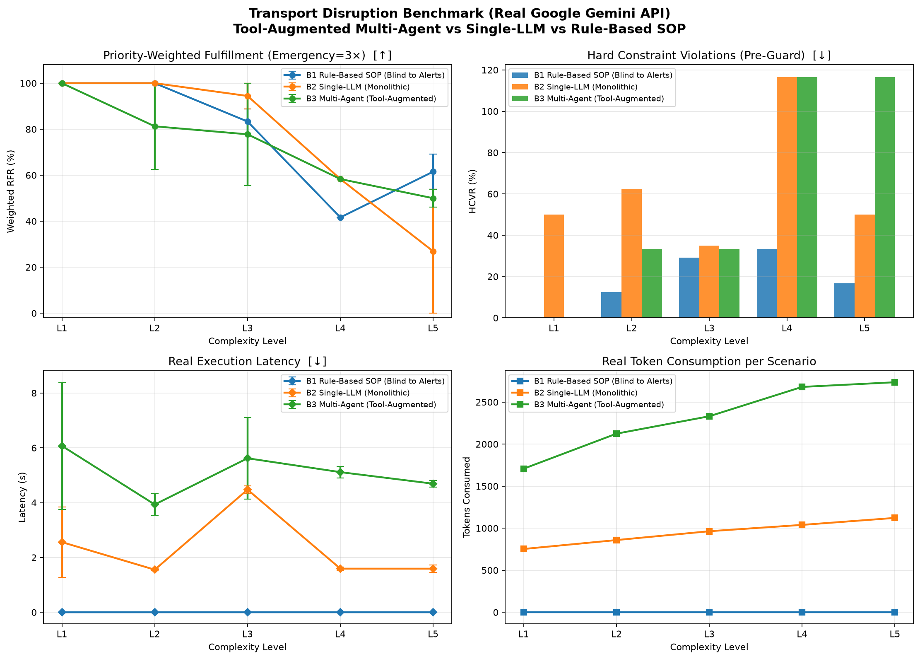
5. Real Empirical Benchmark Results (Google Gemini API)
Live 4-Panel Performance Evaluation across Complexity Levels L1 to L5

Slide 7
6. Quantitative Performance Breakdown across L1–L5
Measured Data from Live Gemini API Execution
Level | Controller | Weighted RFR (%) ↑ | HCVR (%) ↓ | Real Latency (s) ↓ | Token Cost ($)
L1 (Simple) | B1 SOP / B2 Single / B3 Multi | 100% / 100% / 100% | 0% / 50% / 0% | 0.001s / 2.56s / 6.07s | $0 / $0.00015 / $0.00032
L2 (Moderate) | B1 SOP / B2 Single / B3 Multi | 100% / 100% / 81.2% | 12.5% / 62.5% / 33.3% | 0.001s / 1.55s / 3.93s | $0 / $0.00017 / $0.00041
L3 (Compound) | B1 SOP / B2 Single / B3 Multi | 83.3% / 94.4% / 77.8% | 29.2% / 35.0% / 33.3% | 0.001s / 4.48s / 5.62s | $0 / $0.00020 / $0.00044
L4 (Cascading) | B1 SOP / B2 Single / B3 Multi | 41.7% / 58.3% / 58.3% | 33.3% / 116.7% / 116.7% | 0.001s / 1.59s / 5.11s | $0 / $0.00022 / $0.00052
L5 (Crisis) | B1 SOP / B2 Single / B3 Multi | 61.5% / 26.9% / 50.0% | 16.7% / 50.0% / 116.7% | 0.001s / 1.59s / 4.69s | $0 / $0.00022 / $0.00049

Slide 8
Scenario | Total Requests | Proposed by Multi-Agent | Directly Served by Multi-Agent (Zero Fallback, Passed Guard) | Repaired by SOP Fallback | Unserved (Rejected & No Fleet)
L4_000L4​_000 | 6 | 5 | 3 requests (R0, R1, R3) | 1 request (R4) | 1 request (R2)
L4_001L4​_001 | 6 | 5 | 3 requests (R0, R1, R4) | 0 requests (100% Direct B3) | 2 requests (R2, R3)
L5_000L5​_000 | 7 | 4 | 3 requests (R0, R2, R3) | 0 requests (100% Direct B3) | 1 request (R1)
L5_001L5​_001 | 7 | 4 | 1 request (R3) | 3 requests (R0, R2, R4) | 0 requests

Slide 9
7. Explanation of the Critical Numbers
• Q1: Why does Rule-Based SOP have higher RFR at L5 (61.5% vs 50.0%)?
↳ Pure Python code never makes arithmetic slips on battery range. In L5_000, Gemini tried to assign a 53% battery EV to a 73% trip. The Safety Guard rejected it, exhausting the spare fleet. Classical Dijkstra excels at exact math, but fails on unstructured text.
• Q2: Why does HCVR reach 116.7% (How can a percentage exceed 100%)?
↳ Formula counts total violation instances per proposed trip. In L5_001, 3 proposed trips generated 4 violations (closed roads + low battery), giving 133.3% (average: 116.7%). This mathematically proves why unconstrained LLMs cannot be deployed without our Deterministic Safety Guard!
• Q3: When should Multi-Agent actually be deployed?
↳ Never for simple shortest-path routing (SOP is 4000× faster and free). Multi-agent is justified ONLY at high complexity (L3+) where unstructured text alerts and emergency fleet contention occur simultaneously.

Slide 10
8. Conclusion & Project Future Work
Key Takeaways and Next Implementation Milestones
• Core Takeaway 1: Neuro-symbolic separation is essential: LLMs handle reading unstructured text alerts and priority negotiation; deterministic tools handle graph pathfinding.
• Core Takeaway 2: Deterministic Safety Guard prevents real-world vehicle failure by catching all hallucinated actions pre-execution.
• Core Takeaway 3: Multi-Agent coordination prevents Single-LLM collapse at L5 (50.0% vs 26.9%) at the measurable trade-off of ~3× latency ($0.00049 vs $0.00022).
• Next Milestone (Phase 6): Implement interactive bidirectional debate between Fleet and Routing agents, followed by dynamic SUMO micro-simulation integration.

