Slide 1
Meta-GGA functionals

Slide 2
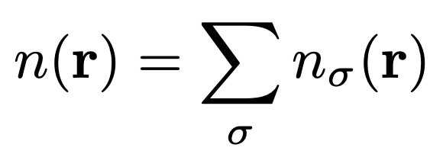
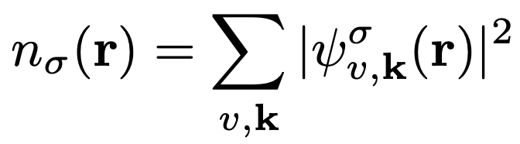
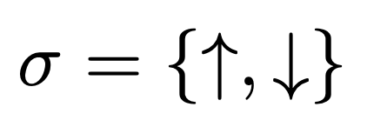
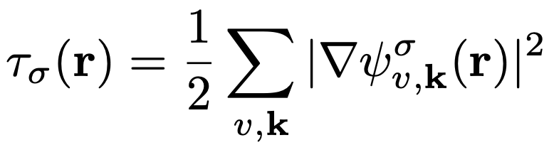
Meta-GGA
total charge density
spin-charge density
kinetic energy density

Slide 3
Plethora of meta-GGA functionals
MVS
BR89
r²SCAN
TPSS
SCAN
MGGA_MS2
rSCAN
TASK
revTPSS
HLE17
TM
SCAN-L

Slide 4
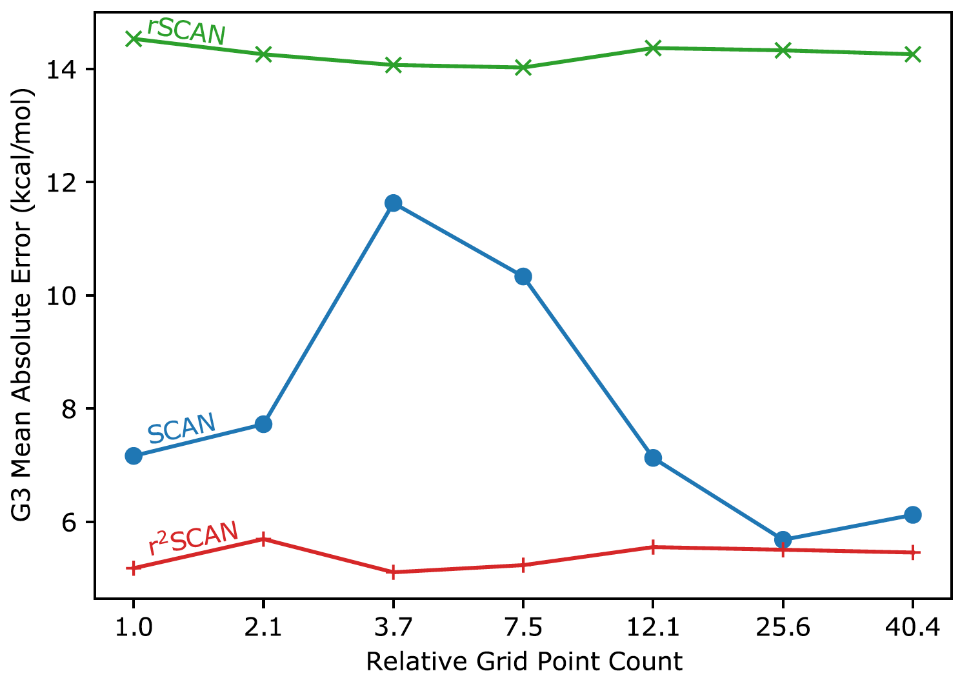
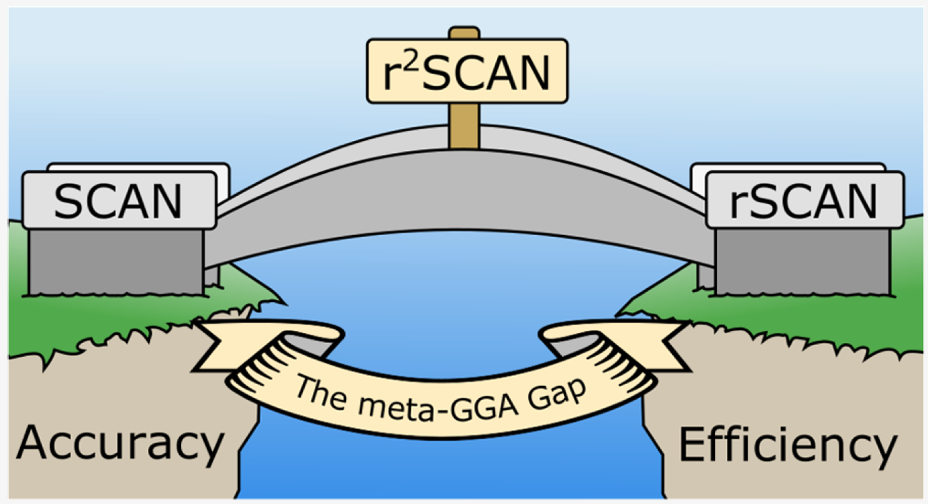
SCAN, rSCAN, r²SCAN
SCAN: J. Sun et al., Phys. Rev. Lett. 115, 036402 (2015).
rSCAN: A. Bartok et al., J. Chem. Phys. 150, 161101 (2019).
r²SCAN: J. Furness et al., J. Phys. Chem. Lett. 11, 8208 (2020).

Slide 5
Exercise 3
Calculation of a band gap of bulk Si using SCAN

Slide 6
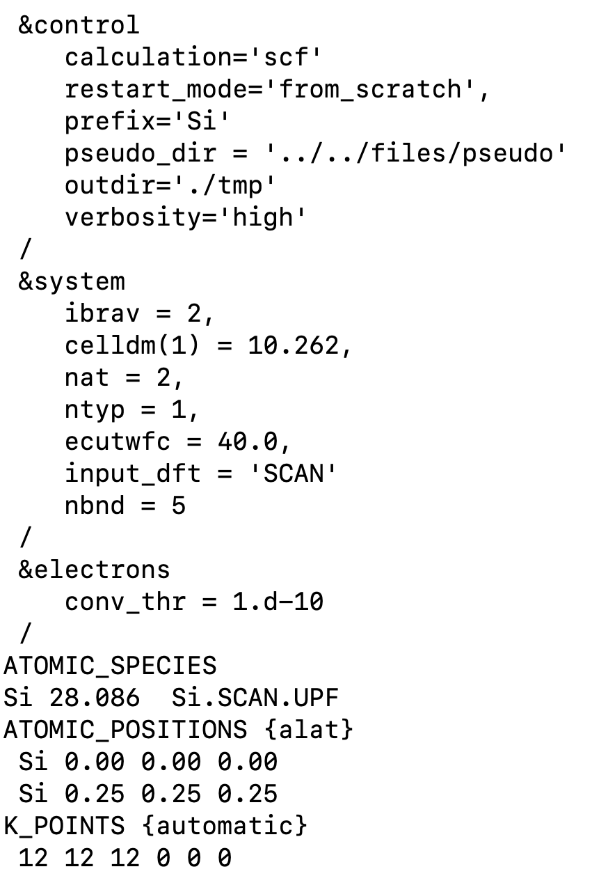
Input file
Experimental lattice parameter
It is necessary to perform convergence tests w.r.t ecutwfc
Set up the SCAN functional from the input
Quantum ESPRESSO must be compiled with Libxc
Pseudopotential generated using the SCAN functional
https://yaoyi92.github.io/scan-tm-pseudopotentials.html
It is necessary to perform convergence tests w.r.t k points mesh

Slide 7
SCAN functional & SCAN pseudopotential
Si
k mesh: 12x12x12

Slide 8
SCAN functional & SCAN pseudopotential
Si
110 Ry
0.939 eV
k mesh: 12x12x12

Slide 9
SCAN functional & SCAN pseudopotential
Si
110 Ry
FFT grid: 60x60x60
40 Ry
FFT grid: 32x32x32

Slide 10
SCAN functional & SCAN pseudopotential
Si
110 Ry
FFT grid: 60x60x60
Let us use a denser FFT grid
of size 60x60x60
40 Ry
FFT grid: 32x32x32

Slide 11
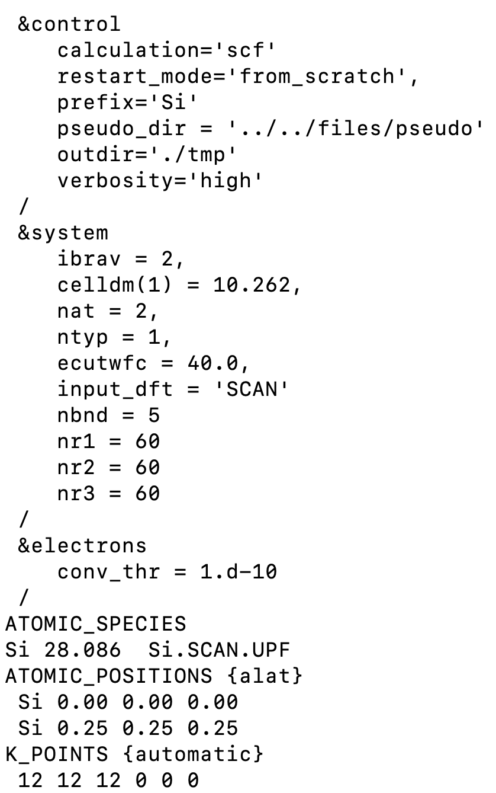
FFT grid specified from the input

Slide 12
SCAN functional & SCAN pseudopotential
Si
FFT grid: 60x60x60
0.002 eV
Meta-GGA contribution to the XC potential is compu-
ted in real space on the FFT grid. This is why the FFT
grid must be very dense.
Y. Yao and Y. Kanai, J. Chem. Phys. 146, 224105 (2017).
FFT grid: 32x32x32

Slide 13
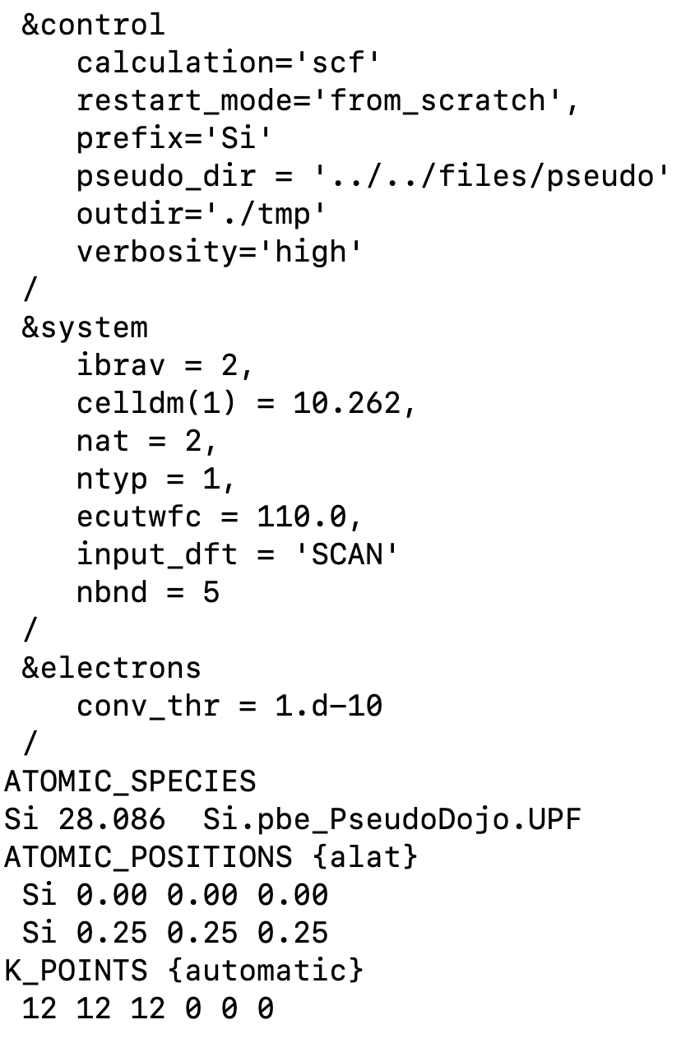
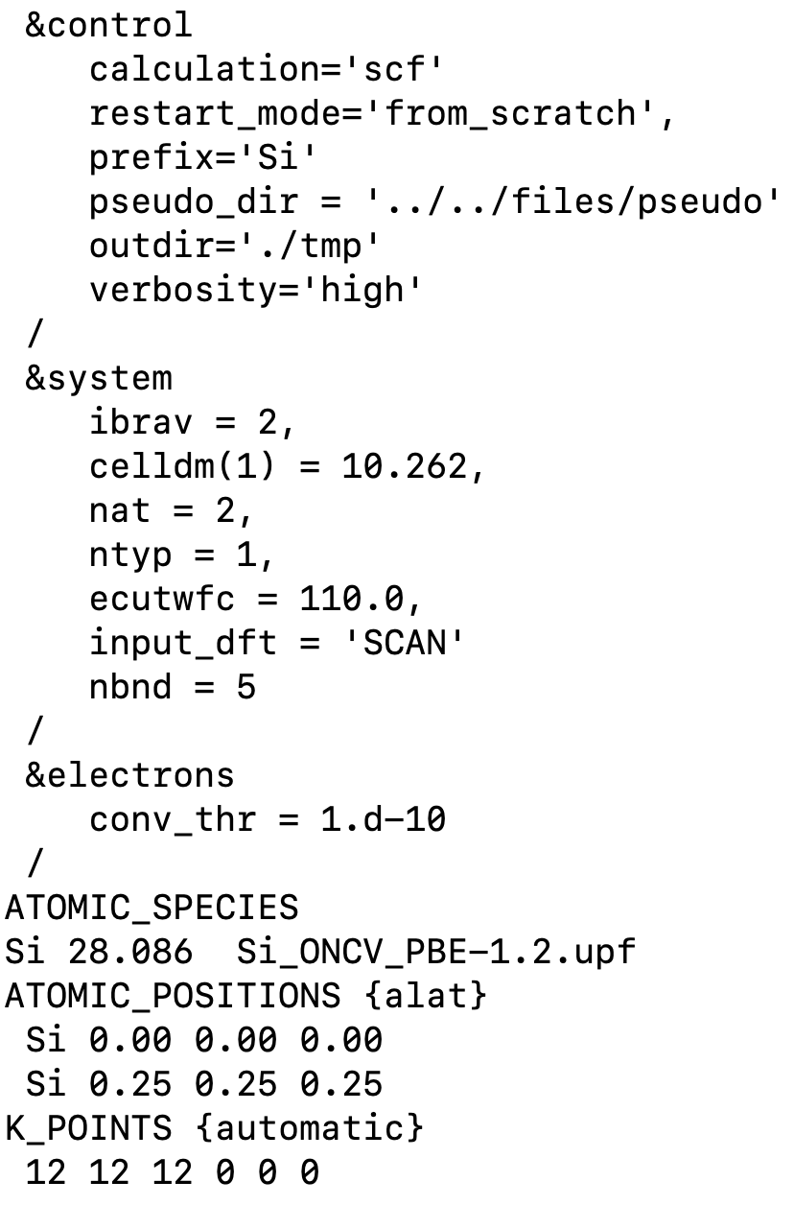
SCAN functional & PBE pseudopotential
Pseudo Dojo library
http://www.pseudo-dojo.org
SG15 library
http://www.quantum-simulation.org/potentials/sg15_oncv/

Slide 14
SCAN functional with different pseudopotentials
Ecut = 110 (Ry), k mesh: 12x12x12
Functional | Pseudopotential | Library | Gap (eV)
SCAN | SCAN | Yi Yao’s library | 0.94
SCAN | PBE | SG15 ONCV | 0.83
SCAN | PBE | Pseudo Dojo | 0.64
Gap_{expt} = 1.17 (eV)

Slide 15
SCAN functional with different pseudopotentials
Ecut = 110 (Ry), k mesh: 12x12x12
Functional | Pseudopotential | Library | Gap (eV)
SCAN | SCAN | Yi Yao’s library | 0.94
SCAN | PBE | SG15 ONCV | 0.83
SCAN | PBE | Pseudo Dojo | 0.64
NLCC=.false.
NLCC=.false.
WARNING
NLCC=.true.
Gap_{expt} = 1.17 (eV)
Currently, nonlinear core correction (NLCC) is not implemented for meta-GGA in Quantum ESPRESSO!
Pseudopotentials that have NLCC=.true. introduce some inconsistency for meta-GGA calculations.

Slide 16
SCAN functional with different pseudopotentials
Ecut = 110 (Ry), k mesh: 12x12x12
Functional | Pseudopotential | Library | Gap (eV)
SCAN | SCAN | Yi Yao’s library | 0.94
SCAN | PBE | SG15 ONCV | 0.83
SCAN | PBE | Pseudo Dojo | 0.64
PBE | PBE | SG15 ONCV | 0.56
PBE | PBE | Pseudo Dojo | 0.57
Gap_{expt} = 1.17 (eV)
SCAN calculation with the SCAN pseudopotential gives the most accurate results
Y. Yao and Y. Kanai, J. Chem. Phys. 146, 224105 (2017).

Slide 17
Convergence with respect to E_{cut}
k mesh: 12x12x12
SCAN with SCAN pseudopotential
PBE with PBE pseudopotential (SG15)
Convergence is achieved must faster with PBE than with SCAN

Slide 18
Setting up the XC functional
input_dft = ‘PBE’ or input_dft=‘XC-000I-000I-101L-130L-000I-000I’
Read more about this here: https://www.quantum-espresso.org/Doc/user_guide/node13.html
Libxc with IDs: https://tddft.org/programs/libxc/functionals/libxc-6.0.0/

Slide 19
Setting up the XC functional
GGA
exchange
GGA
correlation
input_dft = ‘PBE’ or input_dft=‘XC-000I-000I-101L-130L-000I-000I’
LDA
exchange
LDA
correlation
meta-GGA
exchange
meta-GGA
correlation
Read more about this here: https://www.quantum-espresso.org/Doc/user_guide/node13.html
Libxc with IDs: https://tddft.org/programs/libxc/functionals/libxc-6.0.0/

Slide 20
Setting up the XC functional
GGA
exchange
GGA
correlation
input_dft = ‘PBE’ or input_dft=‘XC-000I-000I-101L-130L-000I-000I’
LDA
exchange
LDA
correlation
meta-GGA
exchange
meta-GGA
correlation
input_dft = ‘SCAN’ or input_dft=‘XC-000I-000I-000I-000I-263L-267L’
no short
name in QE
input_dft = ‘rSCAN’ or input_dft=‘XC-000I-000I-000I-000I-493L-494L’
input_dft = ‘r2SCAN’ or input_dft=‘XC-000I-000I-000I-000I-497L-498L’
Read more about this here: https://www.quantum-espresso.org/Doc/user_guide/node13.html
Libxc with IDs: https://tddft.org/programs/libxc/functionals/libxc-6.0.0/

Slide 21
Different flavors of SCAN
Functional | Pseudopotential | Library | Gap (eV)
SCAN | PBE | SG15 ONCV | 0.83
rSCAN | PBE | SG15 ONCV | 0.71
r²SCAN | PBE | SG15 ONCV | 0.70
Gap_{expt} = 1.17 (eV)
SCAN is more accurate than rSCAN and r²SCAN for predicting the band gap of bulk Si
(at least when using the PBE pseudopotential)

Slide 22
Exercise 4
Calculation of a magnetic moment of bulk Fe using SCAN

Slide 23
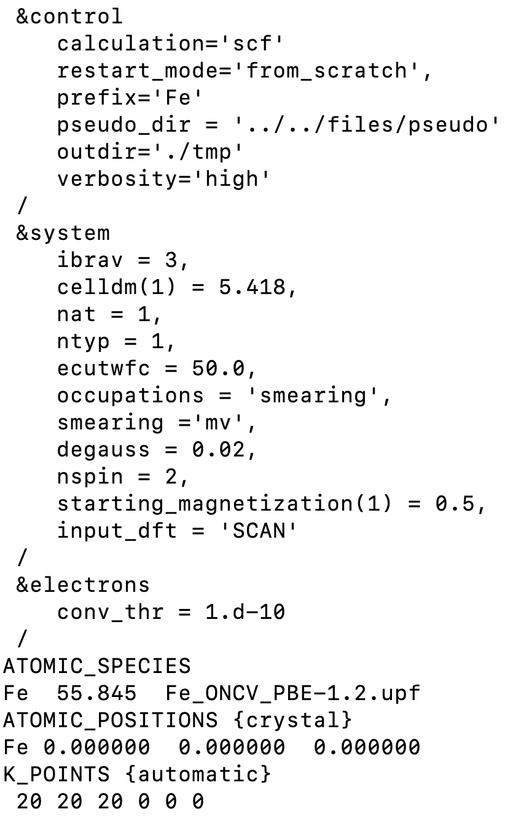
Input file
Experimental lattice parameter
It is necessary to perform convergence tests w.r.t ecutwfc
Set up the SCAN functional from the input
Quantum ESPRESSO must be compiled with Libxc
Pseudopotential generated using the PBE functional
SG15 ONCV library (there is no SCAN pseudo for Fe)
It is necessary to perform convergence tests w.r.t k points mesh

Slide 24
SCAN functional & PBE pseudopotential (SG15)
Fe
k mesh: 20x20x20

Slide 25

SCAN functional & PBE pseudopotential (SG15)
Fe
50 Ry
2.76 $μ$_{B}
k mesh: 20x20x20

Slide 26

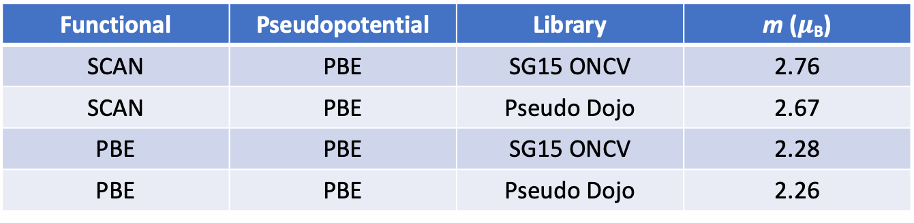
SCAN functional with different pseudopotentials
Ecut = 50 (Ry), k mesh: 20x20x20
Functional | Pseudopotential | Library | m ($μ$_{B})
SCAN | PBE | SG15 ONCV | 2.76
SCAN | PBE | Pseudo Dojo | 2.67
PBE | PBE | SG15 ONCV | 2.28
PBE | PBE | Pseudo Dojo | 2.26
NLCC=.false.
WARNING
NLCC=.true.
m_{expt} = 1.98 – 2.13 ($μ$_{B})
SCAN overestimates magnetic moments in itinerant ferromagnets
PBE is in closer agreement with experiments than SCAN for magnetic moments of itinerant ferromagnets
M. Ekholm et al., Phys. Rev. B 98, 094413 (2018).

Slide 27

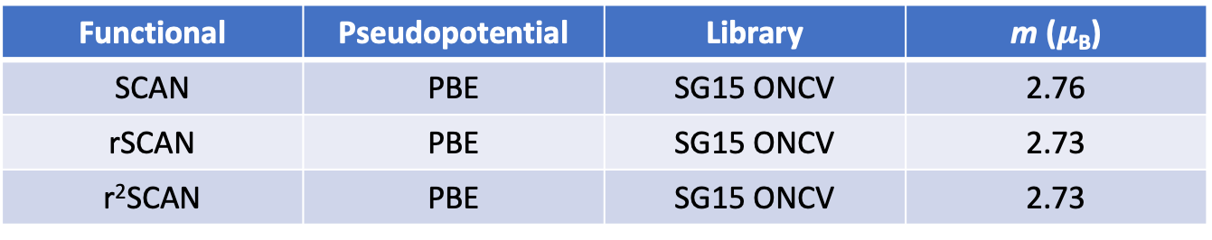
Different flavors of SCAN
Functional | Pseudopotential | Library | m ($μ$_{B})
SCAN | PBE | SG15 ONCV | 2.76
rSCAN | PBE | SG15 ONCV | 2.73
r²SCAN | PBE | SG15 ONCV | 2.73
m_{expt} = 1.98 – 2.13 ($μ$_{B})
Different flavors of SCAN give very similar magnetic moments for bulk Fe

