Slide 1

GUB Student Information System (SIS)
Presenter: Aktarul Pramanik

Slide 2
Introduction:
Student Information System (SIS) is a software project developed using Oracle Apex that has been designed for submission to the German University Bangladesh. The main objective of this project is to provide a comprehensive solution for managing student information, academic records, Accounts Transaction and administrative tasks. The system allows administrators, faculty, and students to access and manage information in a secure and user-friendly way. With SIS, the university can streamline their operations, increase efficiency, and reduce paperwork, resulting in a more efficient and effective academic environment. The system has been developed with a focus on flexibility, scalability, and ease of use, ensuring that it can be easily customized and adapted to meet the specific needs of the university.

Slide 3
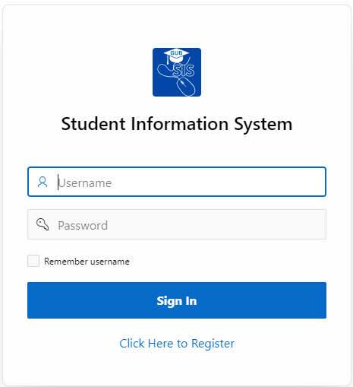
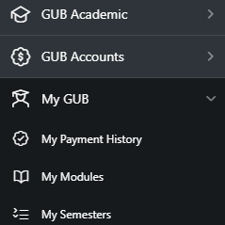

Modules
Administrative Module
Academic Module
Students Module
Accounts Module

Slide 4
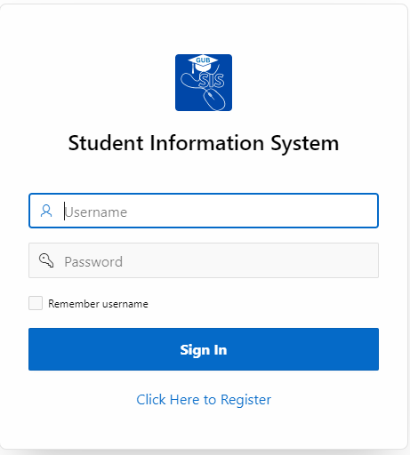
Login Page
Login Page Also Contain a Self Registration Link

Slide 5
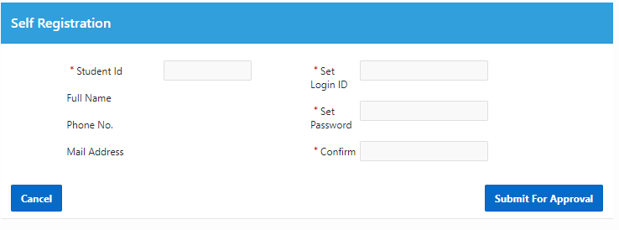
Self Registration Page

Slide 6

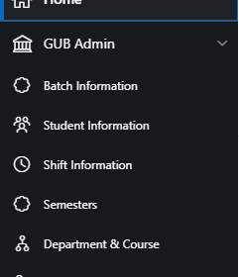
Administrative Module
Module - 1

Slide 7
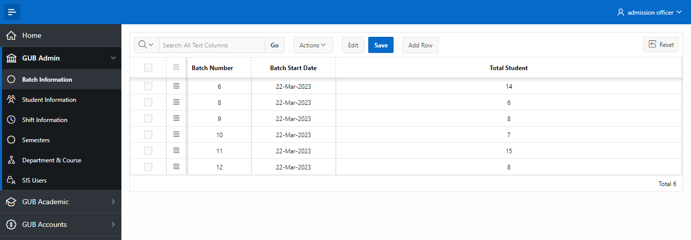
Batch Information
Batch Information is an interactive Grid that allows user to insert, update or delete of any batch without moving to another forms.

Slide 8
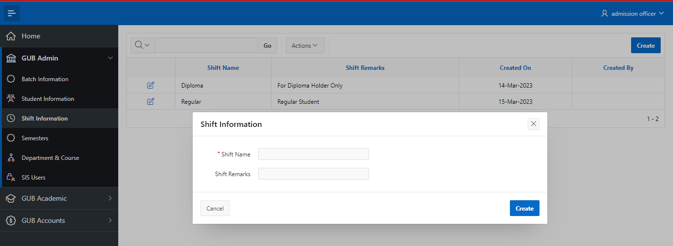
Shift Report & Pop-up form
Shift Information is an interactive Report Page that allows user to sort & filter of the report data conveniently. It also contain a “Create” button to add new shift and an edit button to modify shift information.

Slide 9
Semester Report
Semester Information is an interactive Grid that allows user to insert, update or delete of any semester without moving to another forms.

Slide 10
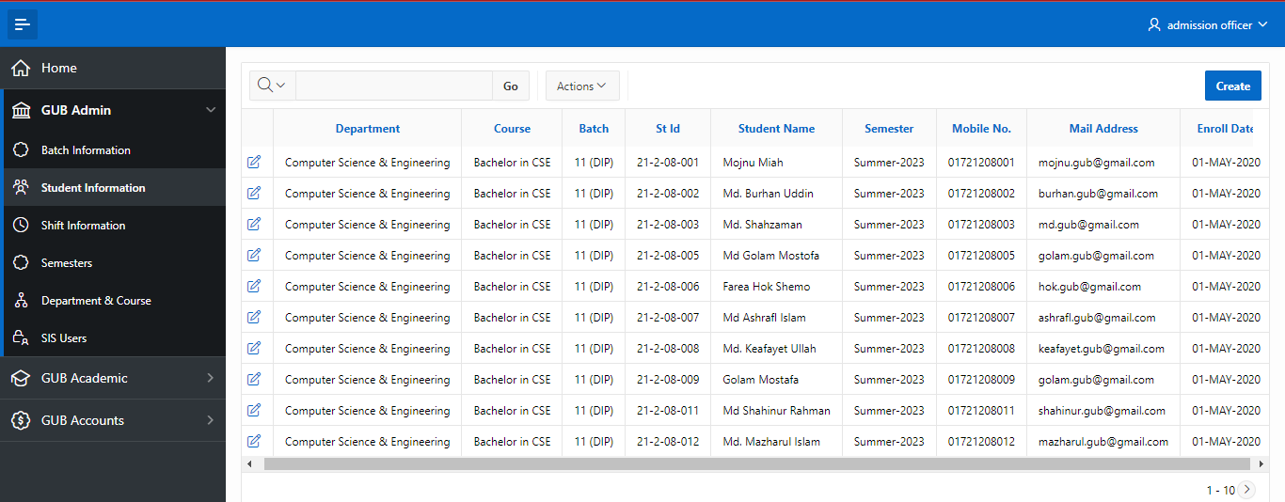
Student Information
Batch Information is an interactive Report Page that allows user to sort & filter of the report data conveniently. It also contain a “Create” button to add new student and an edit button to modify student information.

Slide 11
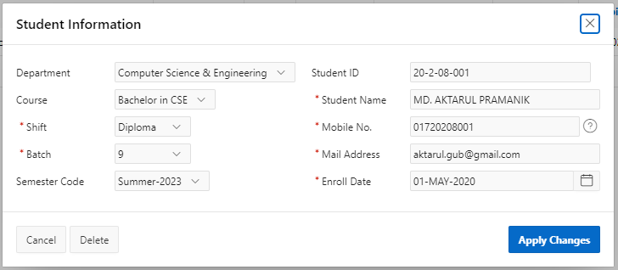
Student Form
This form is a pop-up modal dialog form that contain all the dynamic action, validation and PL/SQL process to add or edit students in the system.

Slide 12
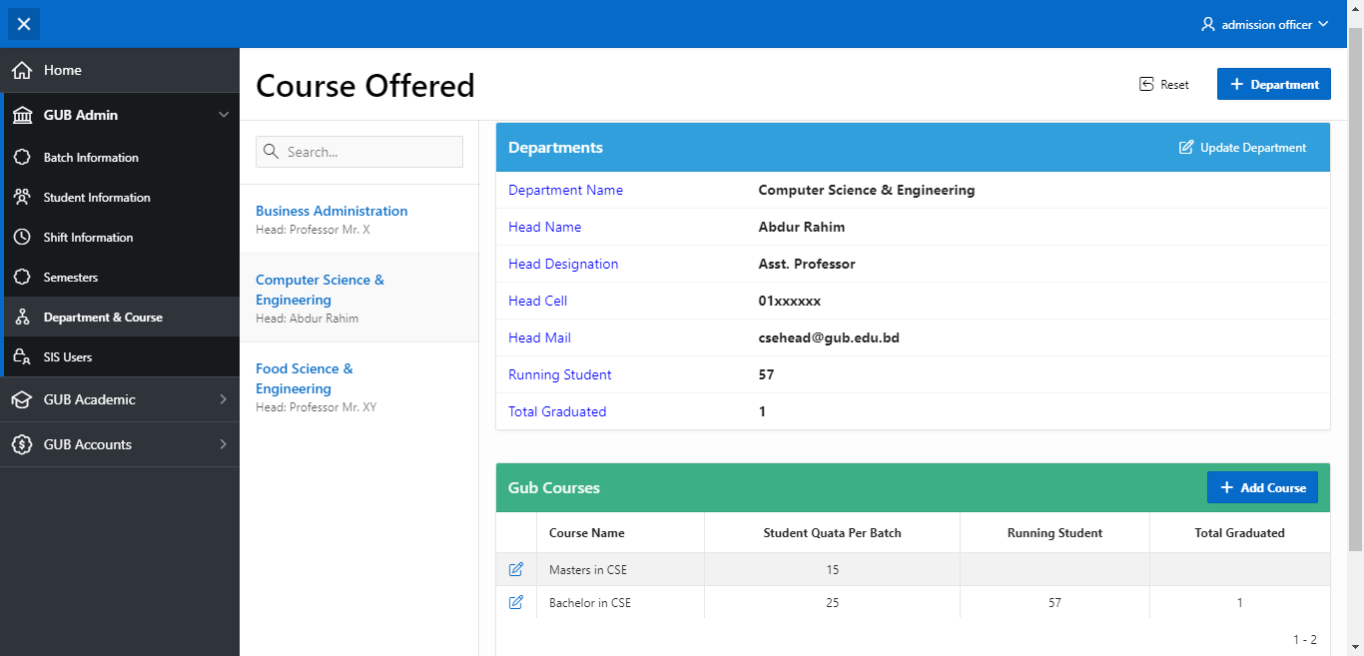
Course Offering
Course offering is an advance master details page that include functionality of searching record, selecting them and generating details record set of selected master record.

Slide 13
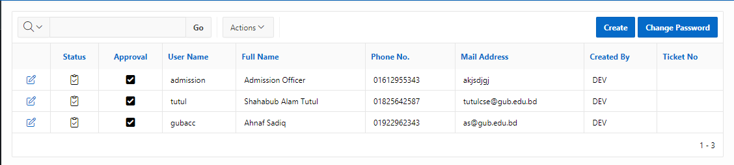
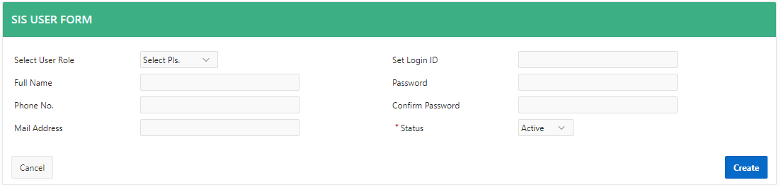
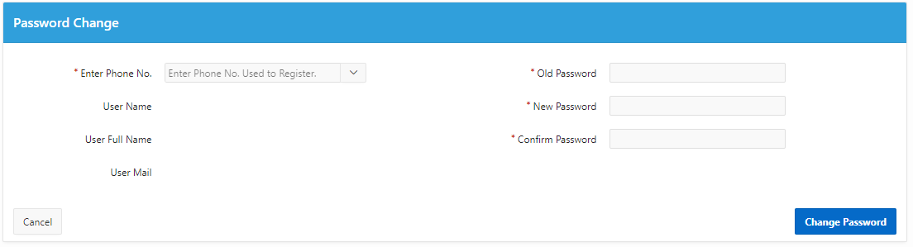
User Manager
Contain report, Form & Password change form of GUB staff

Slide 14
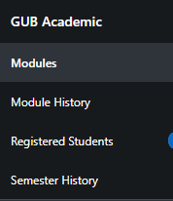
Academic Module
Module - 2

Slide 15
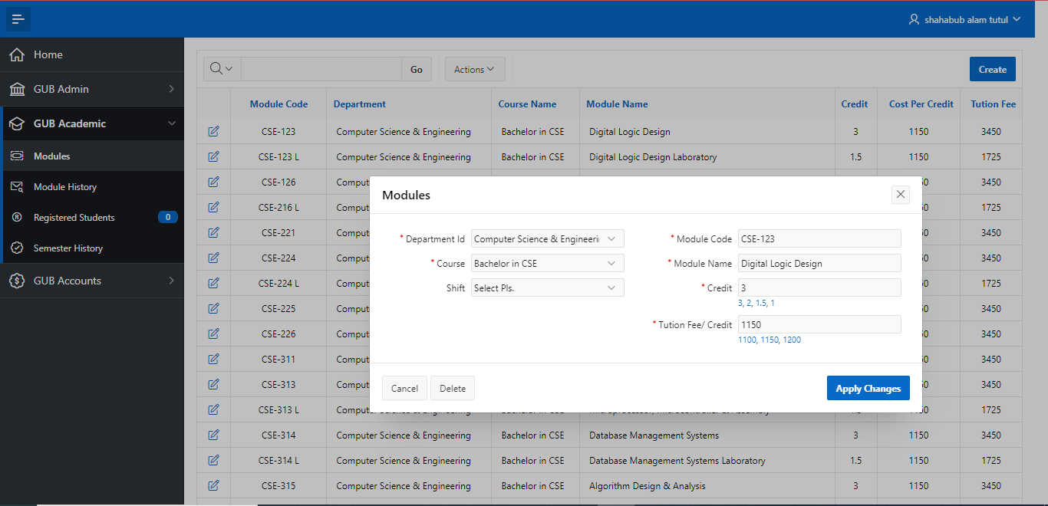
Module Information
Here faculty can create module, update if required and view report.

Slide 16
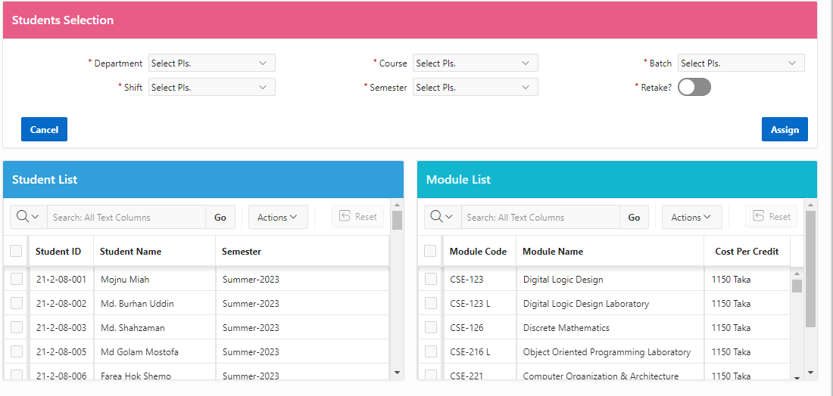
Module Assignment
Here faculty can Assign multiple module to multiple students at once semester wise.

Slide 17
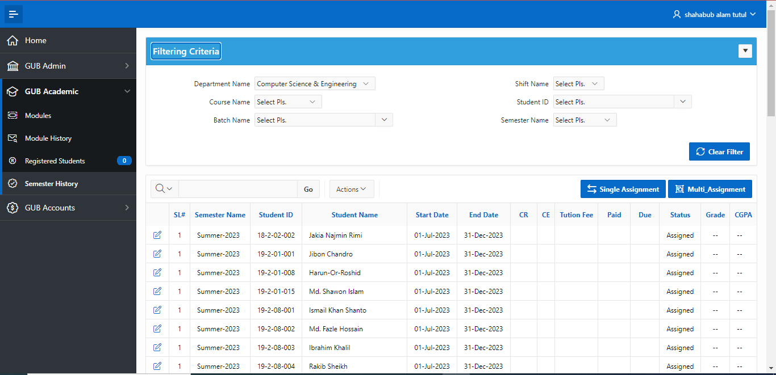
Module History
Faculty can view semester wise module history with multiple sort & filtering criteria and update them if required.

Slide 18
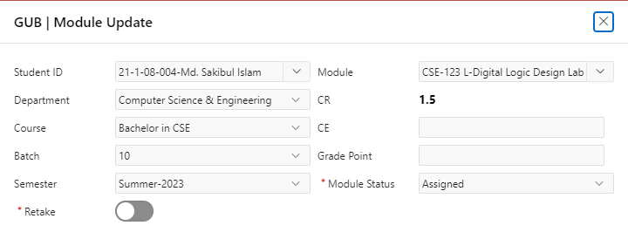
Module Update
Faculty can view semester wise module history with multiple sort & filtering criteria. Also can change academic status of every modules assigned to students.

Slide 19
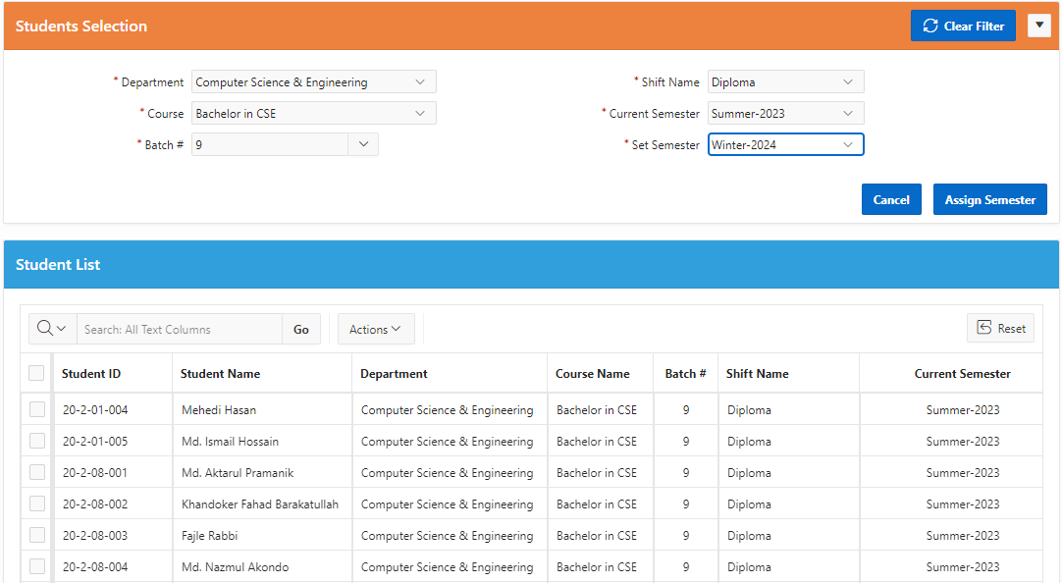
Semester Assignment
Faculty can assign semester multiple students at once.

Slide 20
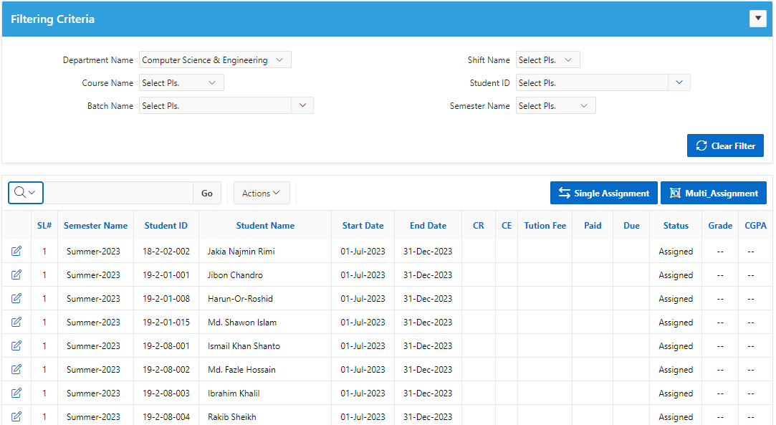
Semester History
Faculty can view semester history with multiple sort & filtering criteria. Also, can change academic status of every semester assigned to students.

Slide 21
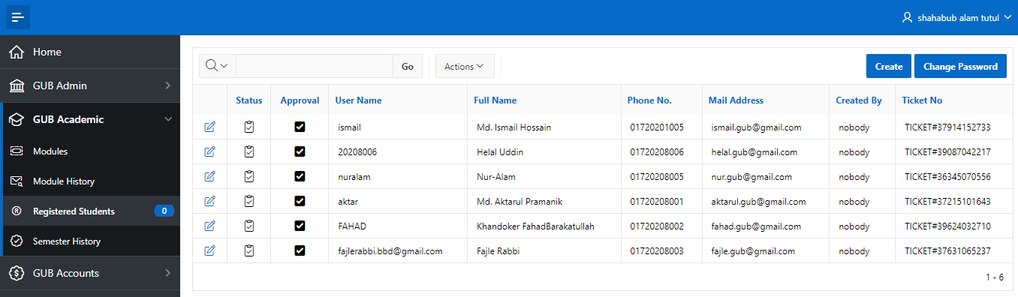
Student Access Report
Here is the report of students who are using the system. Faculty can access their information can help them to sort login issues. Also, can approve self registration information.

Slide 22
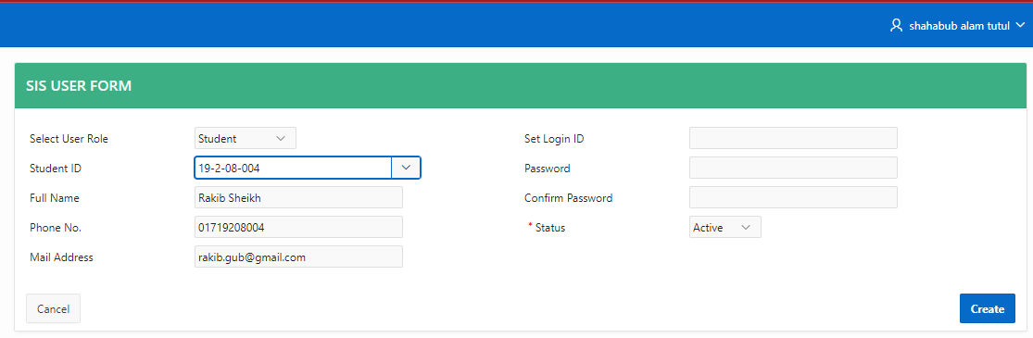
Add Students to Access SIS
Here Faculty can give access to students belongs to their faculty to access SIS.

Slide 23
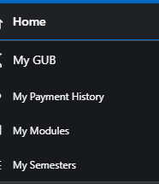
Students Module
Module - 4

Slide 24
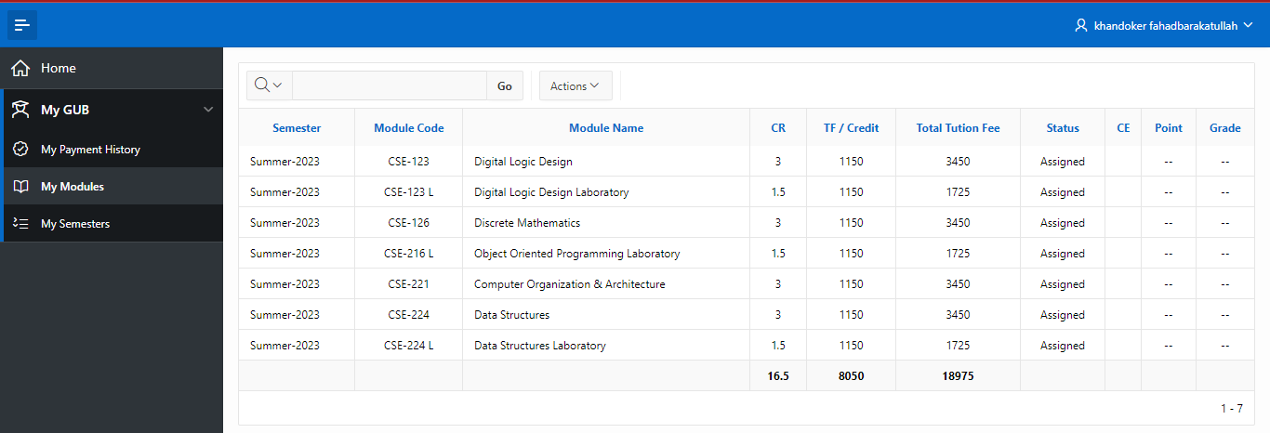
My Module
Here Students can view his semester wise all the modules and their status.

Slide 25
My Semesters
Here Students can view his semester wise academic and other status.

Slide 26
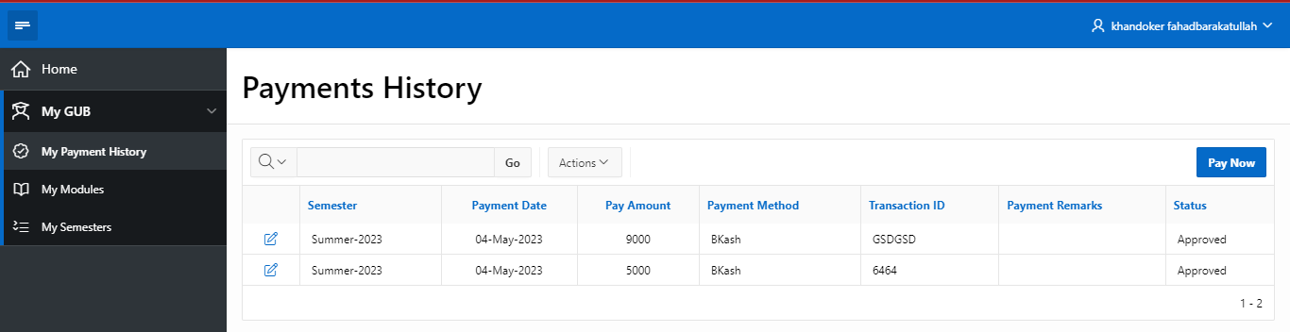
My Payment History
Here Students can view Payment history and submit e-payment information for accounts departments approval.

Slide 27
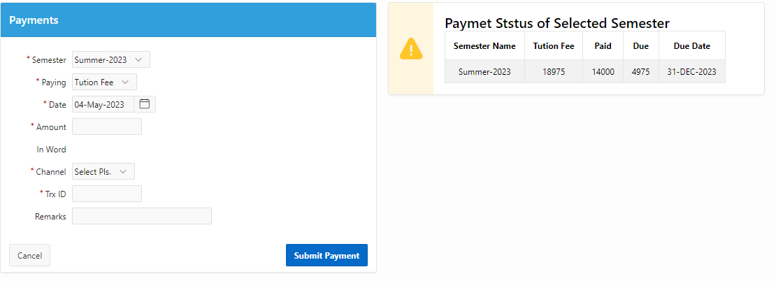
Pay Now
By using this form students can submit e-payments information.

Slide 28
Accounts Module
Module - 3

Slide 29
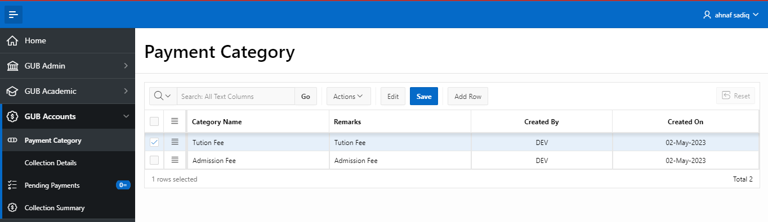
Payment Category
This is an interactive grid report where account department can create and modify Payment Category.

Slide 30
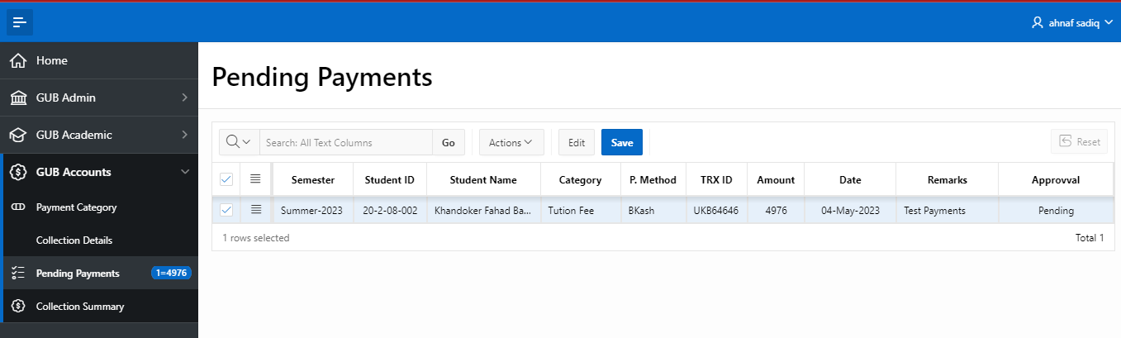
E-Payment Approval
Here Accounts department approve or decline electronic payments initiated by Students.

Slide 31
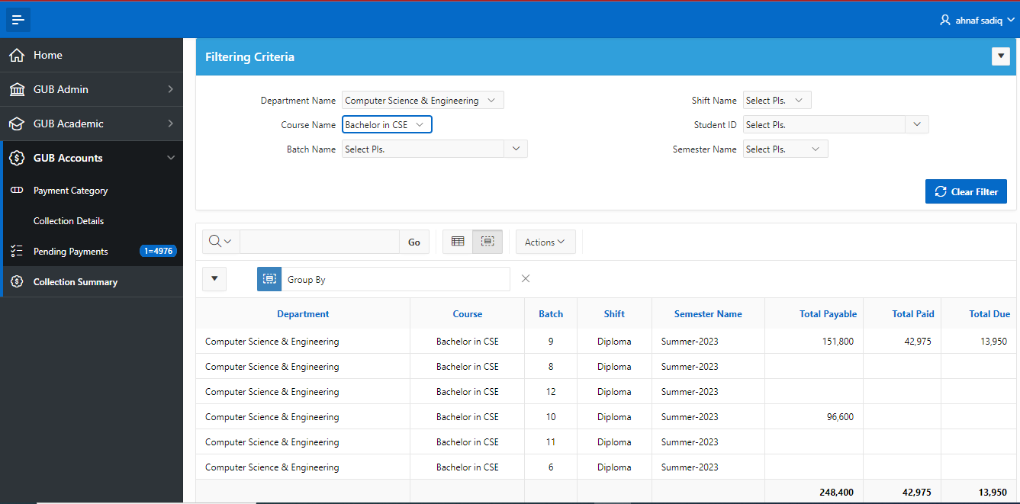
Collection Summary
Here authority can view collectable, paid & due status of every semester based on department, course, shift and many more.

Slide 32

Oracle APEX
Build enterprise apps 20x faster with 100x less code.
Oracle APEX is the world's most popular enterprise low-code application platform.
&
Thousands of
Authentication
Application Item
Application Computation
Navigation Menu
Navigation Bar
Page Level Authorization
Item Level Authorization
PL/SQL Validation
JavaScript Validation
Dynamic Action
SQL Query
PL/SQL Process
PL/SQL Program Unit
Stored Procedure
Function
HTML
CSS
JAVASCRIPT
& Still Thinking to make it better

Slide 33
Conclusion
The SIS software project is a comprehensive solution for managing student data in an educational institution. The system is designed to streamline administrative processes, enhance communication, and provide data-driven insights to help administrators make informed decisions about school management. With its user-friendly interface, advanced features, and secure architecture, the SIS software project

Slide 34

Any Question?

Slide 35
Thank You
Md. Aktarul Pramanik
Student ID : 20-2-08-001
CSE 9th Batch (DH)
German University Bangladesh.

