Slide 1

Introduction
Companion slides for
The Art of Multiprocessor Programming
by Maurice Herlihy & Nir Shavit
TexPoint fonts used in EMF.
Read the TexPoint manual before you delete this box.: AAAA

Slide 2
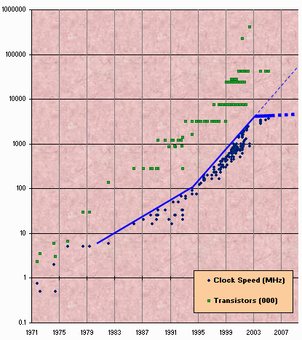
Moore’s Law
Transistor count still rising
Clock speed flattening sharply
Art of Multiprocessor Programming
Notes:
Most of you have probably heard of Moore’s law, which states that the number of transistors on a chip tends to double about every two years. Moore’s law has been the engine of growth for our field, and the reason you can buy a laptop for a few thousand dollars that would have cost millions a decade earlier. The green dots on this graph show

Slide 3
Why do we care?
Time no longer cures software bloat
  The “free ride” is over
When you double your program’s path length
  You can’t just wait 6 months
  Your software must somehow exploit twice as much concurrency
Art of Multiprocessor Programming
Notes:
Why do you care? Because the way you wrote software until now will disappear in the next few years. The free ride where you write software once and trust Intel, Sun, IBM, and AMD to make it faster is no longer valid.

Slide 4
Nearly Extinct: the Uniprocesor
cpu
memory
Art of Multiprocessor Programming
Notes:
Traditionally, we have had inexpensive single processor with an associated memory on a chip, which we call a uniprocessor.

Slide 5
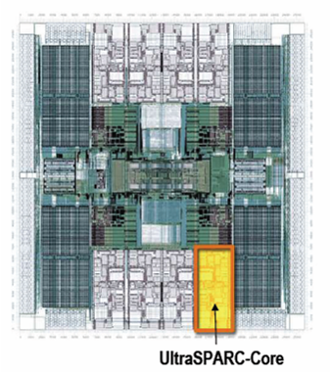
The New Boss:
The Multicore Processor
(CMP)
All on the
same chip
Sun T2000
Niagara
cache
cache
cache
Bus
Bus
shared memory
Art of Multiprocessor Programming
Notes:
The revolution we are going through is that the desktop is now becoming a multiprocessor also. We call this type of processor a system-on-a-chip or a multicore machine or a chip multiprocessor (CMP). The chip you see here is the Sun T2000 Niagara CMP that has 8 cores and shared cache and memory. We will learn about the Niagara in more detail later. It is the machine you will be using for your homework assignments.

Slide 6
Traditional Scaling Process
7x
Speedup
3.6x
1.8x
User code
Traditional
Uniprocessor
Time: Moore’s law
Art of Multiprocessor Programming
Notes:
Recall the traditional scaling process for software: write it once, trust Intel to make the CPU faster to improve performance.

Slide 7
Ideal Scaling Process
7x
3.6x
Speedup
1.8x
User code
Multicore
Unfortunately, not so simple…
Art of Multiprocessor Programming
Notes:
With multicores, we will have to parallelize the code to make software faster, and we cannot do this automatically (except in a limited way on the level of individual instructions).

Slide 8
Actual Scaling Process
Speedup
2x
2.9x
1.8x
User code
Multicore
Parallelization and Synchronization
require great care…
Art of Multiprocessor Programming
Notes:
This is because splitting the application up to utilize the cores is not simple, and coordination among the various code parts requires care.

Slide 9
Multicore Programming:
Course Overview
Fundamentals
  Models, algorithms, impossibility
Real-World programming
  Architectures
  Techniques
Art of Multiprocessor Programming
Notes:
Here is our course overview. (at the end, we aim to give you a basic understanding of the issues, not to make you experts)
In this course, we will study a variety of synchronization algorithms,
with an emphasis on informal reasoning about correctness.
Reasoning about multiprocessor programs is different in many ways from the more
familiar style of reasoning about sequential programs.
Sequential correctness is mostly concerned with safety properties,
that is, ensuing that a program transforms each before-state to the correct
after-state.
Naturally, concurrent correctness is also concerned with safety,
but the problem is much, much harder,
because safety must be ensured despite the vast number of ways steps of
concurrent threads can be be interleaved.
Equally important, concurrent correctness encompasses a variety of
\emph{liveness} properties that have no counterparts in the sequential world.
The second part of the book concerns performance.
Analyzing the performance of synchronization algorithms is also different
in flavor from analyzing the performance of sequential programs.
Sequential programming is based on a collection of well-established and
well-understood abstractions.
When you write a sequential program,
you usually do not need to be aware that underneath it all,
pages are being swapped from disk to memory,
and smaller units of memory are being moved in and out of a hierarchy of
processor caches.
This complex memory hierarchy is essentially invisible,
hiding behind a simple programming abstraction.
In the multiprocessor context, this abstraction breaks down,
at least from a performance perspective.
To achieve adequate performance,
the programmer must sometimes ``outwit'' the underlying memory system,
writing programs that would seem bizarre to someone unfamiliar with
multiprocessor architectures.
Someday, perhaps, concurrent architectures will provide the same degree of
efficient abstraction now provided by sequential architectures,
but in the meantime, programmers should beware.
We start then with fundamentals, trying to understand what is and is not computable before we try and write programs. This is similar to the process you have probably gone through with sequential computation of learning computability and complexity theory so that you will not try and solve unsolvable problems. There are many such computational pitfals when programming multiprocessors.

Slide 10
Sequential Computation
thread
memory
object
object
Art of Multiprocessor Programming

Slide 11
Concurrent Computation
threads
memory
object
object
Art of Multiprocessor Programming

Slide 12
Asynchrony
Sudden unpredictable delays
  Cache misses (short)
  Page faults (long)
  Scheduling quantum used up (really long)
Art of Multiprocessor Programming

Slide 13
Model Summary
Multiple threads
  Sometimes called processes
Single shared memory
Objects live in memory
Unpredictable asynchronous delays
Art of Multiprocessor Programming

Slide 14
Road Map
We are going to focus on principles first, then practice
  Start with idealized models
  Look at simplistic problems
  Emphasize correctness over pragmatism
  “Correctness may be theoretical, but incorrectness has practical impact”
Art of Multiprocessor Programming
Notes:
We want to understand what we can and cannot compute before we try and write code. In fact, as we will see there are problems that are Turing computable but not asynchronously computable.

Slide 15
Concurrency Jargon
Hardware
  Processors
Software
  Threads, processes
Sometimes OK to confuse them, sometimes not.
Art of Multiprocessor Programming
Notes:
We will use the terms above, even though there are also terms like strands, CPUs, chips etc also…

Slide 16
Parallel Primality Testing
Challenge
  Print primes from 1 to 10¹⁰
Given
  Ten-processor multiprocessor
  One thread per processor
Goal
  Get ten-fold speedup (or close)
Art of Multiprocessor Programming
Notes:
We want to look at the problem of printing the primes from 1 to 10^10 in some arbitrary order.

Slide 17
Load Balancing
1
10⁹
2·10⁹
…
10¹⁰
P₀
P₁
…
P₉
Split the work evenly
Each thread tests range of 10⁹
Art of Multiprocessor Programming
Notes:
Split the range ahead of time

Slide 18
Procedure for Thread i
void primePrint {
int i = ThreadID.get(); // IDs in {0..9}
for (j = i*10⁹+1, j<(i+1)*10⁹; j++) {
if (isPrime(j))
print(j);
}
}
Art of Multiprocessor Programming
Notes:
Code matches code in Chapter 1 of book.

Slide 19
Issues
Higher ranges have fewer primes
Yet larger numbers harder to test
Thread workloads
  Uneven
  Hard to predict
Art of Multiprocessor Programming
Notes:
You can mention that the use of prime() is a bit artificial since it makes sense to use earlier numbers detected as prime in testing whether a later number is prime.
Jean-Paul Rigault of the University of Nice Sophia Antipolis in France tells us that there are
Overall 454 millions Primes between 1 and 10¹⁰, 51 million of them between 0x10⁹ and 1x10⁹ and 43 million of them between 9x10⁹ and 10x10⁹. The primes seem rather uniformly distributed in the given range, although there are indeed fewer between 9x10⁹ and 10¹⁰ than between 1 and 10⁹ (about 20% less).
He obtained these numbers using a Python program implementing Legendre's approximation for pi(n), the number of primes less than n: pi(n) = n/(log n - 1).

Slide 20
Issues
Higher ranges have fewer primes
Yet larger numbers harder to test
Thread workloads
  Uneven
  Hard to predict
Need dynamic load balancing
rejected
Art of Multiprocessor Programming
Notes:
You can mention that the use of prime() is a bit artificial since it makes sense to use earlier numbers detected as prime in testing whether a later number is prime.
Jean-Paul Rigault of the University of Nice Sophia Antipolis in France tells us that there are
Overall 454 millions Primes between 1 and 10¹⁰, 51 million of them between 0x10⁹ and 1x10⁹ and 43 million of them between 9x10⁹ and 10x10⁹. The primes seem rather uniformly distributed in the given range, although there are indeed fewer between 9x10⁹ and 10¹⁰ than between 1 and 10⁹ (about 20% less).
He obtained these numbers using a Python program implementing Legendre's approximation for pi(n), the number of primes less than n: pi(n) = n/(log n - 1).

Slide 21
Shared Counter
19
each thread takes a number
18
17
Art of Multiprocessor Programming

Slide 22
Procedure for Thread i
int counter = new Counter(1);
void primePrint {
long j = 0;
while (j < 10¹⁰) {
j = counter.getAndIncrement();
if (isPrime(j))
print(j);
}
}
Art of Multiprocessor Programming

Slide 23
Procedure for Thread i
Counter counter = new Counter(1);
void primePrint {
long j = 0;
while (j < 10¹⁰) {
j = counter.getAndIncrement();
if (isPrime(j))
print(j);
}
}
Shared counter
object
Art of Multiprocessor Programming

Slide 24
Where Things Reside
void primePrint {
int i = ThreadID.get(); // IDs in {0..9}
for (j = i*10⁹+1, j<(i+1)*10⁹; j++) {
if (isPrime(j))
print(j);
}
}
Local
variables
code
cache
cache
cache
Bus
Bus
shared
memory
1
shared counter
Art of Multiprocessor Programming
Notes:
Need this slide since some students do not understand where the counter resides, where the shared variables reside, and where the code resides etc. This is our opportunity to explain.

Slide 25
Procedure for Thread i
Counter counter = new Counter(1);
void primePrint {
long j = 0;
while (j < 10¹⁰) {
j = counter.getAndIncrement();
if (isPrime(j))
print(j);
}
}
Stop when every value taken
Art of Multiprocessor Programming

Slide 26
Procedure for Thread i
Counter counter = new Counter(1);
void primePrint {
long j = 0;
while (j < 10¹⁰) {
j = counter.getAndIncrement();
if (isPrime(j))
print(j);
}
}
Increment & return each new value
Art of Multiprocessor Programming

Slide 27
Counter Implementation
public class Counter {
private long value;
public long getAndIncrement() {
return value++;
}
}
Art of Multiprocessor Programming

Slide 28
Counter Implementation
public class Counter {
private long value;
public long getAndIncrement() {
return value++;
}
}
OK for single thread,
not for concurrent threads
Art of Multiprocessor Programming

Slide 29
Why?
int a = 0;
void increment() {
a += 1;;
}
clang -S -c increment.c
movl _a(%rip), %eax
addl $1, %eax
movl %eax, _a(%rip)
Art of Multiprocessor Programming

Slide 30
What It Means
public class Counter {
private long value;
public long getAndIncrement() {
return value++;
}
}
temp = value;
value = temp + 1;
return temp;
Art of Multiprocessor Programming

Slide 31
Not so good…
Value… 1
2
3
2
read
1
write
2
read
2
write
3
read
1
write
2
time
Art of Multiprocessor Programming
Notes:
Time goes from left to right. The Blue thread might read 1 from \fValue{}, but before
it sets \fValue{} to 2, the Red thread would go through the
increment loop several times, reading 1 and setting to 2, reading
2 and setting to 3. When the Blue thread finally completes its
operation and sets \fValue{} to 2, it will actually be setting
the counter back from 3 to 2.

Slide 32
Is this problem inherent?
!!
!!
write
read
read
write
If we could only glue reads and writes together…
Art of Multiprocessor Programming
Notes:
Is this phenomena inherent or is there a better implementation we are missing?
To understand why such bad interleavings can always happen, consider
the following situation that all of us run into every once in a while.
You are walking down the street, and
suddenly someone is coming straight at you. You move to the right, and they
move to the right, so you move to the left, and they happen to do the
same, now you try and make a final break to either left or right, many
times you manage not to bump, but sometimes you do. Are these
collisions avoidable? Can we think of a protocol to follow in order to
prevent people from ever colliding?
The answer is NO! \footnote{One might think that you
can agree to always move to the right, to which you can answer ``but
what if the other person is British?'' Alternately,
think of Atlantis and Mir flying one towards the other in space, where
the is no predefined ``right side.''} It can be mathematically shown
that there is always a sequence of moves that will result in people
bumping (this is the famous result of Fischer, Lynch, and Paterson we will
Study later in the course).
The problem arises from the fact that ``looking'' at the other person
and ``moving'' aside to avoid him are two separate operations. If one
could ``look-and-jump'' instantaneously the problem could be avoided.
In the same way that people compete for the right to pass, computers
compete to gain access to shared locations in memory. In the case of
our {\tt shared-counter}, processors are in a competition where the
winner gets the lower counter value and the looser gets the higher
one. The moral of the ``people in the street'' example is that we need
to ``glue together'' the {\tt get} and {\tt increment} operations to
get an ``instantaneous'' {\tt get-and-increment}. This operation
would execute the {\tt get} and the {\tt increment} instructions
like one indivisible operation with no other operation taking place
between the start of the {\tt get} and the end of the {\tt
increment}. If we have such an operation then the following is a
correct and efficient solution to the prime printing problem.

Slide 33
Challenge
public class Counter {
private long value;
public long getAndIncrement() {
temp = value;
value = temp + 1;
return temp;
}
}
Art of Multiprocessor Programming

Slide 34
Challenge
public class Counter {
private long value;
public long getAndIncrement() {
temp = value;
value = temp + 1;
return temp;
}
}
Make these steps atomic (indivisible)
Art of Multiprocessor Programming

Slide 35
Hardware Solution
public class Counter {
private long value;
public long getAndIncrement() {
temp = value;
value = temp + 1;
return temp;
}
}
ReadModifyWrite()
instruction
Art of Multiprocessor Programming
Notes:
We will see later that modern multiprcessors provide special types of readModiftWrite() instructions to allow us to overcome the
problem at hand. But how do we solve this problem in software?

Slide 36
An Aside: Java™
public class Counter {
private long value;
public long getAndIncrement() {
synchronized {
temp = value;
value = temp + 1;
}
return temp;
}
}
Art of Multiprocessor Programming

Slide 37
An Aside: Java™
public class Counter {
private long value;
public long getAndIncrement() {
synchronized {
temp = value;
value = temp + 1;
}
return temp;
}
}
Synchronized block
Art of Multiprocessor Programming

Slide 38
An Aside: Java™
public class Counter {
private long value;
public long getAndIncrement() {
synchronized {
temp = value;
value = temp + 1;
}
return temp;
}
}
Mutual Exclusion
Art of Multiprocessor Programming
Notes:
Java provides us with a solution: mutual exclusion in software…lets try and understand how this is done

Slide 39
Why do we care?
We want as much of the code as possible to execute concurrently (in parallel)
A larger sequential part implies reduced performance
Amdahl’s law: this relation is not linear…
Art of Multiprocessor Programming
Notes:
Mutual exclusion and waiting imply that code is essentially executed sequentially, while one is executing it others spin doing nothing useful. The larger these sequential parts, the worst our utilization of the multiple processors on our machine. Moreover, this relation is not linear: if 25% of the code is sequential, it does not mean that on a ten processor machine we will see a 25% loss of speedup…to understand the real realation, we need to understand
Amdahl’s law. Gene Amdahl was a computer science pioneer.

Slide 40
Amdahl’s Law
1-thread execution time
Speedup=
n-thread execution time
Art of Multiprocessor Programming
Notes:
This kind of analysis is very important for concurrent computation.
The formula we need is called \emph{Amdahl's Law}.
It captures the notion that the extent to
which we can speed up any complex job (not just painting)
is limited by how much of the job must be executed sequentially.
Define the \emph{speedup} $S$ of a job to be the ratio between the
time it takes one processor to complete the job (as measured by a wall clock)
versus the time it takes $n$ concurrent processors to complete the same job.
\emph{Amdahl's Law} characterizes the maximum speedup $S$ that can be achieved by $n$
processors collaborating on an application where $p$ is the fraction of
the job that can be executed in parallel.
Assume, for simplicity,
that it takes (normalized) time 1 for a single processor to complete the job.
With $n$ concurrent processors, the parallel part takes time $p/n$ and the sequential part takes time $1-p$.
Overall, the parallelized computation takes time:
$$
1 - p + \frac{p}{n}
$$
Amdahl's Law says that the speedup, that is,
the ratio between the sequential (single-processor) time and the parallel time,
is:
$$
S = \frac{1}{1 - p + \frac{p}{n}}
$$
We show this in the next set of slides

Slide 41
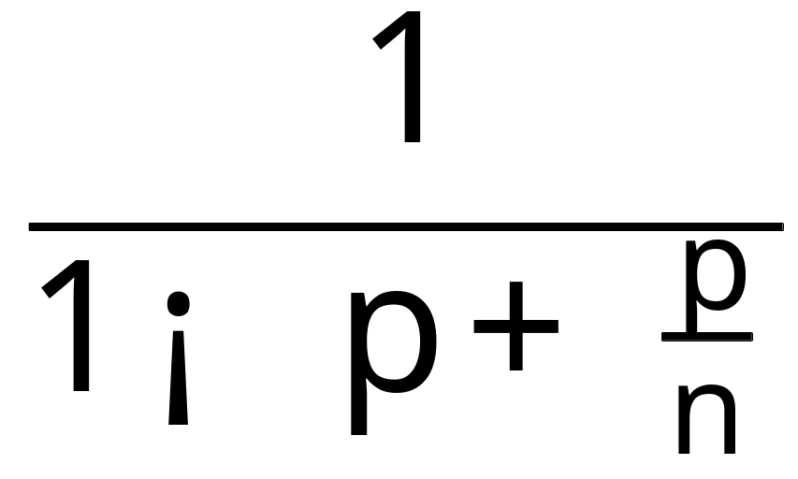
Amdahl’s Law
Speedup=
–
Art of Multiprocessor Programming
Notes:
AVOID USING THE WORD “CODE”, P is not a fraction of the code but if the execution time of the solution algorithm. It could be that 5% of the code are executed in a loop and account for 90% of the execution time.

Slide 42
Amdahl’s Law
Parallel fraction
Speedup=
–
Art of Multiprocessor Programming

Slide 43
Amdahl’s Law
Sequential fraction
Parallel fraction
Speedup=
–
Art of Multiprocessor Programming

Slide 44
Amdahl’s Law
Sequential fraction
Parallel fraction
Speedup=
–
Number of threads
Art of Multiprocessor Programming

Slide 45
Example
Ten processors
60% concurrent, 40% sequential
How close to 10-fold speedup?
Art of Multiprocessor Programming

Slide 46
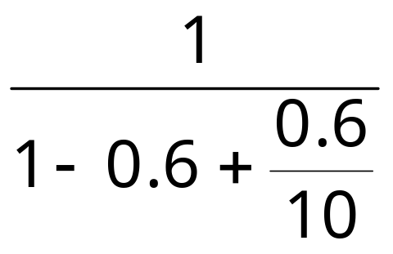
Example
Ten processors
60% concurrent, 40% sequential
How close to 10-fold speedup?
Speedup = 2.17=
Art of Multiprocessor Programming
Notes:
Explain to students that you work really hard and parallelize 60% of the applications execution (NOT ITS CODE, its EXECUTION)
and get little for your money

Slide 47
Example
Ten processors
80% concurrent, 20% sequential
How close to 10-fold speedup?
Art of Multiprocessor Programming

Slide 48
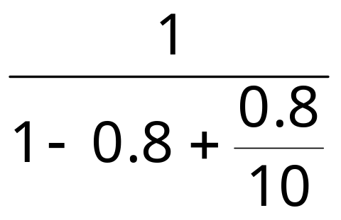
Example
Ten processors
80% concurrent, 20% sequential
How close to 10-fold speedup?
Speedup = 3.57=
Art of Multiprocessor Programming
Notes:
Even with 80% we are only 2/5 utilization, we paid for 10 CPUs and got 4…

Slide 49
Example
Ten processors
90% concurrent, 10% sequential
How close to 10-fold speedup?
Art of Multiprocessor Programming
Notes:
With 90% parallelized we are using only half our computing capacity…

Slide 50

Example
Ten processors
90% concurrent, 10% sequential
How close to 10-fold speedup?
Speedup = 5.26=
Art of Multiprocessor Programming
Notes:
With 99% parallelized we are now utilizing 9 out of 10. What does this say to us?

Slide 51
Example
Hundred processors
90% concurrent, 10% sequential
How close to 100-fold speedup?
Art of Multiprocessor Programming
Notes:
With 90% parallelized we are using only half our computing capacity…

Slide 52
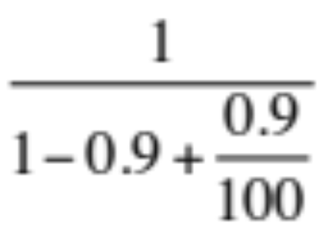
Example
Hundred processors
90% concurrent, 10% sequential
How close to 100-fold speedup?
Speedup = 9.17=
Art of Multiprocessor Programming
Notes:
With 99% parallelized we are now utilizing 9 out of 10. What does this say to us?

Slide 53
Example
Ten processors
99% concurrent, 01% sequential
How close to 10-fold speedup?
Art of Multiprocessor Programming

Slide 54
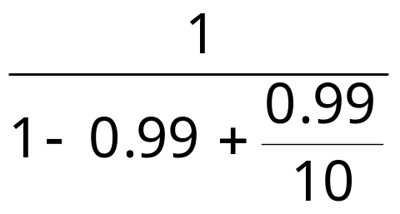
Example
Ten processors
99% concurrent, 01% sequential
How close to 10-fold speedup?
Speedup = 9.17=
Art of Multiprocessor Programming

Slide 55
Back to Real-World Multicore Scaling
Speedup
2x
2.9x
1.8x
User code
Multicore
Not reducing sequential % of code
Art of Multiprocessor Programming
Notes:
A saying that is in todays jargon something like “It’s the parallel part, stupid” is attributed to Amdahl.

Slide 56
Shared Data Structures
Coarse
Grained
Fine
Grained
25%
Shared
25%
Shared
75%
Unshared
75%
Unshared

Slide 57
Shared Data Structures
Honk!
Honk!
Honk!
Why only 2.9 speedup
Coarse
Grained
Fine
Grained
25%
Shared
25%
Shared
75%
Unshared
75%
Unshared

Slide 58
Shared Data Structures
Honk!
Honk!
Why fine-grained parallelism maters
Honk!
Coarse
Grained
Fine
Grained
25%
Shared
25%
Shared
75%
Unshared
75%
Unshared

Slide 59
This work is licensed under a Creative Commons Attribution-ShareAlike 2.5 License.
You are free:
  to Share — to copy, distribute and transmit the work
  to Remix — to adapt the work
Under the following conditions:
  Attribution. You must attribute the work to “The Art of Multiprocessor Programming” (but not in any way that suggests that the authors endorse you or your use of the work).
  Share Alike. If you alter, transform, or build upon this work, you may distribute the resulting work only under the same, similar or a compatible license.
For any reuse or distribution, you must make clear to others the license terms of this work. The best way to do this is with a link to
  http://creativecommons.org/licenses/by-sa/3.0/.
Any of the above conditions can be waived if you get permission from the copyright holder.
Nothing in this license impairs or restricts the author's moral rights.
Art of Multiprocessor Programming

