Slide 1

Concurrent Queues
Companion slides for
The Art of Multiprocessor Programming
by Maurice Herlihy & Nir Shavit

Slide 2
Another Fundamental Problem
We told you about
  Sets implemented by linked lists
Next: queues
Next: stacks
Art of Multiprocessor Programming
Notes:
We have already talked about concurrent lists, and today we look at another ubiquitous data structure: queues. Queues provide enqueue and dequeue methods and they are used to route requests from one place to another. For example, a web site might queue up requests for pages, for disk writes, for credit card validations and so on.

Slide 3
Queue: Concurrency
enq(x)
y=deq()
tail
head
enq() and deq() work at different ends of the object
Art of Multiprocessor Programming
Notes:
Making a queue concurrent is quite a challenge. Very informally, it seems that it should be OK for one thread to enqueue an item at one end of the queue while another thread dequeues an item from the other end, since they are working on disjoint parts of the data structure. Does that kind of concurrency seem easy to realize? (Answer: next slide)

Slide 4
Concurrency
enq(x)
y=deq()
tail
head
Challenge: what if the queue is empty or full?
Art of Multiprocessor Programming
Notes:
Concurrent enqueue and dequeue calls should in principle be able to proceed without interference, but it gets tricky when the queue is nearly full or empty, because then one method call should affect the other. The problem is that whether the two method calls interfere (that is, need to synchronize) depends on the dynamic state of the queue. In pretty much all of the other kinds of synchronization we considered, whether or not method calls needed to synchronize was determined statically (say read/write locks) or was unlikely to change very often (resizable hash tables).

Slide 5
Bounded Queue
head
tail
Sentinel
Art of Multiprocessor Programming
Notes:
Let’s use a list-based structure, although arrays would also work. We start out with head and tail fields that point to the first and last entries in the list. The first Node in the list is a sentinel Node whose value field is meaningless. The sentinel acts as a placeholder.

Slide 6
Bounded Queue
head
tail
First actual item
Art of Multiprocessor Programming
Notes:
When we add actual items to the queue, we will hang them off the sentinel Node at the head.

Slide 7
Bounded Queue
head
tail
deqLock
Lock out other deq() calls
Art of Multiprocessor Programming
Notes:
The most straightforward way to allow concurrent enq and deq calls is to use one lock at each end of the queue. To make sure that only one dequeuer is accessing the queue at a time, we introduce a dequeue lock field. Could we get the same effect just by locking the tail Node? (Answer: there’s a race condition between when a thread reads the tail field and when it acquires the lock. Another thread might have enqueued something in that interval. Of course you could check after you acquire the lock that the tail pointer hadn’t changed, but that seems needlessly complicated.)

Slide 8
Bounded Queue
head
tail
deqLock
enqLock
Lock out other enq() calls
Art of Multiprocessor Programming
Notes:
In the same way, we introduce an explicit enqLock field to ensure that only one enqueuer can be accessing the queue at a time. Would it work if we replaced the enqLock by a lock on the first sentinel Node? (Answer: Yes, it would because the value of the head field never changes. Nevertheless we use an enqLock field to be symmetric with the deqLock.)

Slide 9
Not Done Yet
head
tail
deqLock
enqLock
Need to tell whether queue is full or empty
Art of Multiprocessor Programming
Notes:
In the same way, we introduce an explicit enqLock field to ensure that only one enqueuer can be accessing the queue at a time. Would it work if we replaced the enqLock by a lock on the first sentinel Node? (Answer: Yes, it would because the value of the head field never changes. Nevertheless we use an enqLock field to be symmetric with the deqLock.)

Slide 10
Not Done Yet
head
tail
deqLock
enqLock
size
1
Max size is 8 items
Art of Multiprocessor Programming
Notes:
Let’s add another size field, which will keep track of the number of items.

Slide 11
Not Done Yet
head
tail
deqLock
enqLock
size
1
Incremented by enq()
Decremented by deq()
Art of Multiprocessor Programming
Notes:
This field is decremented by the deq method (which creates a space) and incremented by the enq method (which consumes a space).

Slide 12
Enqueuer
head
tail
deqLock
enqLock
Lock enqLock
size
1
Art of Multiprocessor Programming
Notes:
Let’s walk through a very simple implementation. A thread that wants to enqueue an item first acquires the enqLock. At this point, we know there are no other enq calls in progress.

Slide 13
Enqueuer
head
tail
deqLock
enqLock
Read size
size
1
OK
Art of Multiprocessor Programming
Notes:
Next, the thread reads the size. What do we know about how this field behaves when the thread is holding the enqLock? (Answer: it can only decrease. Dequeuers can decrement the counter, but all the enqueuers are locked out.) If the enqueuing thread sees a value less than 8 for size, it can proceed.

Slide 14
Enqueuer
head
tail
deqLock
No need to lock tail
enqLock
size
1
Art of Multiprocessor Programming
Notes:
The thread does not need to lock tail Node before appending a new Node. Clearly, there is no conflict with another enqueuer and we will see a clever way to avoid conflict with a dequeuer.

Slide 15
Enqueuer
head
tail
deqLock
enqLock
Enqueue Node
size
1
Art of Multiprocessor Programming
Notes:
Still holding the enqLock, the thread redirects both the tail Node’s next field and the queue’s tail field to point to the new Node.

Slide 16
Enqueuer
head
tail
deqLock
enqLock
size
2
1
getAndincrement()
Art of Multiprocessor Programming
Notes:
Still holding the enqLock, the thread calls getAndIncrement() to increase the size. Remember that we know the number is less than 8, although we don’t know exactly what it is now. Why can’t we release the enqLock before the increment? (Answer: because then other enqueuers won’t know when they have run out of size.)

Slide 17
Enqueuer
head
tail
deqLock
enqLock
size
Release lock
8
2
Art of Multiprocessor Programming
Notes:
Finally, we can release the enqLock and return.

Slide 18
Enqueuer
head
tail
deqLock
If queue was empty, notify waiting dequeuers
enqLock
size
2
Art of Multiprocessor Programming
Notes:
There is one more issue to consider. If the queue was empty, then one or more dequeuers may be waiting for an item to appear. If the dequeuer is spinning then we don’t need to do anything, but if the dequeuers are suspended in the usual Java way, then we need to notify them. There are many ways to do this, but for simplicity we will not try to be clever, and simply require any enqueuer who puts an item in an empty queue to acquire the deqLock and notify any waiting threads.
TALKING POINT; Notice that Java requires you to acquire the lock for an object before you can notify threads waiting to reacquire that lock. Not clear if this design is a good idea. Does it invite deadlock? Discuss.

Slide 19
Unsuccesful Enqueuer
…
head
tail
deqLock
enqLock
Read size
size
8
Uh-oh
Art of Multiprocessor Programming
Notes:
Let’s rewind and consider what happens if the enqueing thread found the queue full. Suppose the threads synchronize by blocking, say using the Java wait() method. In this case, the thread can wait() on the enqLock, provided the first dequeuer to remove an item notifies the waiting thread.
An alternative is for the enqueuer to spin waiting for the number of size to be less than 8. In general, it is a dangerous practice to spin while holding a lock. It so happens that it works in this case, provided the dequeuer also spins when the queue is empty. Spinning here is cache-friendly, since the thread is spinning on a locally-cached value, and stops spinning as soon as the field value changes.

Slide 20
Dequeuer
head
tail
deqLock
enqLock
Lock deqLock
size
2
Art of Multiprocessor Programming
Notes:
Now let’s walk through a similar deq() implementation. The code is similar, but not at all identical. As a first step, the dequeuer thread acquires the deqLock.

Slide 21
Dequeuer
head
tail
deqLock
enqLock
Read sentinel’s next field
size
2
OK
Art of Multiprocessor Programming
Notes:
Next, the thread reads the sentinel node’s next field. If that field is non-null, the queue is non-empty. Once the enqueuer sees a non-empty next field, that field will remain that way. Why? (ANSWER: the deq() code, which we have seen, changes null references to non-null, but never changes a non-null reference). The enqueuers are all locked out, and no dequeuer will modify a non-null field. There is no need to lock the Node itself, because it is implicitly protected by the enqLock.

Slide 22
Dequeuer
head
tail
deqLock
enqLock
Read value
size
2
Art of Multiprocessor Programming
Notes:
Next, the thread reads the first Node’s value, and stores it in a local variable.

Slide 23
Dequeuer
Make first Node new sentinel
head
tail
deqLock
enqLock
size
2
Art of Multiprocessor Programming
Notes:
The thread then makes the first Node the new sentinel, and discards the old sentinel. This step may seem obvious, but, in fact, it is enormously clever. If we had tried to physically remove the Node, we would soon become bogged down in quagmire of complications. Instead, we discard the prior sentinel, and transform the prior first real Node into a sentinel. Brilliant.

Slide 24
Dequeuer
head
tail
deqLock
enqLock
Decrement size
size
1
Art of Multiprocessor Programming
Notes:
Finally, we decrement the number of size. By contrast with enqueuers, we do not need to hold the lock while we decrement the size. Why? (Answer: we had to hold the lock while enqueuing to prevent lots of enqueuers from proceeding without noticing that the capacity had been exceeded. Dequeuers will notice the queue is empty when they observe that the sentinel’s next field is null.)

Slide 25
Dequeuer
head
tail
deqLock
enqLock
size
1
Release deqLock
Art of Multiprocessor Programming
Notes:
Next we can release the deqLock
ck.

Slide 26
Unsuccesful Dequeuer
head
tail
deqLock
enqLock
Read sentinel’s next field
size
0
uh-oh
Art of Multiprocessor Programming
Notes:
If the dequeuer observes that the sentinel’s next field is null, then it must wait for something to be enqueued. As with the dequeuer, the simplest approach is just to wait() on the deqLock, with the understanding that any enqueuer who makes the queue non-empty will notify any waiting threads. Spinning works too, even though the thread is holding a lock. Clearly, mixing the two strategies will not work: if a dequeuer spins while holding the deq lock and an enqueuer tries to acquire the deq lock to notify waiting threads, then a deadlock ensues.

Slide 27
Bounded Queue
public class BoundedQueue<T> {
ReentrantLock enqLock, deqLock;
Condition notEmptyCondition, notFullCondition;
AtomicInteger size;
Node head;
Node tail;
int capacity;
enqLock = new ReentrantLock();
notFullCondition = enqLock.newCondition();
deqLock = new ReentrantLock();
notEmptyCondition = deqLock.newCondition();
}
Art of Multiprocessor Programming

Slide 28
Bounded Queue Fields
public class BoundedQueue<T> {
ReentrantLock enqLock, deqLock;
Condition notEmptyCondition, notFullCondition;
AtomicInteger size;
Node head;
Node tail;
int capacity;
enqLock = new ReentrantLock();
notFullCondition = enqLock.newCondition();
deqLock = new ReentrantLock();
notEmptyCondition = deqLock.newCondition();
}
Enq & deq locks
Art of Multiprocessor Programming

Slide 29
Bounded Queue Fields
public class BoundedQueue<T> {
ReentrantLock enqLock, deqLock;
Condition notEmptyCondition, notFullCondition;
AtomicInteger size;
Node head;
Node tail;
int capacity;
enqLock = new ReentrantLock();
notFullCondition = enqLock.newCondition();
deqLock = new ReentrantLock();
notEmptyCondition = deqLock.newCondition();
}
Enq lock’s associated condition
Art of Multiprocessor Programming

Slide 30
Bounded Queue Fields
public class BoundedQueue<T> {
ReentrantLock enqLock, deqLock;
Condition notEmptyCondition, notFullCondition;
AtomicInteger size;
Node head;
Node tail;
int capacity;
enqLock = new ReentrantLock();
notFullCondition = enqLock.newCondition();
deqLock = new ReentrantLock();
notEmptyCondition = deqLock.newCondition();
}
size: 0 to capacity
Art of Multiprocessor Programming

Slide 31
Bounded Queue Fields
public class BoundedQueue<T> {
ReentrantLock enqLock, deqLock;
Condition notEmptyCondition, notFullCondition;
AtomicInteger size;
Node head;
Node tail;
int capacity;
enqLock = new ReentrantLock();
notFullCondition = enqLock.newCondition();
deqLock = new ReentrantLock();
notEmptyCondition = deqLock.newCondition();
}
Head and Tail
Art of Multiprocessor Programming

Slide 32
Enq Method Part One
public void enq(T x) {
boolean mustWakeDequeuers = false;
enqLock.lock();
try {
while (size.get() == Capacity)
notFullCondition.await();
Node e = new Node(x);
tail.next = e;
tail = tail.next;
if (size.getAndIncrement() == 0)
mustWakeDequeuers = true;
} finally {
enqLock.unlock();
}
…
}
Art of Multiprocessor Programming
Notes:
A remarkable aspect of this queue implementation is that the methods are subtle, but they fit on a single slide.
The \mEnq{} method (Figure~\ref{figure:boundedQueue:enq})
works as follows.
A thread acquires the \fEnqLock{}
(Line \ref{line:bounded:lock}),
and repeatedly reads the \fsize{} field
(Line \ref{line:bounded:size}).
While that field
is zero, the queue is full, and the enqueuer must wait until a
dequeuer makes room.
The enqueuer waits by waiting on the \fNotFullCondition{} field
(Line \ref{line:bounded:notfull}),
which releases the enqueue lock temporarily,
and blocks until the condition is signaled.
Each time the thread awakens
(Line \ref{line:bounded:notfull}),
it checks whether the
\fsize{} field is positive (that is, the queue is not empty)
and if not, goes back to sleep.

Slide 33
Enq Method Part One
public void enq(T x) {
boolean mustWakeDequeuers = false;
enqLock.lock();
try {
while (size.get() == capacity)
notFullCondition.await();
Node e = new Node(x);
tail.next = e;
tail = tail.next;
if (size.getAndIncrement() == 0)
mustWakeDequeuers = true;
} finally {
enqLock.unlock();
}
…
}
Lock and unlock enq lock
Art of Multiprocessor Programming
Notes:
A remarkable aspect of this queue implementation is that the methods are subtle, but they fit on a single slide.
The \mEnq{} method (Figure~\ref{figure:boundedQueue:enq})
works as follows.
A thread acquires the \fEnqLock{}
(Line \ref{line:bounded:lock}),
and repeatedly reads the \fsize{} field
(Line \ref{line:bounded:size}).
While that field
is zero, the queue is full, and the enqueuer must wait until a
dequeuer makes room.
The enqueuer waits by waiting on the \fNotFullCondition{} field
(Line \ref{line:bounded:notfull}),
which releases the enqueue lock temporarily,
and blocks until the condition is signaled.
Each time the thread awakens
(Line \ref{line:bounded:notfull}),
it checks whether the
\fsize{} field is positive (that is, the queue is not empty)
and if not, goes back to sleep.

Slide 34
Enq Method Part One
public void enq(T x) {
boolean mustWakeDequeuers = false;
enqLock.lock();
try {
while (size.get() == capacity)
notFullCondition.await();
Node e = new Node(x);
tail.next = e;
tail = tail.next;
if (size.getAndIncrement() == 0)
mustWakeDequeuers = true;
} finally {
enqLock.unlock();
}
…
}
Wait while queue is full …
Art of Multiprocessor Programming
Notes:
Once the number of size exceeds zero, however, the enqueuer may proceed.
Note that once the enqueuer observes a positive number of size,
then while the enqueue is in progress no other thread can cause the number of
size to fall back to zero,
because all the other enqueuers are locked out,
and a concurrent dequeuer can only increase the number of size.
We must check carefully that this implementation does not suffer
from a ``lost-wakeup'' bug. Care is needed because an enqueuer
encounters a full queue in two steps: first, it sees that
\fsize{} is zero, and second, it waits on the
\fNotFullCondition{} condition until there is room in the queue.
When a dequeuer changes the queue from full to not-full, it
acquires \fEnqLock{} and signals the \fNotFullCondition{}
condition. Even though the \fsize{} field is not protected by
the \fEnqLock{}, the dequeuer acquires the \fEnqLock{} before it
signals the condition, so the dequeuer cannot signal between the
enqueuer's two steps.

Slide 35
Enq Method Part One
public void enq(T x) {
boolean mustWakeDequeuers = false;
enqLock.lock();
try {
while (size.get() == capacity)
notFullCondition.await();
Node e = new Node(x);
tail.next = e;
tail = tail.next;
if (size.getAndIncrement() == 0)
mustWakeDequeuers = true;
} finally {
enqLock.unlock();
}
…
}
when await() returns, you might still fail the test !
Art of Multiprocessor Programming
Notes:
Once the number of size exceeds zero, however, the enqueuer may proceed.
Note that once the enqueuer observes a positive number of size,
then while the enqueue is in progress no other thread can cause the number of
size to fall back to zero,
because all the other enqueuers are locked out,
and a concurrent dequeuer can only increase the number of size.
We must check carefully that this implementation does not suffer
from a ``lost-wakeup'' bug. Care is needed because an enqueuer
encounters a full queue in two steps: first, it sees that
\fsize{} is zero, and second, it waits on the
\fNotFullCondition{} condition until there is room in the queue.
When a dequeuer changes the queue from full to not-full, it
acquires \fEnqLock{} and signals the \fNotFullCondition{}
condition. Even though the \fsize{} field is not protected by
the \fEnqLock{}, the dequeuer acquires the \fEnqLock{} before it
signals the condition, so the dequeuer cannot signal between the
enqueuer's two steps.

Slide 36
Be Afraid
public void enq(T x) {
boolean mustWakeDequeuers = false;
enqLock.lock();
try {
while (size.get() == capacity)
notFullCondition.await();
Node e = new Node(x);
tail.next = e;
tail = tail.next;
if (size.getAndIncrement() == 0)
mustWakeDequeuers = true;
} finally {
enqLock.unlock();
}
…
}
After the loop: how do we know the queue won’t become full again?
Art of Multiprocessor Programming
Notes:
Once the size is below the capacity, however, the enqueuer may proceed. Once the enqueuer observes the size is less than capacity,
then while the enqueue is in progress no other thread can cause size to become capacity, because all the other enqueuers are locked out,
and a concurrent dequeuer can only decrease the size.
We must check carefully that this implementation does not suffer
from a ``lost-wakeup'' bug. Care is needed because an enqueuer
encounters a full queue in two steps: first, it sees that
\fsize{} is zero, and second, it waits on the
\fNotFullCondition{} condition until there is room in the queue.
When a dequeuer changes the queue from full to not-full, it
acquires \fEnqLock{} and signals the \fNotFullCondition{}
condition. Even though the \fsize{} field is not protected by
the \fEnqLock{}, the dequeuer acquires the \fEnqLock{} before it
signals the condition, so the dequeuer cannot signal between the
enqueuer's two steps.

Slide 37
Enq Method Part One
public void enq(T x) {
boolean mustWakeDequeuers = false;
enqLock.lock();
try {
while (size.get() == capacity)
notFullCondition.await();
Node e = new Node(x);
tail.next = e;
tail = tail.next;
if (size.getAndIncrement() == 0)
mustWakeDequeuers = true;
} finally {
enqLock.unlock();
}
…
}
Add new node
Art of Multiprocessor Programming

Slide 38
Enq Method Part One
public void enq(T x) {
boolean mustWakeDequeuers = false;
enqLock.lock();
try {
while (size.get() == capacity)
notFullCondition.await();
Node e = new Node(x);
tail.next = e;
tail = tail.next;
if (size.getAndIncrement() == 0)
mustWakeDequeuers = true;
} finally {
enqLock.unlock();
}
…
}
If queue was empty, wake frustrated dequeuers
Art of Multiprocessor Programming

Slide 39
Enq Method Part Deux
public void enq(T x) {
…
if (mustWakeDequeuers) {
deqLock.lock();
try {
notEmptyCondition.signalAll();
} finally {
deqLock.unlock();
}
}
}
Art of Multiprocessor Programming
Notes:
Why do we hold the lock during signaling. Well, as explained by David Holmes, a top java concurrency programmer/designer, once you wait() for a condition there is an expectation that some other thread will cause the condition to become true and notify you of that fact.
The notification must only occur before the waiter sees the condition
doesn't hold (queue is full), or after the waiter enters the actual wait, otherwise the
notification won't be seen. In our case these are the lines
while (size.get() == capacity)
notFullCondition.await();
Hence the notifying thread has to hold the same
lock while it sets the condition and performs the notification.
Now strictly speaking in terms of synchronization correctness it is not
necessary to hold a lock when you do a condition signal - as long as you
signal AFTER changing the state. However Java requires that you do hold the
lock - why? Because otherwise people would forget to hold the lock when
setting the condition and the program would be incorrect. The situation
where doing a notification/signal without holding the lock is beneficial
only in rare circumstances as a potential performance optimisation. This is
an example of the language designers choosing what's best for the majority
of programmers.

Slide 40
Enq Method Part Deux
public void enq(T x) {
…
if (mustWakeDequeuers) {
deqLock.lock();
try {
notEmptyCondition.signalAll();
} finally {
deqLock.unlock();
}
}
}
Are there dequeuers to be signaled?
Art of Multiprocessor Programming
Notes:
Why do we hold the lock during signaling. Well, as explained by David Holmes, a top java concurrency programmer/designer, once you wait() for a condition there is an expectation that some other thread will cause the condition to become true and notify you of that fact.
The notification must only occur before the waiter sees the condition
doesn't hold (queue is full), or after the waiter enters the actual wait, otherwise the
notification won't be seen. In our case these are the lines
while (size.get() == capacity)
notFullCondition.await();
Hence the notifying thread has to hold the same
lock while it sets the condition and performs the notification.
Now strictly speaking in terms of synchronization correctness it is not
necessary to hold a lock when you do a condition signal - as long as you
signal AFTER changing the state. However Java requires that you do hold the
lock - why? Because otherwise people would forget to hold the lock when
setting the condition and the program would be incorrect. The situation
where doing a notification/signal without holding the lock is beneficial
only in rare circumstances as a potential performance optimisation. This is
an example of the language designers choosing what's best for the majority
of programmers.

Slide 41
Enq Method Part Deux
public void enq(T x) {
…
if (mustWakeDequeuers) {
deqLock.lock();
try {
notEmptyCondition.signalAll();
} finally {
deqLock.unlock();
}
}
}
Lock and unlock deq lock
Art of Multiprocessor Programming
Notes:
The deq() method is symmetric.

Slide 42
Enq Method Part Deux
public void enq(T x) {
…
if (mustWakeDequeuers) {
deqLock.lock();
try {
notEmptyCondition.signalAll();
} finally {
deqLock.unlock();
}
}
}
Signal dequeuers that queue is no longer empty
Art of Multiprocessor Programming

Slide 43
The Enq() & Deq() Methods
Share no locks
  That’s good
But do share an atomic counter
  Accessed on every method call
  That’s not so good
Can we alleviate this bottleneck?
Art of Multiprocessor Programming
Notes:
The key insight is that the enqueuer only decrements the counter, and really cares only whether or not the counter value is zero. Symmetrically, the dequeuer cares only whether or not the counter value is the queue capacity.
NB: the deq() method does not explicitly check the size field, but relies on testing the sentinel Node’s next field. Same thing.

Slide 44
Split the Counter
The enq() method
  Increments only
  Cares only if value is capacity
The deq() method
  Decrements only
  Cares only if value is zero
Art of Multiprocessor Programming
Notes:
The key insight is that the enqueuer only decrements the counter, and really cares only whether or not the counter value is zero. Symmetrically, the dequeuer cares only whether or not the counter value is the queue capacity.
NB: the deq() method does not explicitly check the size field, but relies on testing the sentinel Node’s next field. Same thing.

Slide 45
Split Counter
Enqueuer increments enqSize
Dequeuer decrements deqSize
When enqueuer runs out
  Locks deqLock
  computes size = enqSize - DeqSize
Intermittent synchronization
  Not with each method call
  Need both locks! (careful …)
Art of Multiprocessor Programming
Notes:
Let’s summarize. We split the size field in to two parts. The enqueuer decrements the enqSize field, and the dequeuer increments the deqSize field. When the enqueuer discovers that its field has reached capacity, then it tries to recalculate the size. Why do this? It replaces synchronization with each method call with sporadic, intermittent synchronization. As a practical matter, an enqueuer that runs out of space needs to acquire the dequeue lock (why?) (ANSWER: to prevent the dequeuer from decrementing the size at the same time we are trying to copy it).
WARNING: Any time you try to acquire a lock while holding another, your ears should prick up (alt: your spider-sense should tingle) because you are just asking for a deadlock. So far, no danger, because all of the methods seen so far never hold more than one lock at a time.

Slide 46
A Lock-Free Queue
head
tail
Sentinel
Art of Multiprocessor Programming
Notes:
Now we consider an alternative approach that does not use locks. The Lock-free queue is due to Maged Michael & Michael Scott
HUMOR: this construction is due to Maged Michael and Michael Scott. Everyone cites it as Michael Scott, which means that many people (unjustly) think that Michael Scott invented it. The moral is, make sure that your last name is not the same as your advisor’s first name.
Here too we use a list-based structure. Since the queue is unbounded, arrays would be awkward. As before, We start out with head and tail fields that point to the first and last entries in the list. The first Node in the list is a sentinel Node whose value field is meaningless. The sentinel acts as a placeholder.

Slide 47
Compare and Set
CAS
Art of Multiprocessor Programming
Notes:
One difference from the lock-based queue is that we use CAS to manipulate the next fields of entries. Before, we did all our synchronization on designed fields in the queue itself, but here we must synchronize on Node fields as well.

Slide 48
Enqueue
head
tail
enq( )
Art of Multiprocessor Programming
Notes:
As a first step, the enqueuer calls CAS to sent the tail Node’s next field to the new Node.

Slide 49
Logical Enqueue
CAS
head
tail
Art of Multiprocessor Programming
Notes:
As a first step, the enqueuer calls CAS to sent the tail Node’s next field to the new Node.

Slide 50
Physical Enqueue
head
CAS
tail
Art of Multiprocessor Programming
Notes:
Once the tail Node’s next field has been redirected, use CAS to redirect the queue’s tail field to the new Node.

Slide 51
Enqueue
These two steps are not atomic
The tail field refers to either
  Actual last Node (good)
  Penultimate Node (not so good)
Be prepared!
Art of Multiprocessor Programming
Notes:
[pe·nul·ti·mate – adjective -- next to the last: “the penultimate scene of the play”]
As you may have guessed, the situation is more complicated than it appears. The enq() method is supposed to be atomic, so how can we get away with implementing it in two non-atomic steps? We can count on the following invariant: the tail field is a reference to (1) actual last Node, or (2) the Node just before the actual last Node.

Slide 52
Enqueue
What do you do if you find
  A trailing tail?
Stop and help fix it
  If tail node has non-null next field
  CAS the queue’s tail field to tail.next
Art of Multiprocessor Programming
Notes:
Any method call must be prepared to encounter a tail field that is trailing behind the actual tail. This situation is easy to detect. How? (Answer: tail.next not null). How to deal with it? Fix it! Call compareAndSet to set the queue’s tial field to point to the actual last Node in the queuel

Slide 53
When CASs Fail
During logical enqueue
  Abandon hope, restart
  Still lock-free
During physical enqueue
  Ignore it
Art of Multiprocessor Programming
Notes:
What do we do if the CAS calls fail? It matters a lot in which CAS call this happened. In Step One, a failed CAS implies a synchronization conflict with another enq() call. Here, the most sensible approach is to abandon the current effort (panic!) and start over. In Step Two, we can ignore a failed CAS, simply because the failure means that some other thread has executed that step on our behalf.

Slide 54
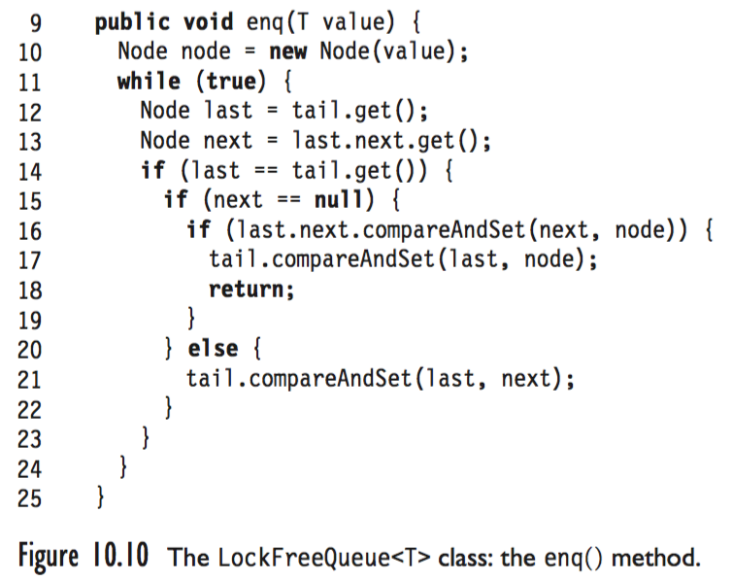
Art of Multiprocessor Programming

Slide 55
Dequeuer
head
tail
Read value
Art of Multiprocessor Programming
Notes:
Next, the thread reads the first Node’s value, and stores it in a local variable. The slide suggests that the value is nulled out, but in fact there is no need to do so.

Slide 56
Dequeuer
Make first Node new sentinel
CAS
head
tail
Art of Multiprocessor Programming
Notes:
The thread then makes the first Node the new sentinel, and discards the old sentinel. This is the clever trick I mentioned earlier that ensures that we do not need to lock the Node itself. We do not physically remove the Node, we just demote it to sentinel.

Slide 57
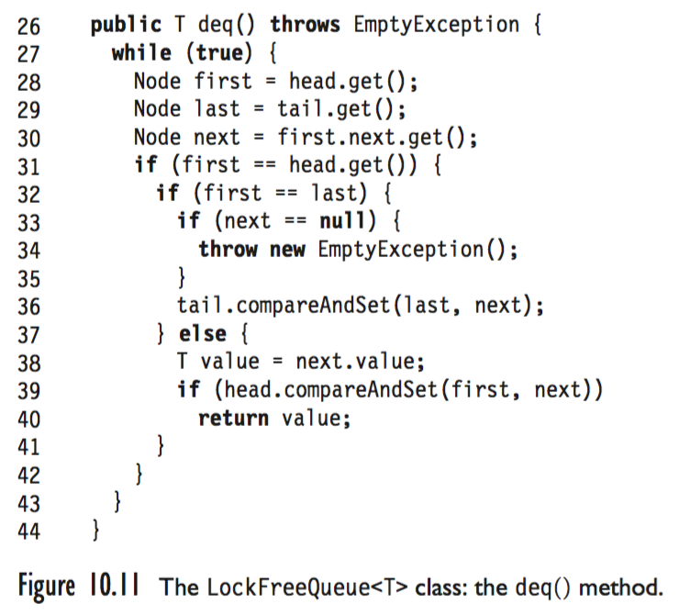
Art of Multiprocessor Programming

Slide 58
Memory Reuse?
What do we do with nodes after we dequeue them?
Java: let garbage collector deal?
Suppose there is no GC, or we prefer not to use it?
Art of Multiprocessor Programming
Notes:
Let’s take a brief detour. What do we do with nodes after we remove them from the queue? This is not an issue with the lock-based implementation, but it requires some thought here. In Java, we can just let the garbage collector recycle unused objects. But what if we are operating in an environment where there is no garbage collector, or where we think we can recycle memory more efficiently?

Slide 59
Dequeuer
CAS
head
tail
Can recycle
Art of Multiprocessor Programming
Notes:
Let us look at the dequeue method from a different perspective. When we promote the prior first Node to sentinel, what do we do with the old sentinel? Seems like a good candidate for recylcling.

Slide 60
Simple Solution
Each thread has a free list of unused queue nodes
Allocate node: pop from list
Free node: push onto list
Deal with underflow somehow …
Art of Multiprocessor Programming
Notes:
The most reasonable solution is to have each thread manage its own pool of unused nodes. When a thread needs a new Node, it pops one from the list. No need for synchronization. When a thread fees A Node, it pushes the newly-freed Node onto the list. What do we do when a thread runs out of nodes? Perhaps we could just malloc() more, or perhaps we can devise a shared pool. Never mind.

Slide 61
Why Recycling is Hard
Head reference has value A
Thread reads value A
head
tail
Want to redirect head from gray to red
zzz…
Free pool
Art of Multiprocessor Programming
Notes:
Now the green thread goes to sleep, and other threads dequeue the red object and the green object, sending the prior sentinel and prior red Node to the respective free pools of the dequeuing threads.

Slide 62
Both Nodes Reclaimed
Head reference has value B
Node A freed
head
tail
zzz
Free pool
Art of Multiprocessor Programming
Notes:
Despite what you might think, we are perfectly safe, because any thread that tries to CAS the head field must fail, because that field has changed. Now assume that the enough deq() and enq() calls occur such that the original sentinel Node is recyled, and again becomes a sentinel Node for an empty queue.

Slide 63
One Node Recycled
Head reference has value A again
Node A recycled and reinitialized
head
tail
Yawn!
Free pool
Art of Multiprocessor Programming
Notes:
Now the green thread wakes up. It applies CAS to the queue’s head field ..

Slide 64
Why Recycling is Hard
CAS succeeds because references match,
even though reference’s meaning has changed
CAS
head
tail
OK, here I go!
Free pool
Art of Multiprocessor Programming
Notes:
Surprise! It works! The problem is that the bit-wise value of the head field is the same as before, even though its meaning has changed. This is a problem with the way the CAS operation is defined, nothing more.

Slide 65
Recycle FAIL
head
tail
zOMG what went wrong?
Free pool
Art of Multiprocessor Programming
Notes:
In the end, the tail pointer points to a sentinel node, while the head points to node in some thread’s free list. What went wrong?

Slide 66
The Dreaded ABA FAIL
Is a result of CAS() semantics
  I blame Sun, Intel, AMD, …
Not with Load-Locked/Store-Conditional
  Good for IBM?
Art of Multiprocessor Programming

Slide 67
Dreaded ABA – A Solution
Tag each pointer with a counter
Unique over lifetime of node
Pointer size vs word size issues
Overflow?
  Don’t worry be happy?
  Bounded tags?
AtomicStampedReference class
Art of Multiprocessor Programming

Slide 68
Atomic Stamped Reference
AtomicStampedReference class
  Java.util.concurrent.atomic package
Can get reference & stamp atomically
Reference
address
S
Stamp
Art of Multiprocessor Programming
Notes:
The actual implementation in Java is by having an indirection through a special sentinel node. If the special node exists then the mark is set, and if the node does not, then the bit is false. The sentinel points to the desired address so we pay a level of indirection. In C, using alignment on 32 bit architectures or on 64 bit architectures, we can “steal” a bit from the pointer.

Slide 69
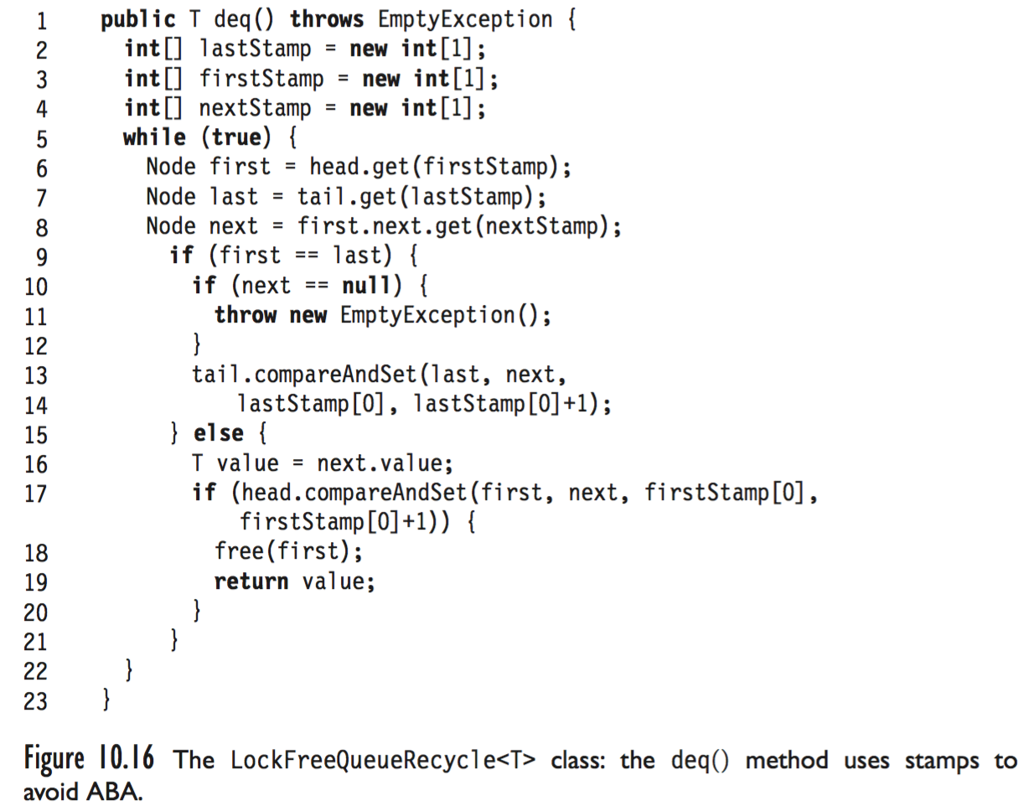
Art of Multiprocessor Programming

Slide 70
This work is licensed under a Creative Commons Attribution-ShareAlike 2.5 License.
You are free:
  to Share — to copy, distribute and transmit the work
  to Remix — to adapt the work
Under the following conditions:
  Attribution. You must attribute the work to “The Art of Multiprocessor Programming” (but not in any way that suggests that the authors endorse you or your use of the work).
  Share Alike. If you alter, transform, or build upon this work, you may distribute the resulting work only under the same, similar or a compatible license.
For any reuse or distribution, you must make clear to others the license terms of this work. The best way to do this is with a link to
  http://creativecommons.org/licenses/by-sa/3.0/.
Any of the above conditions can be waived if you get permission from the copyright holder.
Nothing in this license impairs or restricts the author's moral rights.
Art of Multiprocessor Programming

