Slide 1


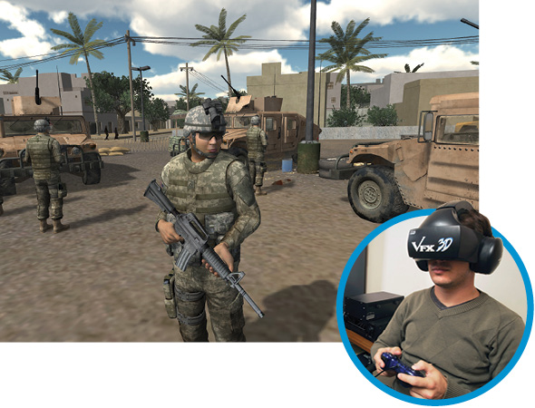

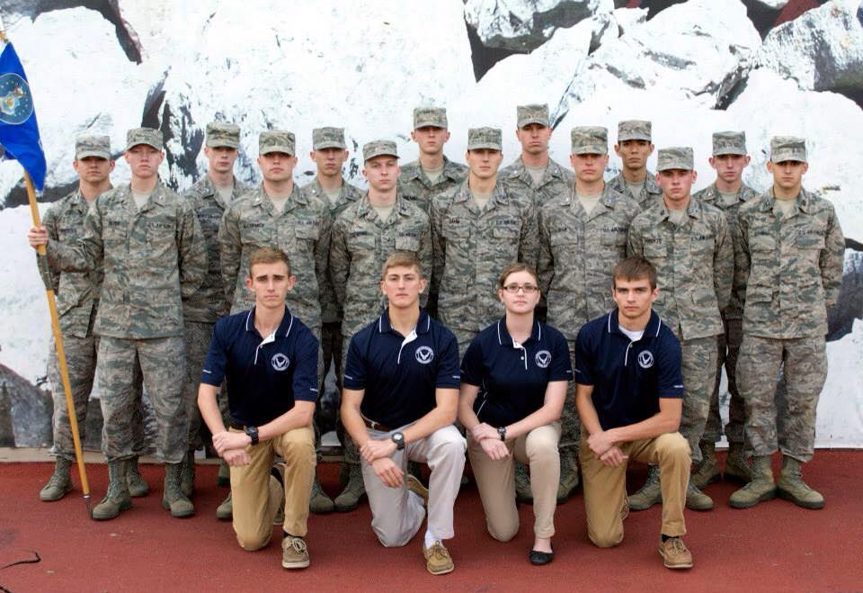
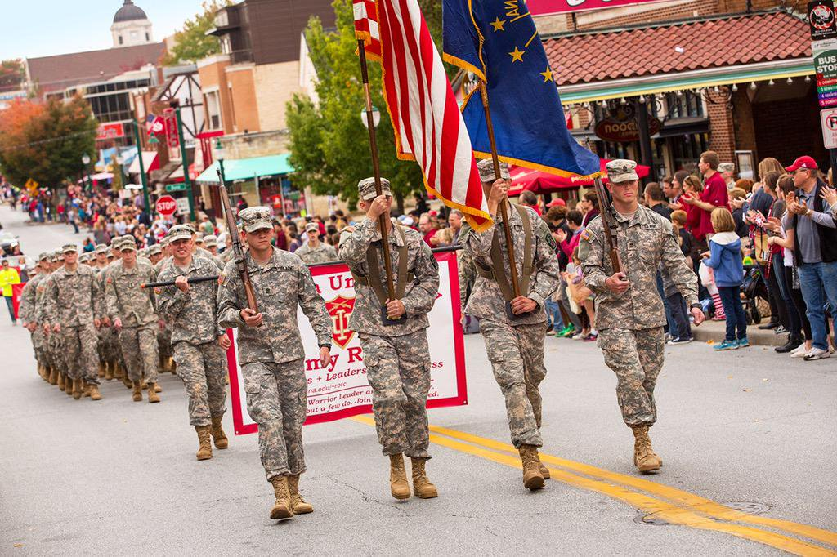
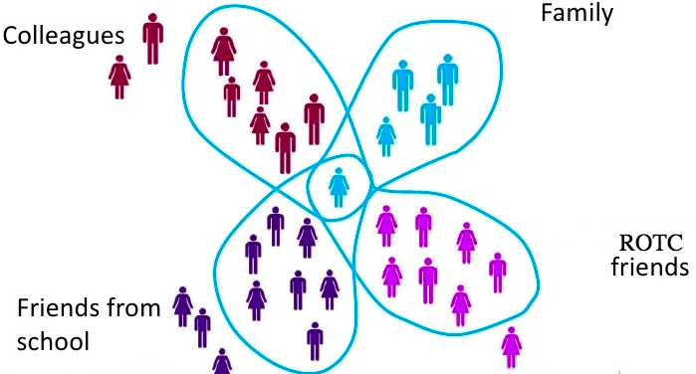
Challenges in Transitioning from Civil to Military Culture: Hyper-Selective Disclosure through ICTs
Bryan Dosono*, Yasmeen Rashidi, Taslima Akter, Bryan Semaan*, Apu Kapadia
School of Informatics, Computing and Engineering, Indiana University Bloomington, *School of Information Studies, Syracuse University
`
Abstract
The Hyper-Competitive Environment
Social Media: From real identity to anonymity
Discussion
Explored transition disclosure practices of Reserve Officers’ Training Corps (ROTC) students
Hyper-competitive nature and peer assessment system for evaluation encourage different levels of privacy for different audiences
Shared implications for designing ICTs to help them
Peer assessment system encourages to hyper-Selective disclosure in transition
Peer ranking system for evaluations
Participants share general issues in social media
They look at how you’re ranked in your peer evaluations, but also performance and extracurricular activities (P7)
Through social media, a bunch of people posted on my page: ‘I’m so sorry,’ and that really helped to know I wasn’t alone because it did feel like I was kind of alone. (P1)
Implications for designing ICTs
Peer ranking affects future career
Prefer anonymous media for problems related to ROTC and personal crises.
We compete against peers. There is national ranking called the OML by which we rank every cadet in the nation. Your standing in that influences what you get, whether you go to active duty, or to the national guard, or you’re working in the kitchen in the basement. (P2)
I did like that it was anonymous because of my pride, I don’t want to broadcast it. (P6)
Design for cultural translation
Design for supportive anonymity
Hyper-masculine nature of ROTC
If there was Yik Yak at the time, I would probably have used it, since it is anonymous nobody would have known that I’m in a relationship. (P4)
You have to have a certain mental toughness … you don’t want to come across as being someone who is weak. (P2)
Research Questions
Design context collapse and audience selection
R1: What emergent challenges do ROTC students deal with? How do ROTC students cope with these challenges? What are their privacy concerns when seeking (or not seeking) support?
R2: What role do ICTs play while seeking support? How does the level of privacy afforded by the ICTs affect the student’s ability to seek support when coping with emergent challenges?
R3: How are ROTC students transitioning as they move into military culture?
Leads to disclose problems with ROTC peers depending on the context.
Family: No fear of judgment
Conclusion & Future work
More open to sharing their personal challenges beyond their ROTC crowd.
Participant expressed concerns of the stereotypes about sexual assault victims in the military.
A qualitative interview study of ROTC students to explore how they use ICTs to cope with personal crises.
Other collectivist groups in transition (immigrant students, student athletes) and their willingness to disclose personal issues to others should be studied.
“It depends on the situation, because if it’s a breakup I would go to girl friends first, then go to ROTC guys ” (P4)
“With an ROTC friend, if he asks me ‘how are you doing?’, I would say, ‘I am fine. But I might text a friend from high school and say ‘It is awful and this is ruining my life right now.’” (P2)
Formal support infrastructures
Strong infrastructural support for injuries, mental health and academic issues.
“Regarding injuries, we already have athletic training staffs, so they are always there to help us out.”(P2)
“With the sexual harassment, I don’t talk about that at all… My worst fear was that people are going to think I was lying or doing to get back at him. I tried to do what I could to not let that assumption happen.” (P3)
References
Dosono, B., Rashidi, Y., Akter, T., Semaan, B., Kapadia, A. (2017). Challenges in transitioning from civil to military culture: Hyper-selective disclosure through ICTs. Proceedings of the ACM on Human-Computer Interaction, 1(2). ACM.
Acknowledgement
“There is an honor society called Scabbard and Blade…they have tutoring sessions where any cadet can work on homework.” (P7)
This material is based upon work supported by the National Science Foundation under Grant Nos. 1408730 and 1252697. Any opinions, findings, and conclusions or recommendations expressed in this material are those of the author(s) and do not necessarily reflect the views of the National Science Foundation.

